Slide 1

The Game of Volatility

Slide 2
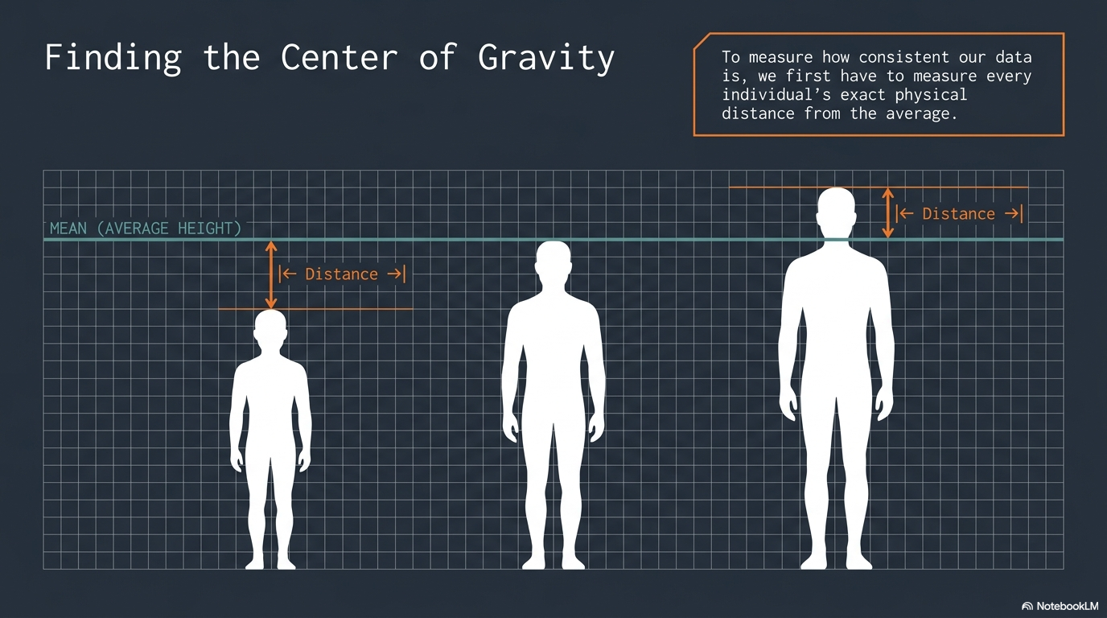

Slide 3
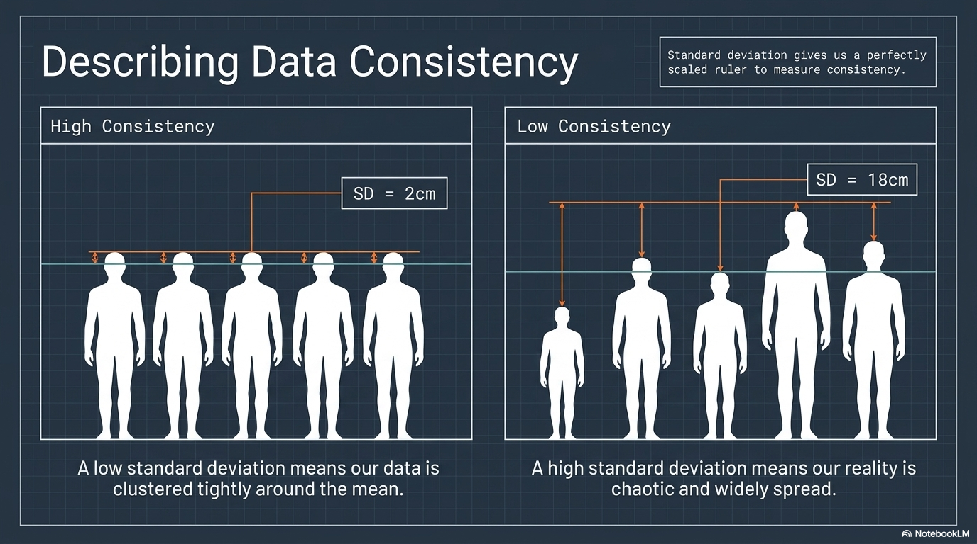

Slide 4
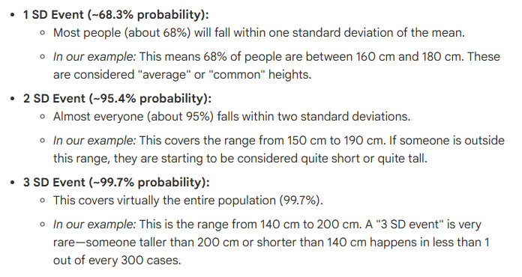
Probability

Slide 5
Standard Deviation measure Volatility of the data .
Volatility characteristics
Volatility is cyclical – meaning it moves from contraction to expansion and vice versa
Volatility is persistent

Slide 6
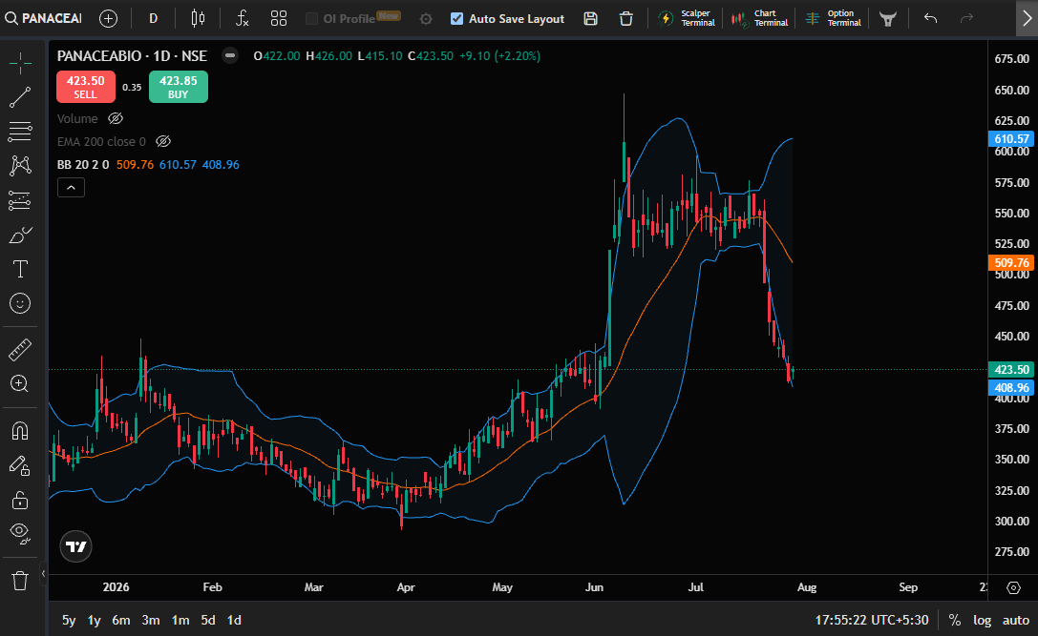
Bollinger bands
Middle band – 20SMA
Upper band = +2SD
Lower Band = -2SD

Slide 7
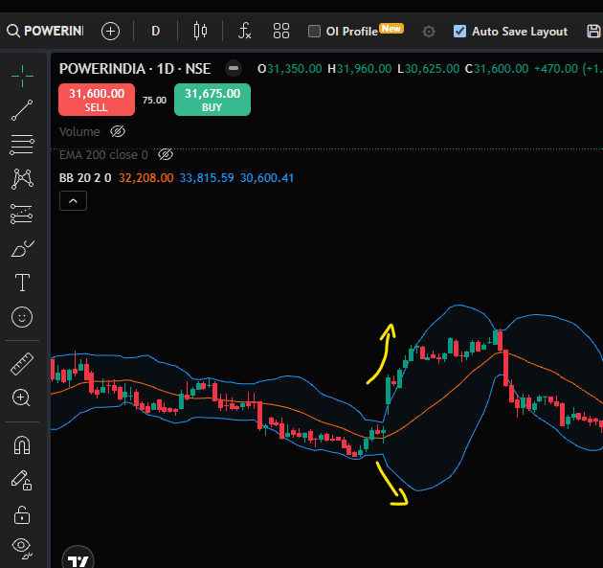
Volatility is expanding
When upper band and lower band are moving away from each other it means volatility is expanding

Slide 8
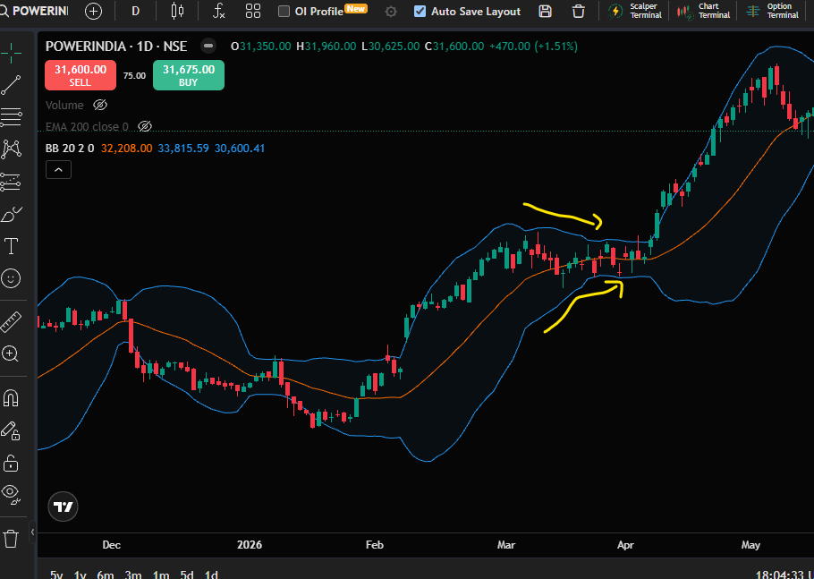
Volatility is contracting
When bands are moving towards each other.

Slide 9
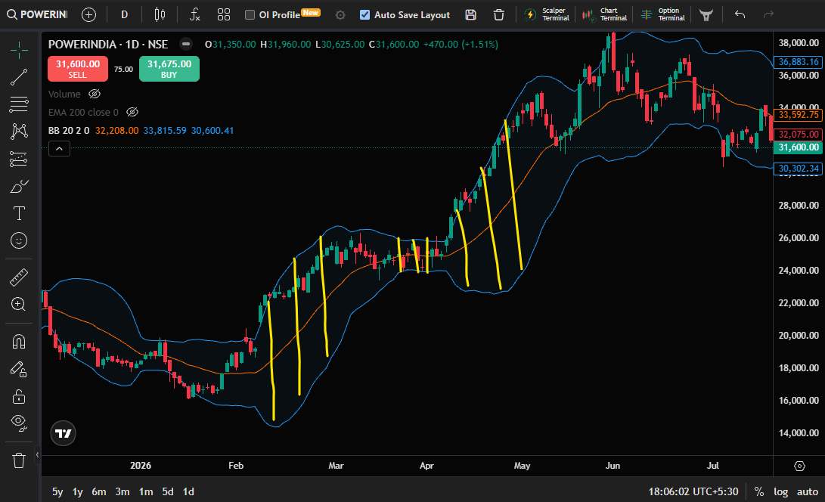
Expanion to contraction
Contraction to expansion

Slide 10
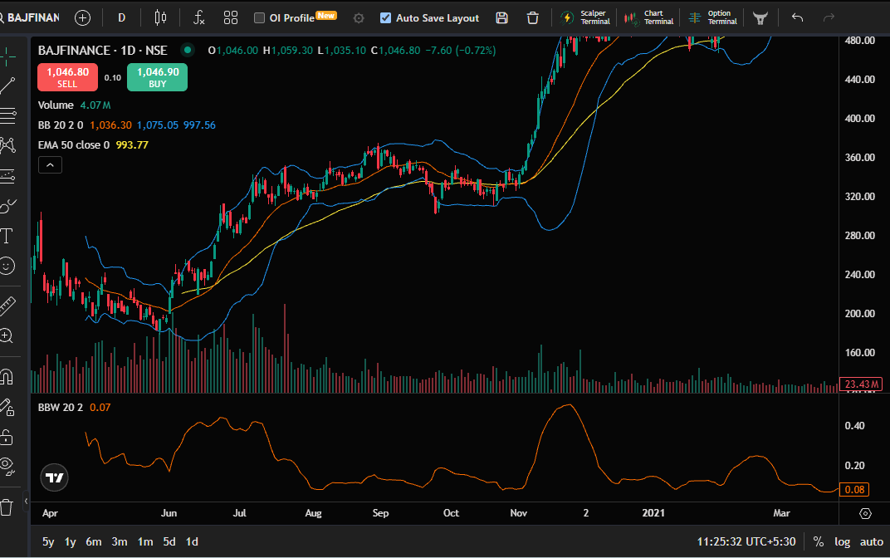
False breakouts ??

Slide 11
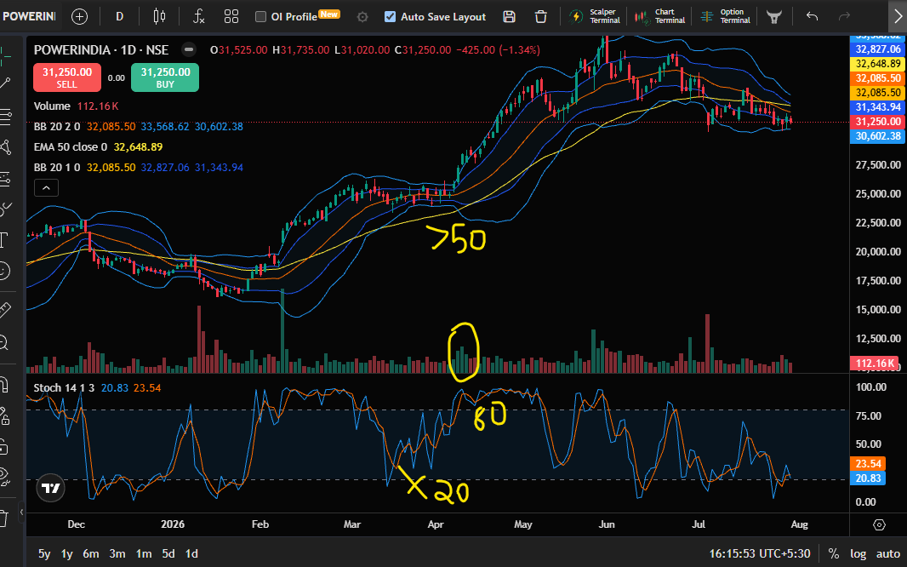
First trade – Volatility expansion and trend continuation
Squeeze breakout
Price closes outside the upper band
Volume higher than last few trading sessions
Price above 50EMA
Stoch – Above 80 and not crossing below 20

Slide 12
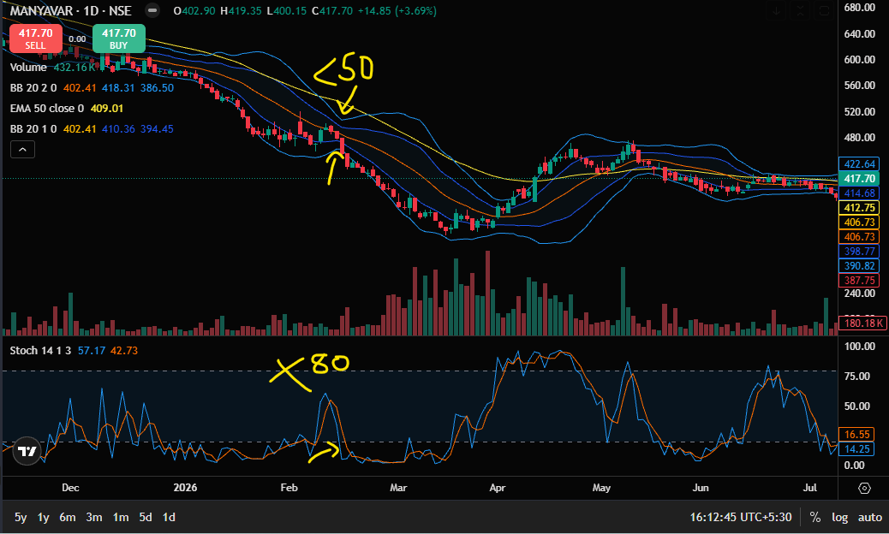
False breakouts how to avoid ?
Conditions
Price below 50EMA
20SMA below 50EMA
Volume high
Price closing outside LB
BBW around 0.05
If Price < 50 & 20SMA < 50EMA
Take only bearish trades and slope of BB lower

Slide 13
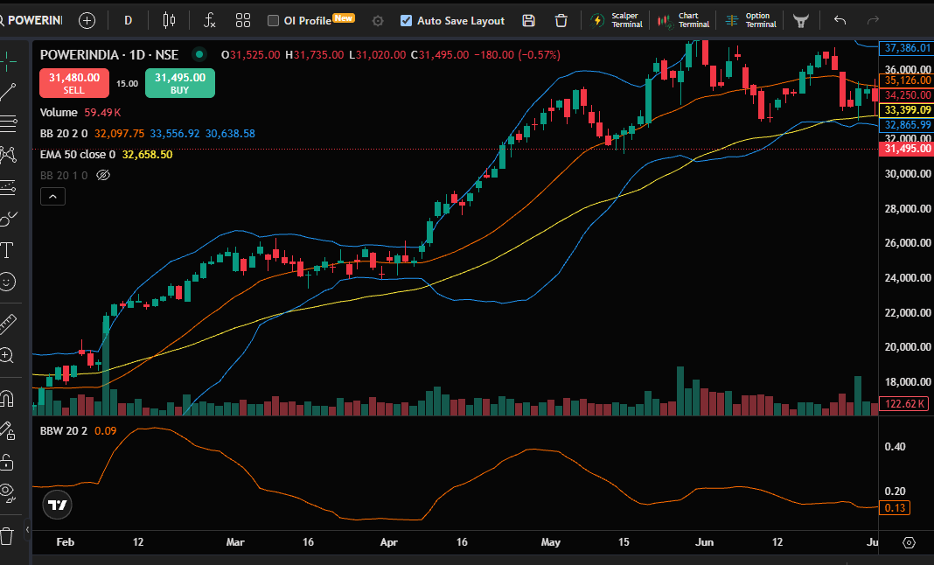
Entry and Initial Stop loss
Entry @ close of the candle
SL = Low of the candle

Slide 14
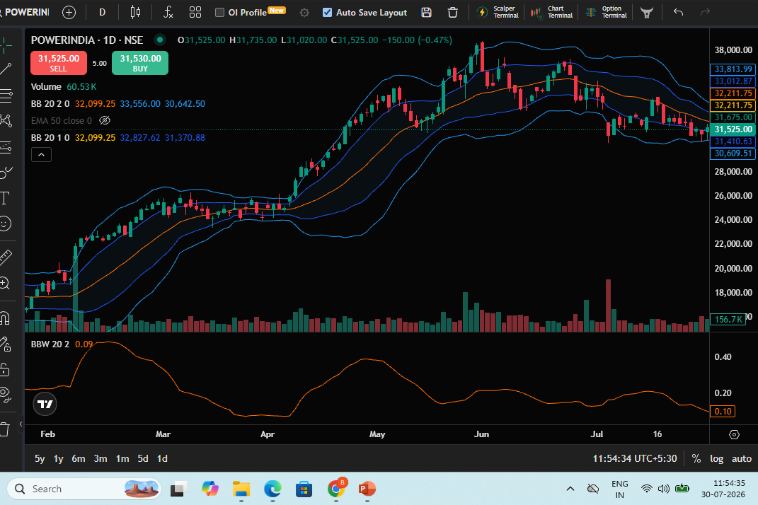
EXIT – Below 1SD band
EXIT –
When price closes below 1SD Band

Slide 15
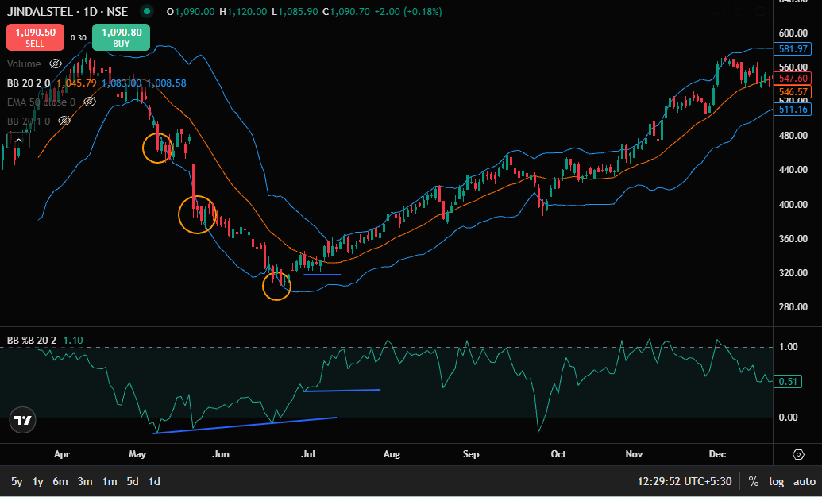
Volatility divergence and market bottoms

Slide 16
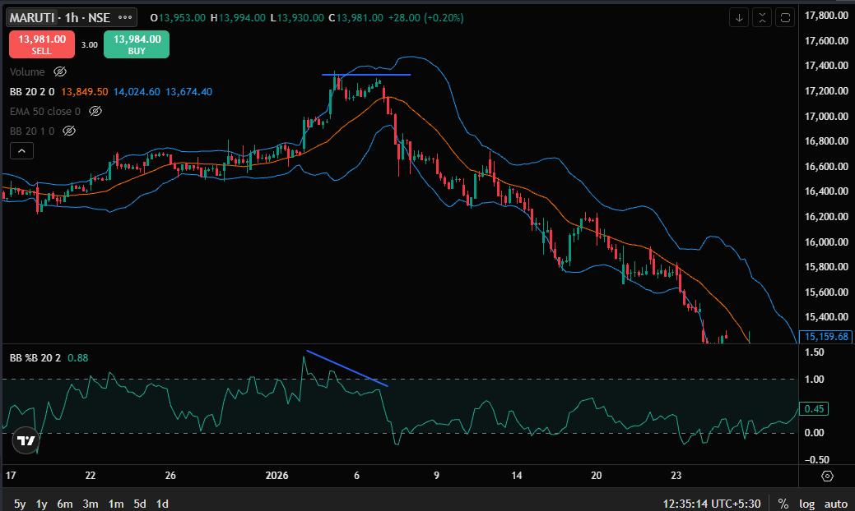
Volatility divergence and market tops

Slide 17
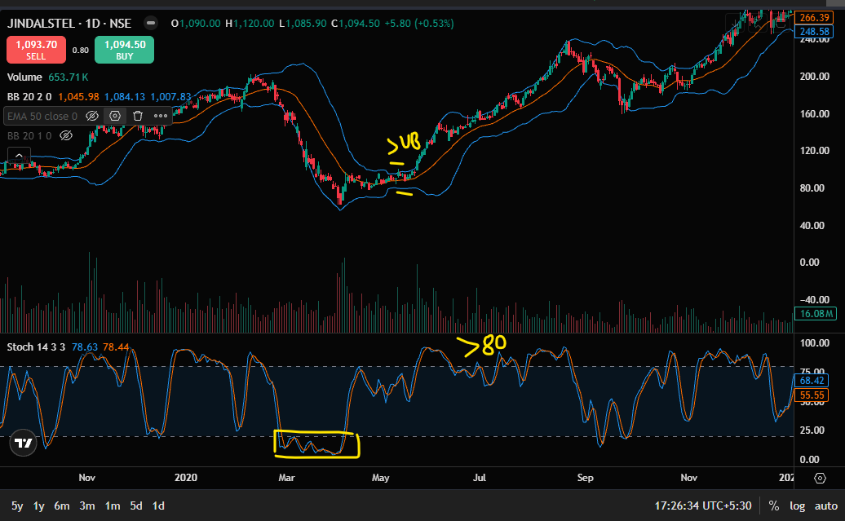
Market reversals + Vol contraction
Stoch consolidating below 20.
Volatility contraction
Stoch breaks out above 80 and doesn’t come below 20.
Price tags upper band
Hold as long as price stays above 20sma
Stoch below 20 for couple of days

Slide 18
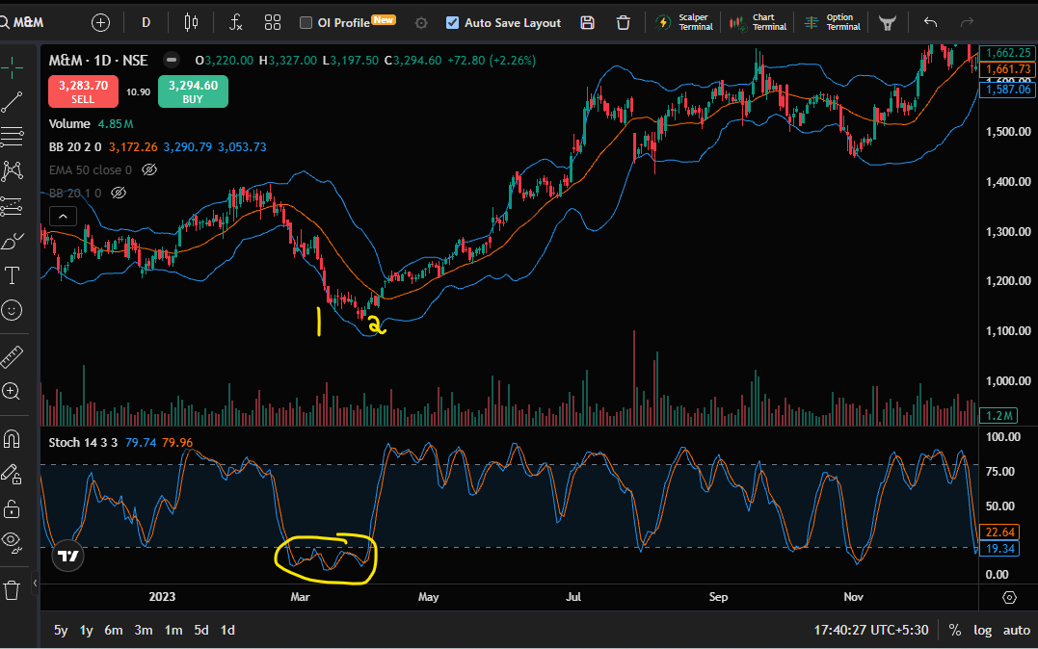
Market reversals + Vol contraction
Stoch consolidating below 20.
Volatility contraction
Stoch breaks out above 80 and doesn’t come below 20.
Price tags upper band
Hold as long as price stays above 20sma
Stoch below 20 for couple of days

Slide 19
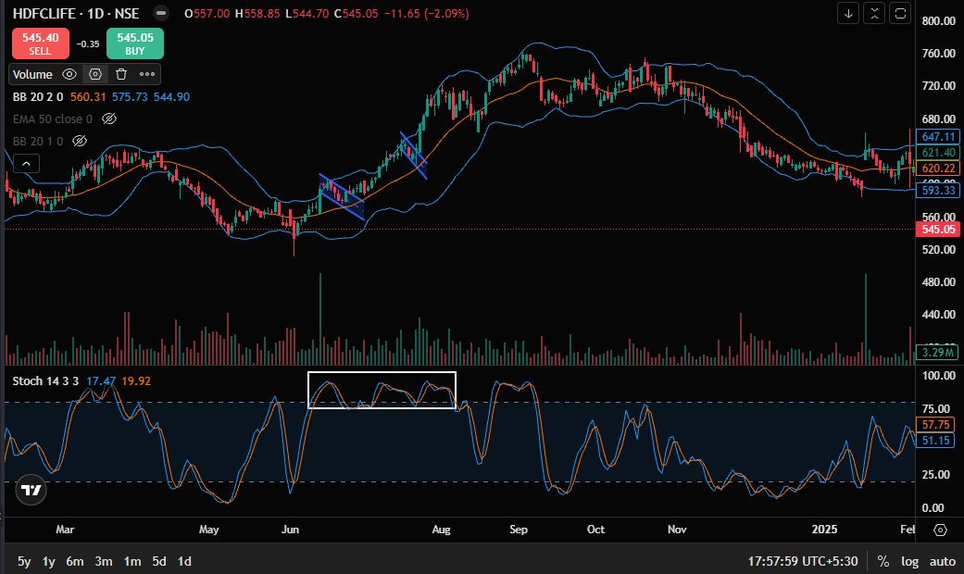
Catching the cream of the move using Bollinger
Stoch poked and stayed above 80
And doesn’t go below 50 on pull back
Price retracing to MB
Enter – channel b/o
Target – UB
SL – low/MB

Slide 20
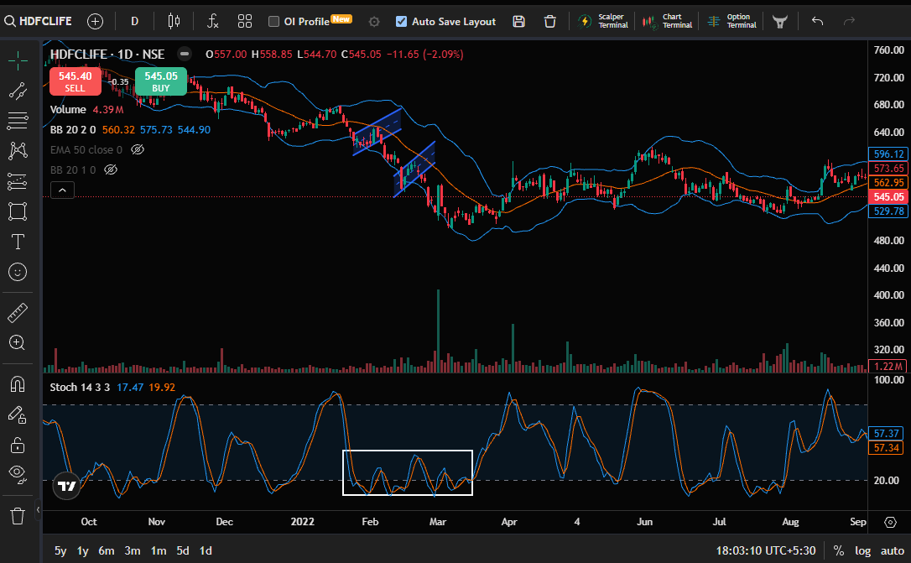
Catching the cream of the move using Bollinger
Stoch poked and stayed below 20
And doesn’t go above 50 on pull back
Price retracing to MB
Enter – channel b/o
Target – LB
SL – high/MB

Slide 21
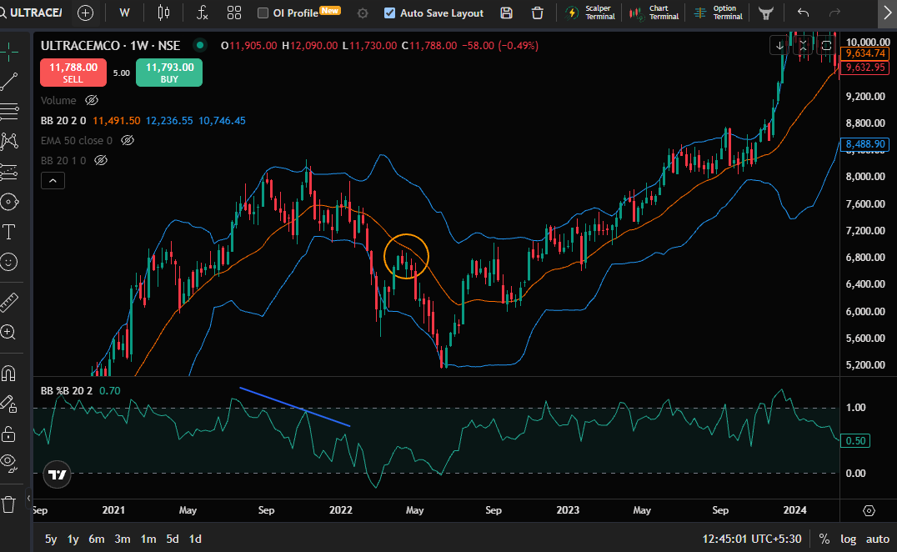
First trade after market tops/bottoms
First change of polarity after W or M’s
At middle band

Slide 22
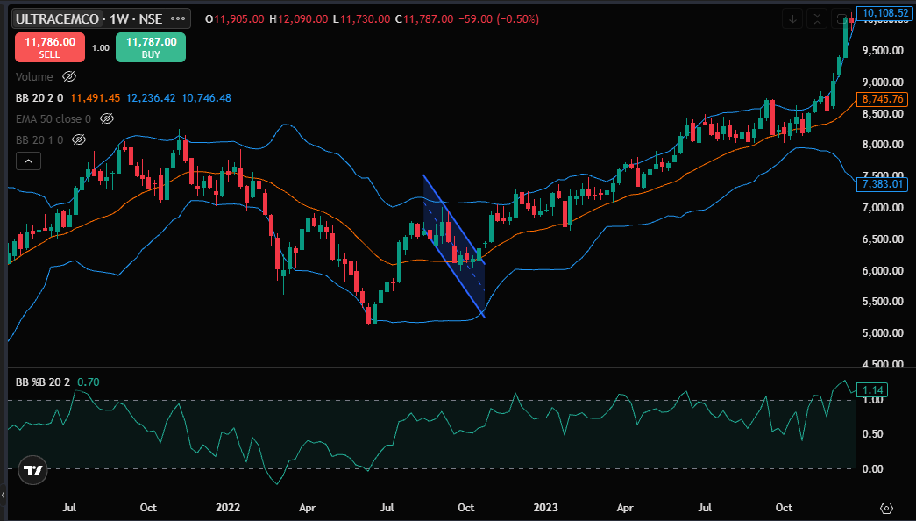
Entry – channel break
SL = Swing low
Target = Upper Band

Slide 23


