Slide 1
Straddle
A straddle is a popular options trading strategy where an investor simultaneously buys (or sells) both a call option and a put option for the same underlying asset with the identical strike price and expiration date
Both call and Put together
Same strike
Same expiry
ATM strike – Atm straddle
ITM call straddle
ITM put straddle

Slide 2
Our Strategy - Long Straddle
Buy both call and put – same strike and same expiry

Slide 3
Indicators
SMA 20
EMA 45
RSI 14 period

Slide 4
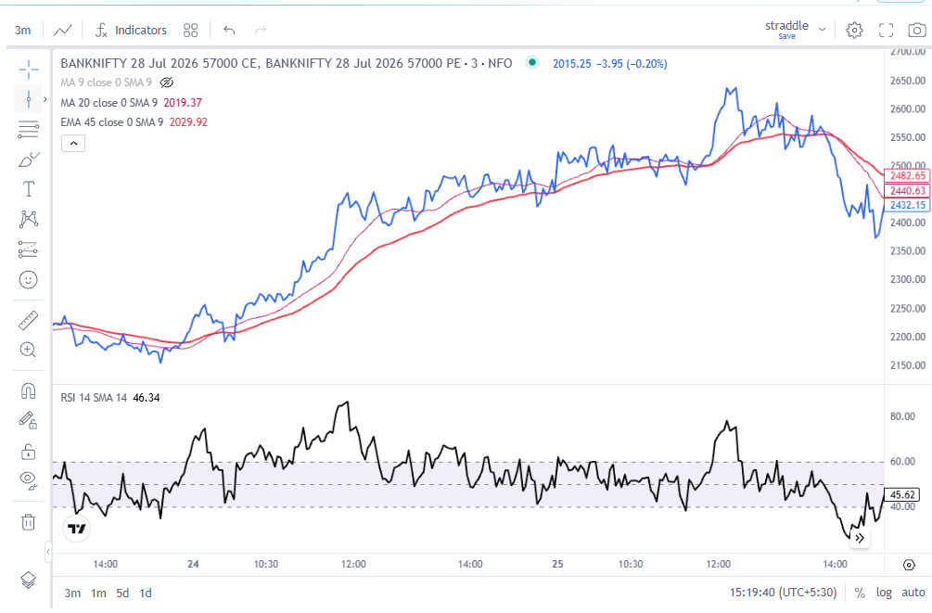
During straddle upmove
Above 45
Range 60 - 40
Base @40

Slide 5
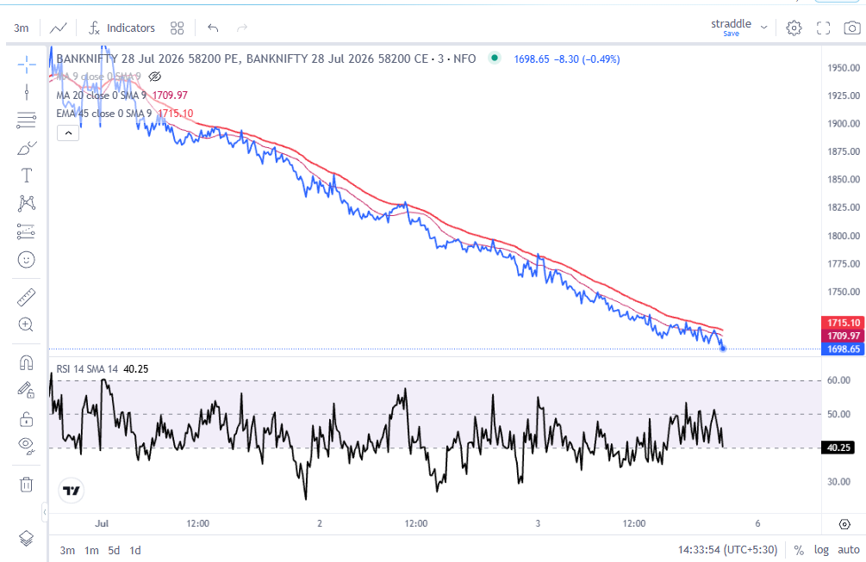
Downtrend
PRICE below 45
RSI – 60 to 20

Slide 6
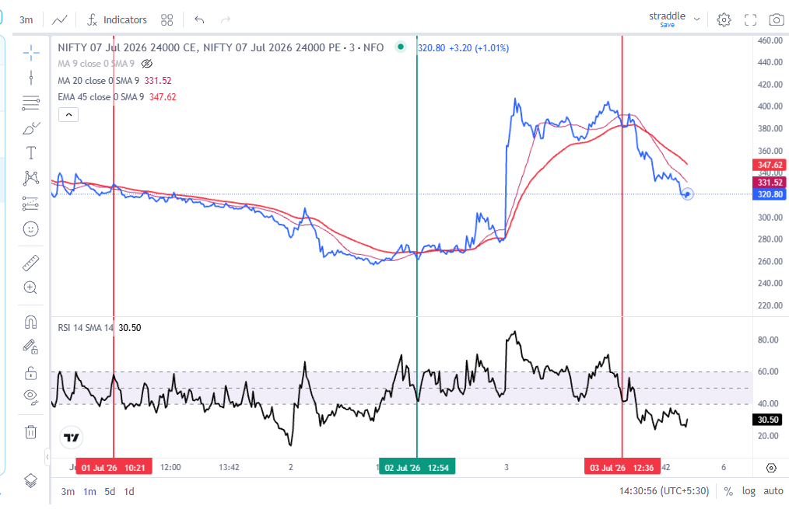
Downtrend
RSI 60 top
Range is 60-20
Uptrend
RSI 40 bottom
Range 80-40

Slide 7
Straddle buying Setup
20 SMA above 45EMA
Premium above 45
RSI 45 above 50 and support at 50

Slide 8
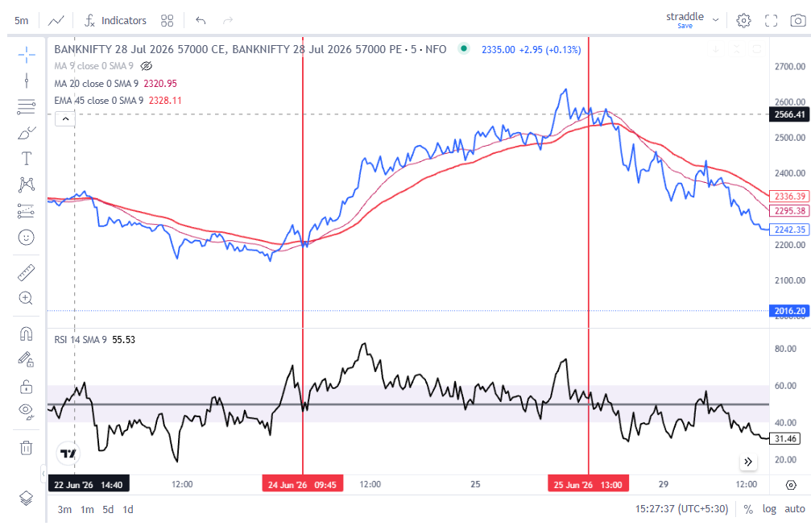
Cream of the move in straddle
Above 45
Above 50

Slide 9
FAKEOUTS to avoid
RSI trading above 50 but premiums below 45

Slide 10
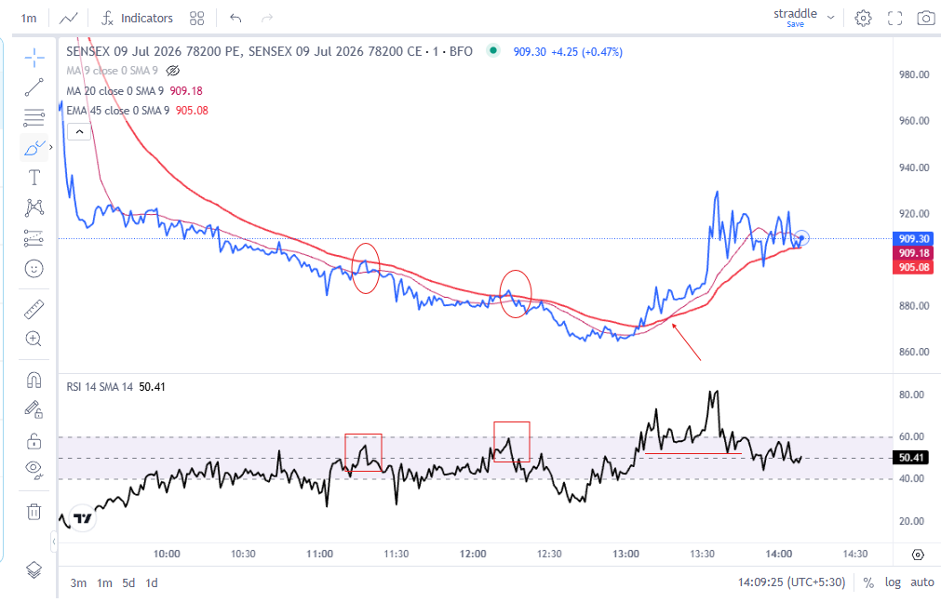
Fakeouts moves on RSI to avoid

Slide 11
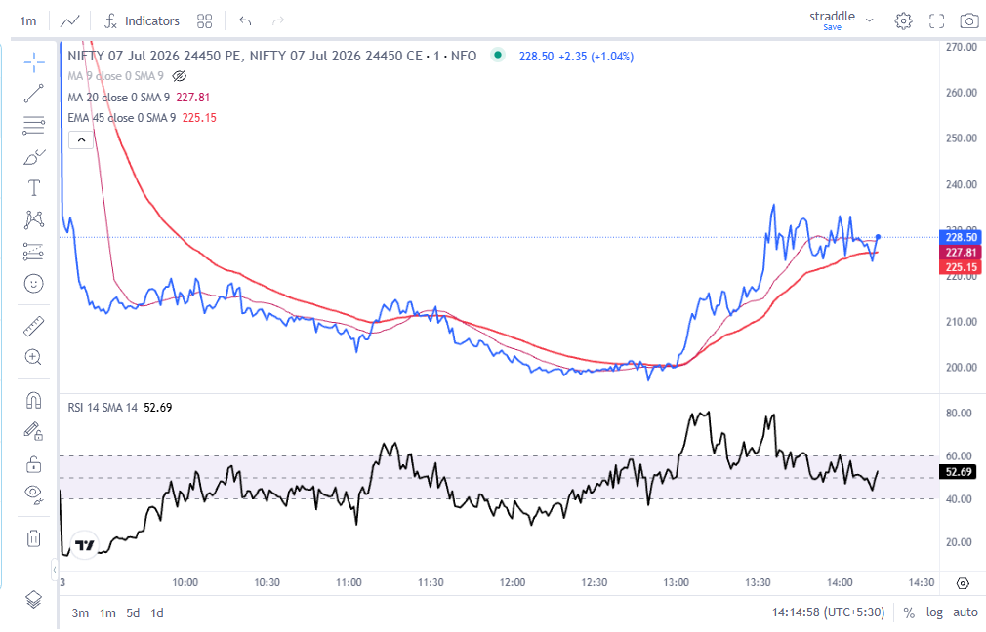
Entry when Price at 45 and RSI at 50
Initial SL = swing low
Entry @210
SL = 203
Entry at 200
SL 196

Slide 12
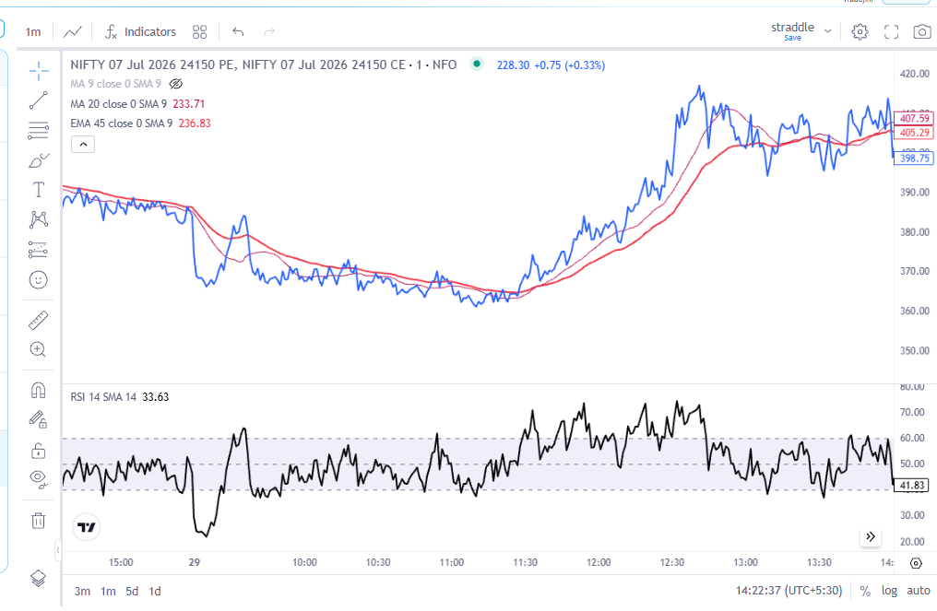
Partial and complete exit
Trail SL with 45EMA
Partial exit at 20SMA
Stop at 60
RSI @50
RSI at 40
RSI < 40

Slide 13
Straddle V/s Naked options
Biggest issues with naked options
Bull and bear Traps
Stop loss width
Trap + V shape
Sideways

Slide 14
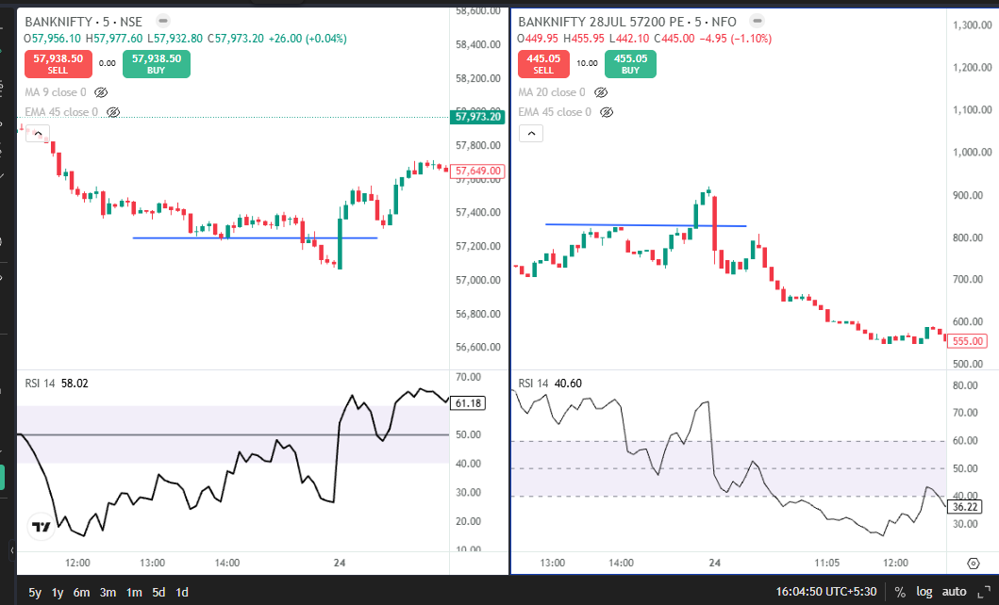
Naked buying disadvantage
57200 pe broke
Support broke @ 57200
826 entry
727 SL ( swing low )

Slide 15
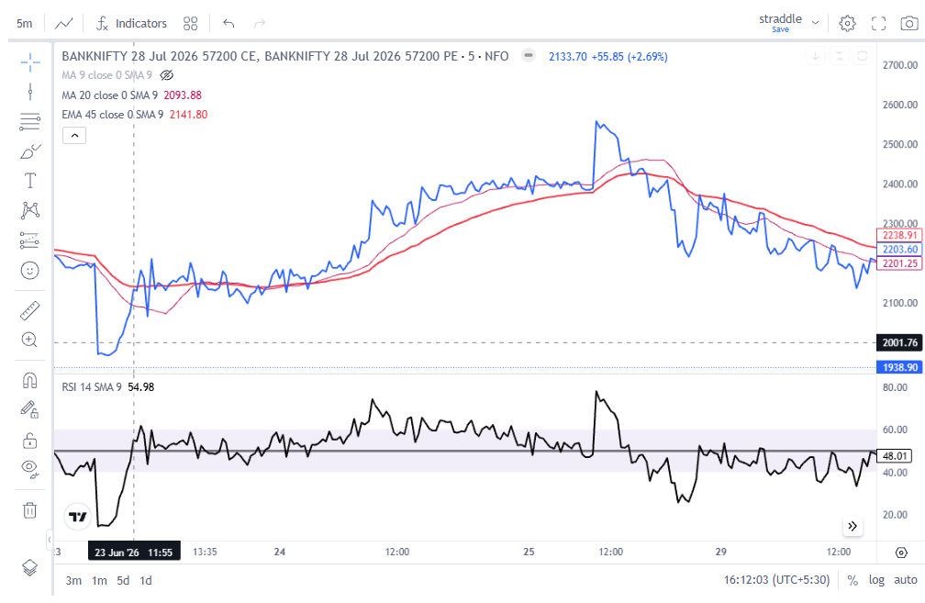
Straddle did give money
SL not triggered

Slide 16
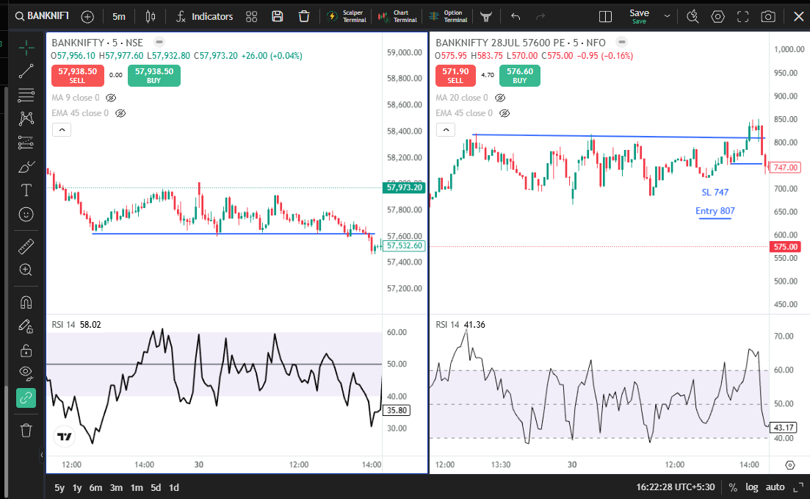
Consolidation breakdown
Put buy triggered

Slide 17
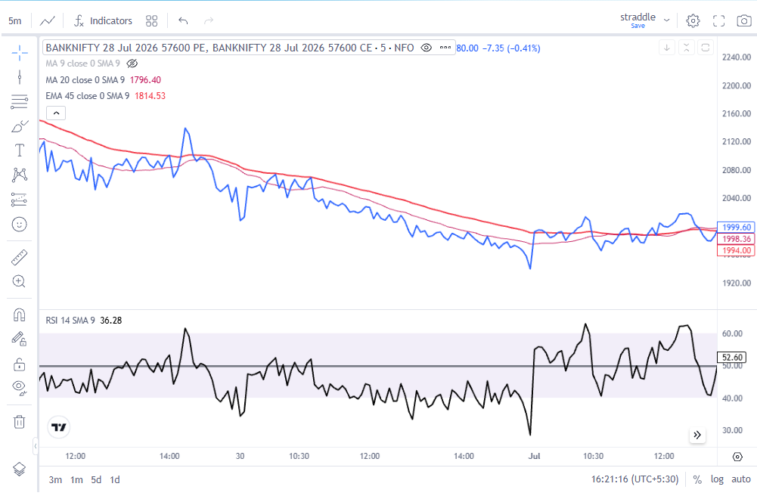
Straddle Not trigger as per setup

Slide 18
Entry when Price at 45 and RSI at 50
Initial SL = swing low
Entry @210
SL = 203
Entry at 200
SL 196

Slide 19
Trend Identification using straddles

Slide 20
Bearish
ITM put straddles higher highs + ITM call straddles lower highs
Bullish
ITM Call straddles higher highs +
ITM put straddles lower lows
Sideways + Theta + IV crash
All trending lower

Slide 21
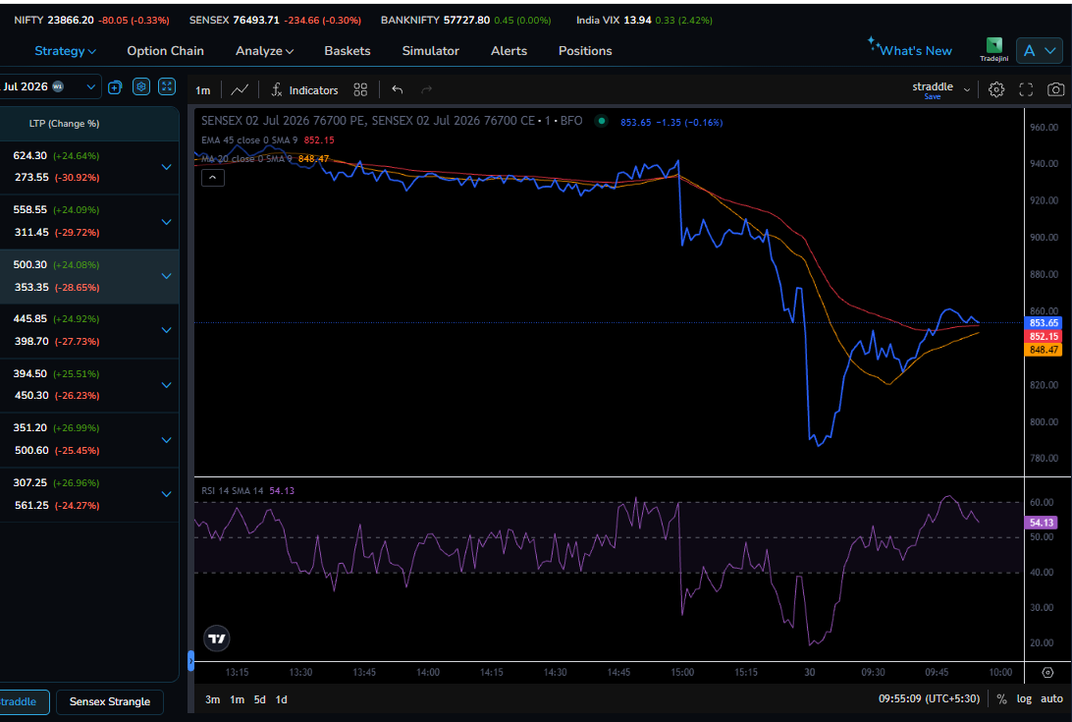
Sensex at 76500 - 76700 ITM put Straddle making higher highs

Slide 22
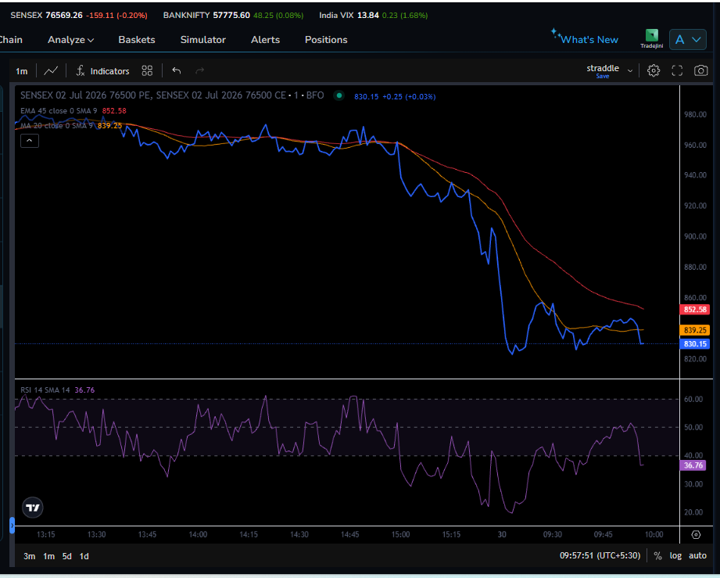
Sensex@ 76500 – ATM straddle making lower lows

Slide 23
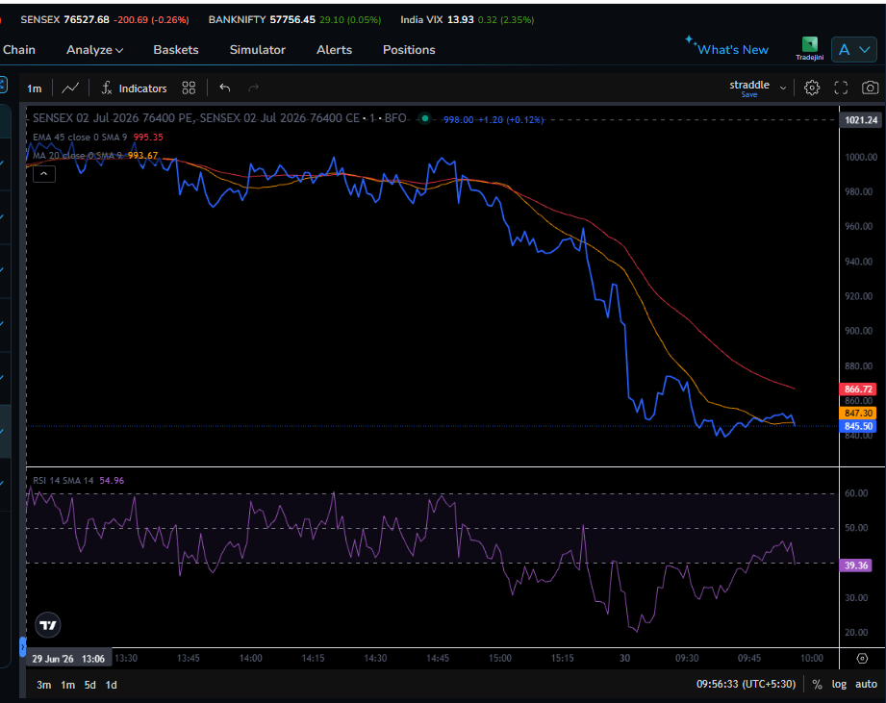
Sensex at 76500 – ITM Call straddle lower lows – breaking support

