Slide 1
THEME 3 How we Pray Together
Synod 2020

Slide 2
Welcome

Slide 3
What people said:
Sunday Mass is very important to us, but some people find it hard to get there
People like to pray in many different ways
People love to go to Church to pray
Prayer helps to make us strong
Families need help to pass on their faith
Liturgy and worship are
central to our school’s
mission
People love seeing children at Mass

Slide 4
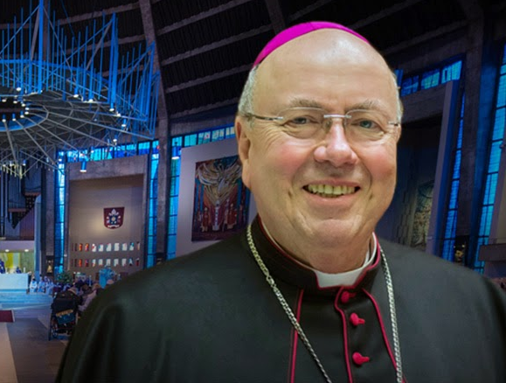

Slide 5
We are invited to think about the various ways and places we pray.

Slide 6
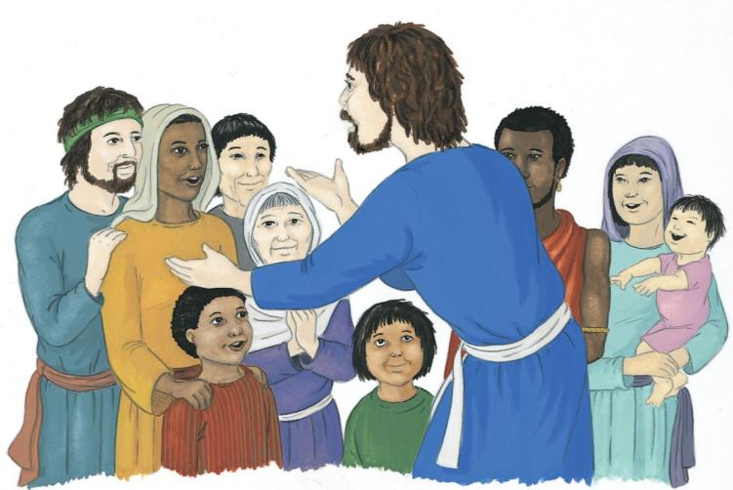

Slide 7
Jesus prays to his Father:
“Holy Father, I am coming to you.
Keep my friends safe.
They belong to you.
Keep them close to you and to each other.
Let them be as close as I am to you.
I kept them close to you.” “Father, I pray for these my friends and for all those in the future whom they will bring to know me.
Just as you and I are one,
I pray that my friends will always be one with us and with one another.”

Slide 8
Jesus was praying one day. When he had finished, one of the disciples said, “Lord, will you teach us to pray?” Jesus said to them, “When you pray, say this:
Father, let everyone honour your holy name.
May everyone live in your love and friendship.
May we all have enough to eat every day.
Forgive us when we do something wrong because we forgive anyone who has hurt us.
And be with us if we have to make difficult choices.”

Slide 9
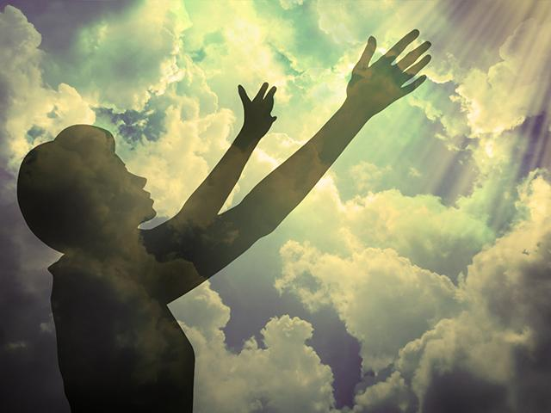
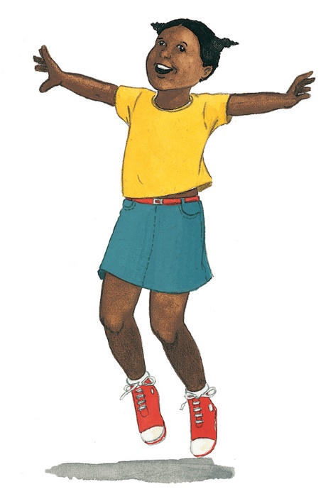
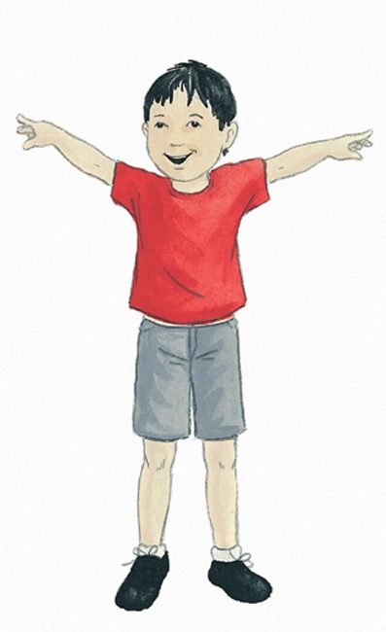
Our Father:
Our Father, Who art in heaven, Hallowed be Thy Name. Thy Kingdom come. Thy Will be done, on earth as it is in Heaven.
Give us this day our daily bread. And forgive us our trespasses, as we forgive those who trespass against us. And lead us not into temptation, but deliver us from evil. Amen

Slide 10
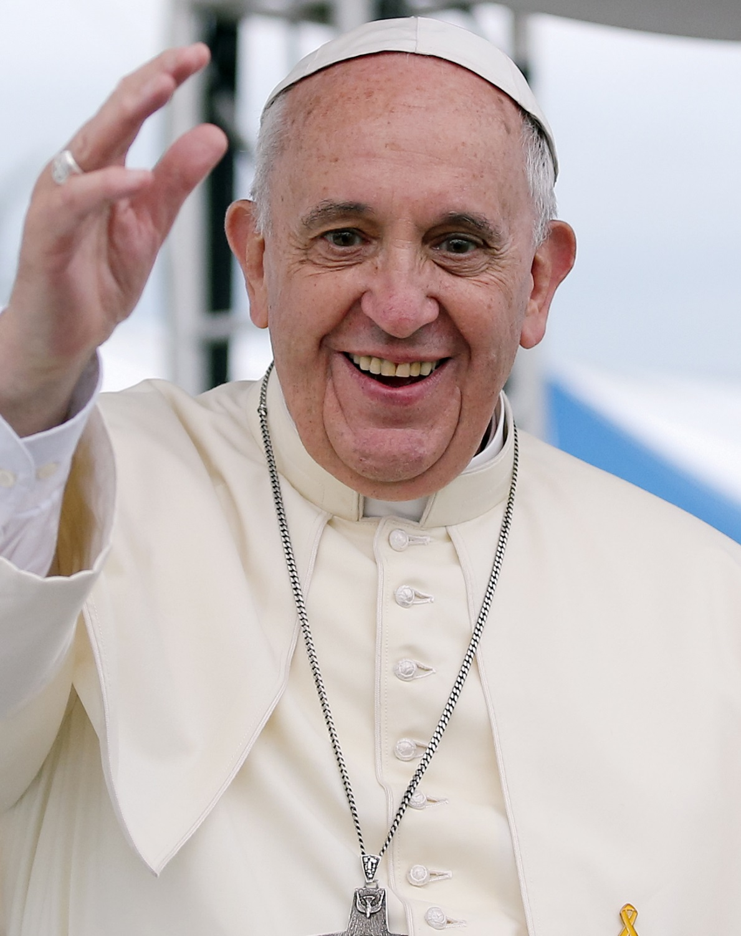
Pope Francis tells us that,
“Our prayer cannot be reduced to an hour on Sundays.
It is important to have a daily relationship with the Lord.”

Slide 11
How can we talk to God each day?

Slide 12
Think about…..
When and where do we pray?
What different ways do you
know how to pray?
Who do we pray for and why do we pray for them?
What could help you to pray more at, school, at home and in church?

Slide 13
Loving God, We know you are always with us.
May our hearts be open to you. May our lives be a prayer to you. May our worship remind us how much we need you.

Slide 14
Fill our hearts with love so we can make a difference to the world and make it a better place.
AMEN!

Slide 15
Discuss:
What more can the Catholic Church do to help you young people to go to Mass and to pray?

Slide 16
Thank you!

