Slide 1
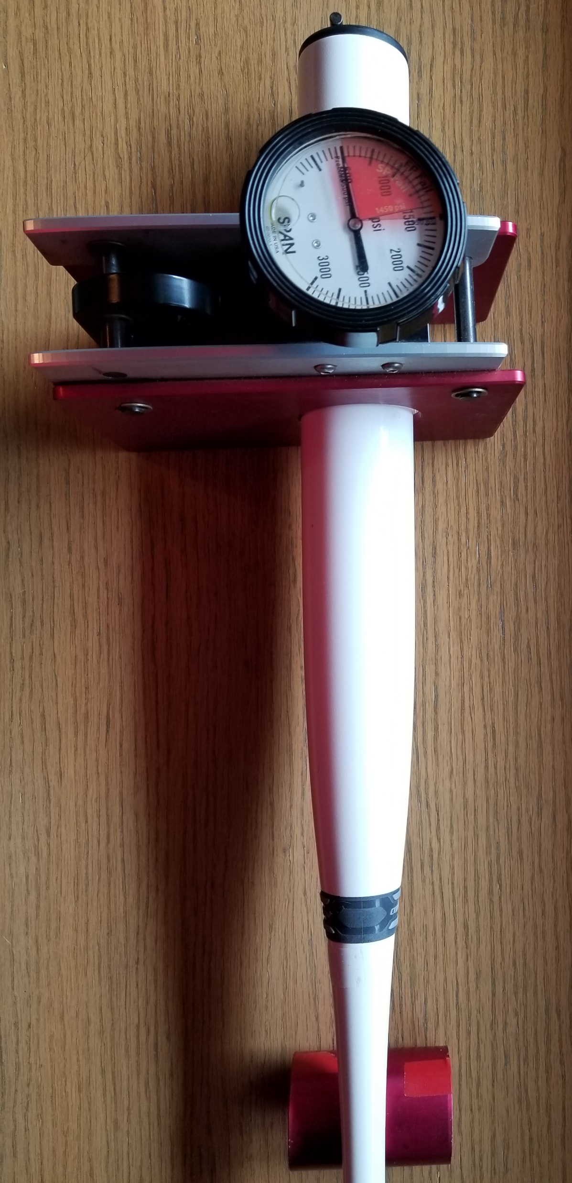
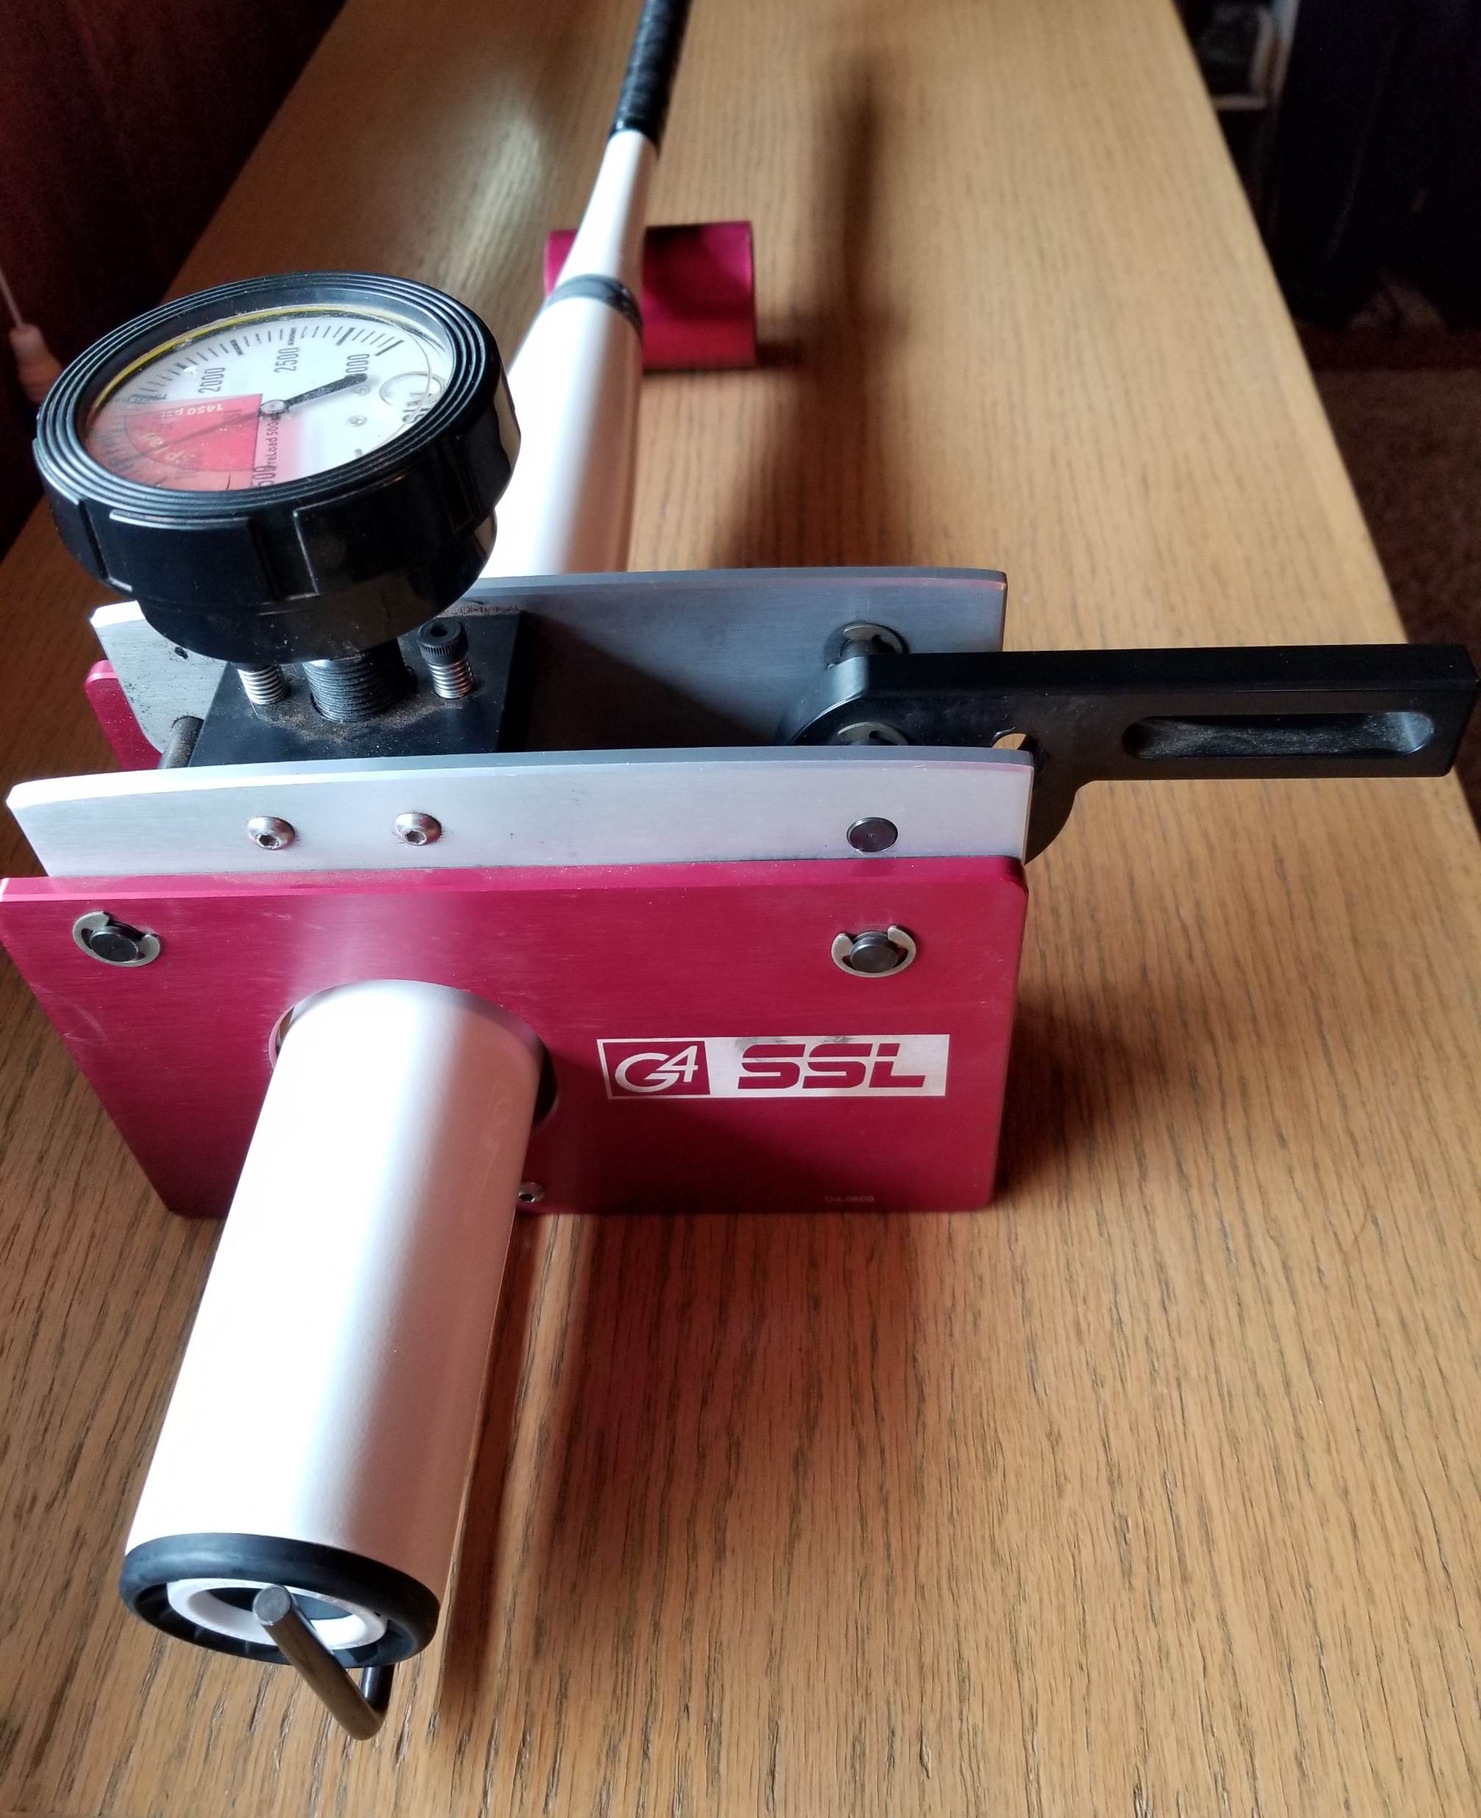
Human resources slide 2
NCAA
SOFTBALL BAT
COMPLIANCE
Dee Abrahamson
Batology Presentation
1.25 edition
Notes:
Welcome to a brief presentation on the NCAA Softball Bat Compliance Program with an emphasis on the barrel compression testing…referred to as BCT.
Before we dive into the details on how to perform BCT, let me quickly explain the goals of the entire compliance program and where barrel compression testing fits into the big picture.
Following that theory are the details for executing BCT.
Note that the NCAA Softball Playing Rules REQUIRE BCT occur prior to play in tournaments, series, doubleheaders and single games. No stickers = illegal bats = no game.
Finally, at the end of the presentation is an easy-to-use flow chart suitable for printing and putting in the bat testing fixture case for reference on the bat testing responsibilities.

Slide 2
Human resources slide 1
REASONS TO REGULATE BATS
Protect the integrity of the game and credibility to its participants.
Assure fair and equitable competition between teams.
Ensure performance is a result of player’s skill more than of her equipment.
Maintain the balance of offense and defense.
Regulate the defender’s
available reaction time.
Notes:
On behalf of the NCAA Softball Rules Committee, I want to thank you for your diligence in helping monitor the appropriateness of bats used in the collegiate game. Several years ago, there was significant concern about the impact various bat models were having on our game and thus the NCAA Softball Bat Compliance Program was created.
The five goals listed here are the foundation of that program.
To protect the integrity of the game and the credibility to its participants;
To assure fair and equitable competition between teams;
To maintain the delicate balance of offense and defense;
To regulate the defender’s available reaction time and therefore minimize injury risk; and
To ensure a player’s performance is a result of the player’s skill more than of her equipment by eliminating rogue bats.

Slide 3
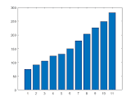
Human resources slide 7
OVERVIEW OF THE NCAA SOFTBALL
BAT COMPLIANCE PROGRAM
Bat is USA
Softball
certified
& 0n NCAA
Approved
Softball
Bat List
Barrel
Compression
Testing
On-field
Inspection
Lab
Testing
Coach responsibility
every day
Admin responsibility
prior to competition
Umpire responsibility
every game
NSRC responsibility
selected bats
Notes:
To address those goals, a five-prong approach was created.
The first and second are the responsibility of the coach. The first is the requirement that bats used in NCAA competition must be USA Softball certified.
And the second is the model must be included on the current NCAA Approved Softball Bat List.
The third is the one we are going to concentrate on today -that is, Barrel Compression Testing which is done PRIOR to games, tournaments and daily in every tier of the NCAA post season.
The fourth is to provide a safety net for the opposing team by having umpires perform a pre-game inspection of bats for BCT verification (i.e. the appropriate sticker) and their suitability (that is, not damaged) prior to every game.
The fifth is post-competition compliance testing done in a lab on bats that both pass and fail BCT to confirm the test’s validity as
a predictor of compliance with the batted ball speed standard.
The generic term “bat testing” could refer to either of these last two prongs but remember BCT is done locally and PRIOR to competition and lab testing is done at the Sport Science lab AFTER competition.

Slide 4
Human resources slide 4
PRIOR TO THE START OF THE SEASON,
HOST ADMINISTRATIONS MUST
SECURE A BCT FIXTURE AND
HAVE PLANS FOR TESTING AT
EVERY COMPETITION INCLUDING
IN THE NCAA POSTSEASON.
Individual conferences and tournaments must establish protocols to include, at a minimum…
M
source of distinctive stickers to indicate bats have passed BCT;
and when, where and by whom BCT will be performed.
the disposition of bats surrendered following BCT failure;
R
Notes:
Prior to the season, host administrations must secure a BCT fixture and have the following plans for every competition with the exception of those using NCAA assigned bat testing managers.
First, prior to the start of the season, each institution is responsible for acquiring the appropriate number of distinctive stickers to be used on bats that pass barrel compression testing for individual competitions.
Second, prior to competition, the disposition of bats that are surrendered following BCT failure, needs to be established and communicated.
Finally, the time, location, and bat testing manager for BCT should be communicated to participating coaches in a timely manner but no later than 48 hours before game time.

Slide 5

Human resources slide 8
STICKER PLANS
Stickers for single-opponent competitions
are typically provided by each team as each
places its stickers on the passed bats of
their opponent.
Tournament hosts should provide stickers distinctive to the event and secure them from all teams. Alternatively, they may inform competing teams they will be responsible for providing stickers for their opponents.
Notes:
Coaches must acquire enough stickers to accommodate use on every passed bat for either their opponents or for all events they host.
Stickers need not be the same event to event but must be distinctive each day of a multiday event if BCT occurs daily.
In tournament settings, the host may provide distinctive stickers for all teams in the event.
Alternatively, stickers may be used from teams competing in their first game. This process can also be used in a tournament as long as teams are notified as to the number of teams requiring their stickers.
The NCAA will provide hosts with the appropriate stickers for the postseason.

Slide 6
Human resources slide 3
NCAA
APPROVED
SOFTBALL
BAT LIST
Planned postings of the NCAA Approved Bat List will be the 2nd Monday in December 2023, April and August 2024; additional lists will post
 |  |  | when model(s) must be immediately removed. Information new to the list is noted in blue font.
Summary of strikes assessed to models currently on the NCAA Approved Softball Bat List:
 | 1 strike each- Demarini CFF34-19, CFP34-21 & PZP-20; Dirty South FSSW08; Mizuno 340500, 340531, 340556, 340606, & 340651
 | 2 strikes each - Easton FP18GH10*** Mizuno 340554
BARREL COMPRESSION TESTING MINIMUMS: ALL BATS MUST MEET A MINIMUM OF 1550PSI EXCEPT THE FOLLOWING MODELS WHICH ARE
SUMMARIZED BELOW AND NOTED ON THE APPROPRIATE LINES AND PAGES OF THE CURRENT NCAA APPROVED SOFTBALL BAT LIST
*Demarini Models |  | *Prism & custom (PZF-20 & 21, PZ1-21, PZP-19, 20, 21 & 23)-1200psi minimum; all Whisper series -1100psi minimum
***Easton Models |  | ***Ghost EFP4GHAD8, FP21GHADG4TG10, FP22GH & FP22GHAD series, FP22GHAF10, and FP22GHAM10,
 |  |  | FP22GHT10, FP23GH8, FP23GHU series- 900psi minimum
 |  | ***Ghost FP18GH, FP20GH, FP20GHAD series & FP20GHCAN10, FP20GHSNS10, FP21GHADGLD -1000psi minimum
 |  |  | ***Ghost EFP3GHB10, EFP4GHAD9 & 10, FP23GH9 & 10-1050psi minimum
**Louisville Slugger |  |  | **All LXT, PXT, RXT & XENO series -1400psi minimum; KRYO & META series -950psi minimum
*****Mizuno Models |  |  | *****PWR CRBN (340527,340528, 340529, 350551 350552, 340553, 340603 340604 340605) -1400psi minimum
******Monsta Model |  |  |  | ******22FPH24A2 & 24FPFUL-1350psi minimum
****Rawlings Models |  |  | ****MANTRA (FP1M9&10 & RFPM39&10) -1100psi minimum; MANTRA 3.0 (RFP4M9&10) -1200psi minimum
 |  |  | ****MANTRA PLUS (RFP3MP9&10 & RFPMP9&10) -1000psi minimum
Barrel Compression Testing and Pregame Inspection Information:
Bat Testing Manager Name (s)__________________________________________________________________
Day One Sticker Color______________________ # Passed Bats_______ Date ______ Umpire Initials__________ # Bats Presented & Approved_______
Day Two Sticker Color______________________ # Passed Bats_______ Date ______ Umpire Initials__________ # Bats Presented & Approved_______
Day Three Sticker Color____________________ # Passed Bats_______ Date _______ Umpire Initials__________ # Bats Presented & Approved_______
 |  |  |  |  | FOR NCAA GAMES--Disqualified bats MUST be reported via the Noncompliant/Inappropriate Bat Report found on www.refquest.com
 |  |  |  |  | (under governing body choose NCAA; scroll down to softball banner and select the form).
Bat testing managers MUST file the report for failed bats including the actual BCT readings; umpires MUST complete the form for bats disqualified for damage.
Failed BCT Information:
Date |  | Manufacturer |  | Model Number |  | BCT Readings |  | Bat Manager Initials
Disqualified Damaged Bat Information:
Date |  | Manufacturer |  | Model Number | Issue (e.g. break, crack, illegal, illegible, rattle, wobble, endcap, connection) |  |  | Initials
FOR ALL COMPETITION:
Notes:
The responsibility for legally equipping the team rests with the coach regardless of if the bats are team or player owned, purchased or gifted.
In addition to presenting legal bats at testing, coaches must provide the first page and all relevant pages of a current NCAA Approved Softball Bat List that has their presented models highlighted and indicates the number of each in the first column.
The redesigned bat list includes a new multi-color section to enter the information for use by the bat testing manager and umpires to detail bats that are disqualified and those that are appropriate for competition.
A summary of all backstop style models with an exception to the 1550psi is provided at the top of the first page in a blue box for the convenience of the bat testing manager as an alternative to using the individually listed bats by manufacturer.

Slide 7
Human resources slide 10
THE BASICS OF
BARREL COMPRESSION TESTING
Barrel compression testing is a simple
predictor of bat performance.
In general, a reading of 1550 pounds
per square inch (psi) is the minimum
standard because it correlates to
the maximum allowable batted
ball speed of 98mph.
However there are approved
lower minimums for “backstop
style” models as noted on the NCAA Approved Softball Bat List.
Notes:
The basics of barrel compression testing is that it is a simple, reasonably accurate predictor of bat performance. A portable fixture is used to apply pressure to the bat barrel to measure barrel stiffness in specific locations.
In general, there’s a linear correlation between the softness of the bat barrel and the exit speed of a batted ball.
Meaning if the barrel is stiff, the batted ball speed is likely slower than the 98mph standard and if it is soft, the batted ball speed is likely faster.
So a reading of 1550 pounds per square inch (psi) is the minimum standard of stiffness, as measured with this testing unit.
However, due to unique construction of “backstop style” models, there is a process for manufacturers to be granted a lower psi minimum as noted on the NCAA Approved Softball Bat List. Note-this is a number exception NOT an exception to the required testing.

Slide 8
Human resources slide 3
G
E
T
T
I
N
G
PREP BY TESTERS
PREP BY COACHES
LOCATE ALL TESTING MATERIALS
PRESENT EVERY BAT
Obtain case with fixture, cylinder, stop stick plus tape and pen to identify failures and stickers (note postseason stickers and log sheets will be provided by the NCAA to tournament hosts).
Bats without the appropriate sticker will not be allowed in team areas.
ANNOTATED BAT LIST
Highlight the models presented and indicate
the number of each that
will be tested.
CALIBRATION TRIAL
S
T
A
R
T
E
D
Insert and compress cylinder to confirm reading matches the load printed on it.
LINE UP BATS
Arrange the bats in the
order in which they appear on the NCAA Approved Softball Bat List.
STOP STICK
Insert stop stick from preferred side until it is flush with far side then tighten set screw.
Notes:
So let’s talk about getting started in barrel compression testing.
Prior to testing, coaches must gather all the bats they wish to have available for use. At the designated time, coaches must present their annotated bat list and should arrange the bats in the order in which they appear.
Note- coaches need not present the entire NCAA Approved Softball Bat List…only the first page and all additional relevant pages.
If testing is done daily, there is flexibility to present different bats daily but if testing is for an entire series or tournament, there is only one opportunity to present bats for testing.
Also prior to testing, the bat testing manager must ensure that all the necessary materials are present, test the fixture to ensure it is calibrated correctly and secure the stop stick to the BCT fixture for ease in testing the approximate sweet spot of the bat.

Slide 9

Human resources slide 7
THE PROCESS
VERIFY
BAT MODELS
DISQUALIFY
OBVIOUS DAMAGE
COMPRESSION
TEST
FOLLOW-UP
Model numbers on the bat must exactly match those on the list.
Don’t waste your time testing obviously damaged bats.
Test until the bat passes or fails twice, whichever happens first.
Sticker bats that pass; retain
failures and
amend bat list.
Notes:
Let’s briefly talk about the process of barrel compression testing. There are four distinct parts:
The first is the bat testing manager must verify the model number on each bat EXACTLY MATCHES the model numbers on the annotated NCAA Approved Softball Bat List before continuing.
The second is to disqualify any bat with significant damage such as cracks and damaged end caps .
Next, compression test all bats that survive until each one has two passes or two fails, which ever happens first.
Finally, follow-up the test by applying a sticker to each bat that passes and retain possession of failed bats while amending the provided bat list to reflect those failures.
Let’s go into detail on each part…

Slide 10
Human resources slide 8
VERIFY BAT MODELS
Using the coach-provided NCAA
Approved Softball Bat List, the model numbers on the bats must exactly match.
Disqualify those bats that do
not match the list or are illegible.
The number of bats of each model are totaled and the bat testing manager completes the paperwork.
Notes:
Returning to the first step…
Although by rule, coaches are responsible for legally equipping their teams, verification is the responsibility of the bat testing manager.
It is essential that testing only occurs on bats with legible model numbers and letters that exactly match models on the current NCAA Approved Softball Bat List. If the model number on the bat is illegible, it is excluded.
Finally, check to ensure the most current list is provided and that it appropriately documents what is presented for testing before totaling the team’s bats and completing the information in the appropriate box of page one.

Slide 11
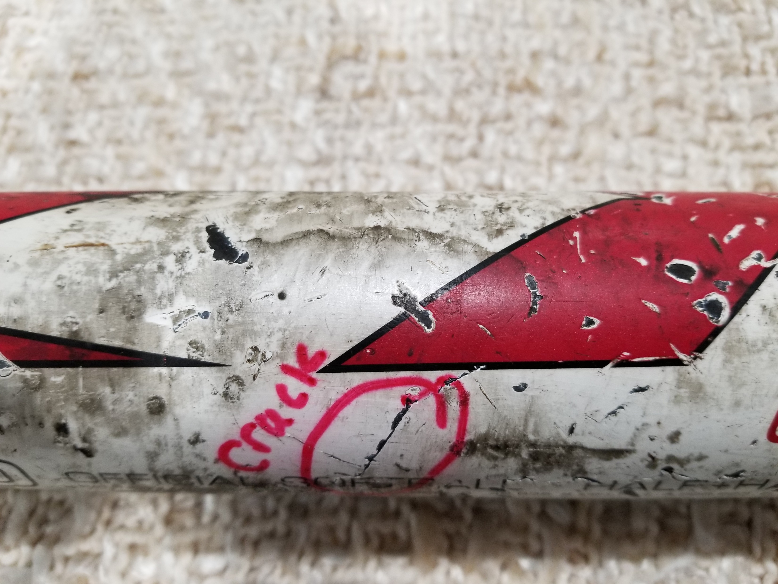
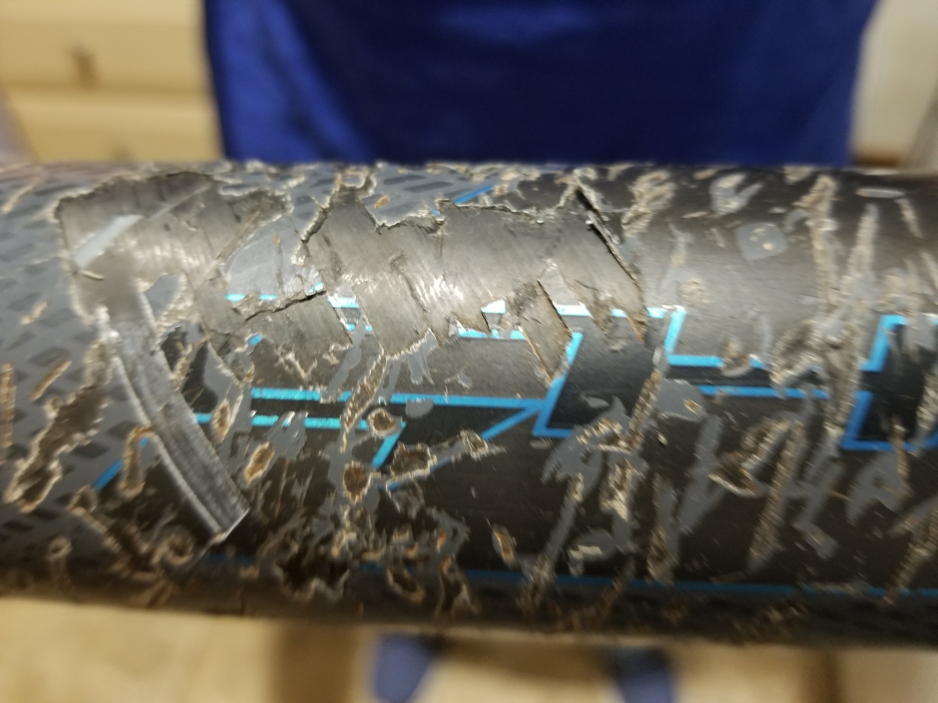
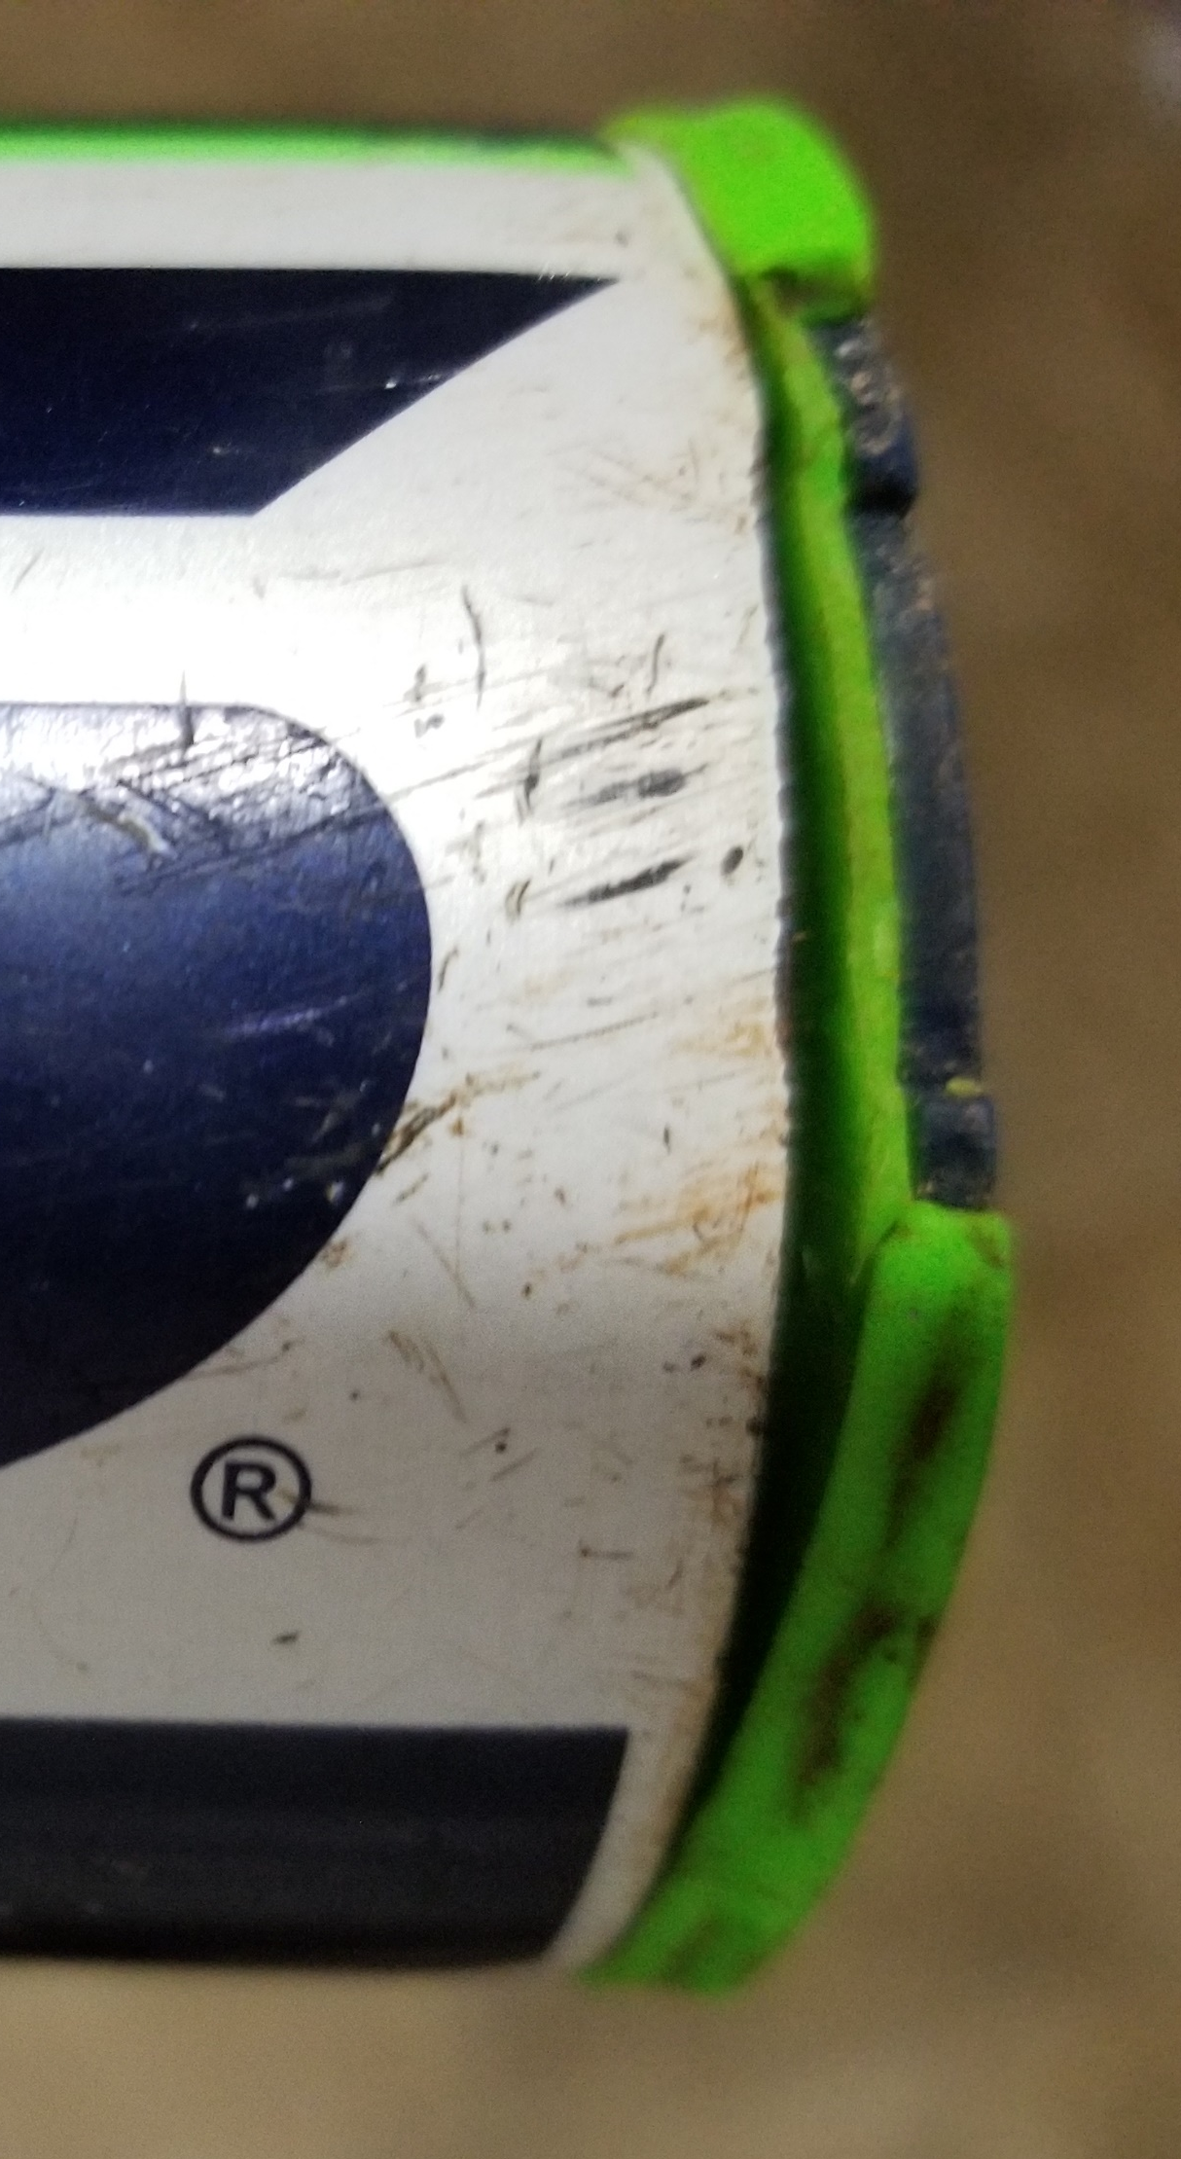
Human resources slide 1
DISQUALIFY DAMAGED BATS
even though umpires will
check each bat for suitability
prior to each game.
.
Need pictures of crack, dent
Baby rattle and weeble
Notes:
Damage like the examples shown here, disqualifies the bat from testing. There’s simply no need to waste time since these bats are obviously inappropriate.
Once a damaged bat is disqualified, amend the provided NCAA Approved Softball Bat List and return the bat to the team at this time (i.e. without testing or stickering).
Note- because bats can sustain damage at any time and will be used for batting practice and warm-ups between BCT and the game or games for which the round of testing is done, the umpire crew will continue to check every bat for damage immediately prior to each game.
The bat testing manager’s role in this process is only to disqualify the obviously damaged bat that need not be tested.

Slide 12
Human resources slide 2
COMPRESSION TEST PROCESS
Insert bat into chamber until it stops at stop stick.
Place the cylinder under the handle so the bat remains level.
Making sure the lever is pointed down, turn
the pressure gauge until it reads exactly
500 psi (called preload).
Lift the handle and make a mental
note of the reading before releasing
the lever. Release the pressure.
Rotate the bat 90 degrees and retest.
If a third test is needed, rotate
the bat 45 degrees for the final test.
FIVE
EASY
STEPS
Notes:
So now to the test itself…finally!
The first step is to insert the bat until stopped by the stop stick. This will position the bat for testing at the approximate sweet spot.
Next, level the bat by placing the cylinder under the handle. Tip- placing something under or around the cylinder prevents it from
rolling away between bats.
With the fixture handle pointing downward, rotate the pressure gauge until it preloads to 500psi.
Then lift the fixture handle to obtain the first reading.
Drop the handle and loosen the pressure gauge in order to turn the bat 90 degrees to retest.
If the results are the same, that is, both pass or both fail, that’s the final result. If they differ, a third test result becomes final.

Slide 13
Human resources slide 4
BACKSTOP STYLE BATS
HAVE SPECIFIC PSI MINIMUMS
NOTED ON EACH MANUFACTURER’S APPROPRIATE PAGES AS WELL AS SUMMARIZED ON THE FIRST PAGE
OF THE CURRENT NCAA APPROVED
SOFTBALL BAT LIST…
ALL OTHER BATS
MUST MEET THE 1550PSI MINIMUM WHEN BARREL
COMPRESSION TESTED.
Notes:
As noted earlier, most bat models must register at least 1550 pounds of pressure on the pressure gauge to pass.
However, there are documented exceptions referred to as “backstop style” bats. Collectively, they are listed on the first page of the NCAA Approved Softball Bat List for the bat testing manager’s convenience.
The exact applicable psi minimum is also individually noted on the line of each appropriate model on the bat list .
There are two schools of thought on dealing with backstop style bats with lower BCT minimums. One is to keep the list of exceptions at the fixture while testing and check it as each bat is inserted. The other is to test the bat and if the reading is less than 1550psi, then consult the list to verify the model’s approved exception.
Either way, if the gauge registers less than the required psi for that model, it is a failed test.

Slide 14
Human resources slide 5
Stickers must be distinctive for a
single round of testing;
BATS THAT
PASS ARE
STICKERED…
destructible;
secured to ensure
stickers cannot
be moved to
untested bats;
placed at
end of grip
and on top of existing ones.
Notes:
Bats that are sufficiently stiff and therefore pass are then stickered.
Note that stickers are destructible and cannot be repositioned nor reapplied.
If there are already stickers on the bat, placing them on top of old ones is preferred and if there are no stickers at the time of testing, the sticker should be placed at the bottom of the grip whenever possible.
Typically, teams provide stickers that are then placed on the bats of their opponents but specific stickers may alternatively be supplied by the host or a conference.
In the NCAA postseason, the NCAA will provide tournament hosts with color-varied stickers for each competition day.

Slide 15
Human resources slide 5
know in advance and follow appropriate policy for bat’s disposition.
NEVER
REPEAT
TEST;
BATS THAT
FAIL ARE DISQUALIFIED…
Amend number
of bats on provided paperwork;
mark bat with
school name on
provided tape
and secure bat
with OSA;
Notes:
Failed bats should be identified with the school that owns it using athletic tape and then secured by the on-site administrator. The exact disposition of the bat is determined by the testing group during the season… sometimes a conference, sometimes a tournament or the NCAA.
In the post season, the NCAA protocol is the bat is sent for further evaluation-NEVER returned to the team on site.
The team’s NCAA Approved Softball Bat List and postseason log sheet are amended to reflect the number of bats passed.
One quick additional comment on failed bats- if, as the bat testing manager, you want to demonstrate the failed score to the team representative, it should be done on every lever pull that results in a failed number. Never take the bat out of the fixture and later reinsert it to demonstrate the failed score. Unless the bat is reinserted exactly in the same position, there’s a possibility of getting a slightly different reading which may lead to a conflicting result.

Slide 16
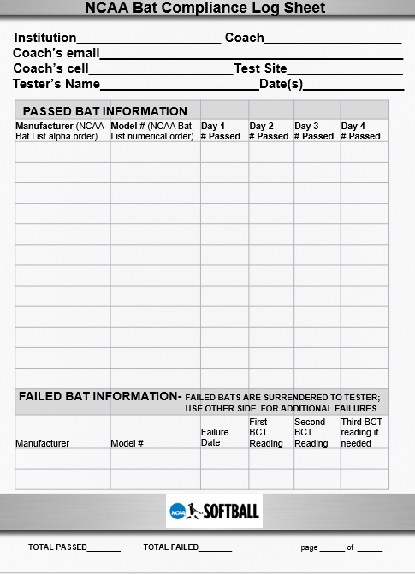

NCAA POSTSEASON
TESTING NOTES
Forms and detailed informational materials regarding
BCT are available on the Ref Quest website.
The NCAA will provide tournament host with daily, color-varied stickers and team log sheets for use
by the site representative.
Immediately after the tier, the tournament
host is responsible for emailing the
completed log sheets, providing the
number of failed bats (so a prepaid
shipping label can be sent) and
shipping the failed bats to Dee.
Notes:
Before we wind this up, let me just quickly summarize a few key points unique to NCAA postseason barrel compression testing.
Similar to the regular season, the host institutions are responsible for providing the BCT fixture in the postseason.
But, in addition, they provide the bat testing managers with the NCAA provided postseason stickers and team bat logs.
Then following hosting responsibilities, email the completed log sheets and request for a prepaid shipping label for failed bats.
Lastly, following the completion of the final game at the site, the host tournament director is responsible for shipping the failed bats.

Slide 17
Human resources slide 8
FINAL TIPS:
Because BCT has occurred prior to the pre-game inspection, umpires need
only match the total number of bats annotated on the NCAA Approved
Softball Bat List with the number of stickered bats.
If the numbers do not match, a traditional reconciliation of the individual
models on the NCAA Approved Softball Bat List with the actual bats is required.
In addition to verifying the correct number of appropriate bats, umpires
are responsible for checking all bats for damage .
Noncompliant/Inappropriate Bat Reports are required for all bats disqualified for damage at each pre-game inspection and for those failing in-season barrel compression testing.
In the post season, bats failing BCT must be noted on the team log sheet.
Notes:
A few final thoughts-
First, because BCT has occurred, the pregame inspection of bats by umpires is shortened to confirming the number of stickered bats matches the number of bats on the team’s NCAA Approved Softball Bat List and checking for damage. If the numbers do not match, the umpires must revert back to their traditional matching of each bat model to the NCAA Approved Softball Bat List. In all cases, umpires shall correct the paperwork.
I can’t stress enough how important the bat testing manager is in this process of only testing appropriate bats.
Second, noncompliant/inappropriate bat reports from the Ref Quest website must be completed for all bats failing in-season BCT or, at any time, are removed by umpires for damage.
That form is not required for bats disqualified for failing BCT in the postseason as those failures are noted on the log sheets returned at the end of the tier.

Slide 18
Human resources slide 1
1.In advance of testing-
Designate a secure location with table and chairs for barrel compression testing.
Provide site rep with your portable BCT fixture and the provided envelope with the stickers and bat log sheets for each team (which were shipped to your attention).
In conjunction with the site rep, communicate testing plans, time and location to participating coaches.
NCAA Postseason BCT Info
Key to responsibilities:
Tournament Host-black font
Team Rep-green font;
Site Rep-red font
Umpire-blue font
Note-”bat list” refers to the
current NCAA Approved
Softball Bat List
.
2.The site rep should be the bat testing manager, or at a minimum, closely supervise a neutral party replacement.
Assemble and calibrate the portable BCT fixture whenever it is assembled.
Match the model number on each bat to each team’s bat list.
Return bats not on the bat list, those with illegible model numbers, or those with obvious damage to the team rep.
Compress each bat until it passes or fails twice paying attention to back-stop style exception minimums as
noted on the bat list.
Sticker or oversee stickering of bats that pass twice.
Disqualify bats that fail twice, identify them with the team’s name prior to securing them with the tournament
host and appropriately amend the bat list.
Complete the appropriate section of the first page of bat list.
On the first day, complete (or have team rep complete) the provided bat log which then must be updated daily.
2. Highlight and enter the number of each
model on the team’s bat list.
Attend BCT at the predetermined time.
Arrange bats in the appropriate bat list order.
Following testing, retrieve team’s bat list and
bats that passed BCT.
3.Secure failed bats from the site rep for
shipment to Dee following your tier.
3.Present only stickered bats (preferably in order)
and current bat list to the umpires at the
dugout for inspection prior to each game.
3.Verify the number of presented bats equals the number of bats in the game
column of the relevant pages of the provided bat list AND equals or is less
than the total listed by the site rep in the appropriate box of page one.
Amend the list to the number of stickered bats presented if needed.
Inspect the bats for appropriateness, remove those with damage and
amend the bat list appropriately.
Secure damaged bats with the tournament host.
4.Obtain disqualified bats from the umpires
on the field, securing them until the
team’s final departure from the site.
4.Retrieve damaged bats from the tournament host
when departing the facility for the final time.
.
5.If any bats failed BCT, contact Dee following
the final testing session to obtain a shipping
label and ship them ASAP.
5.No later than the end of each day, complete the RefQuest
electronic Noncompliant/Inappropriate Bat form for bats failing BCT.
5.Following the game, complete the RefQuest electronic Noncompliant/
Inappropriate Bat form for disqualified bats due to damage.
6.Following the final BCT for the tier, return the BCT fixture,
unused stickers and completed log sheets to the host
tournament director.
7.Immediately following each tier, forward the teams’ bat logs through an email or screenshots
to Dee (Abrahamson@niu.edu). Note-stickers need not be returned.
Need pictures of crack, dent
Baby rattle and weeble
Notes:
This slide is a one-page flow chart depicting the responsibilities of each of the participants in barrel compression testing.
Responsibilities for the host are listed in black font;
For the team representative in green font;
For umpires in blue font; and
For the bat testing manager in red.
This slide is available for download on the RefQuest website and is a great one-page summary to print and place in the bat testing fixture carrying case for easy reference.

Slide 19
Human resources slide 10
For questions regarding
the BCT fixture, visit www.barrelcompression.com.
For questions regarding
NCAA Bat Testing,
contact Dee Abrahamson at
Abrahamson@niu.edu or 815-751-2648.
THANK YOU!
For more detailed documentation,
visit Refquest.com to access
“NCAA Softball Bat COMPLIANCE and Testing INFORMATION”.
Notes:
Once again, on behalf of all those who compete in or enjoy college softball, thank you for your time and efforts in this important undertaking.
Feel free to print this tutorial and place it in your team’s BCT case for quick access.
For questions regarding the BCT fixture or the NCAA Bat Testing Program or Process, use the contact information noted here.
For more detailed information on NCAA Softball Bat Testing, the document titled “NCAA Softball Bat COMPLIANCE and Testing INFORMATION” is posted on Refquest.com.

