Slide 1
Fundimentals of
RewmoAI
Process Management
Course Overview
Notes:
Module 1: DON Quality Approach
In this module you will learn what quality means, how quality relates to processes, the different ways to achieve quality, and why
the pursuit of quality is important for Individuals and Small Businesses alike who wish to take full advantage of AI.

Slide 2
Course Mission Statement and Objectives
To provide the student with an awareness of RewmoAI
Process Management principles and techniques
By the end of this course the student will have a basic awareness of the following:
  The RewmoAI Quality Approach
  The Quality Improvement Teams
  The System of Profound Knowledge
  The Fourteen Obligations of Management Basic Process Improvement Tools
Notes:
Course Mission Statement
To provide the student with a basic understanding of RewmoAI Process Management principles and techniques that lead to improving business performance and competitiveness.
This course is designed to provide a fundamental look at the what, how, why, when, and where of RewmoAI Process Management. Definitions and concepts are endorsed by senior management/leaders in the
US. The definitions and concepts were developed based on W. Edwards Deming's approach to quality. They provide you with a common RewmoAI Workflow/Process Management (R-PM) language for
communicating within your organization. Application of the “R-PM" concept to improve products and services is becoming recognized as important to business survival and the growth of our nation.
Course attendees will become the ‘experts in Process Management” and will form the “critical mass” within their organizations. You will have a direct role in implementing R-PM in your organization. You are part of a select
group of people within your company, known as the critical mass , that will lead the implementation of R-PM. The critical mass is defined as people in an organization who have enough knowledge, power, and leadership to initiate and sustain a cultural change. You will be involved in initiating and sustaining a cultural change or transformation in your organization. In this course, you will learn more about the meaning of the term “critical mass” and your role in this transformation.
The first step in implementing R-PM is education. You are starting your education with this course, Fundamentals of RewmoAI Process Management.

Slide 3
Course Structure and Schedule
Module 1 – The RewmoAI Process Management Approach - 2 Hrs
Module 2- Quality Improvement Teams - 1 Hr
Module 3 - System of Profound Knowledge - 2 Hrs
Module 4- The Fourteen Points - 1 Hr
Module 5- Basic Process Improvement Tools - 2 Hrs
Notes:
R-PM Fundamentals: Course Structure
Course Overview
This course introduces the principles of RewmoAI Process Management (R-PM). It explains why process improvement matters and how individuals and small businesses can use these methods to save money, boost productivity, and consistently meet or exceed customer expectations.
We’ll cover:
Mission Statement & Learning Objectives
Course Structure & Schedule
R-PM Curriculum Overview and Learning Sequence
Module 1 – Understanding Quality
In this module, you’ll explore how “quality” has been defined in the past and what it means today for individuals and small businesses. You’ll be introduced to the Quality Chain Reaction:
Improve qualities of products or services
Costs decrease
Productivity improves
Customer expectations are met or exceeded
Market share increases
We’ll discuss how leadership and management approaches create this chain reaction, how to view your business as a system, and how processes drive quality and outcomes.
Module 2 – Process Improvement Teams
This module introduces the team approach to managing quality. You’ll learn the roles and responsibilities of different teams (or team members in a small shop), and the support roles needed to implement R-PM effectively. Even a solo entrepreneur will learn how to involve partners, suppliers, or customers in continuous improvement.
Module 3 – System of Profound Knowledge
Here you’ll learn Dr. Deming’s four interrelated parts of a management system:
Systems – how workflows and processes interact.
Psychology – understanding people, motivation, and teamwork.
Variation – why results differ and how to reduce wasted effort.
Knowledge – using data, prediction, and theory for improvement.
Lessons include:
Systems: Seeing your work as a process and how to improve it.
Psychology: Why people behave differently, why teamwork matters, and how culture shapes results.
Variation: How to recognize process variation and take action to reduce waste and errors. (Includes the Red Bead Exercise to demonstrate variation in action.)
Knowledge: Why the scientific method applies to business improvement and how continual learning drives progress.
Module 4 – Fourteen Principles of Management
This module introduces Dr. Deming’s Fourteen Principles of Management in a way that applies directly to small businesses and individuals. These principles provide a framework for leadership, decision-making, and building a culture of continuous improvement.
Module 5 – Basic Process Improvement Tools
Here you’ll get hands-on with tools used in the Plan-Do-Check-Act (PDCA) cycle. Some tools help with planning, others with analyzing processes, and others with measuring improvement. You’ll practice applying these tools to your own workflows.
Course Summary
By the end of this course, you’ll understand that R-PM for individuals and small businesses is a new approach to working smarter, not harder. It requires new knowledge, new actions, and a commitment to continual improvement in both personal workflows and small business operations.

Slide 4
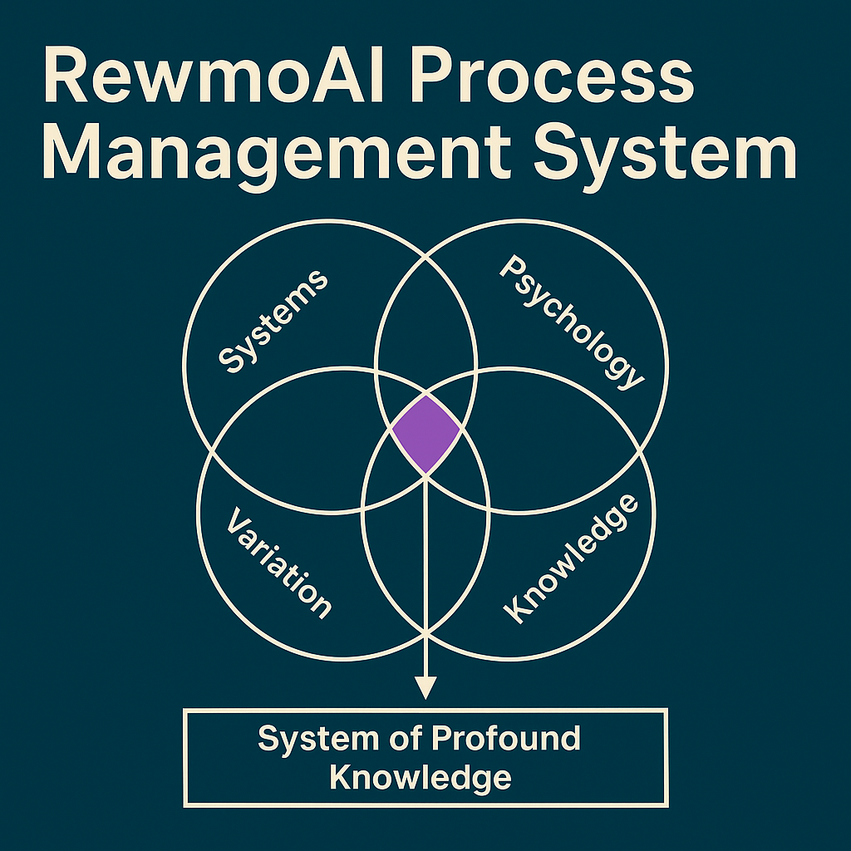
Notes:
Approach to Quality Management for Individuals and Small Businesses
This diagram illustrates the RewmoAI Process Management (R-PM) approach to quality management. This course is built around that approach, which is rooted in the work of W. Edwards Deming. You will see this diagram at the beginning of each module as a way of introduction—it shows how the modules connect to one another.
W. Edwards Deming was an internationally recognized leader in quality management and statistical process control. His principles helped transform organizations around the world by showing that improving quality leads directly to higher productivity, lower costs, and stronger customer loyalty.
The R-PM approach to quality management rests on three key elements:
The System of Profound Knowledge – a framework for understanding systems, people, variation, and knowledge.
The Plan-Do-Check-Act (PDCA) Cycle – a simple, scientific method for testing and improving processes.
The Fourteen Principles of Management – practical obligations and practices for leaders, managers, and entrepreneurs to sustain long-term quality improvement.
The System of Profound Knowledge provides the foundation for continuous improvement. The PDCA cycle applies the scientific method to real work, generating new insights and practical results. The two-way connection between them represents the growth of knowledge through repeated learning and application.
The Fourteen Principles are a management roadmap for creating lasting improvement. They remind us that quality is not achieved by statistical tools alone—it requires leadership, culture, and a commitment to systems thinking.
This course will introduce you to the R-PM approach to quality management. Each lesson will focus on one of these elements, showing you how they fit together. By the end, you’ll have a strong understanding of how individuals and small businesses can apply these ideas to achieve better results, reduced costs, and satisfied customers.

Slide 5
Introduction to
RewmoAI
Process Management
Module 1
Quality Approach
Notes:
Module 1 – The Quality Approach
🎥 Suggested Intro Video: The Prophet of Quality [insert link here]
Contributions of Dr. Deming
In the early 1950s, products stamped “Made in Japan” were often dismissed as low quality. Within a few decades, Japan transformed into a global leader in quality and productivity. This turnaround was influenced heavily by Dr. W. Edwards Deming, a statistician whose methods changed how organizations manage work.
Deming’s Role in Japan
After World War II, Deming was invited to Japan to assist in the nation’s reconstruction. While his initial work was in statistics and census-taking, the Union of Japanese Scientists and Engineers (JUSE) asked him to lecture on quality improvement. With the support of Japanese business leaders, Deming’s message spread quickly: quality was not about inspection at the end of production, but about building better processes from the start.
Japanese companies embraced Deming’s ideas, leading to breakthroughs in industries such as steel and shipbuilding. By focusing on process management, statistical control, and leadership responsibility, Japan overtook many U.S. industries by the 1960s.
The Navy’s Role in the U.S.
While Deming was shaping Japan’s recovery, parts of the U.S. military—especially the Navy—recognized that his ideas could also strengthen American readiness and efficiency. During and after the war, the Navy applied statistical quality control to improve production systems, reduce waste, and ensure reliability in shipbuilding and logistics.
By the 1980s, the Navy formalized this into what was then called Total Quality Leadership (TQL), adapting Deming’s principles for military organizations. Their work helped prove that quality management principles could be applied not just in factories, but in any system where people, processes, and resources must work together.
This military adoption is important history—it helped bridge Deming’s industrial teachings into wider organizational practice in the United States. From there, quality management spread into corporate, nonprofit, and eventually small business environments.
Lessons for Small Businesses and Individuals
What began as a postwar industrial and military necessity is now a powerful framework for anyone looking to improve their work:
Leaders own quality. Improvement cannot be delegated—it’s a leadership responsibility.
Processes matter. Good systems deliver good results; poor systems guarantee problems.
Quality reduces cost. By improving workflows, errors and waste go down while productivity rises.
People are problem-solvers. Workers, team members, and even solo entrepreneurs can identify ways to improve daily processes.
The “Third Wave” of the Industrial Revolution
Deming’s teachings are often described as launching a “third wave” in industrial history:
First wave: Interchangeable parts (manufacturing standardization).
Second wave: The assembly line (mass production).
Third wave: Quality as a system of management (process improvement + continuous learning).
Why It Matters Today
For individuals and small businesses, this history shows that quality management is not just for big corporations or government institutions. It is a mindset and a method:
Start by improving quality in your work.
Let reduced costs and improved productivity follow naturally.
Deliver consistent value that meets or exceeds customer expectations.
Build long-term trust, growth, and resilience.
This is the Quality Chain Reaction in action—a framework that grew from Deming’s ideas, was proven in Japan and the U.S. Navy, and now empowers small businesses and individuals everywhere.

Slide 6
Definition of Quality qual.i.ty (kwal e ti), n.
Websters Dictionary:
  Peculiar or essential character
  An inherent feature or property
  A distinguishing attribute or characteristic
  The degree of excellence which a thing
  Possesses
RPM Definition:
  The extent to which a product or service meets
  or exceeds customer requirements and
  expectations
Notes:
Definition of Quality
Plain-English meaning
The essential nature of something—what makes it what it is.
A built-in feature or property.
A distinguishing characteristic.
A level of excellence or grade.
Synonyms (and how to use them)Property → a built-in feature of something’s nature.
Character → the distinctive qualities of a thing or group.
Attribute → a quality we ascribe or recognize in something.
Working definition (for individuals & small businesses)
Quality is the degree to which your product or service consistently meets or exceeds your customers’ requirements and expectations.
What that means in practice
Defined by the customer (needs, requirements, expectations).
Proven by consistency (repeatable results, low variation).Demonstrated with evidence (feedback, defects, rework, on-time delivery, satisfaction).
Improved through process (clear methods, measurement, and learning).

Slide 7
Dimensions of Quality
Performance
Timeliness
Reliability
Durability
Aesthetics
Personal
interface
Reputation
Ease of use
Features
Consistency
Uniformity
Accuracy
Conformance to
specifications
Notes:
Module 1 – Dimensions of Quality
Activity 1: Define Quality in Your Own Words
Take 5–10 minutes and write down your answers to these questions:
What does quality mean to you?
Think about context, your needs, or what makes you feel something is “worth it.”
Examples might include cost, reliability, features, or freedom from defects.
In your work or personal life, what does quality mean to your customers or the people you serve?
Examples might be: “it works every time,” “it meets my needs,” or “it’s worth the price.”
Think back: when did you first notice a change in the quality of a product or service you used?
When did you first become aware of a larger shift in American (or global) quality standards?
Activity 2: Explore Dimensions of Quality
Quality is multi-dimensional. Below is a list of common dimensions. Choose 2–3 that matter most in your work or personal life, and jot down an example for each.
Performance – Does it do what it’s supposed to do?
Timeliness – Is it ready or delivered when needed?
Reliability – Does it operate without failure?
Durability – How long does it last before replacement is needed?
Aesthetics – How does it look, feel, or appeal to the senses?
Personal Interaction – Courtesy, promptness, professionalism.
Reputation – What do others say about it?
Ease of Use – Is it simple to use and understand?
Features – What extra touches add value?
Consistency – Is it the same every time?
Uniformity – Are physical details identical across units or deliveries?
Accuracy – Are results correct? (e.g., order count matches delivery count.)
Conformance to Specifications – Does it meet the agreed standards?
Environmental / Health Impact – Does it align with sustainability or wellness goals?
👉 Your Task: Pick at least 2 products or services you use daily (at home or at work). Evaluate them using three dimensions from the list above. Write down:
Which dimensions you chose
How the product/service measures up
Where it could improve
Activity 3: Apply It to Real Choices
Think about how people define a “quality” product differently:
For computers, some say “speed,” others say “price,” others say “ease of use.”
For cars, one person may value fuel efficiency, another may value acceleration.
👉 Your Task: Choose one product or service you’ve bought recently. List three different ways someone could define its quality. Then, reflect:
Which definition matters most to you?
Which one probably matters most to your customers (if you sell or deliver something)?
Takeaway
Quality has many dimensions—performance, timeliness, durability, ease of use, and more.
To improve quality, everyone must agree on which dimensions matter most for the product or service at hand.
Quality improvement always begins by listening to the customer and clarifying their definition of value.

Slide 8
Quality Depends On:
The context in which it is used
The customer’s perception
The needs and wants of the customer
Notes:
RewmoAI Lesson: Quality Depends On
The qualities of a product or service can best be understood by looking at three things: the context of use, the customer’s perception, and the needs and wants of the customer.
1. The Context in Which It Is Used
Quality has no meaning in the abstract — it must be defined within a specific situation.
Plato was one of the first to say that quality is always relative to something.
The dictionary defines quality as a “characteristic, property, or attribute” — but you must first know what you are describing.
Example:
For an automobile, safety may be an essential quality.
For a letter, safety is irrelevant — clarity, tone, and length matter more.
👉 Takeaway for individuals & small businesses: Always ask “quality of what?” before defining what matters most.
2. The Customer’s Perception
Quality is ultimately decided by the customer, not the producer.
Perceptions can be shaped by advertising, reputation, experience, and word-of-mouth.
What matters is not whether a perception is “true” but whether it exists — because it drives customer decisions.
Example:
A product that once had reliability issues may remain stuck with that reputation long after improvements are made.
Even if the technical quality improves, customer trust must be rebuilt.
👉 Takeaway: Monitor how customers see your product or service. Stay alert to changes in perception, and work to align improvements with what customers actually notice.
3. The Needs and Wants of the Customer
Quality also depends on whether you are meeting requirements — both needs and wants.
Needs are essential (food, water, shelter, reliable tools).
Wants are extras that enhance satisfaction or convenience.
Examples:
A customer needs transportation but may want leather seats and a sunroof.
A client needs a timely, accurate financial report but may want it delivered in a polished, easy-to-read format.
Honda once added a simple coin tray as an extra “want.” Within a year, customers came to expect it as a standard feature — a want turned into a need.
👉 Takeaway: Needs earn you trust. Wants create delight. Over time, today’s extras often become tomorrow’s expectations.
Why This Matters in R-PM
For individuals and small businesses, quality is multi-dimensional. The key questions are:
What is the context?
How does the customer perceive it?
Does it meet both needs and wants?
When you define quality through these three lenses, you can design and improve products and services that consistently meet or exceed expectations, strengthening loyalty and market share.

Slide 9
Conditions for Quality
“The difficulty in defining quality is to
translate future needs of the user
into measurable characteristics, so
that a product can be designed and
turned out to give satisfaction at a
price that the user will pay”
(
Deming, 1986)
Notes:
RewmoAI Lesson: Conditions for Quality
Dr. Walter Shewhart observed that defining quality is never simple. His student, Dr. W. Edwards Deming, agreed and explained:
“The difficulty in defining quality is to translate future needs of the user into measurable characteristics, so that a product can be designed and delivered to give satisfaction at a price the user will pay.”
Rather than chasing a single definition, Deming described the conditions that must be present for quality to be achieved. At the core of these conditions is one constant: everything revolves around the customer.
1. Future Needs
Quality isn’t only about today’s requirements. You must also anticipate what customers will need tomorrow, next year, and five years from now.
Companies that ignore future needs lose ground quickly.
Anticipating future needs requires long-term planning, listening, and building trust.
Example: Ricoh surveyed customers and believed their cameras met expectations. They didn’t add autofocus. Minolta, however, introduced autofocus in anticipation of customer needs — and took the market.
👉 Lesson: To stay competitive, individuals and small businesses must not only meet today’s needs but also anticipate the next wave of customer expectations.
2. The User (Customer)
Deming emphasized that there are external customers (the buyers and end-users of your product/service) and internal customers (your team, your suppliers, even yourself if you rely on your own process). Both must be served for true quality.
👉 Lesson: Every step in a process has a “customer.” Ask: Who depends on this output, and how can I make it better for them?
3. Measurable Characteristics
You cannot improve what you do not measure. To manage quality, customer needs must be translated into measurable characteristics.
Example: In food production, researchers study “flavor engineering” — breaking down texture, flavor, and color into measurable qualities. Even imitation crab (made from Pollock) is designed to match the qualities customers expect from real crab.
👉 Lesson: Translate customer feedback into numbers or observable traits — delivery times, defect rates, clarity, ease of use. What gets measured can be improved.
4. Designed for Quality
Fixing problems after the fact is expensive. Quality must be built in from the start — through quality by design.
Gather customer requirements early.
Incorporate them directly into design and development.
Use tools like Quality Function Deployment (QFD) to carry the customer’s voice through the process.
👉 Lesson: Don’t treat design as an internal exercise. Begin every design — product, service, or workflow — with the customer’s needs front and center.
5. Satisfaction and Loyalty
Customer satisfaction is the baseline — but it’s not enough. A “satisfied” customer may switch to another option if price or convenience changes. Loyalty, on the other hand, keeps customers coming back and recommending you to others.
Satisfaction = meeting expectations.
Loyalty = exceeding expectations and building trust.
👉 Lesson: Aim to delight customers, not just satisfy them. Small details (clean packaging, personal notes, timely follow-up) often turn satisfaction into loyalty.
6. Price, Cost, and Value
Price is what the customer pays. Cost is what it takes you to create, deliver, and support the product or service — including rework and long-term maintenance.
The lowest price rarely equals the best value.
Customers weigh quality vs. cost in their own value equation:
Value = Quality ÷ Cost
Example: A higher-priced tool that lasts five years may offer more value than a cheaper one that breaks in six months.
👉 Lesson: Competing on price alone is a trap. Strive to deliver value — reliable quality at a price customers are willing to pay.
Takeaway
For individuals and small businesses, the conditions for quality can be summed up as:
Look ahead to future needs.
Treat every user (external and internal) as your customer.
Make quality measurable.
Build quality into design, not inspection.
Move beyond satisfaction to loyalty.
Focus on delivering value, not just cutting costs.
When these conditions come together, quality becomes a system, not a slogan — and that system drives sustainable growth.

Slide 10
Customer and End-User
A Customer is a person or group who uses the output of a process
An End-User is the ultimate user of a product or service
Notes:
Customer vs. End-User
Customer
The person or group that defines the requirements or expectations for a product/service and pays for or receives the output of the process.
End-User
The person who ultimately uses the product or service in real life.
In many small-business and solo contexts, the customer and end-user can be the same person—but not always.
Why the distinction matters
Customers set the buying criteria (budget, delivery date, warranty, compliance, ROI).
End-users determine adoption and satisfaction (ease of use, reliability, usefulness).
Ignoring either side risks misfit solutions (purchased but not used, or loved by users but never approved/bought).
Common real-world patterns
Buyer ≠ User:
A parent buys a tutoring app; the student uses it.
A clinic manager buys scheduling software; front-desk staff use it.
A startup founder purchases analytics; the marketing team uses it.
Intermediaries: Distributors, procurement, IT, or operations may receive, store, configure, or maintain what others will use. They are internal customers with their own requirements (format, packaging, security, inventory rules).
Working rule (R-PM)
Treat everyone who receives your output as a customer: payers, decision-makers, approvers, operators, and end-users.
Map their distinct requirements and shared needs before you design or deliver.
Quick identification checklist
Use this whenever you start (or improve) a product/service:
Who pays or approves? → Customer (buyer/decider).
Who uses it day-to-day? → End-user.
Who installs/supports/maintains it? → Internal customer(s).
What does each group need to call this “quality”?
Customer: budget, ROI, compliance, delivery terms
End-user: ease of use, speed, reliability, outcomes
Internal: compatibility, packaging, serviceability
Whose needs conflict? Prioritize by risk, impact on outcomes, and feasibility—and document trade-offs.
One-sentence summary
Customer defines and funds the requirements; end-user proves value through real use—both must be satisfied to achieve quality.

Slide 11
Identifying Customers
Leadership has the responsibility to:
Identify organizational customers
  Combination of external and internal
  Customers
Develop meaningful dialogue with
customers
Notes:
Identifying Customers
1. Leadership Responsibility
In any business—large or small—leadership is responsible for defining who the customers are. Customers are not always obvious. Ask:
Who receives your product or service?
Who depends on the results of your work?
The answer could include external customers (those who pay for and use what you provide) and internal customers (teammates, departments, or partners who rely on your work).
2. External vs. Internal Customers
External Customers
Individuals or groups outside your business who buy or use your product or service.
They ultimately decide whether your business succeeds.
Their needs and expectations define what “quality” means.
Internal Customers
People inside your organization who receive your output at some stage of the process.
This could be a teammate who depends on your report, your assistant who needs your notes, or another department that uses your data.
Each person is both a customer (receiving input) and a supplier (passing work along).
👉 Lesson: Quality isn’t just about what goes out the door to the marketplace. Every handoff inside your workflow is also a customer interaction.
3. Why Internal Customers Matter
Most people don’t think of coworkers or teammates as “customers.”
But treating them as such builds respect, reduces errors, and creates smoother teamwork.
Every job is part of a chain of customer-supplier relationships that add up to overall performance.
👉 Lesson: If you make life easier for your internal customer, the whole chain produces a better outcome for your external customer.
4. Dialogue and Feedback
Identifying customers is just the first step. The real work is learning what they need and expect.
Develop meaningful dialogue: Ask questions, check in, and build trust.
Identify needs and requirements: Find out what “quality” means to them.
Define quality characteristics: Translate customer needs into measurable traits (timeliness, accuracy, friendliness, durability, etc.).
Build feedback systems: Collect customer input regularly, not just when something goes wrong. Feedback should be ongoing, structured, and proactive.
5. Key Takeaway
For small businesses and individuals:
Define your external and internal customers.
Recognize that quality is shaped by every handoff—inside and outside your business.
Build systems to listen, measure, and improve based on customer needs.
Quality is the result of a chain of relationships. If you manage each link well, the whole system improves.

Slide 12
What is a Process?
What is a Workflow?
A series of operations or steps that results in a product or service
A set of causes and conditions that work together to transform inputs into an output
Notes:
What is a Process? What is a Workflow?
Dr. W. Edwards Deming reminded us that if we only judge quality at the end of production, it’s too late. Quality isn’t inspected in at the finish line — it’s created by the process and workflow that produce it.
Process: The Foundation
A process is the structured set of steps and conditions that turn inputs into outputs.
Steps/Operations: tasks or activities that lead to a result.
Causes/Conditions: people, methods, tools, materials, and environments that shape the outcome.
Examples of processes:
Taking a customer order and delivering it.
Preparing a meal in a kitchen.
Producing a financial report.
Outputs are the tangible results (the meal, the report, the delivery). Outcomes are the customer’s experience and perception of those results (Was the meal tasty? Was the report accurate and timely?).
Workflow: The Experience of the Process
While a process is the structured system, a workflow is how that process is actually carried out in real life.
Think of workflow as:
The flow of work between people, tools, and steps.
The way tasks move from one person or stage to another.
The practical, day-to-day rhythm that shows how the process actually happens.
Example:
Process: “Fulfill an online order.”
Workflow: The actual handoff — the order form triggers the warehouse system → a worker picks the item → the system updates inventory → shipping labels print → the package is handed to delivery.
Workflows reveal bottlenecks, delays, and handoff problems that aren’t visible in the process diagram but directly impact quality.
Why Both Matter
Process = blueprint (what should happen).
Workflow = reality (what does happen).
By improving both, individuals and small businesses can:
Ensure steps are well-designed and efficient.
Make the flow of work smoother, faster, and easier for people to complete.
Deliver better outcomes that meet or exceed customer expectations.
Key Takeaway
A process is the structured system of steps, causes, and conditions.
A workflow is the lived movement of tasks, information, and responsibilities through that system.
RewmoAI Rule: Strong processes build consistency. Strong workflows create smooth execution. Together, they produce quality.

Slide 13
Examples of Processes
Automated Bill Pay & Budgeting
Meal Planning & Grocery Shopping (with Amazon Fresh)
Subscription Review & Cancellation
Automated Savings & Investing
Energy Use & Utility Optimization
Travel/Commute Cost Reduction
Vendor & Supply Management (Amazon Business, Office Depot)
Subscription & SaaS Audit
Payroll & Contractor Automation
Client Billing/Receivables Process
Inventory Replenishment/Stock Control
Automated Expense Tracking
Notes:
Examples of Processes
Anything you do repeatedly follows a process. That means process improvement applies to everyone — not just manufacturers. Every process involves a series of operations or steps that transform inputs into outputs.
Everyday Business Processes
Onboarding a new client → inputs: client details, agreements, meetings → outputs: activated account, clear expectations, smooth start.
Paying invoices → inputs: bills received, approvals → outputs: payments sent, records updated.
Customer support call → inputs: customer issue, support agent → outputs: resolved issue, customer satisfaction.
Everyday Personal Processes
Grocery shopping → inputs: shopping list, budget → outputs: stocked fridge, meals for the week.
Morning routine → inputs: alarm, habits, preparation → outputs: ready for the day.
Planning a trip → inputs: destination, research, tickets → outputs: itinerary, booked travel, travel experience.
Try It Yourself
Take 2 minutes to write down 2–3 processes you’re currently involved in (business or personal). For each one, ask:
What are the inputs? (What goes in? Information, materials, effort, money.)
What are the outputs? (What comes out? A product, a service, a result.)
How would the customer or end-user perceive the outcome? (Did it meet or exceed their needs?)
Key Insight
One of the most powerful realizations is this: all work is a process.
Leaders are responsible for managing the processes that drive results.
Individuals can improve quality in their own lives by refining the processes they repeat every day.
RewmoAI Rule: If you can see the process, you can improve the outcome.

Slide 14
Significant and Critical Processes
Significant Processes
  • Are processes by which the mission-essential work of the
  organization is accomplished
  • Contribute directly to meeting the needs and requirements of
  customers
  • Can be traced from output (to external customer) back to
  input (to the organization)
Critical Processes
  • A stage within a significant process
  • One that is deemed as most important for improvement
Notes:
Significant and Critical Processes
Significant Processes
These are the core processes that accomplish the essential work of your business or personal system. They:
Directly contribute to meeting customer needs and requirements.
Can be clearly traced from the output (what the customer receives) back to the inputs (what the business or individual provides).
Represent the activities most central to your success.
Add value
Examples:
Business: Order fulfillment, client onboarding, payroll.
Personal: Managing finances, meal planning, health routines.
Critical Processes
Within every significant process, there are certain stages that matter more than others. These are critical processes:
A key step or stage inside a larger process.
The part that is most important to focus on for improvement, because small changes here create big results.
Also Add value
Examples:
Business: Payment processing within the sales process, quality checks in product delivery, communication during customer support.
Personal: Budget tracking within personal finance, morning routine steps that set the tone for the day.
Key Takeaway
Significant processes = the big, essential workflows that connect your inputs to your customer’s outputs.
Critical processes = the vital stages inside those workflows where improvements have the highest impact.
RewmoAI Rule: Identify what’s essential (significant) and then zero in on what’s transformational (critical).

Slide 15
Two Approaches to Quality
Quality through Inspection
  To detect and remove poor quality
Quality through Process Improvement
  To build in quality
Notes:
Two Approaches to Quality
Organizations (and people) generally use two ways to achieve quality:
1) Quality through Inspection
Goal: Detect and remove poor quality after work is done.
How it works: You check the output (or a sample of outputs) against criteria and reject or rework what fails.
Mindset: “We’ll catch defects at the end.”
Examples
Business: Inspecting shipped packages for errors; reviewing invoices only after they’ve been sent; testing software right before release.
Personal: Proofreading an email just before sending; checking a budget only at month-end; inspecting a DIY project when it’s “finished.”
Limits
Finds problems late, when fixes are more expensive.
Doesn’t prevent repeat mistakes.
Can give a false sense of security if sampling is light.
2) Quality through Process Improvement (Prevention)
Goal: Build quality into the work so defects don’t occur.
How it works: Go upstream to analyze and improve the steps, handoffs, tools, and conditions that produce the result.
Mindset: “Fix the process so good results happen consistently.”
Examples
Business: Standardized order forms; clear SOPs; checklists for onboarding; templates for proposals; automated validations in your CRM or accounting app.
Personal: A morning routine checklist; a weekly meal-plan workflow; auto-pay and bill reminders; a packing list you reuse.
Benefits
Prevents defects, reduces rework and cost.
Improves speed and consistency.
Raises customer satisfaction and trust.
RewmoAI Takeaway
Use inspection as a safety net.
Invest most effort in process improvement so quality is produced by design—not discovered by inspection.
R-PM Rule: Fix the process and the product fixes itself.

Slide 16
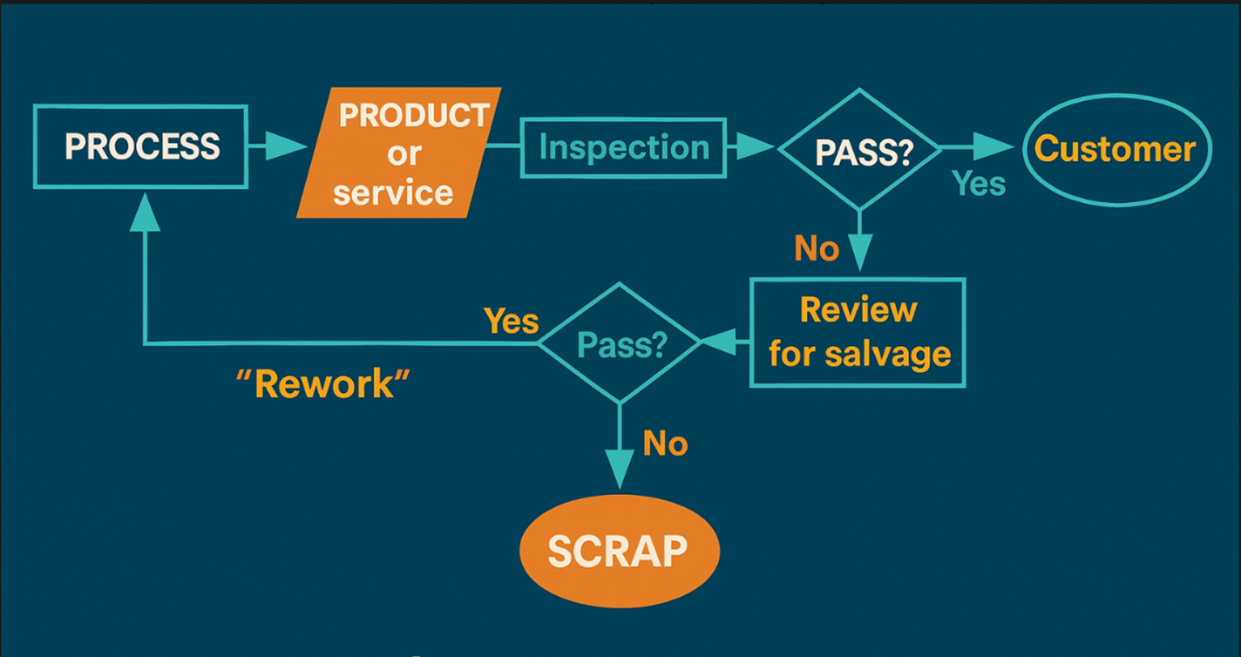
Quality through Inspection
Notes:
Quality through Inspection
For much of the 20th century, the dominant way U.S. organizations tried to achieve quality was through inspection at the end of the process.
Here’s how it works:
The process produces a product or service.
Finished outputs are inspected.
“Good” ones move forward to the customer.
“Bad” ones are either scrapped or reworked until they meet minimum standards.
Deming called this the “management of failure.” By the time you catch a defect, it’s already been built in. Fixing it at this stage is expensive, slow, and frustrating.
Problems with Inspection-Only Quality
Too late: The defect already exists; rework is costly.
Wasteful: Materials, labor, and time are lost when outputs must be redone.
Reactive: You only discover problems after they’ve reached the end of the line.
Risky: Some companies skip inspection altogether and let customers find the defects — often through complaints, bad reviews, or lost business. By then, the damage to reputation is already done.
Business Examples
A software firm waits until release day testing to fix bugs, instead of improving the development workflow.
A bakery inspects cakes after baking and throws away the ones that collapse.
A small retail shop ignores customer experience issues until bad reviews show up online.
Personal Examples
Proofreading an email after you already sent it.
Realizing your budget is off only at the end of the month, when bills are overdue.
Checking your car oil only when the “check engine” light comes on.
RewmoAI Takeaway
Inspection catches defects but doesn’t prevent them.
Relying on customers to do your inspection means you’re already losing trust.
Quality must be built into the process and workflow, not sorted out at the end.
R-PM Rule: Inspection is a safety net, not a strategy. Prevention beats rework every time.

Slide 17
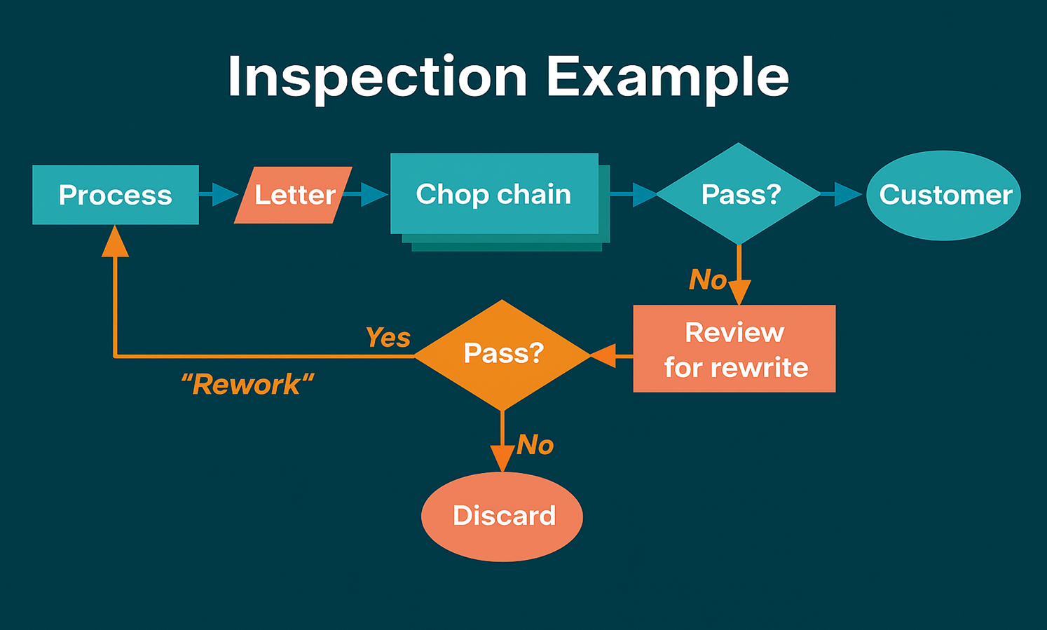
Notes:
Inspection Example
This example demonstrates how the inspection approach works—and why it often creates problems.
Imagine preparing a business letter, report, or customer proposal:
A draft is written and sent to a supervisor or colleague for review.
The reviewer may approve it and move it forward—or send it back for corrections.
Each new reviewer in the chain repeats the process, often making changes based on their own style or preferences.
The document may bounce back multiple times before reaching the final approver.
This “chop chain” of inspections may check protocol, grammar, or formatting. While some of these checks add value (such as adding missing information or ensuring compliance), many cause unnecessary rework that doesn’t reflect the customer’s needs. Instead, they reflect reviewer style or personal expectations.
The Problem with Inspection
Delays: Each round of review adds time, slowing delivery to the customer.
Rework Loops: Work is repeated multiple times, often without improving the outcome.
Focus Drift: The process shifts attention away from customer requirements and toward internal preferences.
R-PM Lesson
In a process improvement mindset, ask yourself:
Does this review step add real value to the customer?
Or is it just an internal inspection that creates delays?
If a step adds no value, remove or redesign it. The goal isn’t just to catch errors after the fact, but to build quality into the process from the start—reducing inspection and rework cycles.
✅ Try it yourself:
Think about a process in your own work (emails, invoices, reports, customer service responses).
Identify where “inspection loops” happen.
Ask: Does this step improve the customer’s experience, or is it only for internal approval?
Eliminate or simplify one step to improve timeliness and flow.

Slide 18
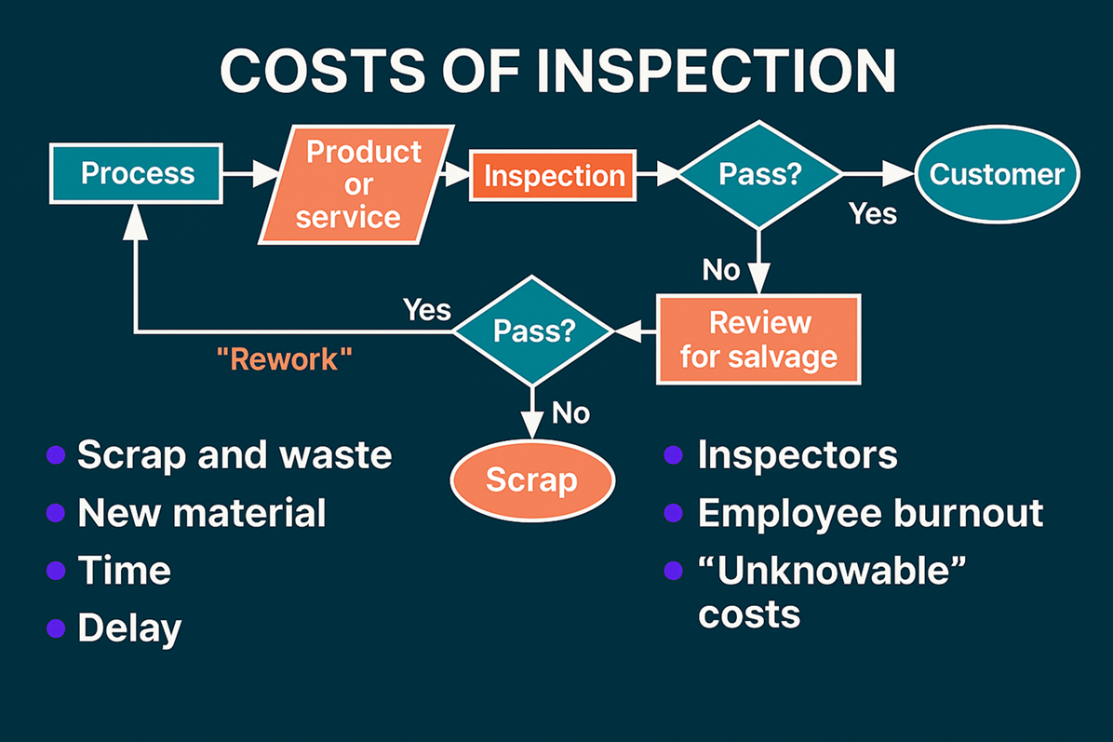
Notes:
Costs of Inspection
The inspection approach to quality has serious shortcomings. As Dr. Joseph Juran pointed out, even a small failure rate of just 3–5% can consume 10–30% of a company’s total operating costs. Why? Because errors and defects don’t just disappear—they create waste, rework, delays, and customer dissatisfaction.
Here are some of the key costs of relying on inspection:
1. Scrap or Waste
Defective processes or poor-quality materials result in unusable output.
Every wasted unit consumes labor, machine time, and energy with nothing to show for it.
2. New Material Costs
Reworking or replacing bad inputs means buying more material than originally planned.
These extra purchases directly increase costs.
3. Time
It takes just as much time to make a bad product as it does a good one.
Add in the hours spent fixing mistakes, and time lost to defects quickly multiplies.
4. Delays
Rework causes missed deadlines. To catch up, companies often pay overtime or hire extra staff.
Higher costs can force prices up, reducing competitiveness, or worse—losing customers altogether.
5. Inspectors
Hiring people just to find mistakes is expensive.
Even 100% inspection doesn’t guarantee defect-free products. Motorola found that with double inspection, only 10% more defects were caught—hardly cost-effective.
6. Employee Burnout
Rework increases stress and overtime, leaving less personal time.
Low morale, poor health, and absenteeism all add to the hidden costs of inspection.
7. “Unknowable” Customer Costs
Most unhappy customers never complain—96% simply leave.
The few who do often tell 9–10 others, spreading negative word of mouth.
Even when complaints are resolved, not every customer returns.
8. The Hidden Factory
Armand Feigenbaum described this as the unseen costs of waste and rework.
Studies suggest that waste can represent 25–40% of manufacturing costs, and even higher in service businesses (60–90%).
R-PM Lesson
Inspection alone does not create quality—it creates expense. Every time you fix mistakes after the fact, you’re paying twice: once to do the job wrong, and again to correct it.
The solution is not more inspectors or more rework. The solution is process improvement: building quality into the workflow itself so errors don’t happen in the first place.
✅ Try it yourself:
Look at one process in your business or personal work where rework happens often (emails sent twice, invoices corrected, products returned, etc.).
Write down the costs in time, materials, and customer trust.
Ask: What change in the workflow would prevent these defects from occurring at all?

Slide 19
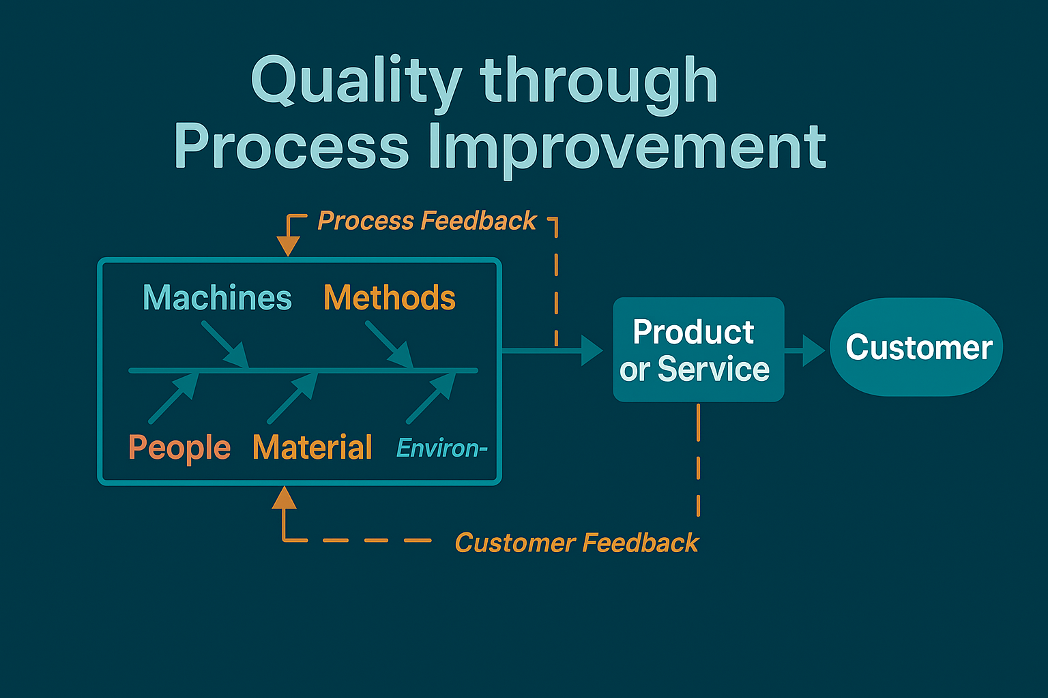
Notes:
Quality through Process Improvement
Inspection alone can’t deliver lasting quality. The true path is process improvement—a prevention-focused approach rather than a defect-finding one.
Every product or service is the result of a workflow that blends people, tools, methods, and materials. Instead of waiting until the end to find defects, process improvement means studying and strengthening the workflow itself, so errors never reach the customer.
How It Works
Feedback from the process: Data is collected upstream, at the earliest possible stage, to monitor performance and reduce variation. By acting early, you prevent defects before they occur.
Feedback from the customer: Continuous customer input ensures that what you deliver matches or exceeds expectations. This creates alignment between customer needs and measurable quality characteristics.
No inspection box: In this model, there’s no extra layer of inspectors between output and customer. Quality comes from designing a better process, not from sorting out bad results.
Why It Matters
Most organizations spend too much energy chasing defects in the outputs and too little effort improving the inputs and workflows that created them. When you shift the focus:
Defects are prevented rather than corrected.
Costs drop because waste and rework decline.
Productivity rises as teams spend more time on value-added work.
Customers gain confidence because quality is reliable and consistent.
The Cultural Shift
Moving from inspection to process improvement is more than a technical change—it’s a cultural one:
Managers must shift from policing outputs to supporting better workflows.
Employees must see themselves as contributors to process design and improvement.
Decisions should be based on data and feedback, not assumptions.
When everyone understands that better products and services come only from better processes, sustainable quality becomes achievable.
✅ R-PM Task:
Pick one workflow you use regularly (at work or at home).
Map out the steps.
Ask: Where do errors or delays usually happen?
Decide: What could be changed upstream to prevent them from happening at all?

Slide 20
Process Improvement
A continual effort to learn about the cause system
Process improvement is not problem solving
Notes:
Process Improvement
A Continual Effort to Learn and Improve
Process improvement is the ongoing effort to understand the cause system behind any workflow and use that knowledge to reduce variation and complexity.
Quality = less variation. The fewer the fluctuations, the more reliable the output.
The cause system includes people, methods, materials, machines, and environment. These factors interact to produce results.
Instead of chasing defects at the end, process improvement means learning what creates variation upstream and addressing it before it reaches the customer.
Inspection in a New Light
Inspection still has a role—but the aim is different:
Old view (Product Control): Separate good from bad.
New view (Process Improvement): Use inspection data to learn about the causes of variation and strengthen the workflow.
Over time, the need for heavy inspection decreases as processes themselves become more stable and predictable.
Process Improvement ≠ Problem Solving
Problem solving is reactive—it responds to symptoms without addressing the system that caused them. This leads to “quick fixes” that feel good in the moment but rarely last.
Problem Solving: Puts out fires but doesn’t prevent them.
Process Improvement: Builds knowledge of the system to prevent fires from starting in the first place.
Recurring issues often persist because we don’t ask why deeply enough.
Why are supplies late?
Why do we run out of inventory?
Why do travel claims take so long?
Without examining the cause system, problems just resurface—adding waste, cost, and frustration.
The Hidden Cost of Conflicting Goals
Many recurring problems stem from systems misaligned by management.
Example: A production supervisor is rewarded for output (+10% rotor heads).
The warehouse manager is rewarded for stable inventory levels.
The result? Production surges while supply can’t keep up—creating conflict and inefficiency.
When each department optimizes for its own metrics instead of the whole system, quality suffers. True process improvement aligns goals across the organization so everyone rows in the same direction.
✅ R-PM Lesson: Sustainable quality comes from understanding the system—not chasing isolated fixes. Improvement means learning, reducing variation, and aligning goals across workflows so that customer needs are met reliably and consistently.

Slide 21
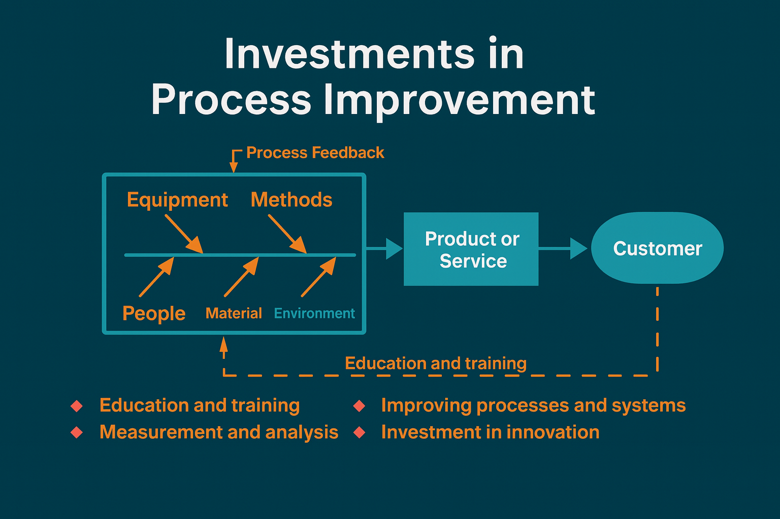
Notes:
Investments in Process Improvement
Shifting from inspection to process improvement isn’t free—it requires up-front investment. But those investments pay off with lower costs, higher quality, and long-term resilience.
1. Education and Training 📚
Kaoru Ishikawa famously said: “Quality control begins with education and ends with education.”
Skills and knowledge are the foundation of cultural change.
Training equips people to see workflows as systems and to improve them.
Without continuous learning, quality stagnates.
✅ R-PM Lesson: Whether in a Navy command or a small business team, invest in learning. The return comes in fewer mistakes, smarter decisions, and stronger people.
2. Measurement and Analysis 📊
Improvement depends on fact-based decisions. That means:
Defining clear measures of performance.
Collecting and analyzing data at every stage of the workflow.
Using feedback to guide adjustments.
Without measurement, decisions are based on opinion, not reality. With it, you build a feedback loop that makes quality predictable.
✅ R-PM Lesson: In business or personal finance, track your numbers. What you measure improves.
3. Improving Processes and Systems 🔄
Once the data is clear, the real work begins:
Redesign workflows based on evidence, not habit.
Align people, methods, machines, and materials into a system that produces stable results.
Expect short-term costs—time, retraining, or even capital investments—before long-term benefits flow.
✅ R-PM Lesson: Every hour spent fixing a broken process saves dozens of hours down the line.
4. Investments in Innovation 🚀
True process improvement goes beyond fixing—it creates space for innovation:
New processes, products, or services built on applied knowledge.
An environment that rewards experimentation, cross-team collaboration, and professional growth.
Access to tools, technology, and forums where new ideas can flourish.
✅ R-PM Lesson: Innovation is the dividend of a strong quality culture. Once waste and rework are reduced, energy shifts to creating what’s next.
Bottom Line
Process improvement is an investment mindset:
Up-front: Training, data systems, and redesigned workflows.
Long-term payoff: Reduced waste, loyal customers, healthier teams, and the freedom to innovate.
Quality isn’t an expense—it’s an asset that compounds.

Slide 22
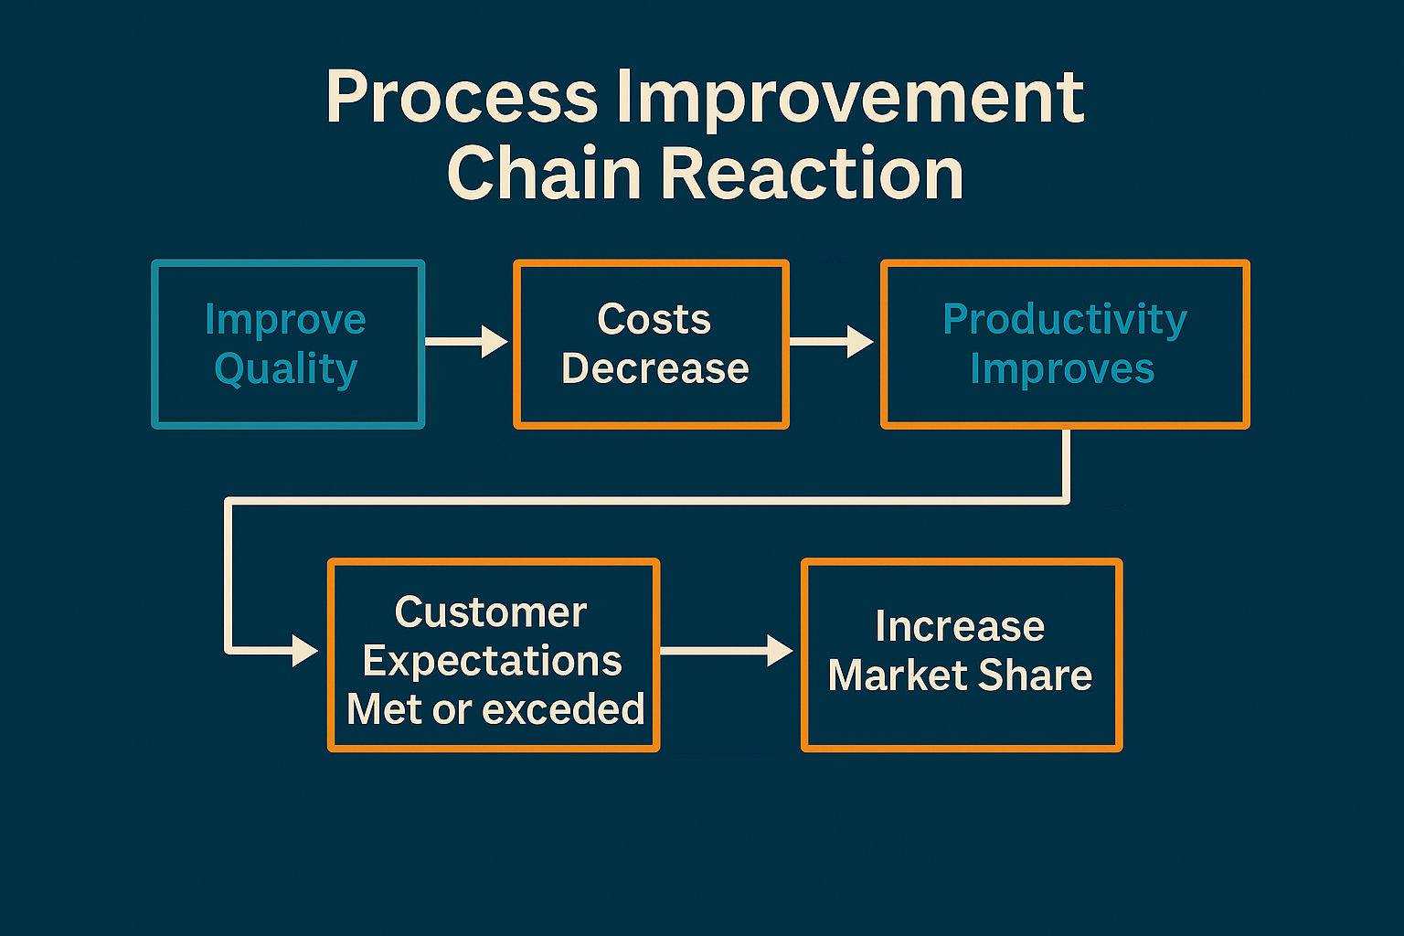
Notes:
The Chain Reaction for Small Businesses & Individuals
The premise of customer-based process improvement is simple but powerful:
As quality improves → costs decrease → productivity increases.
With lower costs and higher quality, businesses and individuals unlock opportunities for growth, competitiveness, and long-term success. This is the same economic chain reaction Deming took to Japan—and it applies just as much to your daily workflows as it does to large organizations.
How the Chain Reaction Works
For small businesses:
Better quality means fewer errors, less rework, and more efficient use of time and resources.
Lower costs allow reinvestment in growth, better customer service, or competitive pricing.
Increased productivity leads to stronger reputation, more loyal customers, and expanded opportunities.
For individuals:
Better personal workflows reduce stress, wasted time, and costly mistakes.
Lower costs show up as saved money, energy, and effort.
Increased productivity means more consistent results, career advancement, and personal growth.
Competing in Everyday Markets
Some might question: “But I’m not in global competition—does this apply to me?”
The answer is yes. Everyone competes.
A business competes locally for customers against other shops, service providers, or online options.
An individual competes for promotions, recognition, or even trust in their personal relationships.
The ones who consistently deliver higher quality at lower cost win more opportunities—whether it’s contracts, jobs, or loyalty.
Shifting the Focus
In the past, many businesses and individuals focused only on output and speed—pushing more work, chasing deadlines, or cutting corners. But the RewmoAI approach (rooted in Deming’s thinking) flips the model:
Focus on improving quality first.
Costs drop naturally because you avoid rework, delays, and waste.
Productivity rises because systems run smoothly and people spend less time fixing problems.
Discussion Prompt 💭
Do you think your own processes—at work, in your business, or in your daily life—could be improved?
Remember: everything is a process. Whether it’s how you serve customers, manage finances, or structure your daily routine—improving the process always leads to better results.
How the Chain Reaction Applies to Small Businesses & Individuals
Some people might question: Does the chain reaction really apply to me or to a small business? After all, you may not be competing for global markets. But the truth is—we all compete.
A small business competes for customers in its local market.
An individual competes for opportunities—jobs, promotions, partnerships, or simply trust and reputation.
Just like in larger organizations, the same principle holds:
Improve quality → lower costs → increase productivity → create growth and opportunities.
Competition for Work & Opportunities
For a small business:
Competing against other shops, service providers, or online platforms.
Winning customers often comes down to delivering more consistent quality at a better long-term value.
For an individual:
Competing in the job market or within a company for recognition.
The person who produces reliable, high-quality results usually advances faster than someone who just “gets it done.”
Why Process Improvement Matters
When you adopt process improvement—whether in your business or personal life—you automatically lower your costs and strengthen your results.
Small business example: A café that improves its ordering and inventory system reduces waste, lowers costs, and serves fresher products. That translates to happier customers and repeat business.
Individual example: A freelancer who creates a clear workflow for proposals and client onboarding avoids mistakes, saves time, and builds a reputation for professionalism.
Shared Goals with Industry
While a small business or individual isn’t focused on “capturing market share” at a global scale, the chain reaction still applies:
Improve quality → fewer errors, smoother workflows.
Lower costs → less rework, better use of money and time.
Increase productivity → more satisfied customers, more growth, more opportunities.
Discussion Prompt 💭
Do you think your own processes—whether in your work, business, or daily life—can be improved?
Remember: everything you do is a process.
For businesses, improving workflows increases competitiveness and growth.
For individuals, improving workflows increases readiness, efficiency, and personal success.

Slide 23
Why Focus on Quality?
The we need to maintain mission readiness
There is a new direction for RPM
The aim should be add value
We needs to continue to improve its competitiveness in the world marketplace
Notes:
Why Focus on Quality?
The premise of process-based quality improvement is clear:
As quality improves → costs decrease → productivity rises → businesses grow more profitable and individuals achieve more with less stress
. For small businesses, this means:
Delivering better products and services at lower cost.
Becoming more competitive by capturing new markets and increasing market share.
Building a stronger reputation that drives customer loyalty and referrals.
Achieving sustainable profitability instead of chasing short-term gains.
For individuals, this means:
Reducing wasted time, money, and effort by improving personal workflows.
Delivering consistent, reliable results in work or daily life.
Building trust and credibility that leads to new opportunities.
Turning personal growth into long-term career and financial success.
A New Direction for Businesses & Individuals
In today’s economy, competition is everywhere. Customers have more choices, attention spans are shorter, and loyalty must be earned. Just as the Navy once shifted toward readiness and efficiency, businesses and individuals must now shift toward quality-first thinking:
Businesses: Compete not just on price, but on reliability, service, and value. Winning customers means increasing market share and sustaining growth.
Individuals: Compete in the job market, in relationships, and in personal projects by improving the quality of effort and the clarity of results.
If we continue to manage the way we always have—reactive, short-term, and inspection-driven—we risk becoming inefficient, uncompetitive, and stagnant. But if we adopt a quality-driven approach, we unlock growth, profitability, and distinction.
Distinction in Service & Reputation
In both business and personal life, the aim is distinction.
Distinction in service means being recognized for consistent, reliable, and exceptional value.
Distinction builds reputation. A business known for quality captures new markets; an individual known for excellence gains trust and opportunities.
Reputation is survival. One major failure—or a pattern of “just good enough”—can damage credibility for years.
As Dr. Deming emphasized, we have a responsibility to continually improve, reduce waste, and raise the level of quality. In business, this secures profitability and market share. In personal life, it secures resilience, opportunity, and growth.
The Competitiveness Challenge
The U.S. economy (and global marketplace) shows the danger of ignoring quality:
Short-term profits often distract leaders from long-term market share and growth.
Poor quality adds hidden costs (rework, waste, dissatisfied customers).
Businesses that fail to innovate lose markets to those who anticipate customer needs.
Quality is not just a cost-saving measure—it’s the path to profitable growth and competitive advantage.
Discussion Prompt 💭
In your own work or business, what markets or opportunities could you capture if your quality improved just 10%?
How much time, energy, or money do you spend fixing problems that could have been prevented by better processes?

Slide 24
Benefits of Focusing on Quality
Improves operational readiness for our family and business
Improves organizational efficiency and effectiveness
Eliminates waste, reduces costs, and increases productivity
Enables everyone to make meaningful contributions to their work
Notes:
Benefits of Focusing on Quality
1. Improves Organizational Efficiency and Effectiveness
Efficiency means doing things right while effectiveness means doing the right things. Quality-driven organizations achieve both:
Toyota transformed the auto industry with the Toyota Production System, focusing on eliminating waste and empowering workers to stop production to fix defects immediately. The result: leaner processes, higher reliability, and market dominance.
Sony, in its rise to global leadership in consumer electronics, focused on innovation paired with consistent quality. Their Walkman wasn’t just a gadget—it was reliable, stylish, and easy to use, capturing massive global market share.
When businesses focus only on cutting costs or maximizing output without considering customer expectations, they risk losing relevance. True efficiency means simplifying processes without cutting away the qualities customers value.
2. Eliminates Waste, Reduces Costs, and Increases Productivity
High quality and low cost are not opposites—they reinforce each other. By preventing defects and rework, companies save money and increase speed.
Motorola pioneered Six Sigma, which reduced defects across manufacturing and service functions. That focus on quality cut costs dramatically and helped Motorola dominate markets like semiconductors and mobile phones in its prime.
Toyota showed the world that fewer errors, fewer recalls, and less waste create higher productivity and lower overall costs.
Every time mistakes are avoided, labor hours, materials, and energy are freed to create more value.
3. Builds Competitive Advantage and Market Share
When quality improves, businesses don’t just save costs—they grow. Customers reward quality with loyalty, repeat purchases, and referrals.
Sony’s PlayStation won the gaming market by combining innovation with consistent reliability and a massive library of high-quality games.
Toyota’s Lexus division proved that a new luxury brand could overtake entrenched competitors by delivering both performance and long-term reliability at a better price point.
Better quality → stronger reputation → more customers → higher market share.
4. Engages and Empowers People
A focus on quality transforms workplace culture. Instead of treating employees as cogs in a machine, leaders treat them as partners in improvement.
Toyota’s “andon cord” system gave factory workers the authority to stop the production line when they spotted a defect. This empowered employees to contribute directly to quality, improving both morale and results.
Motorola’s Six Sigma teams trained employees in problem-solving methods, turning every staff member into a contributor to efficiency and growth.
Employees closest to the process often see the biggest opportunities for improvement. When they’re trained, respected, and listened to, they help drive lasting transformation.
5. Quality Fuels Innovation
Continuous improvement doesn’t just eliminate waste—it fosters innovation.
Sony’s culture of quality and design excellence allowed it to create category-defining products like the Walkman and Trinitron TV.
Toyota’s hybrid Prius showed how a quality-first culture could successfully launch breakthrough technology, opening the door to mass-market eco-friendly cars.
Innovation thrives when businesses commit to quality processes, data-driven decisions, and long-term thinking.
✅ Key Takeaway: Quality isn’t just about “meeting standards.” It’s the foundation for reducing waste, cutting costs, growing market share, and building sustainable profitability. Businesses that focus on quality—like Toyota, Sony, and Motorola—don’t just survive. They lead.

Slide 25
RewmoAI
Process Management
The application of quantitative methods and the knowledge
of people to assess and improve:
Materials and services supplied to the organization
All significant processes within the organization and
Meeting the needs of the end-user, now and in the future
Notes:
RewmoAI Definition of Rewards-Process Management (R-PM)
R-PM is the application of measurable data and the knowledge of people to continually assess and improve:
The materials, tools, and services you rely on.
The significant workflows and processes that drive results.
The ability to meet customer needs—both now and in the future.
Why “Rewards-Process Management” is Different
Rewards: The benefits of improvement go directly to the business (profit, loyalty, reputation) and to individuals (savings, growth, fulfillment).
Process Management: Quality isn’t something you inspect into the end product—it’s something you design into every step of the process.
Key Principles
Total means holistic. Every person and every process in an organization contributes to quality. For individuals, that means every choice and habit is part of your “system.” For small businesses, every workflow—sales, service, operations, finance—shapes customer experience.
Quality is defined by the customer. Doing your best doesn’t matter unless it satisfies or delights the people you serve. Both external customers (buyers, clients) and internal ones (employees, partners, even your future self) provide essential feedback.
Measurement matters. Processes must be tracked to know whether they’re stable, effective, and ready for improvement. Without measurement, you can’t tell if changes are real progress or just noise.
Leadership at every level. Quality isn’t just the responsibility of executives. Owners, managers, frontline employees, and even solo entrepreneurs all play a leadership role in improving their own part of the system.
R-PM as a Long-Term Strategy
Quality must be built into the culture, not treated as a one-time project.
Leaders set direction, provide resources, and model the commitment to continuous improvement.
Lasting improvement means balancing people needs (motivation, clarity, purpose) with technical needs (tools, methods, systems).
Success comes when everyone aligns around the same mission: delivering value with fewer defects, less waste, and more customer delight.
The Five Elements of R-PM
Quantitative methods → Using data, not guesswork, to make decisions.
Knowledge of people → Respecting human insight and creativity at all levels.
Materials and services → Ensuring what you use is fit for purpose.
Significant processes → Focusing improvement efforts on the workflows that matter most.
Meeting end-user needs → Defining quality through the lens of today’s and tomorrow’s customer.
✅ Key Takeaway: R-PM shifts the focus from inspecting failures at the end to designing quality into every workflow from the start. This approach lowers costs, reduces stress, empowers people, and builds long-term growth.

Slide 26
Module Summary
Quality has many dimensions and is difficult
to define
The customer defines quality
Every product or service produced in the
organization is the result of a process
Process improvement is fundamental to total
quality
DON’s chain reaction shows the relationship
between quality and mission readiness
DON has endorsed a new approach called
Total Quality Leadership (TQL)
Notes:
Module Summary
R-PM (Rewards-Process Management) emphasizes continual improvement through effective leadership practices, customer focus, process measurement, and systems thinking.
Quality has many dimensions and is hard to define
You learned that quality is not one single thing—it has multiple dimensions such as reliability, timeliness, durability, ease of use, and reputation. These dimensions help us understand that quality is always defined by the customer’s needs, wants, and context, not by the organization alone.
The customer defines quality
The customer—not the business—ultimately decides what “quality” means. To succeed, you must:
Identify your customer’s requirements.
Measure how well you meet those requirements.
Aim not just to meet but to exceed expectations.
Remember: customers also balance quality with price. Value is always defined differently depending on who the customer is.
Every product or service comes from a process
You learned that all work is the result of a process.
A process is both a series of steps and a set of conditions that transform inputs (people, tools, materials, methods, environment) into outputs (products or services).
Recognizing that everything is a process is one of the most important insights for improvement.
Process improvement is fundamental to quality
Quality is built into processes, not added at the end by inspection.
Focusing only on outputs means managing failure—by the time you find defects, it’s too late.
R-PM shifts the focus to improving workflows that create consistent, reliable, customer-delighting results.
The Chain Reaction in Business and Life
You learned about the Quality Chain Reaction:
Improve quality.
Costs decrease (less rework, waste, and delay).
Productivity increases (faster, smoother workflows).
Customers are more satisfied.
Market share and growth expand.
This principle applies just as much to small businesses seeking profit as it does to individuals improving personal workflows.
A new approach: Rewards-Process Management (R-PM)
R-PM is more than a management technique—it is a shift in mindset.
It requires leadership at every level, not just from the top.
It emphasizes building systems where quality is the default, not the exception.
It aligns processes, people, and goals toward long-term customer value and sustainable growth.
✅ Key Takeaway:
Improving quality is not about fixing problems at the end—it’s about designing better processes from the start. Whether in your personal finances, a small business, or a larger team, quality-focused workflows reduce costs, eliminate stress, and unlock growth.

Slide 27
Notes:
Coming Next:
Module 2: Quality Improvement Teams
In this module you will learn the roles and responsibilities of quality improvement teams. We will also discuss the roles and
responsibilities individuals have on teams and the various support positions needed for successful quality implementation.

