Slide 1

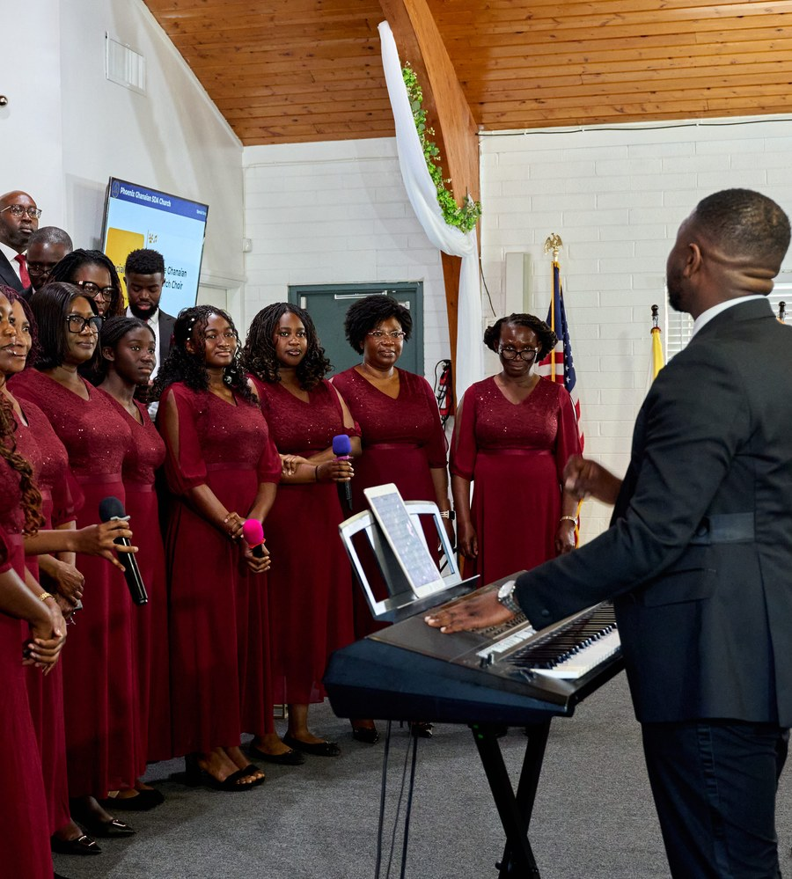


A SEVENTH-DAY ADVENTIST PERSPECTIVE
Singing with
Meaning and Purpose
“Let the word of Christ dwell in you richly… singing with grace in your hearts to the Lord.”
COLOSSIANS 3:16
Nathanael Adjei, MD
Founder & Composer, Psalms of Nate • Music Director, PaGAF
Notes:
Welcome. Introduce yourself briefly — physician by profession, musician by calling — and say why this subject matters to you personally.
Opening line to consider: “Every Sabbath our churches are full of singing. The question this seminar asks is not whether we sing, but whether we know what we are doing when we sing.”
Read Colossians 3:16 aloud and let it sit before moving on. Note the three verbs Paul uses: dwell, teach, sing. Singing is the last of the three, not the first — it carries the Word that already lives in us.
Timing: 2 minutes.

Slide 2


THE ARGUMENT OF THIS SEMINAR
Church singing must be more than beautiful sound.
It must be truthful worship, heartfelt devotion, and intentional ministry.
Truthful
Heartfelt
Intentional
The words are biblically and doctrinally sound — the congregation is being taught, not merely moved.
The singer believes what the text says. Spirit and understanding travel together.
The song has an assignment in this service, at this moment, for these people.
INTRODUCTION
3
Notes:
This is the thesis. Say it slowly, then pause.
The three words on the cards are the seminar's skeleton: truthful (Part One and Two), heartfelt (Part Three), intentional (Part Four).
A useful framing borrowed from clinical teaching: today we will look at the symptom, then the diagnosis, then the prescription. The symptom is that a great deal of our singing is technically excellent and spiritually thin.
Be careful not to sound accusatory. Include yourself: 'I have led songs I had not prayed over.'
Timing: 2 minutes.

Slide 3

Why Do We Sing in Church?
Before the theology, an honest audit. Which of these drives our song selection?
1
2
3
To praise God
The worshipper’s reason.
To prepare hearts for the Word
The service’s reason.
To preserve truth through song
The church’s reason.
4
5
6
To inspire the congregation
Right — if it means edify, not excite.
To display talent
A reason we act on, but cannot defend.
Because it is our tradition
Habit is not the same as worship.
The two outlined cards are not sins — they are insufficient reasons. A ministry built on them will eventually sing well and mean nothing.
INTRODUCTION
4
Notes:
Ask the question and let the room answer before you advance the animation or read the cards. You will normally hear 1, 2 and 4 first.
The two dashed cards are the point of the slide. Handle them gently: nobody stands up on Sabbath intending to display talent, but repertoire chosen for its difficulty, arrangements built around one soloist, and the annual 'we always sing this' anthem tell a different story.
A good line: 'Tradition and talent are servants. The moment either one becomes the reason, the singing has changed masters.'
Timing: 4 minutes, including audience response.

Slide 4
Seven Things Scripture Sends Song to Do
Every one of these is a job. Ask which job today’s song has been given.
1
2
3
4
Praise
Celebrating the character and works of God
Teaching
Preserving doctrine and truth in the memory
Testimony
Telling what God has personally done
Prayer
Turning the heart Godward in song
Psalm 96:1–3
Colossians 3:16
Psalm 40:3
Psalm 42:8
5
6
7
Ask on Sabbath:
“Which of these seven is this song being asked to do this morning?”
Encouragement
Strengthening believers in difficulty
Unity
Joining the congregation in one voice
Mission
Declaring God’s glory among the nations
Acts 16:25
2 Chronicles 5:13
Psalm 96:3
BIBLICAL FOUNDATIONS
7
Notes:
This is the most practically useful slide in Part One. The seven purposes are not a list to memorise — they are a menu the worship planner chooses from.
The common failure is that a song is chosen because the choir already knows it, and then the purpose is invented afterwards. Reverse the order: name the assignment first, then find the song that does it.
Example worth giving: an appeal after a sermon on the judgement does not need a triumphal processional. It needs a song of surrender. The music can be excellent and still be the wrong tool.
Timing: 4 minutes.

Slide 5
Meaning and Purpose — Two Different Questions
Meaning looks at the song. Purpose looks at the service. A song can pass one test and fail the other.
Singing with MEANING
“Do I know and believe what I am about to sing?”
Singing with PURPOSE
“Why is this song here, in this service, today?”
1
Knowing what the words actually say
1
Every song carries a spiritual assignment
2
Understanding the theology behind them
2
Why are we singing this song today?
3
Internalising the text before singing it
3
What truth is it sent to communicate?
4
Matching musical expression to the message
4
How does it fit the worship theme?
5
Ministering from conviction, not memory
5
What should it accomplish in the congregation?
BIBLICAL FOUNDATIONS
10
Notes:
Keep the distinction sharp — most people collapse the two.
Meaning is about the song in itself: is it true, and do I believe it? Purpose is about the song in context: is it the right song for this moment?
The worked example that lands: 'How Great Thou Art' is a magnificent hymn with impeccable meaning. Sung during a funeral appeal for a grieving family, it may still be the wrong song for that moment. Meaning passed. Purpose failed.
And the reverse: a song perfectly suited to the theme of the day whose second verse teaches something the Bible does not. Purpose passed. Meaning failed. The song is disqualified.
Both tests must be passed. Ask the choir leaders present which test they actually apply.
Timing: 4 minutes.

