Slide 1



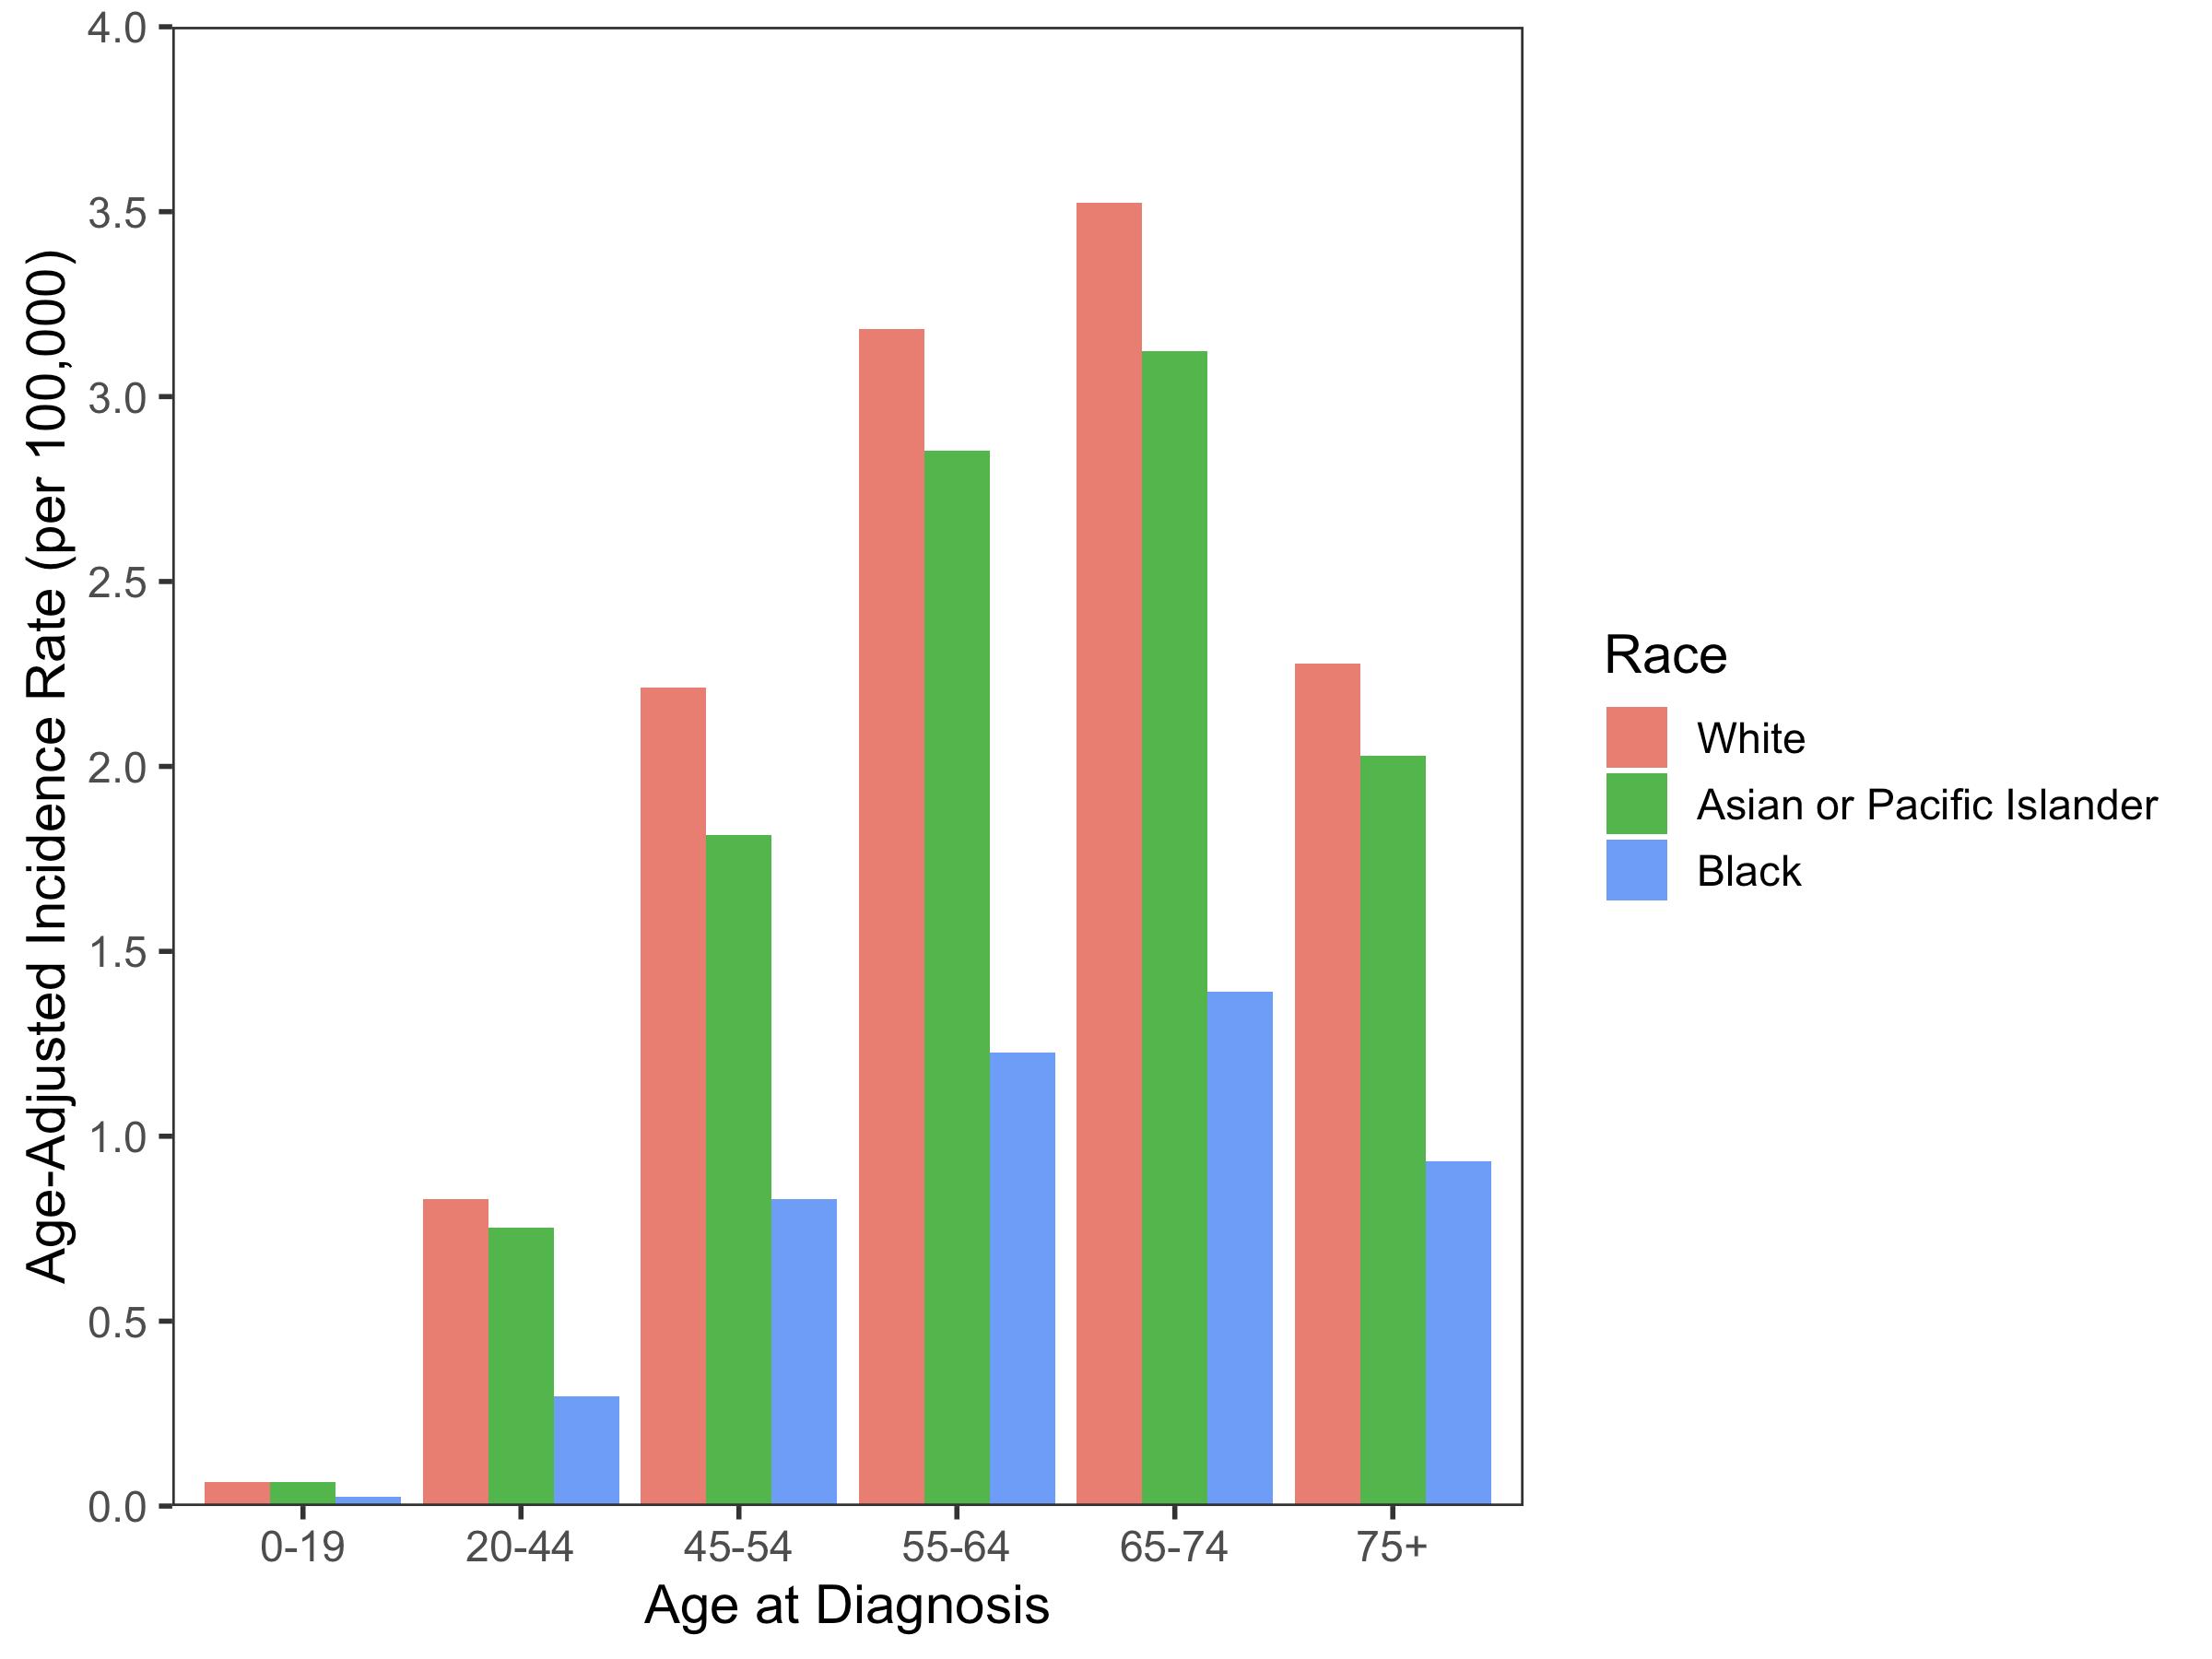
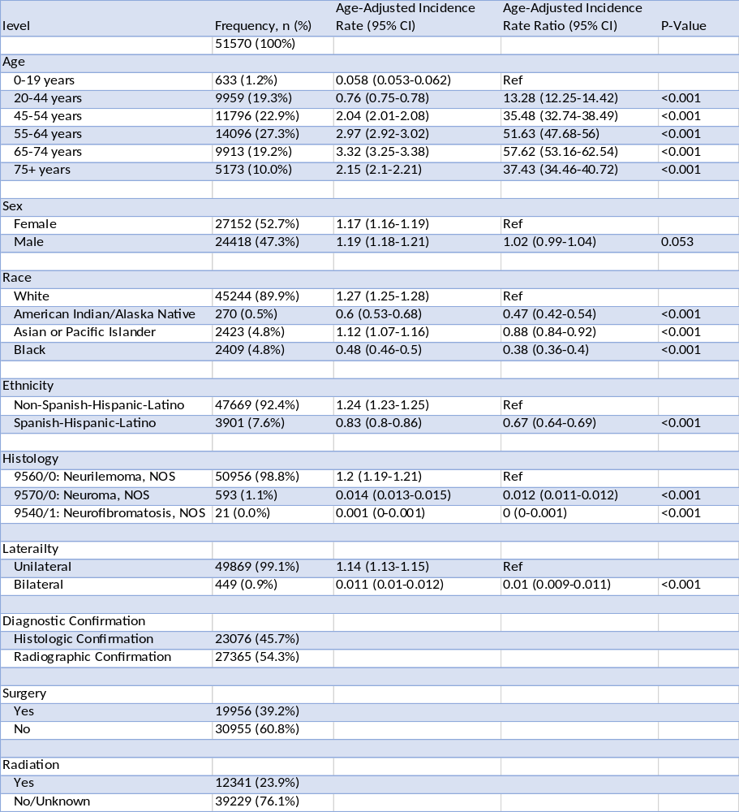
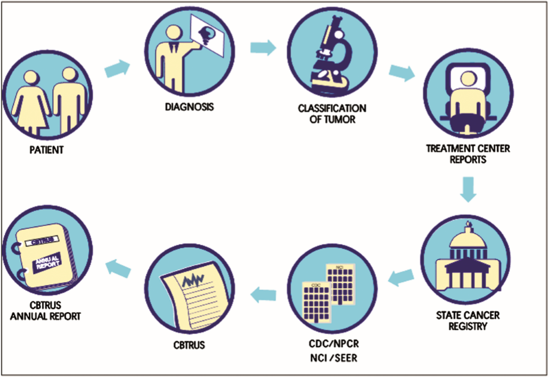
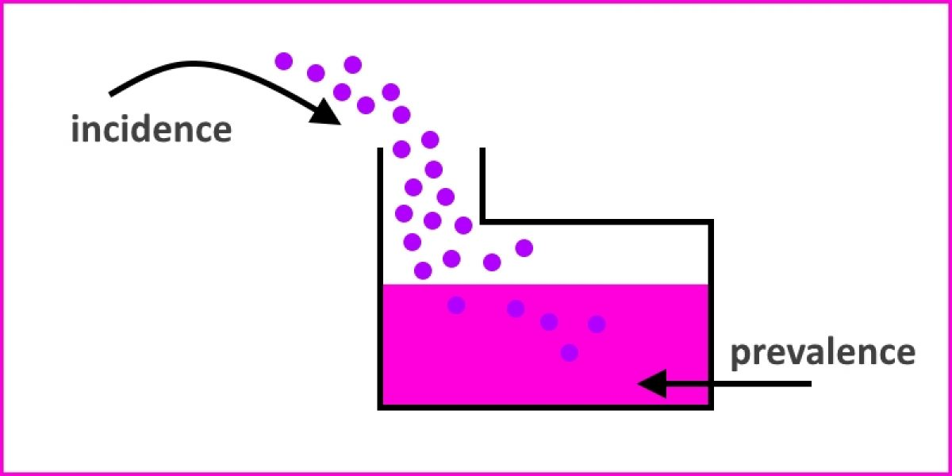
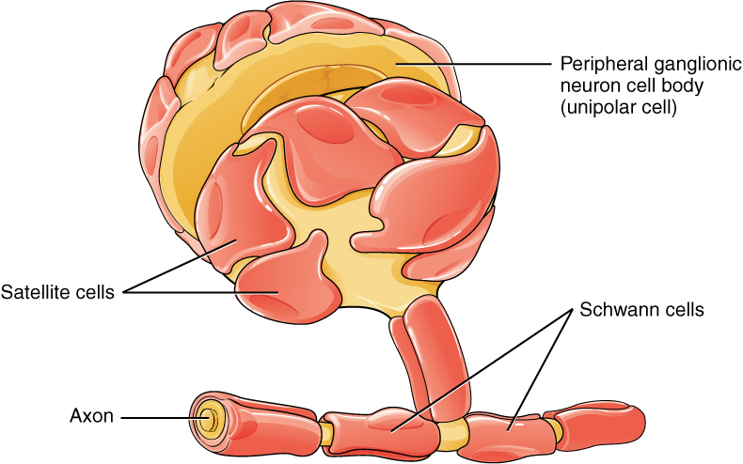
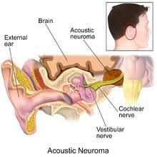
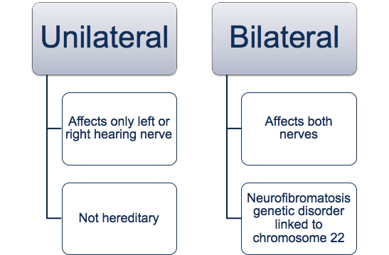
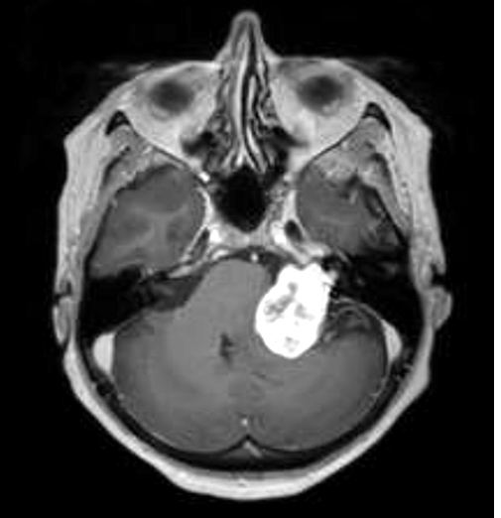
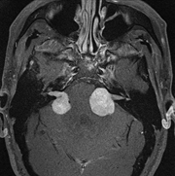
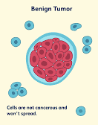

Descriptive Epidemiology on Vestibular Schwannoma
Kaitlyn Greppin¹, Kailey Takaoka¹, Gino Cioffi² , Nirav Patil², and Jill Barnholtz-Sloan²
¹Hathaway Brown School, ²Department of Population Health and Quantitative Health Sciences, Case Western Reserve University
Abstract
Conclusions
Vestibular schwannomas, also known as acoustic neuromas, result from an overproduction of schwann cells on the eighth cranial nerve. This benign brain tumor affects hearing and balance. To perform this statistical analysis, data on 52,926 patients were acquired from the Central Brain Tumor Registry of the United States (CBTRUS) from 2004-2016. Neurofibromatosis (9540/1), neurilemoma (9560/0), and neuroma (9570/0) in the Acoustic nerve (C72.4) defined vestibular schwannomas. Frequencies and age-adjusted incidence rates (AAIR) were calculated using SEER*Stat. Of the patients, 47.3% were male (n=24,938, AAIR: 1.197, 95% CI: 1.182-1.212) and 52.7% were female (n=27,152, AAIR: 1.17, 95% CI 1.16-1.19). The highest incidence appeared in white individuals (89.9%, n=45,244, AAIR: 1.27, 95% CI 1.25-1.28) and lowest in American Indian/Alaska Native individuals (0.5%, n=270, AAIR: 0.6, 95% CI 0.53-0.68). Vestibular schwannomas were most common in patients 55-64 years old (27.3%, n=14,096, AAIR: 2.97, 95% CI 2.92-3.02) and least common in patients 0-19 years old (1.2%, n=633, AAIR: 0.058, 95% CI 0.053-0.062). Out of the total population 45.7 were microscopically confirmed, 39.2% received surgery, and 23.9% received radiation. Vestibular schwannomas are slow growing and not detected easily therefore determining at risk populations is crucial to diagnosis and improving patient care.
Data
Results
Highest incidence appeared in females, and lowest in males
Highest incidence appeared in White and lowest in American Indian/ Alaska Native patients
Most common in patients 65-74 years old, least common in patients 00-19 years old
45.7% were microscopically confirmed, 39.2% received surgery, and 23.9% received radiation
Data obtained from Central Brain Tumor Registry of the United States (CBTRUS).
CBTRUS only population-based site-specific registry in the US.
Study period from January 1, 2004 to December 31, 2016
Age-Adjusted Incidence Rate of Vestibular Schwannomas Based on Race
Table 1: Multivariable Incidence Rates of Vestibular Schwannomas
Future Directions
Conduct prevalence (how widespread the disease is) analyses on vestibular schwannomas
Background
Figure 6: Incidence is new cases and prevalence is all cases
Table 2: Number of Patients with Vestibular Schwannomas Treated with Radiation
References
Vestibular Schwannoma
Also known as acoustic neuroma
Tumors can be classified on one (unilateral) or both (bilateral) hearing nerves
Radiation | Frequency, n (%)
Yes | 12341 (23.9%)
No/Unknown | 39229 (76.1%)
Afshar, N., English, D. R., Thursfield, V., Mitchell, P. L., Te Marvelde, L., Farrugia, H., Giles, G. G., & Milne, R. L. 2018. Differences in cancer survival by sex: a population-based study using cancer registry data. Cancer Causes & Control, 29(11): 1059-1069.
Cook, M. B., McGlynn, K. A., Devesa, S. S., Freedman, N. D., & Anderson, W. F. 2011. Sex disparities in cancer mortality and survival. Cancer Epidemiology and Prevention Biomarkers, 20(8): 1629-1637.
Ellison, L. F. 2016. Differences in cancer survival in Canada by sex: Statistics Canada.
Goldman, N., Glei, D. A., & Weinstein, M. 2016. What matters most for predicting survival? A multinational population-based cohort study. PloS one, 11(7).
Innos, K., Padrik, P., Valvere, V., & Aareleid, T. 2015. Sex differences in cancer survival in Estonia: a population-based study. BMC cancer, 15(1): 72.
Jemal, A., Miller, K. D., Ma, J., Siegel, R. L., Fedewa, S. A., Islami, F., Devesa, S. S., & Thun, M. J. 2018. Higher lung cancer incidence in young women than young men in the United States. New England Journal of Medicine, 378(21): 1999- 2009.
Jung, K.-W., Park, S., Shin, A., Oh, C.-M., Kong, H.-J., Jun, J. K., & Won, Y.-J. 2012. Do female cancer patients display better survival rates compared with males? Analysis of the Korean National Registry data, 2005–2009. PloS one, 7(12).
Kim, H.-I., Lim, H., & Moon, A. 2018. Sex differences in cancer: epidemiology, genetics and therapy. Biomolecules & therapeutics, 26(4): 335.
Oberaigner, W., & Siebert, U. 2011. Do women with cancer have better survival as compared to men after adjusting for staging distribution? The European Journal of Public Health, 21(3): 387-391.
Radkiewicz, C., Johansson, A. L., Dickman, P. W., Lambe, M., & Edgren, G. 2017. Sex differences in cancer risk and survival: A Swedish cohort study. European Journal of Cancer, 84: 130-140.
Yang, W., Warrington, N. M., Taylor, S. J., Whitmire, P., Carrasco, E., Singleton, K. W., Wu, N., Lathia, J. D., Berens, M. E., & Kim, A. H. 2019. Sex differences in GBM revealed by analysis of patient imaging, transcriptome, and survival data. Science translational medicine, 11(473): eaao5253.
Figure 5: Data collection efforts
Figure 1: Vestibular Schwannoma caused by Schwann cell overproduction
Figure 2: Vestibular Schwannoma located on the eighth cranial nerve
Methods
Table 3: Number of Patients with Vestibular Schwannomas Treated with Surgery
CBTRUS Data
1973-2015
n=10,040,243
Surgery | Frequency, n (%)
Yes | 19956 (39.2%)
No | 30955 (60.8%)
Sample Population
2004-2016
n=52,926
Primary, benign tumors histologically or radiologically confirmed
Figure 3: MRI of unilateral vestibular
schwannomas
Figure 4: MRI of bilateral vestibular schwannomas
Table 4: Methods of Confirmation
Slow growing and benign tumor
https://thejns.org/focus/abstract/journals/neurosurg-focus/44/3/2017.11.FOCUS17607f4.jpg
Diagnostic Confirmation | Frequency, n (%)
Histologic Confirmation | 23076 (45.7%)
Radiographic Confirmation | 27365 (54.3%)
Health Risks:
SEER*Stat
Frequencies
Incidence Rate Ratios*
Incidence Rate*
Hearing loss
Balance loss
Paralysis
Life threatening if the tumor becomes too large
R Studio
Plots
ggplot2 R package
*Age-adjusted to the 2004 U.S. standard population

