Slide 1
Brain Teasers

Slide 2
Which of the following methods will NOT work to select all paragraph elements on a page?
A. document.getElementsByTagName('p')
B. document.querySelectorAll('p')
C. document.selectAll('p’)
D. Array.from(document.body.getElementsByTagName('p'))

Slide 3
What's the correct way to change the background color of an element with id "myElement" to red?
A. document.getElementById('myElement').style = 'background-color: red;'
B. document.getElementById('myElement').style.backgroundColor = 'red'
C. document.getElementById('myElement').css('background-color', 'red’)
D. Both a and b

Slide 4
What does the following code output?
A. First
B. Second
C. Third
D. Second Third

Slide 5
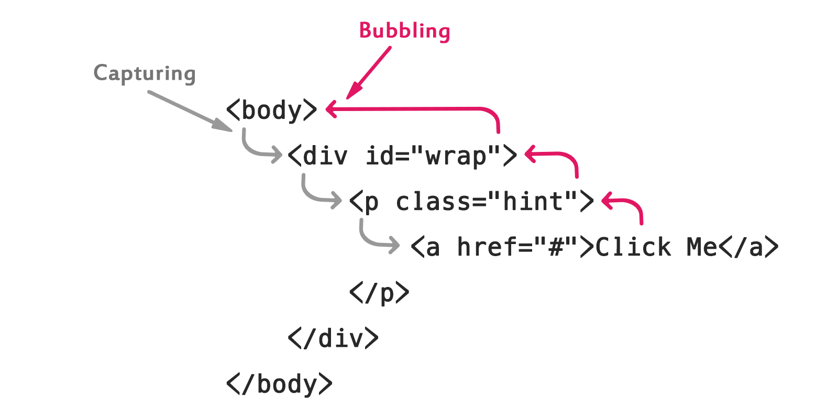
In the context of event propagation, what's the correct order of phases?
A. Target phase, Capturing phase, Bubbling phase
B. Capturing phase, Target phase, Bubbling phase
C. Bubbling phase, Target phase, Capturing phase
D. Target phase, Bubbling phase, Capturing phase

Slide 6
Which of the following will NOT give focus to an input element with id "myInput"?
A. document.getElementById('myInput').focus()
B. document.getElementById('myInput').select()
C. document.getElementById('myInput').click()
D. document.getElementById('myInput').blur()

Slide 7
What will be logged if the user clicks on "Blue"?
A. blue
B. Blue
C. undefined
D. It depends on the browser

Slide 8
What's the difference between element.innerHTML and element.outerHTML?
A. innerHTML includes the element itself, outerHTML doesn't
B. outerHTML includes the element itself, innerHTML doesn't
C. There is no difference
D. innerHTML is faster but less secure

Slide 9
What is the output of the following code? (offsetHeight is a property that returns the height of an element including vertical padding and borders, as an integer)
A. 0
B. undefined
C. null
D. None of the above

Slide 10
What's the purpose of the capture phase in event propagation?
A. To capture the event before it reaches the target (Tell parent first)
B. To improve event handling performance
C. To allow parent elements to handle events before child elements
D. To ensure all elements in the DOM tree are notified of the event programming.

Slide 11
What's the difference between event.preventDefault() and event.stopPropagation()?
A. preventDefault stops the event from bubbling, stopPropagation cancels the default action
B. preventDefault cancels the default action, stopPropagation stops the event from bubbling
C. There is no difference, they can be used interchangeably
D. preventDefault is for form events, stopPropagation is for mouse events

Slide 12
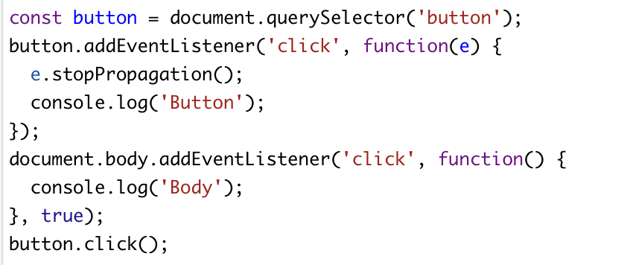
What will the following code log? The third parameter, true, means the event listener is set in the capturing phase.
A. Button
B. Body
C. Body Button
D. Button Body

Slide 13
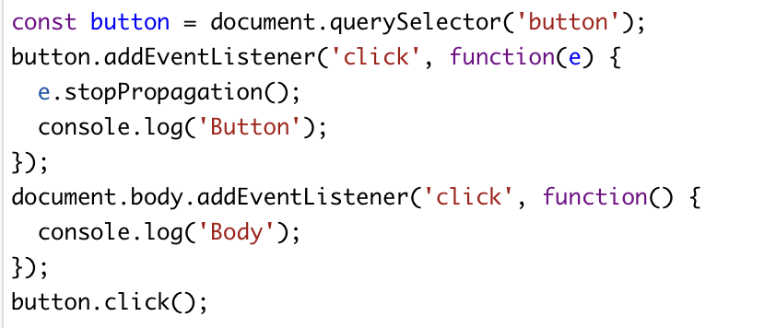
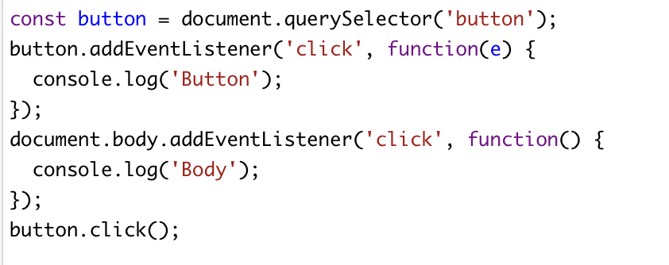
What will the following code log, 1 and 2 respectively?
1.
A. Button, Button Body
B. Button, Body Button
C. Body Button, Body
D. Button Body, Button
2.

Slide 14
Which of the following are NOT valid JavaScript variable name?
A. _myVar
B. $myVar
C. my-Var
D. switch
E. myVa2r

Slide 15
When does the ‘DOMContentLoaded’ event trigger?
A. When the HTML document is completely loaded and parsed
B. When the entire page (including images) is loaded
C. When the browser starts parsing the HTML
D. When all scripts are executed

Slide 16
What is the use of ‘localStorage’ in JavaScript?
A. To store data temporarily
B. To store data permanently
C. To store data that expires after a session
D. o store data on the server

Slide 17
What does DOM stand for?
A. Document Object Model
B. Document Oriented Model
C. Data Object Model
D. Data Oriented Model

Slide 18
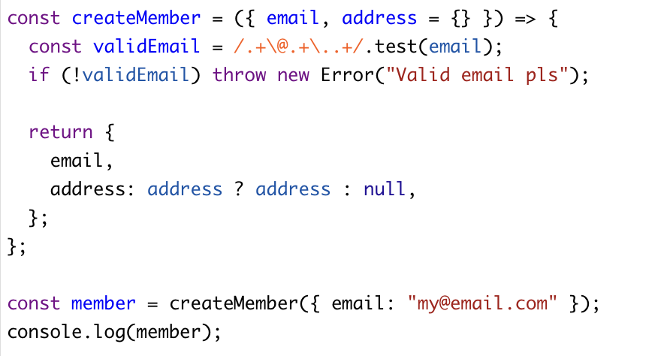
What is the output of the following code?
A. { email: "my@email.com", address : null }
B. { email: "my@email.com" }
C. { email: "my@email.com", address : { } }
D. { email: "my@email.com", address : undefined }

Slide 19
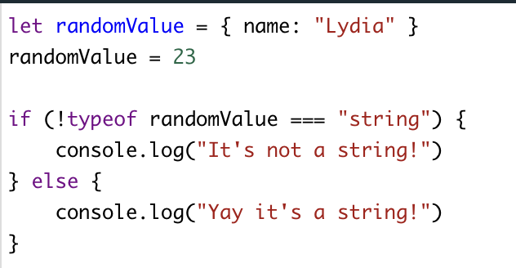
What is the output of the following code?
A. It’s not a string
B. Yay it’s a string
C. error
D. undefined

Slide 20
What is the default value of the ‘position’ property in CSS?
A. absolute
B. relative
C. fixed
D. static

Slide 21
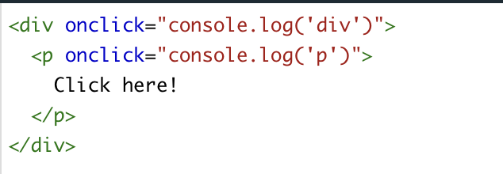
What is the output of the following code?
A. p div
B. div p
C. p
D. div

Slide 22
What is the output of the following code?
A. First Second Third
B. First Third Second
C. Second First Third
D. Second Third Second

Slide 23
Which attribute specifies the character encoding for an HTML document?
A. encode
B. charset
C. character
D. character

Slide 24
In HTML5, which tag is used for graphics and graphical applications that can be drawn on the fly, typically with JavaScript?
A. <canvas>
B. <draw>
C. <graphic>
D. <art>

Slide 25
Which of the following statements about clientX/Y and screenX/Y is correct?
A. clientX/Y values change when the page is scrolled, but screenX/Y values remain constant
B. screenX/Y values are always larger than clientX/Y values
C. clientX/Y are relative to the viewport (client area), while screenX/Y are relative to the entire screen
D. clientX/Y and screenX/Y will always be equal when the browser window is maximized

Slide 26
When dealing with a scaled webpage (e.g., using browser zoom or CSS scaling), which statement is true?
A. Both clientX/Y and screenX/Y will be scaled proportionally
B. clientX/Y will be scaled, but screenX/Y will remain unaffected
C. screenX/Y will be scaled, but clientX/Y will remain unaffected
D. Neither clientX/Y nor screenX/Y will be affected by scaling

Slide 27
Which property is used to hide an element but still take up space in the layout?
A. display: none
B. visibility: hidden
C. opacity: 0
D. visibility: none

Slide 28
Which of the following is NOT a JavaScript data type?
A. String
B. Boolean
C. Integer
D. Undefined

Slide 29
What does the ‘useCapture’ parameter in addEventListener() specify?
A. Whether to use bubbling or capturing event propagation
B. Whether to use default or custom event handler
C. Whether to use synchronous or asynchronous event handling
D. Whether to use internal or external event listener

Slide 30
Exercise: Implement the page below

