Slide 1
Questionnaire

Slide 2
What is the output of the following code? console.log( typeof typeof 1);
A. string
B. number
C. 1
D. true

Slide 3
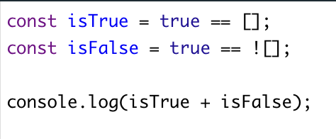
What does the following code output?
A. 1
B. 0
C. “true”
D. true

Slide 4
What does the following code output?
A. 33
B. 2
C. 8
D. 1

Slide 5
What does the following code output?
A. false, "2number", true, "apple"
B. true, "2number", false, "orange"
C. false, "NaNnumber", false, "orange"
D. true, "NaNnumber", true, "apple"

Slide 6
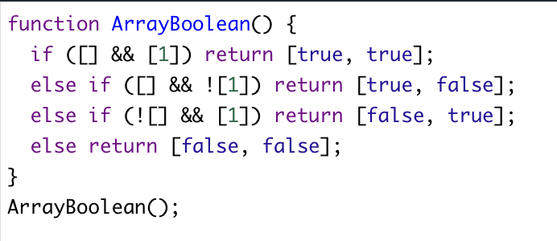
What does the following code output?
A. [true, true]
B. [false, true]
C. [true, false]
D. [false, false]

Slide 7
What is the output of the following code? let b = "4"; console.log(b +++ 3, b);
A. 44, 4
B. 8, 5
C. 7, 5
D. 43, 5

Slide 8
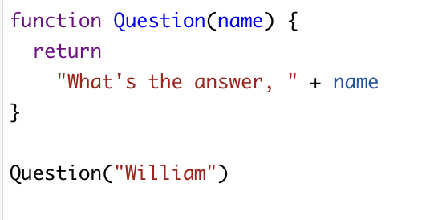
What is the output of the following code?
A. William
B. What’s the answer, William
C. What’s the answer,
D. undefined

Slide 9
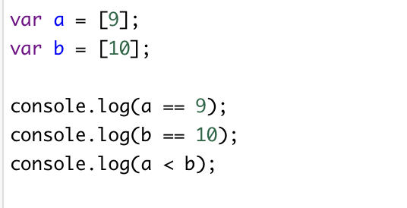
What is the output of the following code?
A. true true true
B. false false false
C. true true false
D. false false trueC

Slide 10
What will the value of citrus be in the below code?
A. ["Banana", "Lemon"]
B. ["Lemon", "Apple"]
C. ["Orange", "Lemon"]
D. ["Orange", "Lemon", "Apple"]

Slide 11
Which of the following options uses the pop array method to remove the last item from myArray, assigning the "popped off" value to removedFromMyArray?
A. var removedFromMyArray.pop()
B. myArray.pop(removedFromMyArray)
C. var removedFromMyArray = myArray.pop()
D. None of the above programming.

Slide 12
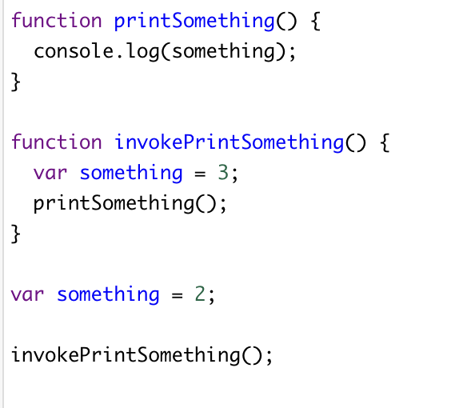
What is the output of the following code?B
A. 2
B. 3
C. undefined
D. error.

Slide 13
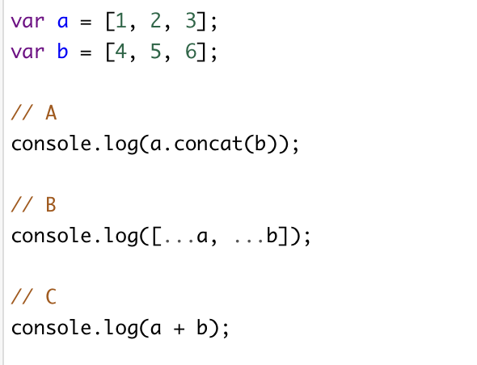
Consider two arrays a and b below. Which option below is NOT correct to merge the arrays?
A. A
B. B
C. C
D. All of them

Slide 14
What is the output of the following code? console.log([1,2,3] + [4,5,6] );
A. error
B. [1, 2, 3, 4, 5, 6]
C. “1, 2, 34, 5, 6”
D. “[1, 2, 3][4, 5, 6]”

Slide 15
What is the output of the following code?
A. 1/1/2019 2/1/2019
B. 1/1/2019 1/1/2019
C. 2/1/2019 2/1/2019
D. 2/1/2019 1/1/2019

Slide 16
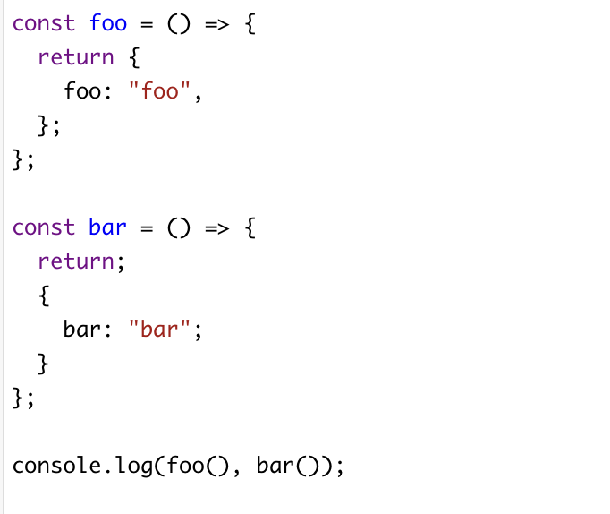
What is the output of the following code?
A. { foo: "foo" } undefined
B. undefined { bar: "bar" }
C. undefined undefined
D. { foo: "foo" } { bar: "bar" }

Slide 17
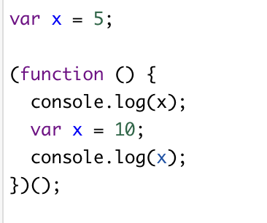
What is the output of the following code?
A. 5 and 10
B. undefined and 10
C. 5 and undefined
D. undefined and undefined

Slide 18
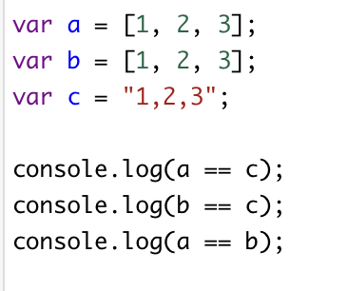
What is the output of the following code?
A. true, true, false
B. true, true, true
C. true, false, false
D. false, false false

Slide 19
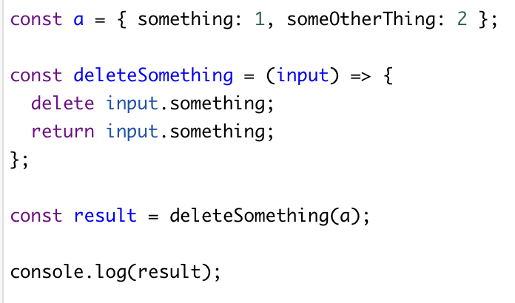
What is the output of the following code?
A. 1
B. error
C. undefined
D. 2

Slide 20
What method would tell you that "bird" is at position 4 in the following word string?? const word = 'The bird is the word';
A. length
B. indexOf
C. find
D. search

Slide 21
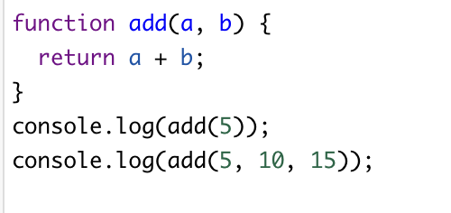
What is the output of the following code?
A. NaN error
B. error error
C. undefined 15
D. NaN 15

Slide 22
What is the output of the following code?
A. -1
B. 0
C. 2
D. None of the above

Slide 23
What is the output of the following code?
A. Some rabbits are rabid
B. Some timbits are timid
C. Some rabbits are timid
D. Some timbits are rabid

Slide 24
True or False: The pop method removes the first element from an array.

Slide 25
True or False: True or False: The unshift method adds an element to the beginning of an array.

Slide 26
True or False: array.findIndex will return 0 when no elements pass the test.

Slide 27
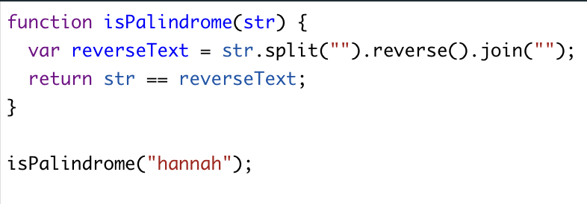
True or False: Does the following function correctly assess 'hannah' to be a palindrome? In other words, what gets logged?

Slide 28
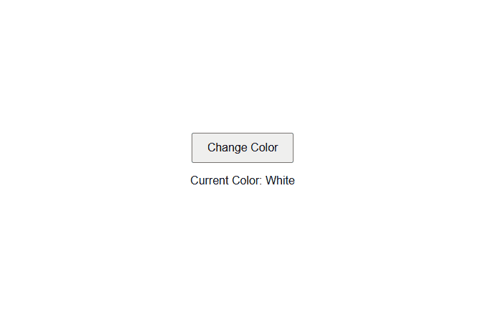
Exercise 1: Create a webpage with a button that, when clicked, changes the background color of the page.

Slide 29
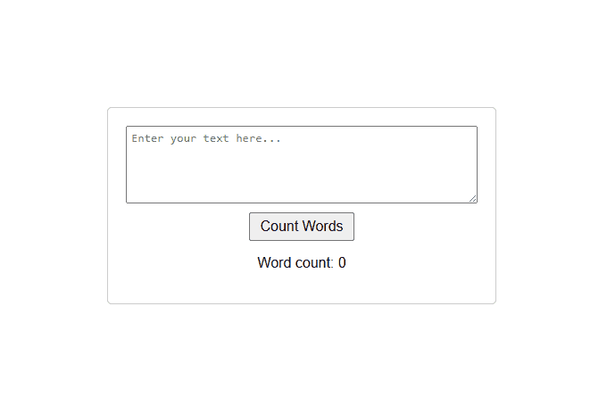
Exercise 2: Create a text area where users can input text, and display the word count when they click a button.

Slide 30
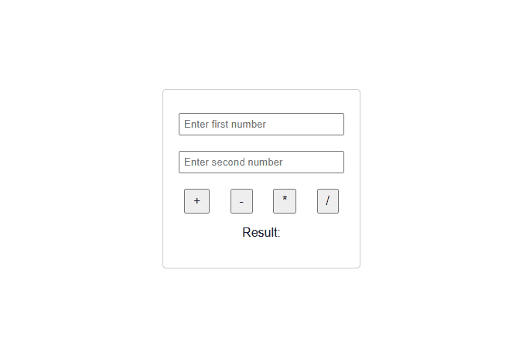
Exercise 3: Create a basic calculator that can perform addition, subtraction, multiplication, and division. Use input fields and buttons for the interface.

