Slide 1
Questionnaire

Slide 2
Which of the following statements about JavaScript is correct?
A. JavaScript must be compiled before running.
B. JavaScript can only be run in a web browser.
C. JavaScript can run on both client and server side.
D. JavaScript cannot handle event-driven programming.

Slide 3
Who originally developed JavaScript, and what was its initial name?
A. Brendan Eich, JavaScript
B. Brendan Eich, LiveScript
C. James Gosling, JavaScript
D. James Gosling, LiveScript.

Slide 4
Which of the following results in string concatenation?
A. 1 + 2
B. "1" + 2
C. 1 + "2"
D. Both b and c

Slide 5
What is the output of the following code? console.log( "5" - 3 );
A. 2
B. "2"
C. NaN
D. Error

Slide 6
What is the output of the following code? +true; ! 'Lydia';
A. 1 and false
B. false and NaN
C. false and false
D. 1 and true

Slide 7
What is the output of the following code? console.log( 1 + "2" + "2" );
A. 122
B. 32
C. NaN2
D. NaN

Slide 8
Which JavaScript feature allows functions to be passed as arguments to other functions?
A. Prototypal inheritance
B. Lambda
C. Hoisting
D. Event bubbling

Slide 9
What is the output of the following code? console.log( 0 == false );
A. true
B. false
C. NaN
D. Undefined

Slide 10
What is the output of the following code? console.log( typeof NaN);
A. NaN
B. number
C. string
D. undefined

Slide 11
What is the output of the following code? console.log(('b' + 'a' + + 'a' + 'a').toLowerCase());
A. bananaa
B. baaa
C. banana
D. ananas

Slide 12
What is the output of the following code? console.log(true + false);
A. truefalse
B. 1
C. error
D. NaN

Slide 13
Which method is used to parse a string and return an integer in JavaScript?
A. parseInt()
B. parseFloat()
C. toString()
D. Number()

Slide 14
What is the result of the following expression? true == "true"
A. true
B. false
C. undefined
D. error

Slide 15
What is the output of the following code? console.log( (null - 0) + "0” );
A. null0
B. 00
C. 0
D. NaN

Slide 16
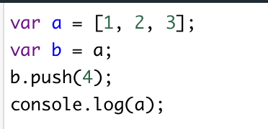
What does the following code output?
A. [1, 2, 3]
B. [1, 2, 3, 4]
C. [4, 1, 2, 3]
D. undefined

Slide 17
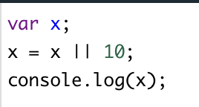
What does the following code output?
A. 0
B. 10
C. NaN
D. undefined

Slide 18
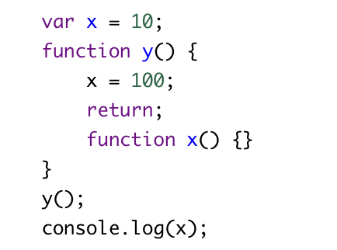
What does the following code output?
A. 100
B. 10
C. Error
D. undefined

Slide 19
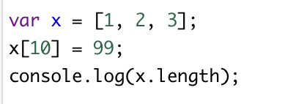
What does the following code output?
A. 3
B. 10
C. 4
D. 11

Slide 20
What does the following code output?
A. greater
B. less
C. undefined
D. error

Slide 21
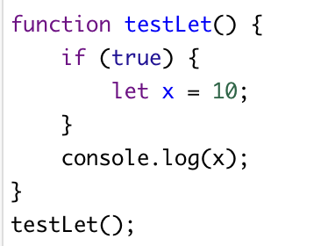
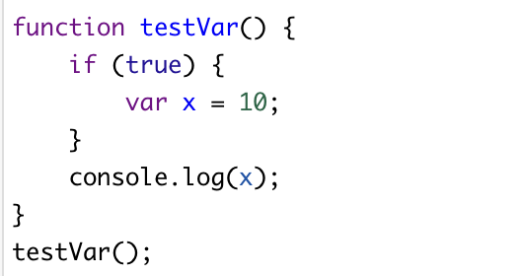
What will be the outputs for testLet and testVar respectively
A. 10, 10
B. 10, undefined
C. error, 10
D. error, error

Slide 22
What will be the outputs for 1 and 2 respectively
A. 5, error
B. error, 5
C. 5, 5
D. undefined, error
1
2

Slide 23
Which of the following is true about null in JavaScript?
A. typeof null returns "null"
B. null is equal to undefined
C. null is an object
D. null has a length of 0

Slide 24
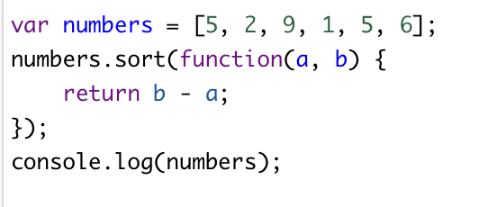
What will be the output of the following code snippet?
A. [9, 6, 5, 5, 2, 1]
B. [1, 2, 5, 5, 6, 9]
C. [1, 5, 2, 6, 5, 9]
D. [5, 2, 9, 1, 5, 6]

Slide 25
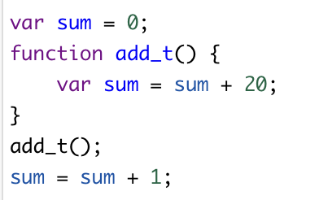
What is the final value of variable sum after the following JavaScript code is executed?
A. 20
B. 0
C. 1
D. 21
E. None of the above

Slide 26
How How do you import a JavaScript file into an HTML document?
A. <import src="myScript.js">
B. <link href="myScript.js">
C. <script src="myScript.js"></script>
D. <include src="myScript.js"></include>

Slide 27
True or False: JavaScript has five primitive types: Number, String, Boolean, Undefined, and Null.

Slide 28
True or False: The following code will print true console.log(NaN == NaN);

Slide 29
True or False: The following code will print true console.log(0.1 + 0.2 == 0.3);

Slide 30
True or False: console.log(3 > 2 > 1); prints true?

Slide 31
True or False: does "hello".split("") has the same effect as […"hello"]?

Slide 32
Write functions that will do the following
Write a JavaScript function that accepts two arguments, a string and a letter and the function will count the number of occurrences of the specified letter within the string. Sample arguments : 'w3resource.com', 'o' Expected output : 2
Write a JavaScript function that checks whether a passed string is a palindrome or not? A palindrome is word, phrase, or sequence that reads the same backward as forward, e.g., madam or was it a car or a cat I saw
Write a JavaScript function that accepts a number as a parameter and checks whether it is prime or not using recursion. Note : A prime number (or a prime) is a natural number greater than 1 that has no positive divisors other than 1 and itself.
Write a JavaScript function to extract unique characters from a string. Example string : "thequickbrownfoxjumpsoverthelazydog" Expected Output : "thequickbrownfxjmpsvlazydg"

