Slide 1
Trivial

Slide 2
Which attribute of the <select> tag determines the number of options visible in the dropdown menu?
A. selected
B. name
C. size
D. value

Slide 3
Which of the following is true about the <audio> element?
A. It automatically plays the second audio source listed.
B. It only supports the MP3 format.
C. The browser skips the content inside the <audio> element if it can play one of the sources.
D. The <audio> element does not require any attributes to function.

Slide 4
Which attribute can be used to specify a preselected option in a dropdown menu?
A. default
B. selected
C. preselect
D. option

Slide 5
How many options will be visible in the dropdown if the size attribute is set to 3 and there are 5 options listed?
A. 1
B. 3
C. 5
D. Depends on the browser

Slide 6
Which HTML element is used to define a section of navigation links?
A. <section>
B. <nav>
C. <header>
D. <footer>

Slide 7
What will be the output if the <video> or <audio> element contains multiple sources but the browser does not support any of the provided formats?
A. The video or audio will not display anything.
B. The browser will show the fallback content inside the <video> or <audio> tag.
C. The browser will throw an error.
D. The browser will try to download the video or audio.

Slide 8
Which of the following is NOT a valid attribute for the <video> element?
A. autoplay
B. controls
C. preload
D. loop

Slide 9
What does the title attribute provide in an HTML element?
A. The main heading of the page.
B. A tooltip that appears when the mouse hovers over the element.
C. A description for screen readers.
D. A CSS style definition.

Slide 10
Which attribute is used to uniquely identify an HTML element?
A. name
B. id
C. class
D. style

Slide 11
Which attribute in the <textarea> element defines the number of visible text lines?
A. cols
B. rows
C. size
D. length

Slide 12
What is a key advantage of using external CSS files?
A. It allows CSS to be applied only to a single HTML document.
B. It makes the HTML document larger and slower to load.
C. It provides a way to style multiple HTML documents with a single CSS file.
D. It requires embedding CSS code directly into the HTML document.

Slide 13
How can you include an external CSS file in an HTML document?
A. <style src="styles.css"></style>
B. <link rel="stylesheet" type="text/css" href="styles.css">
C. <script href="styles.css"></script>
D. <include href="styles.css"></include>.

Slide 14
Which HTTP method is generally considered safer in terms of exposing sensitive data?
A. GET
B. POST
C. PUT
D. DELETE.

Slide 15
True or False: The autoplay attribute in the <video> element causes the video to start playing as soon as it is loaded.

Slide 16
True or False: The “selected” attribute can be used in any HTML element to set it as preselected?

Slide 17
True or False: An HTML document can have multiple <header> elements?

Slide 18
True or False: The <footer> element in HTML must contain the copyright information for the webpage?

Slide 19
True or False: The <audio> element supports the attributes autoplay, controls, and loop?

Slide 20
True or False: The <video> element requires the controls attribute to be specified in order for playback controls to appear?

Slide 21
True or False: The title attribute in HTML is used to define the main title of a webpage, displayed in the browser's title bar.

Slide 22
True or False: The <nav> element is used to define a block of navigation links.

Slide 23
Hosting Demo in class @ 5pm – 5:30pm
https://ta.beaudelaire.ca/nodejs-railway

Slide 24
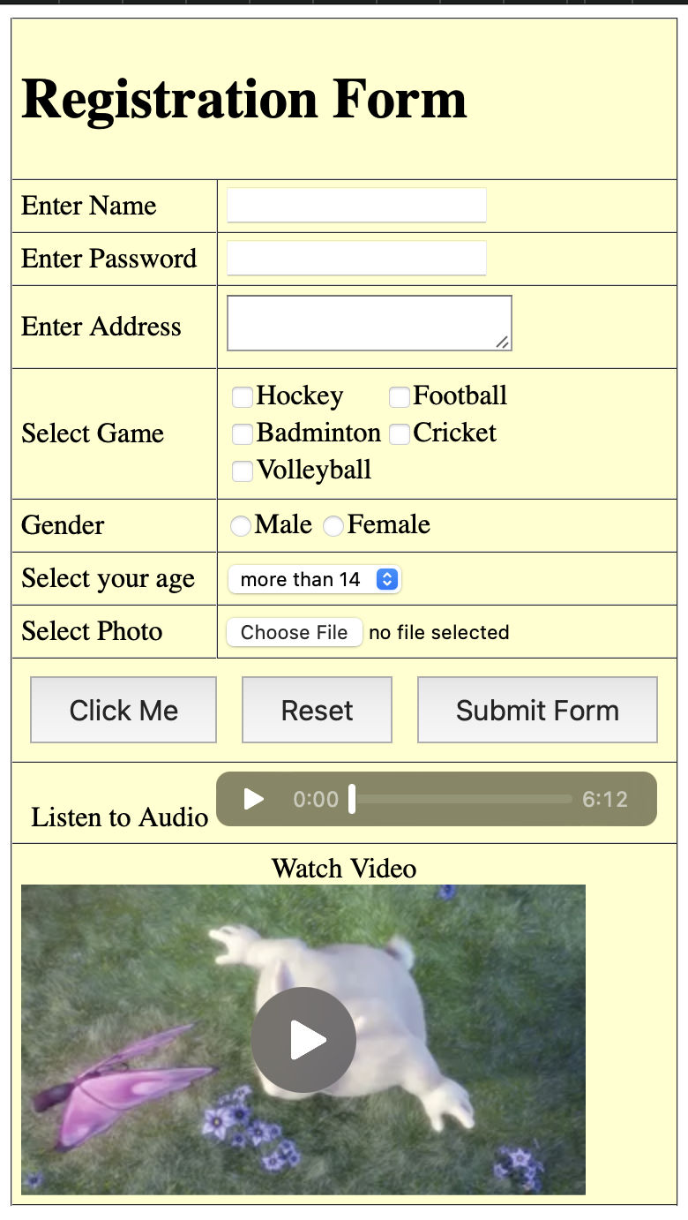
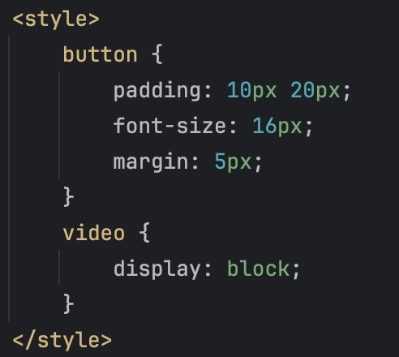
Exercise
Using the <h1>, form and table elements, recreate the given page. Also add a page title
Hint
- audio used: https://www.soundhelix.com/examples/mp3/SoundHelix-Song-1.mp3
- video used: https://www.w3schools.com/html/mov_bbb.mp4
- add cellpadding="5” to your table element
- add to the head of your html

