Slide 1
Brain Teaser

Slide 2
Who is the inventor of HTML?
A. Tim Berners-Lee
B. Marc Andreseen
C. Bill Gates
D. Larry Ellison
E. Al Gore

Slide 3
What happens when you access the page www.google.com ? [Select ALL the correct answers]
A. Multiple GET requests are sent to the server
B. One POST request is sent to the server
C. Some JavaScript code is possibly downloaded from the server
D. One GET request is sent to the server

Slide 4
Which of the following snippets of HTML is/are wrong?
A. <p>SOEN 287 Term Test!</p>
B. <p2> SOEN 287 Term Test! p2>
C. SOEN 287 Term Test! <br /> SOEN 287 Term Test!
D. <p>SOEN <b><i>287</b></i> Term Test!</p>

Slide 5
Which of the following tags are "list" tags in HTML?
A. dt
B. d
C. li
D. ol
E. il
F. td
G. ul

Slide 6
Which HTTP Status Code represents “success” status?
A. 200
B. 300
C. 400
D. 500
E. 600

Slide 7
Which of the following statements about the <meta> tag is incorrect?
A. It provides additional information about a document.
B. It can include attributes like name, content, and charset
C. It is used to link external stylesheets
D. It is placed within the <head> section of an HTML document.

Slide 8
What is the correct way to write a comment in an HTML document?
A. <!-- This is a comment ->
B. /* This is a comment */
C. <!-- This is a comment -->
D. // This is a comment

Slide 9
Which HTML tag is used to create a description/definition list?
A. ul
B. ol
C. dl
D. li

Slide 10
Which of the following attributes is used to control the vertical placement of the contents in a table cell?
A. text-align
B. cell-align
C. align
D. vertical-align

Slide 11
Which attribute is used to specify the location of an image file in an HTML document?
A. href
B. src
C. link
D. img

Slide 12
What is the purpose of the charset attribute in the <meta> tag?
A. To define the character encoding for the HTML document
B. To link an external JavaScript file
C. To specify the document's language
D. To provide additional keywords for search engines

Slide 13
Which of the following type attributes will display an ordered list with lowercase Roman numerals?
A. type="1"
B. type="A”
C. type="i"
D. type="I"

Slide 14
What is the default value for the list-style-type property in an unordered list?
A. disc
B. circle
C. square
D. none

Slide 15
What is the purpose of the colspan attribute in a table

Slide 16
In an HTML table, which attribute is used to merge two or more cells into a single cell horizontally?
A. rowspan
B. colspan
C. merge
D. span

Slide 17
What does the CSS property border-collapse: collapse; do?
A. It merges the borders of adjacent table cells into a single border.
B. It removes all borders from the table.
C. It adds spacing between the borders of adjacent table cells.
D. It collapses the table into a smaller size by removing empty cells.

Slide 18
Which of the following HTML snippets correctly creates a checkbox that is checked by default and belongs to a form for selecting groceries?
A. <input type="checkbox" name="groceries" value="milk" checked>
B. <input type="checkbox" value="milk" name="groceries[]">
C. <input type="checkbox" name="groceries" checked value="milk">
D. <input type="checkbox" name="groceries[]" value="milk” checked="checked">
Note: An array notation for the name is important if multiple values need to be submitted.

Slide 19
What is the purpose of the alt attribute of img?

Slide 20
Does the element “br” need a closing tag, why?

Slide 21
The <pre> tag is used to preserve whitespace in HTML? True or False

Slide 22
The <blockquote> tag is used to define a short quotation.? True or False

Slide 23
The default color for an unvisited link in HTML is purple? True or False

Slide 24
You can style only table, or th, or td ? True or False

Slide 25
The target="_blank" attribute value will open the linked document in a new tab or window? True or False

Slide 26
What does HTML stand for?

Slide 27
Describe the difference between inline, block, and inline-block elements in HTML. Provide examples of each type of element.

Slide 28
<!DOCTYPE html> <html lang = "en" > <head> <title>Page Title</title> </head> <body> <div style="color:red; font-size: 2rem;"> Some Inline Style </div> </body> </html>
HTML + CSS
<!DOCTYPE html> <html lang = "en" > <head> <title>Page Title</title>
<style type="stylesheet">
div{
color: blue;
font-size:3rem;
}
</ style> </head> <body> <div> Some internal Style </div> </body> </html>
html file
<!DOCTYPE html> <html lang = "en" > <head> <title>Page Title</title>
<link rel="stylesheet" href="styles.css" /> </head> <body> <div> Some internal Style </div> </body> </html>
styles. css file
div {
color: blue;
font-size:3rem;
}
Inline styling
Internal styling
External styling
Highest priority
Second Highest priority
Least priority

Slide 29
Colspan Vs Rowspan
Code available here: Click here

Slide 30
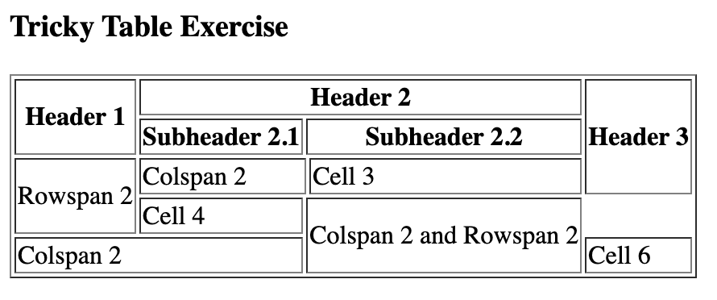
Exercise I
Using the <h3>, <table>, <th>, <tr>, and <td> elements, recreate the given page WITHOUT CSS. Also add a page title
Hint
- Use colspan and rowspan
- Use border attribute for the table element

Slide 31
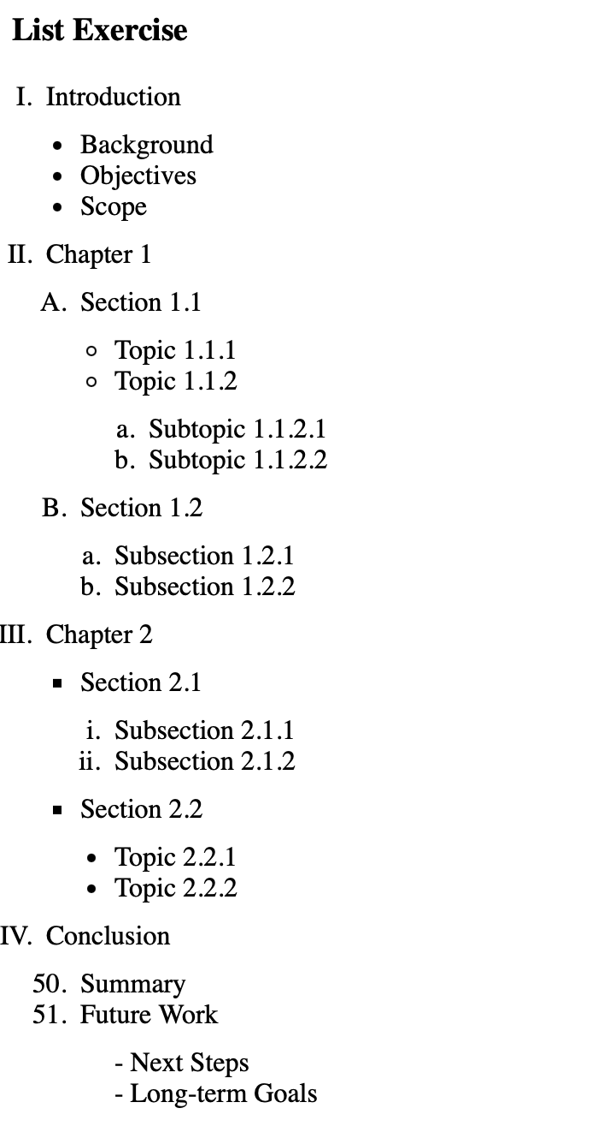
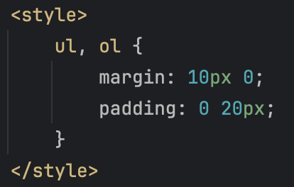
Exercise II
Using the <h3>, <ul>, <ol> and <li> elements, recreate the given page. Also add a page title
Hint
- use list-style-type to change de default bullet point for <ol> items
- use start attribute to start counting from 50
- add in the head for the spacing

Slide 32
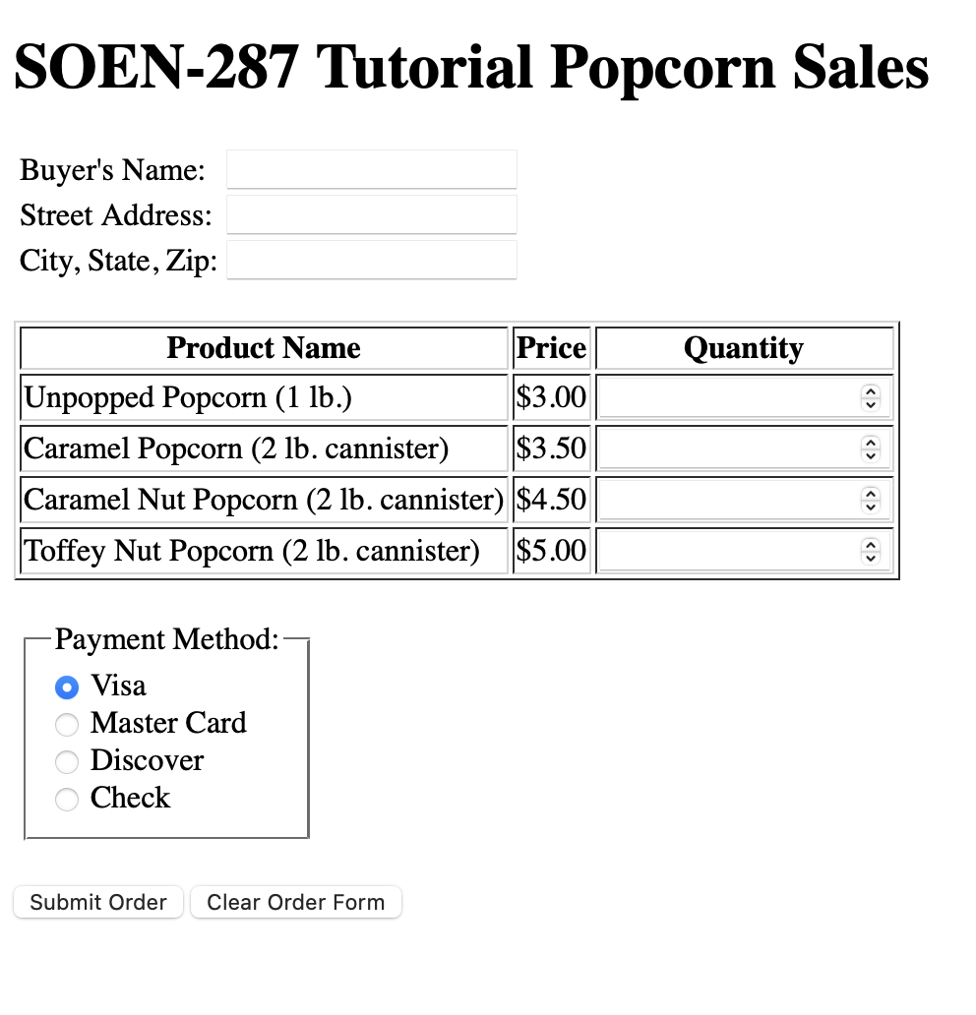
OR
Exercise III: Complete the blanks(___) in the code available at the link on the left to match the output on the right
Click Here

