Slide 1

Please feel free to edit, delete or add to these slides as you see fit for your audience.

Slide 2

MacGyver

Slide 3
At the end of the lesson students will:
Know the fundamental parts of a wind turbine
Be able to use the engineering design process and the scientific method to isolate and adjust variables while designing and testing wind wheels
Understand energy conversions and transfers, and how a wind turbine converts moving air into electrical energy
Design a Wind Wheel for the firefly wind turbine that can light up an LED

Slide 4
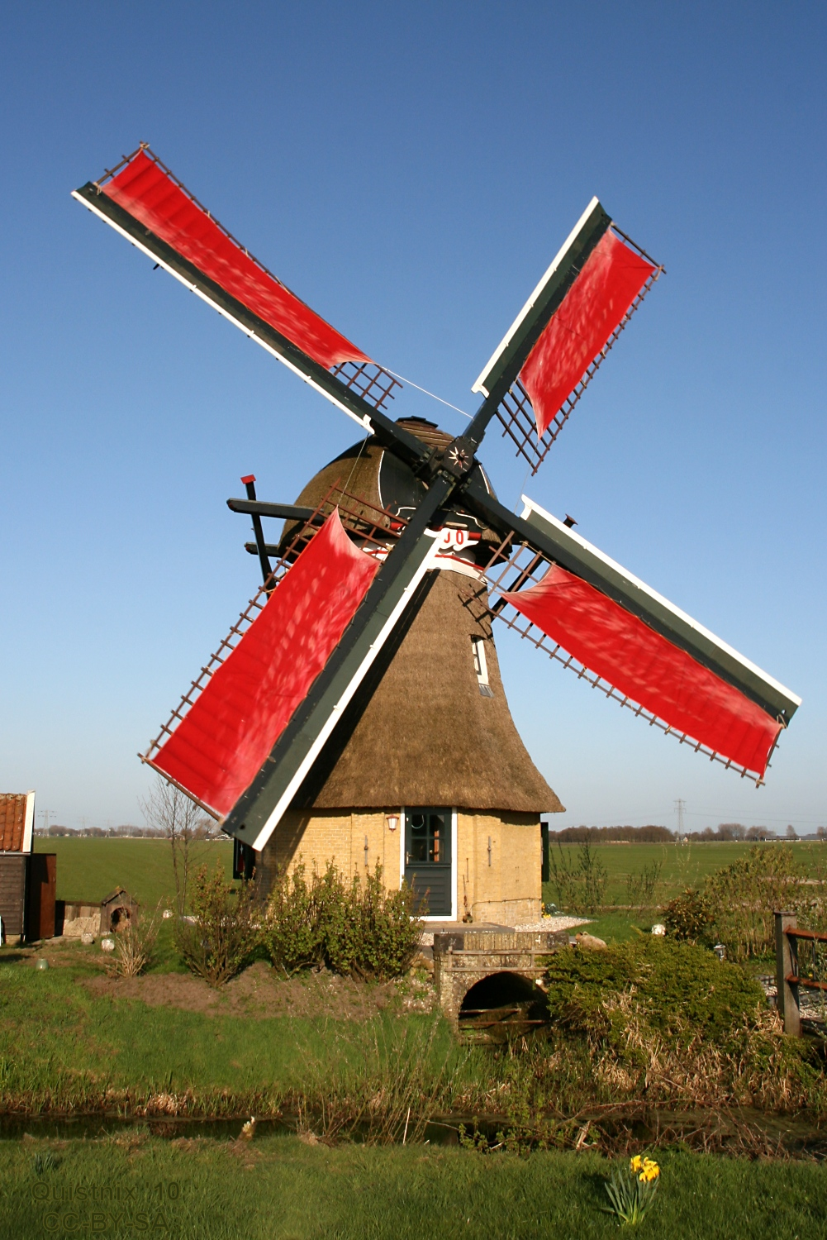
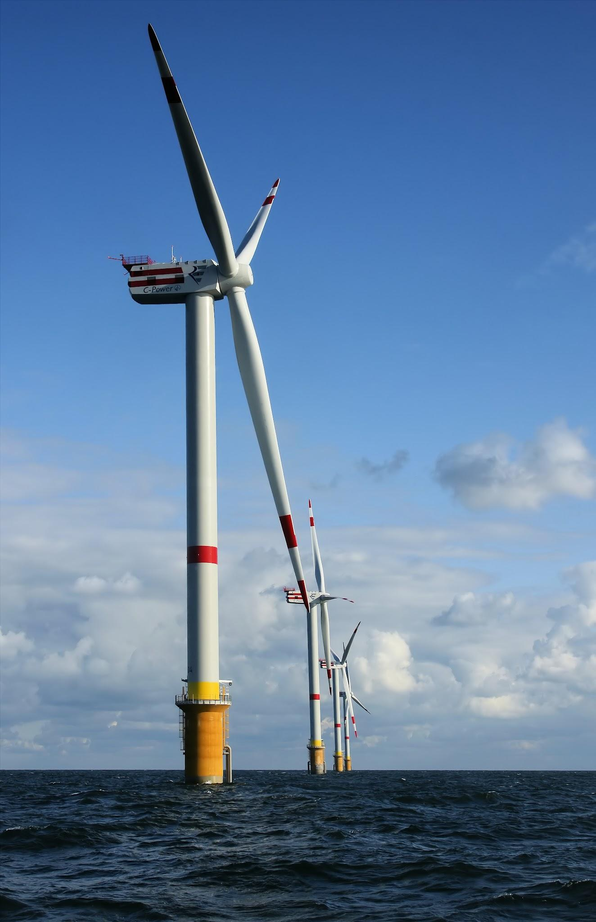
windmill vs. wind turbine
Notes:
Windmills have been around since medieval times. They are smaller and are designed to do things like turn grain into flour, drive machines and move water. Wind turbines are far taller and far more modern, and they transform the power of the wind into electricity.

Slide 5
windmill wind turbine
Notes:
textbox for writing differences if it is being projected on a board you can draw on.

Slide 6

Act this out together:
What if we move our hand flat, like it’s cutting through the wind?

Slide 7
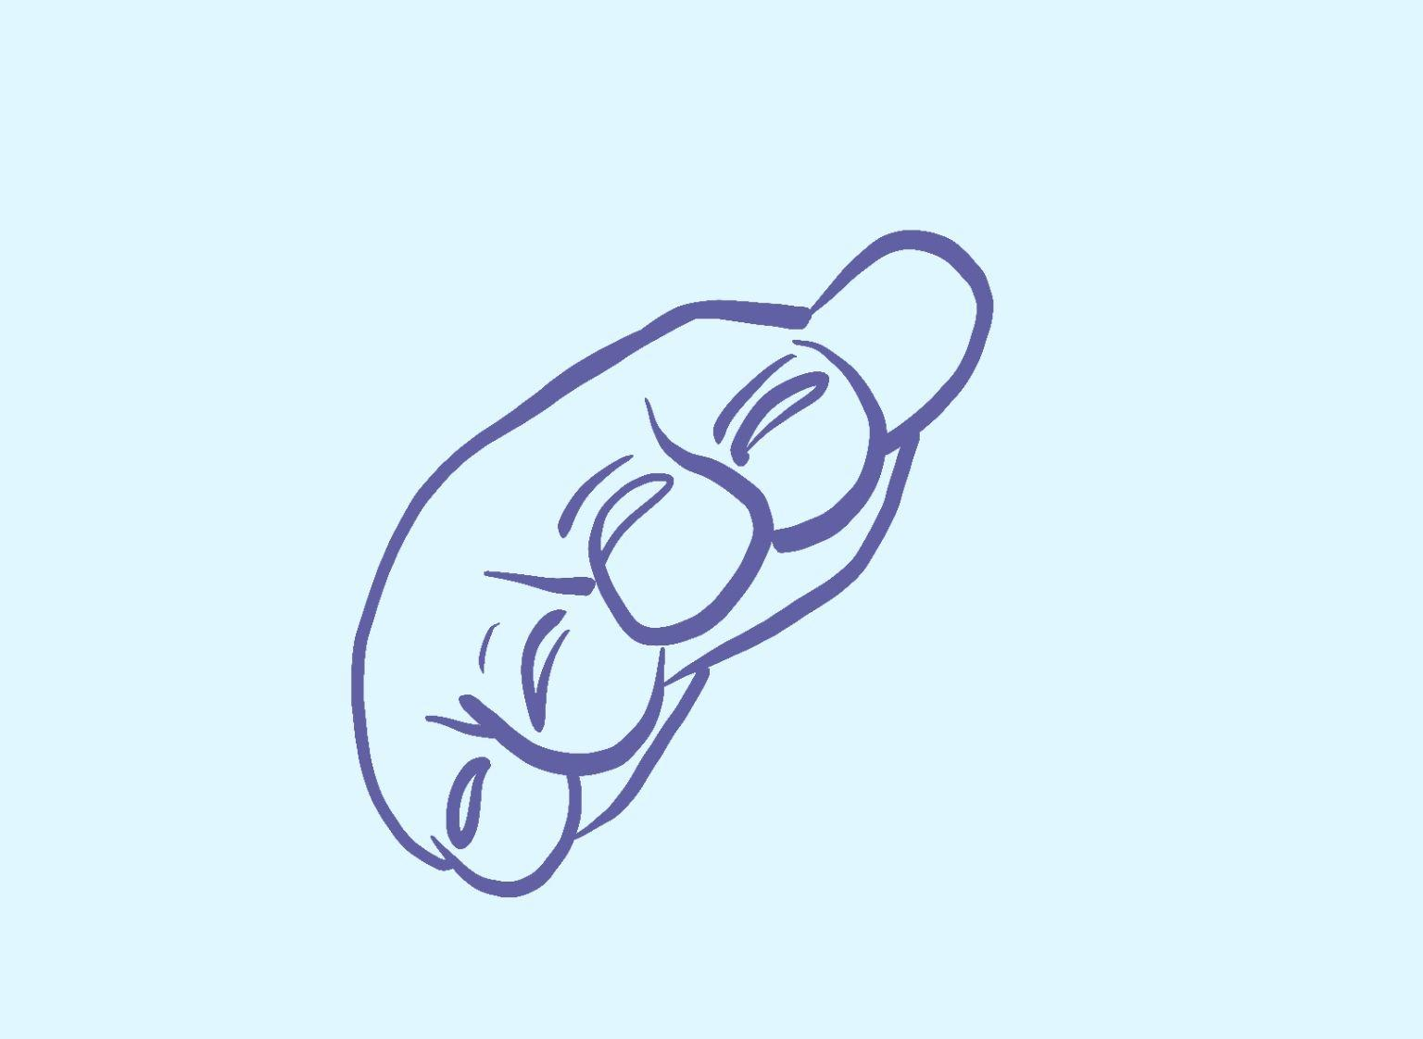
Act this out together:
What happens if we tilt our hand, thumb pointing upward?

Slide 8

Act this out together:
What happens if we tilt our hand, thumb pointing downward?

Slide 9
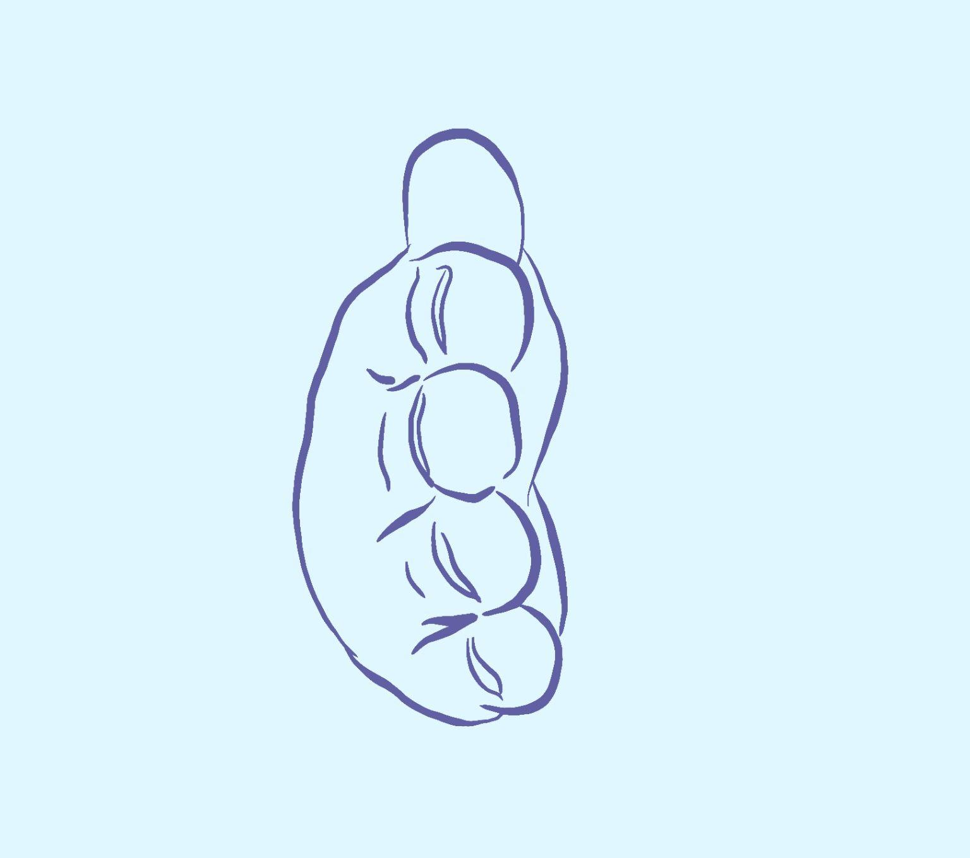
Act this out together:
Now our hand is out, fingers together, like we’re making a wall. What happens to our hand?

Slide 10
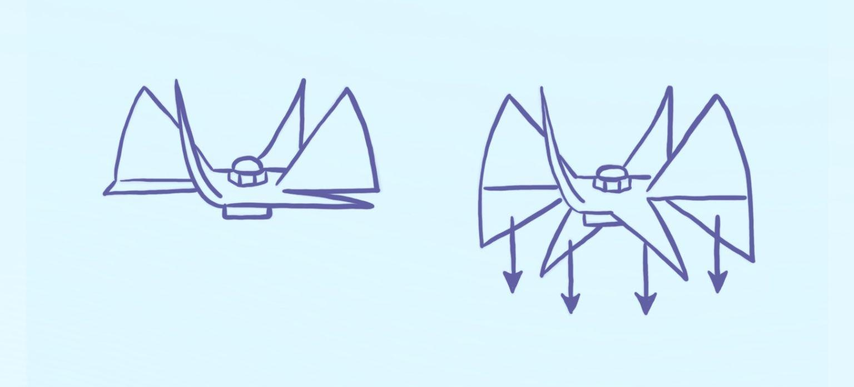
Designing the Wheel
To add more area to catch the wind, fold each left corner down

Slide 11
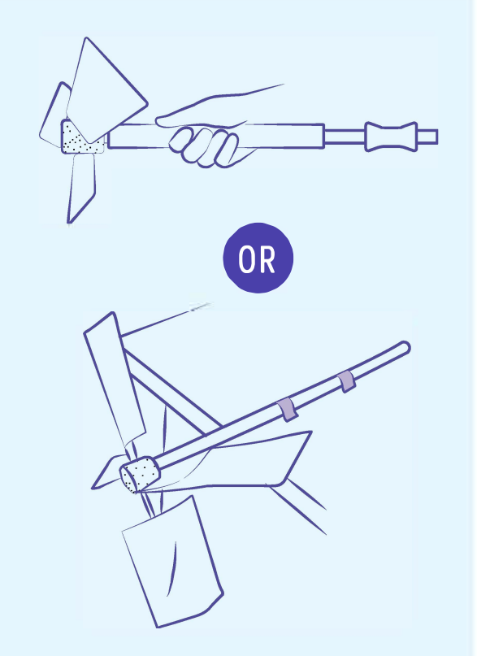
Part 1: Designing the Wheel
Create a blade design that you think creates the most energy.

Slide 12
Class discussion
➔ What is holding it back/preventing spin?
➔ What parts were most difficult to design and make functional?
➔ How did you attach your blades?
➔ Where is there friction in your design?
➔ How did you reduce friction in your windmill?
➔ How did you pitch or angle the blades?
➔ Were your blades changing pitch frequently?
➔ Did the fan work better from the front of the blades or the side?

Slide 13
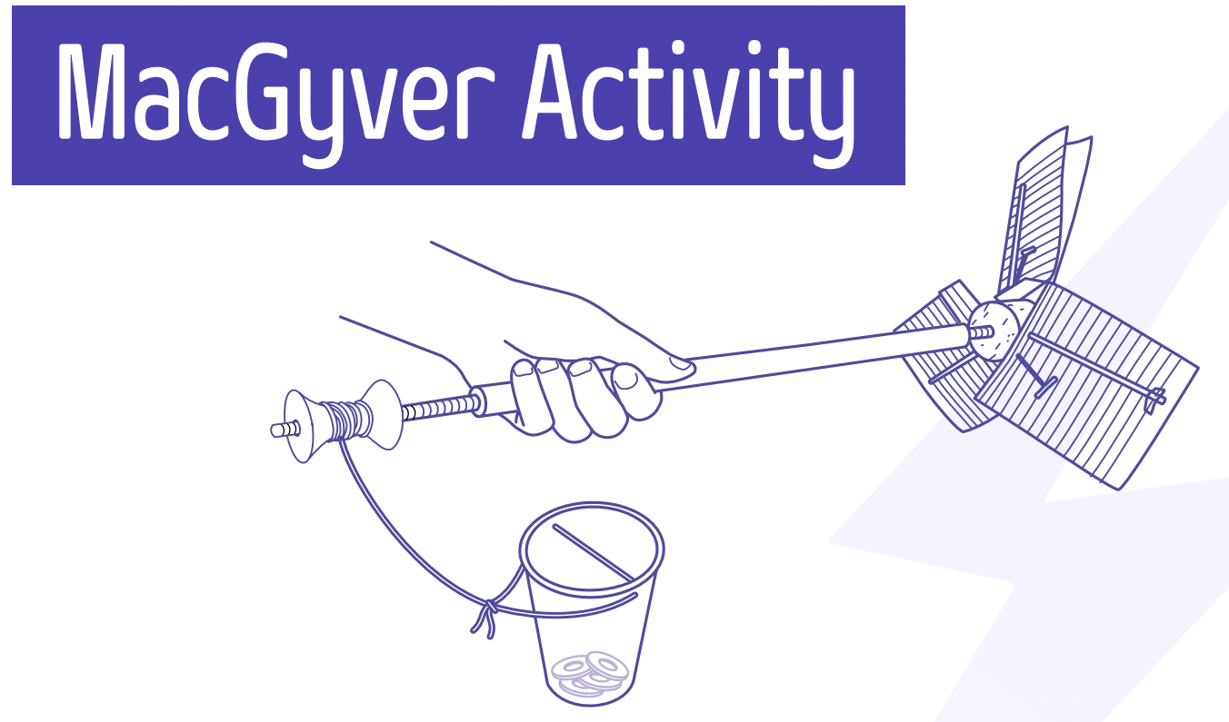
Part 2: Weight lifting challenge

Slide 14
Goal: to lift as many washers as you can
We are going to measure the wind wheel design by how many washers it can pick up.

Slide 15
The Design Process
Identify Problem
Brainstorm
Design
If it doesn’t work the first time, try and try again!
If it does work, how can you make it pick up
more washers?
Build
Redesign
Test & Evaluate
Share Solution

Slide 16
Let’s remember our variables
Independent Variable
(what is changed)
Dependent Variable
(what is measured)
Control Variable
(what conditions are kept the same)

Slide 17
Designing the Wind Wheel
Test in the fan to see if it spins. Let’s come up with some class rules for testing so that everyone has a chance to test and look at others’ designs.
1.
2.
3.
4.
Notes:
Part 7

Slide 18
Vocabulary

Slide 19
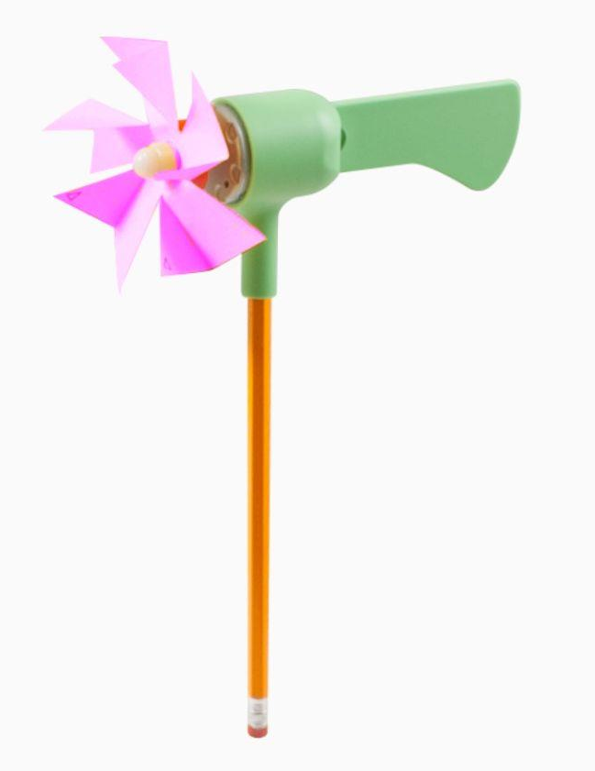
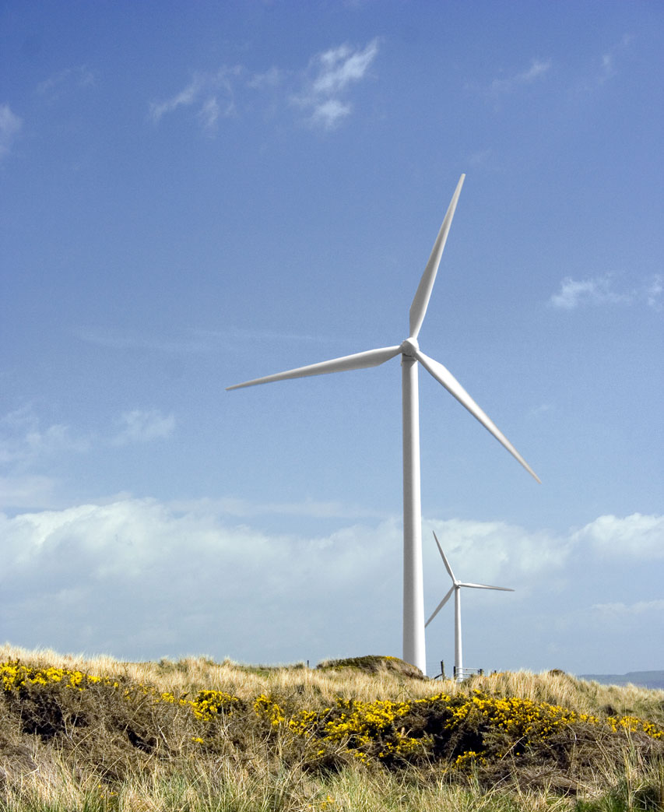
wind turbine
A human-made device engineered to spin in the wind in order to generate electricity
Our Firefly is a small wind turbine that spins in the wind and lights up an LED!

Slide 20
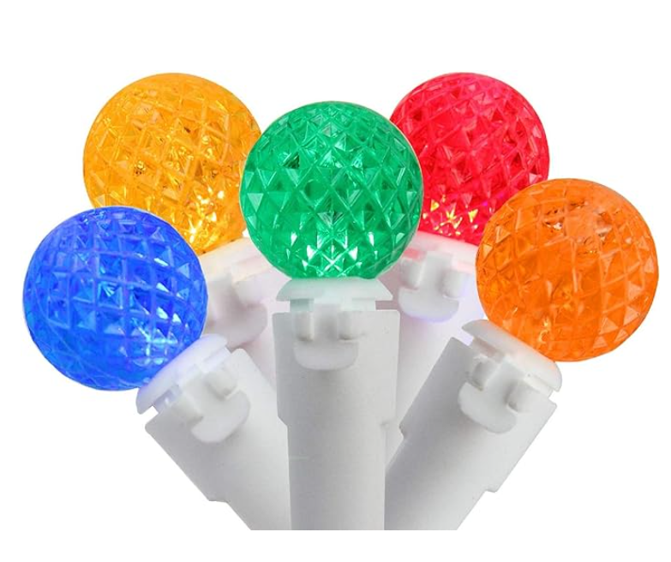
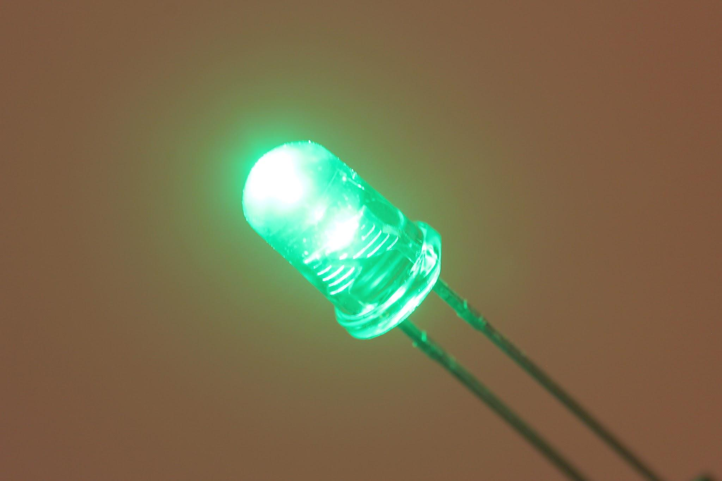
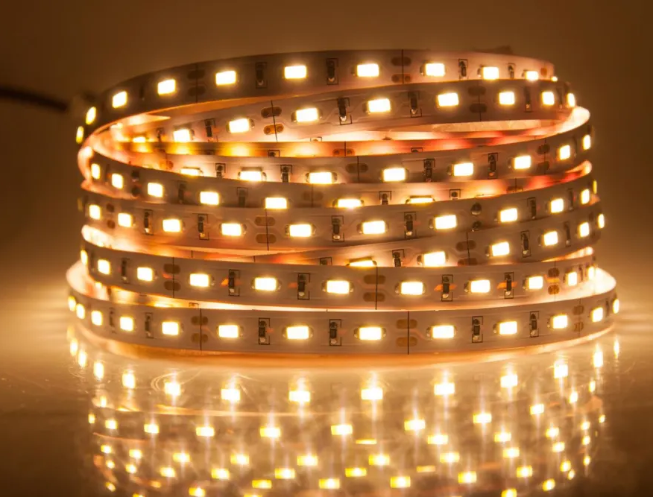
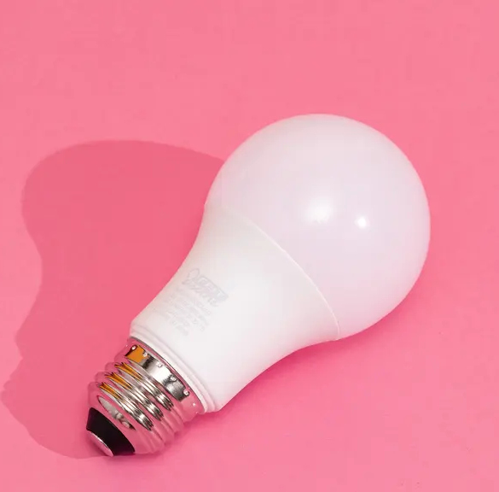
LED
LED stands for light emitting diode, which means it lights up like a light bulb. It uses electricity to light.

Slide 21
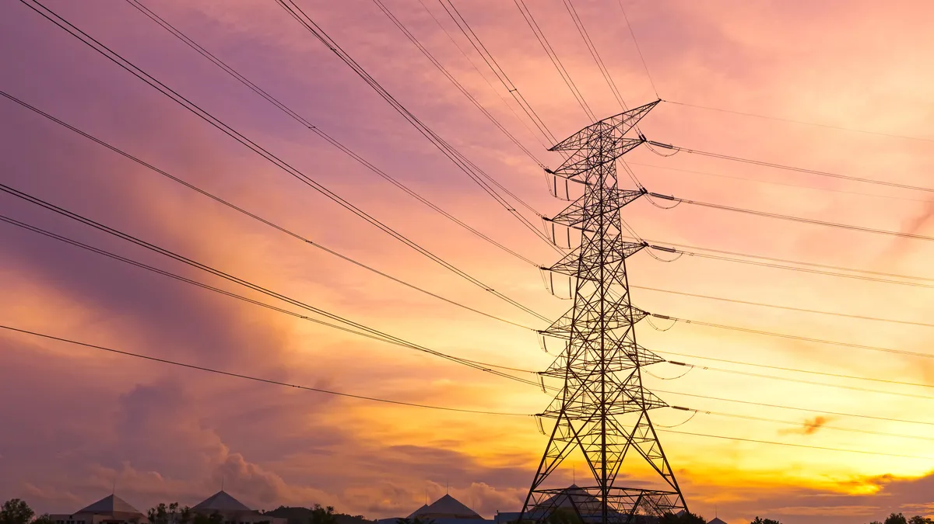
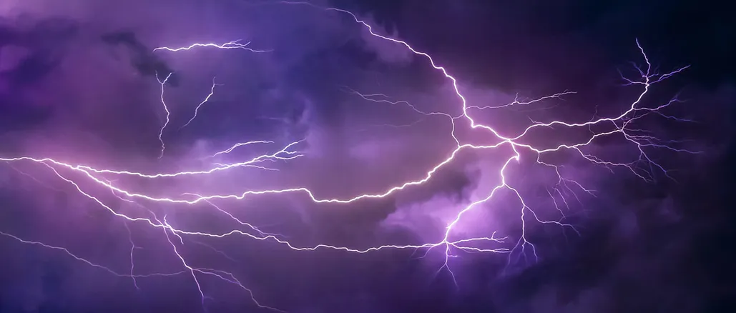
electricity
a form of energy used to light lights, turn on pumps, blow air and so much more

Slide 22
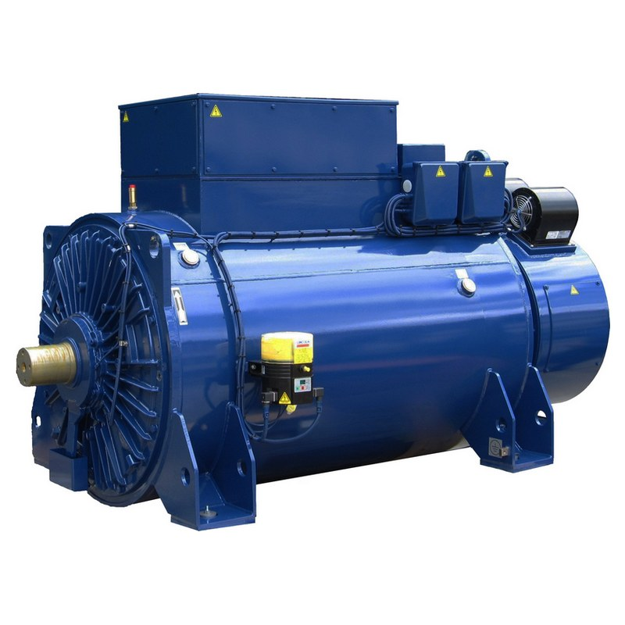
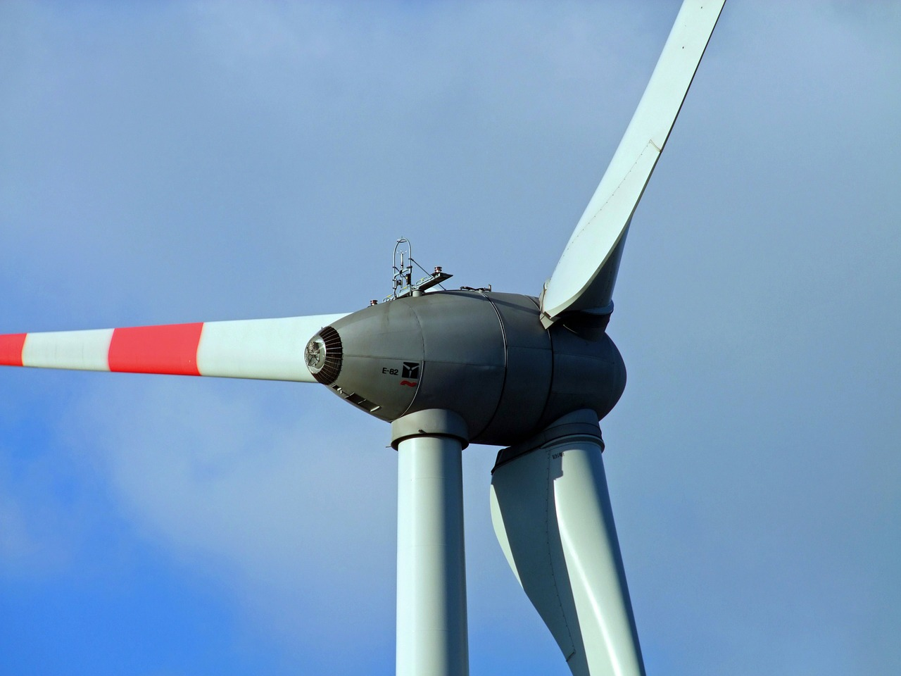
generator
A generator is made of magnets connected to a shaft and conductive wire (meaning electricity can move through the wire). When magnets are moved next to wire quickly, an electrical charge is generated that can power lights or motors.

Slide 23
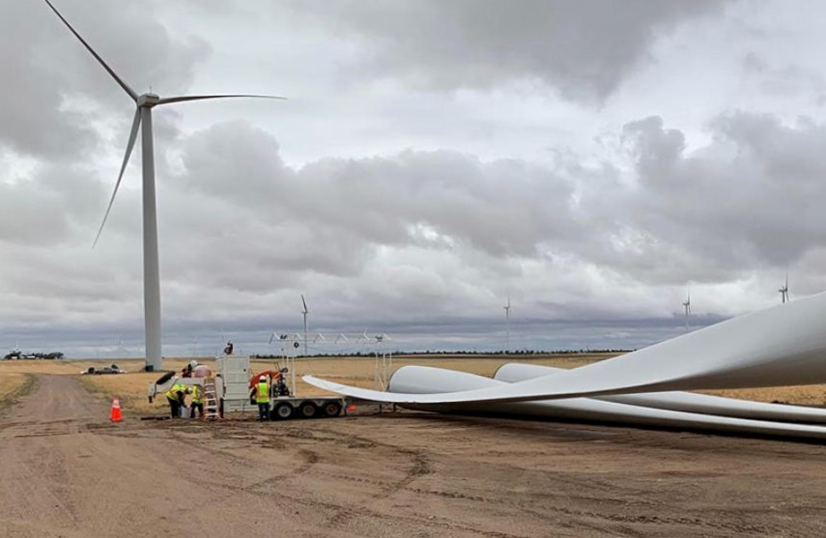
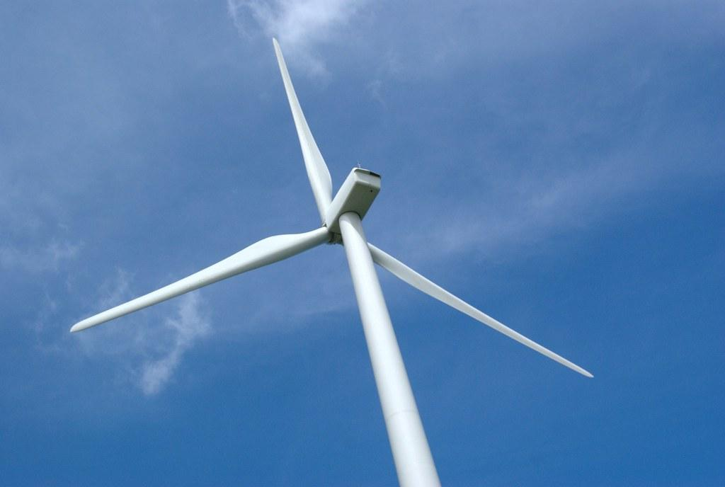
blades
the parts of the wind turbine that spin in the wind because of the way they catch the wind

Slide 24
Calculate how much energy is required to lift the washers!
Measure:
-mass (kilograms) of the washers
- height of the washers being lifted (meters)
Notes:
Extension activity

Slide 25
Energy (J) = Mass (kg) x Acceleration of Gravity (9.8 m/s²) x Height (m)
Notes:
Extension activity

Slide 26
Here are some other ways to provide background information needed for the MacGyver lesson!
Feel free to keep what you like and delete what doesn’t work for you.

Slide 27
What is polarity?
Notes:
Video explaining polarity from Mike!

Slide 28


Slide 29
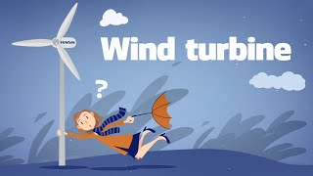

Slide 30
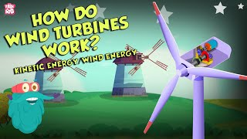

Slide 31
