Slide 1
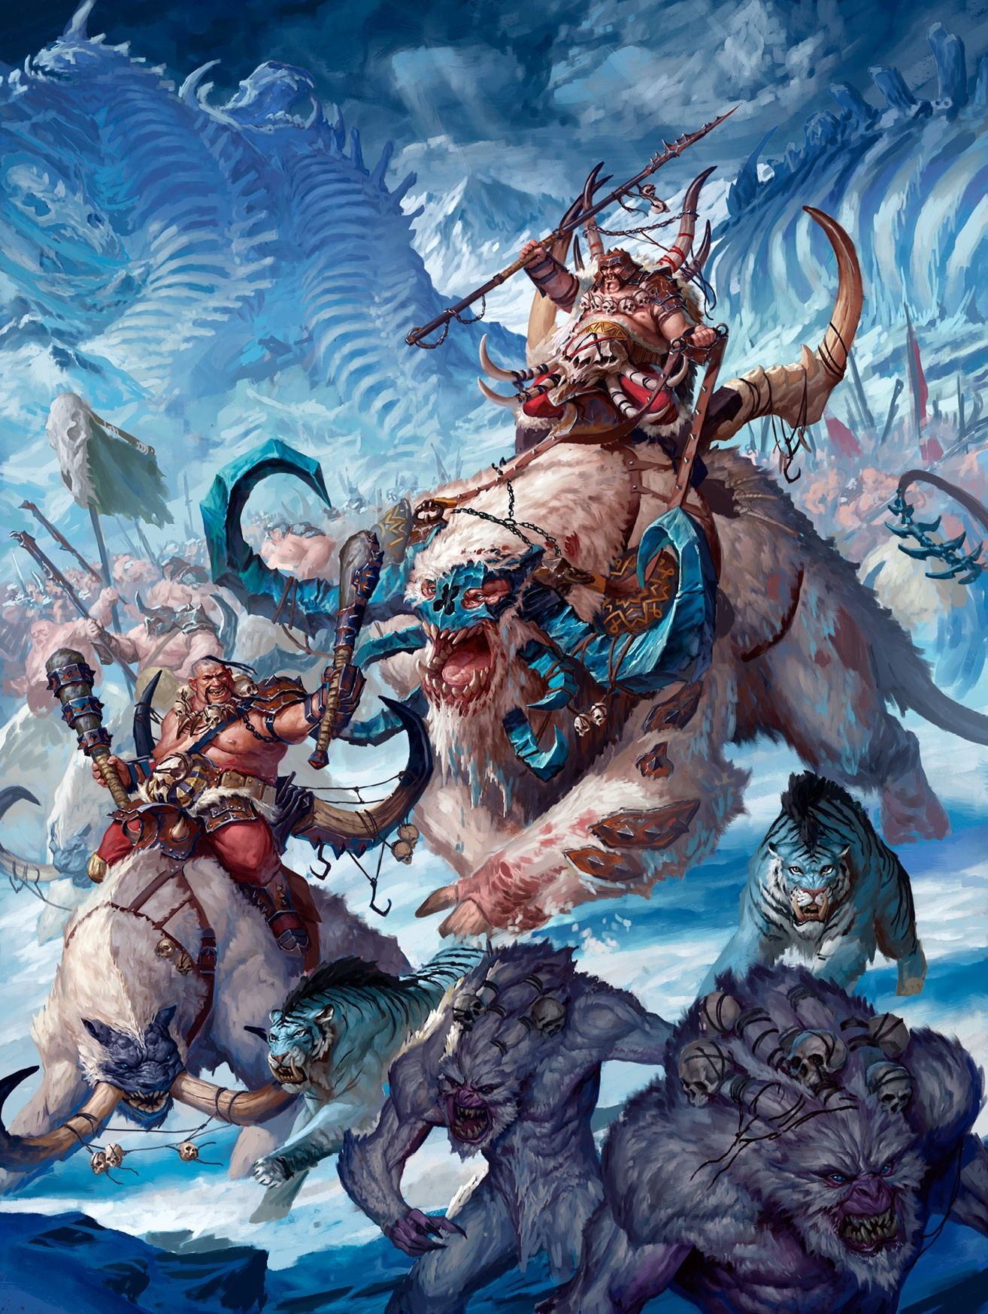


CAPITAL PUNISHMENT 2
Saturday 20th September
The Arena – Edinburgh
2000 pts Age of Sigmar Tournament

Slide 2
Location
Schedule
Arena
Customs House
65-67 Commercial St.
Leith
EH8 6LH
View on Google Maps
Please use the side door entrance.
Saturday 20th September 2025
9:15 – 9:30 Registration
9:30 – 12:15 Game 1
12:15 – 13:00 Lunch & Best Army
13:00 – 15:45 Game 2
15:45 – 16:00 Break
16:00 – 18:45 Game 3
18:45 - 19:00 Awards
Tickets
Tickets are £18. Please send payment via PayPal Friends and Family to sam.mcgrath1997@gmail.com. Tickets will be non-refundable after 23:59 on Friday 12th September 2025.
Lunch is not included. There are loads of places nearby for picking up lunch. Which you can bring back to the venue. While you are out for your lunch please visit Valour games one street away from the arena for all your hobby needs. (set to open Q3 2025)
There are 24 places available.
Please include names & email addresses of all players being paid for.
What to bring
Your army
A copy of your full army list to show each opponent (paper or electronic).
Objective markers (diameter 40mm). Acrylic or mouse mat 3” zones are even better.
Age of Sigmar 4 Core Rules, Current version of the General’s Handbook, and the most recent FAQs (paper or electronic).
Full Warscroll and Formation rules for your army (paper or electronic).
Dice, Tape Measure, Pen, Paper, Glue.
Wound and effect markers.
Updates
The tournament organiser (TO) Sam McGrath can be reached at sam.mcgrath1997@gmail.com
The event will be run on Milarki

Slide 3
Format
This is an Age of Sigmar event & will use the newest version of the ‘Core Rules’.
The event will use the ‘Battlepack: Pitched Battles’ from ‘the current version of the General’s Handbook on the date of list submission.
Armies must be constructed using the restrictions for a 2000 point game.
All Battleplans are from the current version of the General’s Handbook on the date of list submission.
All latest GW FAQs (Designer’s Commentary & Errata), Battlescroll & White Dwarf Battletome updates issued until list submission will be in play.
If multiple versions of any Warscroll or Battletome rules exist, the most recent version must be used.
Any Battletome issued before list submission will be in play.
Any rules queries regarding a Battletome without its official FAQ/Errata will be taken by the TO. Decisions will be based on providing the least possible benefit to the Battletome without its official FAQ/Errata
Players will be randomly paired for Round 1 except for any grudges. Further rounds will be based on gaming scores.
Grudges are allowed and encouraged. (grudges must be formally accepted)
Painting & modelling
Armies should be painted to Games Workshop’s Battle Ready standard in the General’s Handbook, in summary; minimum 3 base colours where possible, cohesive, shaded & have simple basing, Unpainted armies will be accepted however painted armies are preferred and encouraged
Models bases should be round or oval matching the current Games Workshop base sizes within the Warhammer Community FAQs
Conversions or models from other manufacturers will be allowed (in fact positively welcomed), these should be relatively comparable to the stock model in size & shape. Please contact the TO in advance for approval.
If you’re unsure that your army will be considered appropriately painted or based please contact the TO as soon as possible before the event.
Battleplans
Battleplans will be determined by TO from the current version of the General’s Handbook.
Battle plans will be revealed at the same time as list publication

Slide 4
Terrain & objectives
Objective markers should be placed so that their exact position is clear to both players.
Terrain will be placed players at the start of the game according to the battleplan maps.
The type of terrain (unstable etc.) should be agreed before the game starts and ideally marked.
Etiquette and Clean Play
AOS is a collaborative game clear communication is required to make the game work. Players should follow the “Player’s Code” from the General’s Handbook, in addition to this they should also adhere to the following rules:
Rolling Dice
Reroll any dice not flat on the table. Agree with opponent before the game if dice landing in scenery should be rerolled.
Announce all rolls before dice leave your hand, or before you remove any successes/fails. Failing to do so may result in the roll being discounted & you will be required to roll again.
Remove fails & allow opponent to witness successful rolls before proceeding.
Marking Status
Command points available should be marked and clear for both players
Wound/health markers should clearly marked near to the model, this can be done with tokens or dice. Please be clear with your opponent whether you are counting up or down.
Status and effects from abilities of spells or abilities should clearly marked near to the model.
Any additional “off board” abilities such as Tzeentch Destiny Dice or Kruleboyz Dirty Tricks should be clearly marked and available to both players.
Measurements
State intent and get your opponent's agreement before moving models.
Don’t change the game state if there is any doubt in a measurement. Please use proxy bases to check.
Declare if a model/unit is touching a zone (e.g. the range of an objective marker)
Declare if a model/unit intends to be inside/outside the range of an ability (e.g. wholly within 12” of another model)
Declare if a model/unit intends to be in or out of another units combat range.

Slide 5
Timekeeping
Players must endeavour to complete the full 5 turns within the allotted 2 hours 35 minutes for each game & should manage the time appropriately.
Chess clocks may be used on the agreement of both players. You will need to supply your own.
Please contact the TO if you feel your game is being affected by slow play, deliberate or otherwise.
No dice will be rolled after the round time limit has passed unless the TO has approved.
If a game won't be completed in time, the players should have a measured and pragmatic discussion, and any key rolls should be made to determine who would most likely have been the winner and the VP score calculated.
Games that have not been played or extrapolated with both players agreement will be judged as both players losing.
List Submission
Lists must be submitted on Milarki by 23:59 on Friday 12th of September 2025.
Upload the list in text format copied from Listbot or the Games Workshop Stormforge App (Listbot is a nicer format and probably has less mistakes in it).
The following must be specified on the lists & used for all 3 games:
  Army Faction
  Battle Formation
  Spell, Prayer and Manifestation selection
  Units including cost and a note of upgrades
  Clearly marked regiments
  Total number of drops
  Battle tactics
Lists including the reserve player will be published in the week before the event.
Prizes
There isn’t much in the way of prize money, most of the profits will go towards improving events in the local scene going forward. There be prizes for the below three people.
Champion
The player scoring the most wins;
  First tie breaker VPs Scored
  Second tie breaker Battle Tactics Scored
  Third tie breaker will be Strength of Schedule
Best Painted
The player with the most votes from the shortlisted armies.
Best Sports
Sponsored by valour games

