Slide 1
Tafseer Week 5 Surah Al-Quraysh Surah Al-Fīl- The Elephant

Slide 3
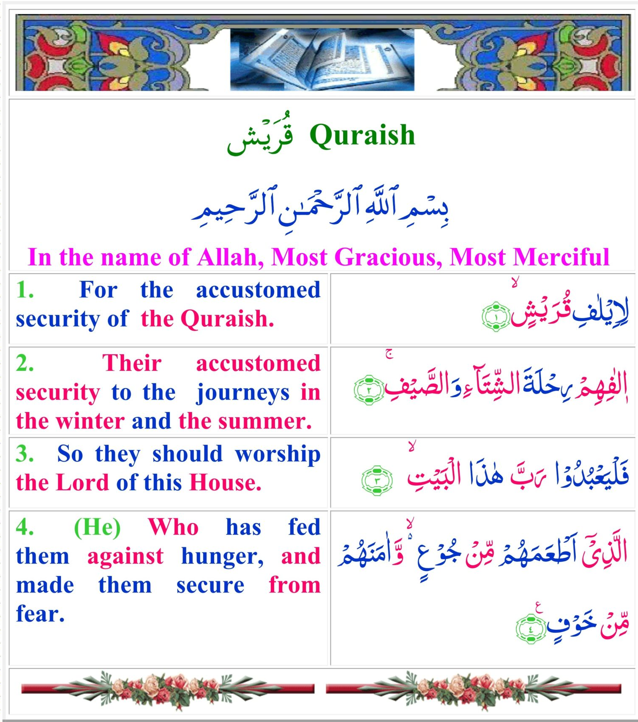

Slide 4
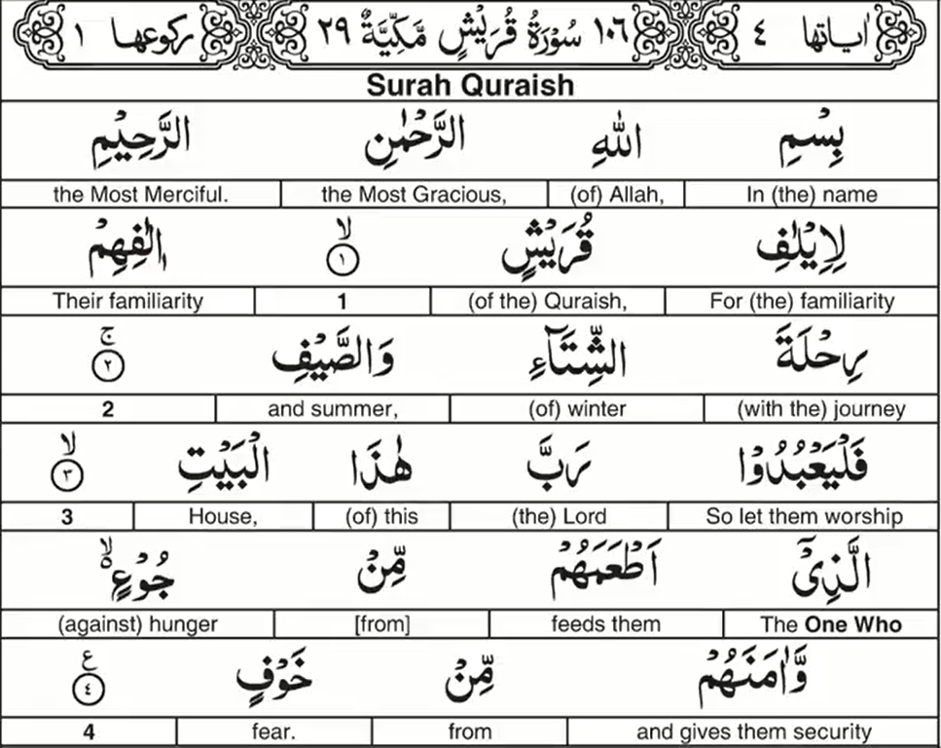
Surah Al-Quraysh Word by Word Translation

Slide 5
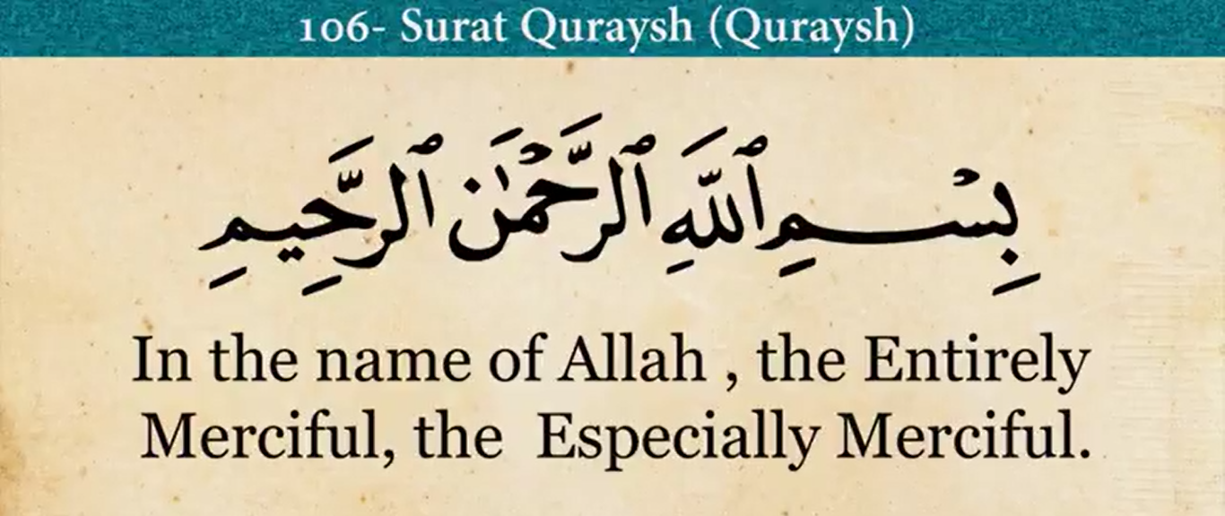
Surah Al-Quraysh

Slide 6
Surah Al-Quraysh
Period of Revelation: Makkan
Surah Number: 106
Order of Revelation: 29
Number of Ayahs: 4
Theme and Subject Matter:
Safety against fear
To remove harm
To give benefit
When you recognize Allah’s favors – you have to be His slave to show appreciation

Slide 7
Surah Al-Quraysh Ayah 1

Slide 8
Surah Al-Quraysh Ayah 1
Li – for
Eelaaf – Ulfa – to have a soft heart and make feelings of affectiontowards someone.
Eelaaf – to make love happen immediately.
Ta/leef - to make love happen gradually.
Allah has – for sudden affection (Eelaaf) from the Quraysh –
He has given them many favors, even destroying the army of Abraha.
Abu Zayd: the entire surah al Feel – every individual aayaat of the previous surah is connected to the first ayah of this surah.

Slide 9
Surah Al-Quraysh Ayah 1
Quraysh – taqarrush – to gather people from many distances.
1st: They were a gathering of many dispersed people by the man al Muj’im
2nd: Qarsh – A massive beast in the ocean.A whale or octopus that can destroy ships
QuraYsh is a tasgheer/smallened version of this big powerful beast. I.e. They are big and powerful, but they are smaller than it
Ibn Abbas was askesd why are they called Quraysh? He replied; Because the beast in the ocean eats – but it is not eaten. It overpowers, but it cannot be overpowered. And this is the case with Quraysh.
3rd: Qarsh – to earn (qasb) – they’re called that because of their constant trading and travelling in the land

Slide 10
Surah Al-Quraysh Ayah 2

Slide 11
Surah Al-Quraysh Ayah 2
The Eelaaf is repeated in the second ayah – Why?
To emphatically declare with emphasis – a strong emphasis. (i.e. Did you hear what I said, Did you hear?!)
Repetition is done in classical arabic to emphasise what Allah said. I.e. For their Elaaf (soften their heart, did you hear – to soften your hearts!)
Allah did the following favours for the Quraysh;
He destroyed Abraha’s army for them
He gave them the house of worship
They are descendants of Ibraheem
Allah sent His final Messenger (sal Allah alayhiwasalam) to them.

Slide 12
Surah Al-Quraysh Ayah 2
Rahla – rihl – merchandise. merchandise / baggage – journey where you carry a lot of bags- i.e. They sell so they pack alot of bags.
So when you travel with camels – people will see all their products loads of bags of merchandise for trade – yet none robs them and whenever they wanted to – they could stop their trade for holidays.
Other people had to travel because they could die if they never had food and trade.
The Quraysh were so rich in their trade – they could stop whenever they wanted to.
Ikrimah: The Quraysh went to Busra and Yemen. They would switch with going to one in summer and the other in winter simultaneously.

Slide 13
Surah Al-Quraysh Ayah 2
Some say Allah criticized them for that, and that they should have stayed in Makkah since the wealth was coming to them anyway.
They were business people and Allah exposed how they liked going to Syria (Sham), and they made alot of poetry about that. In the winter they would go to Yemen because it is extremely hot there, even in Summer, and they would go to Syria in summer because it is cooler there.

Slide 14
Surah Al-Quraysh Ayah 2
Allah mentioned winter first, and summer second.
Winter is associated with lack of produce, and summer is related to produce growing.
Allah mentions winter first because it is miraculous that they even get produce and food for the winter – a special favour of Allah to them.
at-Tabari and Qurtubi: the winter is associated with lack of food, and the warm climate was when the thief tribes would steal from caravans (they would stay inside in the winters because it was really cold then.)

Slide 15
Surah Al-Quraysh Ayah 3

Slide 16
Surah Al-Quraysh Ayah 3
The favors of Allah cannot be counted, and if they cannot – then at least worship Him for this one big favor through which Allah has given you an easy lifestyle.
That is the manifest favor of Allah upon them that their economy can survive.
It is also connected because Allah protected this house from Abraha’s army.

Slide 17
Surah Al-Quraysh Ayah 3
Why did Allah mention ‘that house’ (hadhal bayt)? Because Ibraheem built it – that’s what gives them this status in the sight of the Arabs – so they are not attacked in trade.
This is the house which boosted and increased their economy – because they told the other nations that all the Arabs unite their.
It is that house which Allah protected against Abraha.
And it was that house – when Ibraheem built it – he said Allah make it a house of security and provide it with foods.

Slide 18
Surah Al-Quraysh Ayah 4

Slide 19
Surah Al-Quraysh Ayah 4

Slide 20
Surah Al-Quraysh Ayah 4
Ibn Abbas: referring to Quraysh who were provided with food – based on the du’a of Ibraheem.
az-Zamakhshari: the taNween (nakira) on Joo’iN and khawfiN implies that Allah protected them from the worst types of fear and worst types of hunger (shadeed – severe).
Because before the caravans – they would be in extreme hunger. And Allah protected them from the fear of being destroyed (ie. The army of Abraha – the elephant). Or the fear of being snatched and kidnapped when they travel.

Slide 21
Surah Al-Quraysh Ayah 4
Min joo’ [from hunger] – provides them; despite hunger, He gave them food, when there is no land fertile land for fruit, crops etc. in the barren dry city of Makkah
And there is no real security there either – except because Allah has given it. Because Makkah is in the middle of the desert – it should really be open to attack. But despite that – Allah has given them security
min joo’ [from hunger] – tab’eed [distancing] – Allah put hunger and fear FAR away from them because they have full confidence Allah will protect this city

Slide 22
Surah Al-Quraysh Ayah 4
Allah favors them with safety and gentleness, so they should single Him out for worship alone, without any partner.
They should not worship any idol, rival or statue besides Him.
Therefore, whoever accepts this command, Allah will give him safety in both this life and the Hereafter.
However, whoever disobeys Him, He will remove both of them from him.

Slide 25
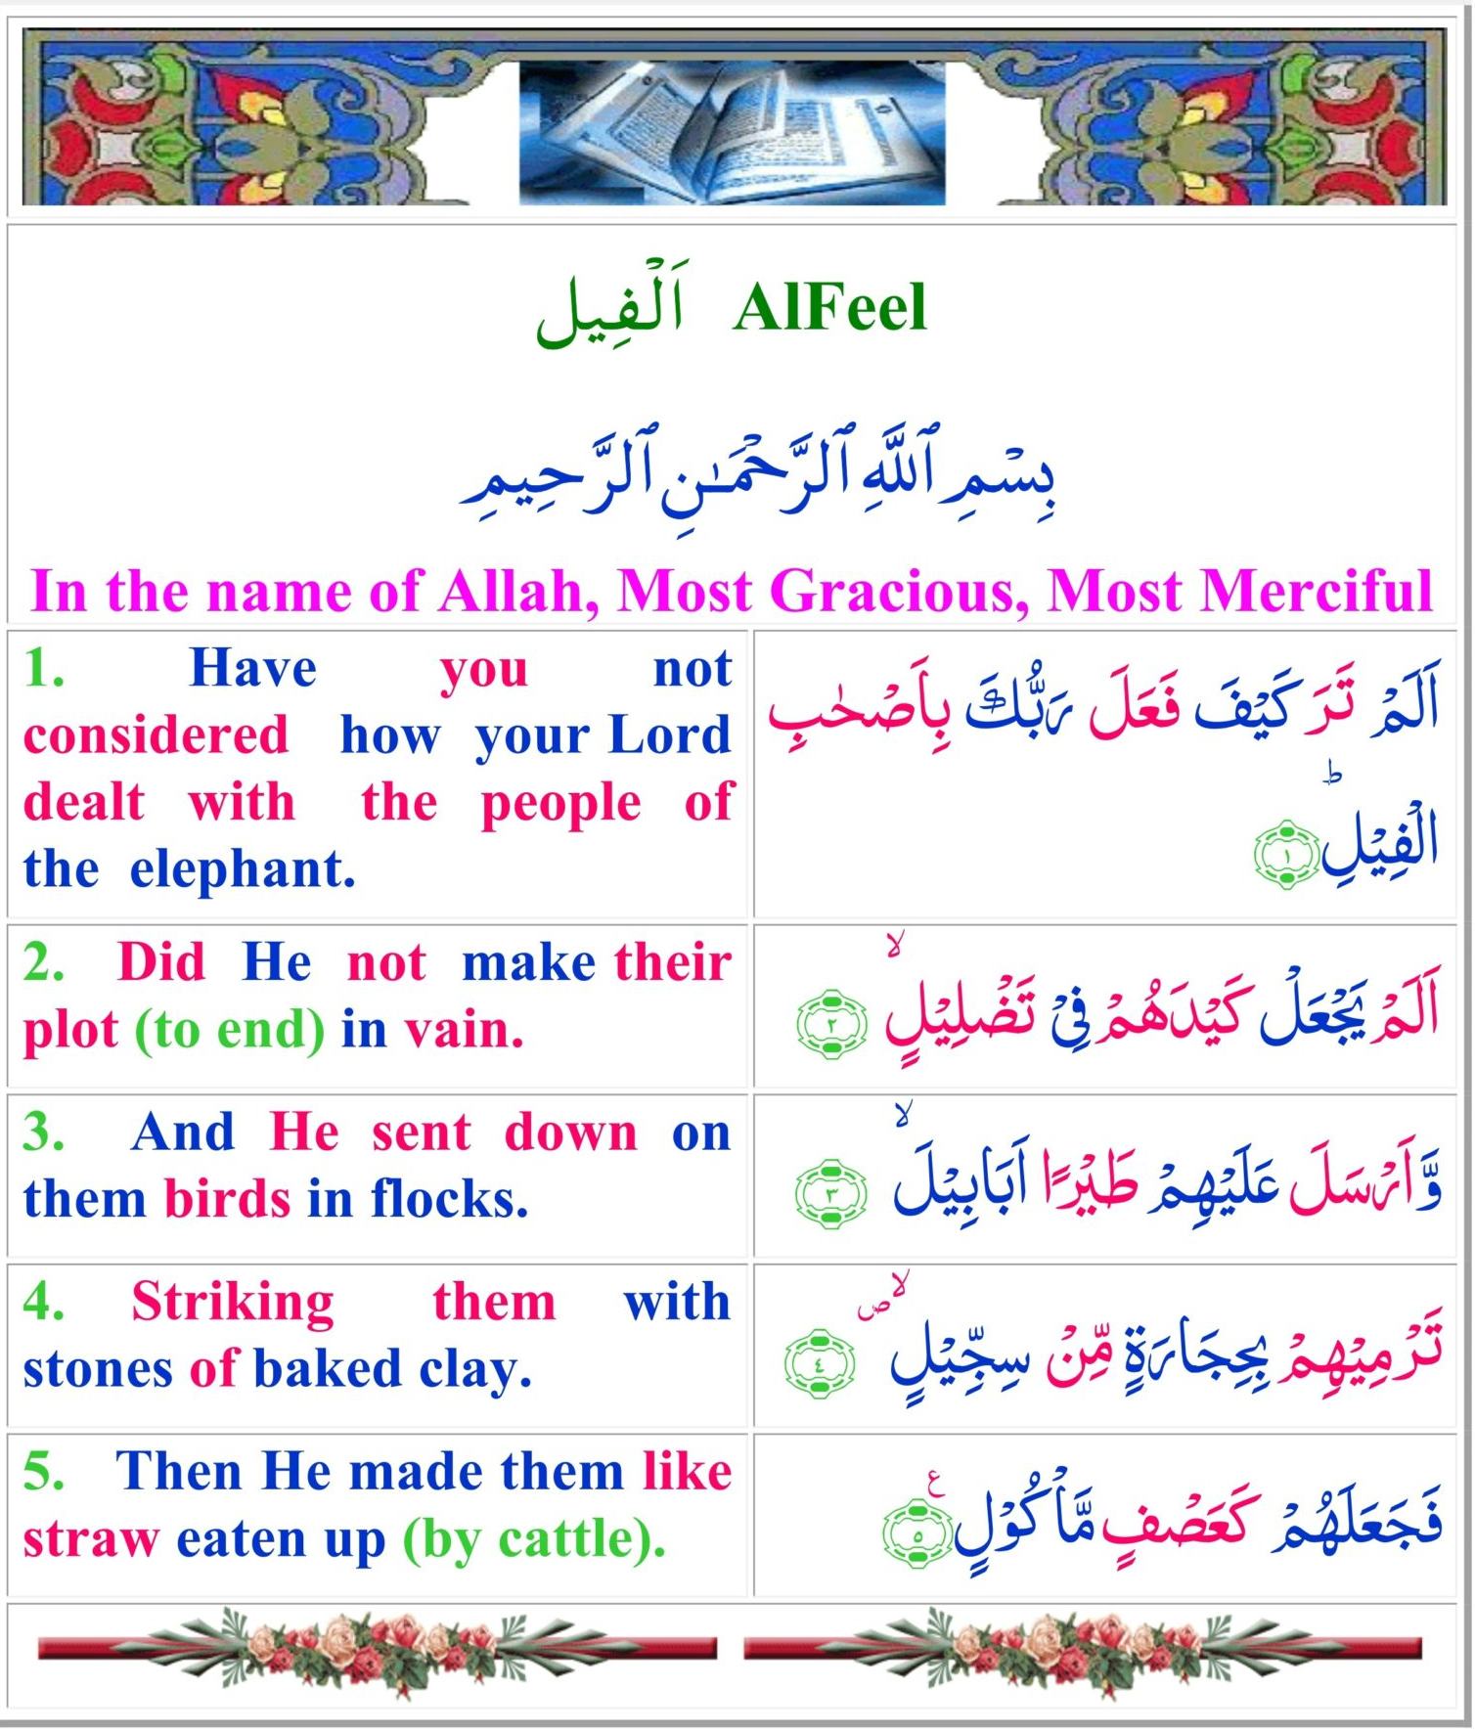

Slide 26
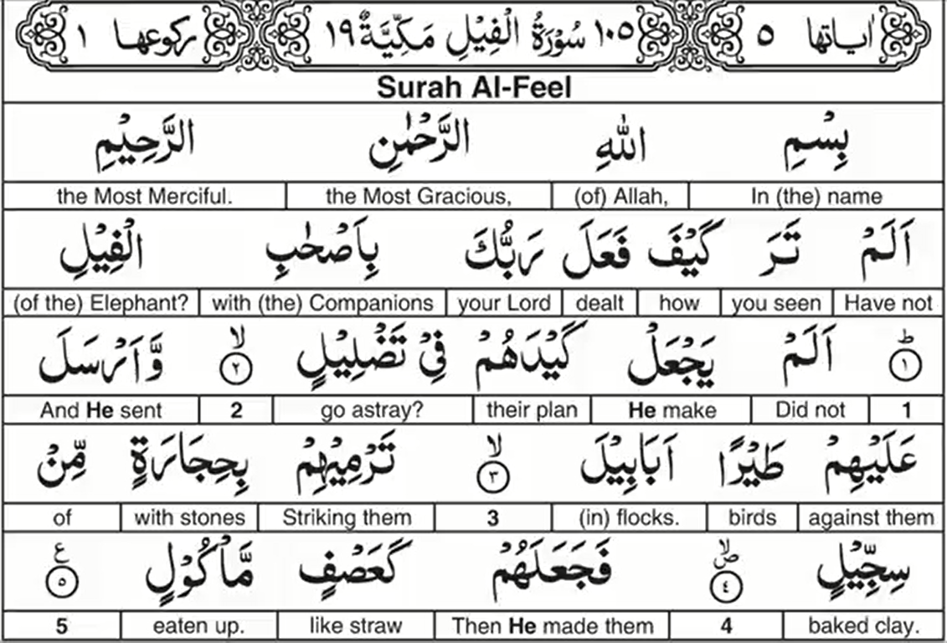
Surah Al-Fīl- The Elephant Word by Word Translation

Slide 27
Surah Al-Fīl- The Elephant

Slide 28
Surah Al-Fīl- The Elephant
Period of Revelation: Makkan
Surah Number: 105
Order of Revelation: 19
Number of Ayahs: 5
Theme and Subject Matter:
The Ka'ba had been protected
People who try to cause harm to the Kaba will be destroyed
Allah shows His might by destroying a colossal army with feeble birds

Slide 29
Surah Al-Fīl- The Elephant
An army of Elephants, arabs had never seen them in battle before. This was so strange and different to the Arabs that they called this year - 'Aam al Feel - The Year of the Elephant.
How are they going to fight an army of Elephants?
So when you see the army of Elephants - you knew the peace of of Makkah had broken. There was fear. Elephants were like war Tanks.
The people of Makkah fled to the Mountains. Except a few who tried to negotiate with Abraha.

Slide 30
Surah Al-Fīl- The Elephant
The people of Makkah fled to the Mountains. Except a few who tried to negotiate with Abraha.
None thought the peace in Makkah would remain. Abraha - the one who was the leader - had the main intent to destroy the Ka'bah and the city of Makkah.
Under the most impossible of circumstances - Allah kept the du'a/prayer of Ibraheem answered - He kept the city safe by destroying Abraha and his army.
This is the du'a/prayer of Prophet Ibraheem "Our Lord! And make us submissive unto You and of our offspring a nation submissive unto You, and show us our Manasik (all the ceremonies of pilgrimage - Hajj and 'Umrah, etc.), and accept our repentance. Truly, You are the One Who accepts repentance, the Most Merciful. (al-Baqarah 128)

Slide 31
Surah Al-Fīl- The Elephant Ayah 1

Slide 32
Surah Al-Fīl- The Elephant Ayah 1
alam taRa - did you not See?
alam taraW - did You (Plural) not see?
The scholars wondered whether this was referring other peoples individually, or to Allah's Messenger?
There is evidences for both. 1 - To Individuals or 2 - the Messenger is being asked

Slide 33
Surah Al-Fīl- The Elephant Ayah 1
1 - To Individuals:
wa bil waalidayni ihsaana - and be good to both your parents. (Surah al Isra' )
Allah's Messenger does not have two parents in his lifetime because they had died along time ago before this command was given.
This command is to other people. Even though the singular was used.
2 - the Messenger is being asked:
But Allah's Messenger did not see it then. He was born after.
so it can be in a figurative way; have you not heard, have you not realised how your Master dealt with the people of the Elephant?

Slide 34
Surah Al-Fīl- The Elephant Ayah 1
In the phrase Alam Tarra there are two benefits:
Something you see physically (literally) with your eyes, or you visualise with your mind (figuratively).
Alam Tarra - also Produces the meaning of Shock. Didn't you not see/hear about how your Master dealt with them?!
ash-Shawkani continues; Alam tarra kayfa - did you not see? (how Allah dealt with His enemies?) So the disbelievers should be aware that if they oppose Allah's Messenger, Allah can destroy them too. Just like He destroyed the people of the Elephant.

Slide 35
Surah Al-Fīl- The Elephant Ayah 1
Kayfa (how) is used for Amazement. How could it be that a massive army of strong elephants come to you and you have no army to defend your city - yet they are destroyed?
When a nations army dies abroad, the nation gets angry and sends more people to avenge them. However, Abraha did not die - he survived and made it all the way back to Yemen, so when the pebbles of Sijjeel hit him - they had peeled and burned his skin off as though he was melting (through which he gradually painfully died), so when he returned to his people - they saw his skin melting off and never wanted to avenge them - out of fear that they would get the same disease as him.

Slide 36
Surah Al-Fīl- The Elephant Ayah 1
RabbuKa - Your Master.
He didn't use the word Allah.
Allah is an Ism 'Aalam - a Name of Allah with ALL His Qualities included within it.
But Rabb signifies one main attribute of Being Master and therefore necessitating slavery. (it also signifies other Attributes like; al Mun'im [giver of favours], al Qayyim [powerful], al MuRabbi [Master], Mu'ttee [who gives alot]).
But the main concept of Rabb is Him being the Master, and us therefore being the slaves.

Slide 37
Surah Al-Fīl- The Elephant Ayah 1
RabbuKa - Your (singular 'you') Master.
Your Master (O Muhammad)
He mentions His Messenger, so He will protect him - just like He protected the Holy House in Makkah.
By saying Rabbuk - Your Master. Allah is implying that I am on your side (O Muhammad), and that I am enemies with your enemies. I can destroy them, just like I destroyed the enemies of this Holy House.

Slide 38
Surah Al-Fīl- The Elephant Ayah 1
Feel is the word for Elephant, and it is in singular form.
Why did Allah use the singular word Elephant, when we know there were between 9 to 13 elephants in the army (the plural for Elephant is aFyaal [Elephants].) So why didn't Allah use the word aFyaal?
1 - Because the army was known for the most famous Elephant which was huge/extremely big and the most famous of the elephants (known as Mahmood)
2 - Feel is a singular word which can refer to an entire category [Ism Jam'].
The Elephant People. Iddaafah (causes an Identification) - these people were associated with the elephants.

Slide 39
Surah Al-Fīl- The Elephant Ayah 2

Slide 40
Surah Al-Fīl- The Elephant Ayah 2
Alam
Didn't He make their plot go to waste?
the second: A lam - didn't He..?
This is further emphasis of Allah helping and reminding us of His favours.
yaj'al is also present tense. Showing Continuity - He took their plot, and took it to waste.
Showing that He will always do this - He will always make the plot of those who attempt to harm Allah's signs (religion etc.) go to waste.

Slide 41
Surah Al-Fīl- The Elephant Ayah 2
Ja'ala as opposed to Fa'ala in this ayah.
Ja'ala - take something and transform it into something else.
So Allah let them make their plan, prepare for it, train for it, march forward in their armies for it, then fully execute it, and then suddenly - Allah transformed it into waste.
Allah didn't alleviate it at the beginning. Rather - He let them think that the plan was working. Yaj'al - Allah played them along and failed and fooled them right at the

Slide 42
Surah Al-Fīl- The Elephant Ayah 2
The word Qayd is similar to Makr - a Plot (a plan made to harm someone). Military plans are Qayd, i.e. Ambush which is secret. Makr = deception in a Plan. I.e. You lead people on and you are decieving them. Didn't He take your secret plot and put it to waste? Qayd is used as an attempt to harm someone secretly. How come it's called when his plan was open in clear day time?

Slide 43
Surah Al-Fīl- The Elephant Ayah 2
Explanation:
Because they were hiding animosity in their hearts against the Makkans which they did not show to them
Society which revolves around religion, similar to secular nations who now call to patriotism to ones nationality. These people use these these calls (of religion or national loyalty) to incite people to fight another people - even though the battle is usually for Economic benefit. So Abraha called people to have war of faiths, but the real Qayd was for economic benefits.

Slide 44
Surah Al-Fīl- The Elephant Ayah 2
Dalaala (taddleel) - to waste, to destroy. So it is no longer useable at all. dal-la - to be lost literally, to place something somewhere and not be able to find it. Didn't We take put the efforts of the Ethiopians /companions of the Elephant go to waste?
Failures:
They built al Qul-lays (the Chrisitian temple - so people would worship at it) - that failed.
He tried to urge Arabs to love it like the Ka'bah - that failed.
It was burnt, and defecated on - another fail.
They planned and marched to take the Ka'bah and break it down - they failed.

Slide 45
Surah Al-Fīl- The Elephant Ayah 3

Slide 46
Surah Al-Fīl- The Elephant Ayah 3
abaabeel - herds upon herds upon herds.
When Abdul Mu'tallib made the du'a (prayer) to Allah, he saw flocks/herds of birds flying from the direction of Yemen (interestingly because the army of Abraha also came from Yemen).
He then said;
I swear by Allah, these are strange birds, they are not from Najd, nor are they from Tahhaam.
Each bird carried 3 stones, two in its feet claws, and one in its beak.
Then the stone that would land - would land on a person and hit their head and come out from the other side.

Slide 47
Surah Al-Fīl- The Elephant Ayah 3
Abu Ubayda said: Ababeel - multiple groups of different kinds (species).
an-Nuhaas (a great arabic grammarian in our Islamic history) said: The reality is that they are huge awesome flocks of many different kinds of birds / species.
They were coming from every part of the sky - so it was very dark in the sky.
Weightless birds destroyed an army of Elephants?
How can Allah use birds destroy an army?

Slide 48
Surah Al-Fīl- The Elephant Ayah 3
Tayr - used as a collective/plural noun = All kinds of birds. (in comparison to tayoor which would be many birds only) Tayran implies ALL kinds of birds.
Adding tanween on it - TayraN - showing they were many birds of different kinds and to terrify.
This exclamation of tanween which had guided shooting stones - they did not hit you. But you were there - what if they had hit you?

Slide 49
Surah Al-Fīl- The Elephant Ayah 4

Slide 50
Surah Al-Fīl- The Elephant Ayah 4
tarmee - Ramee - to throw.
tarmee - present tense is being used. For present tense to be used to describe a past event = it was happening continuously.
The pebbles kept coming down continuously.
If Ramat (past tense of Tarmee) was used - it would imply that the birds only threw once.
But it kept coming down continuously like rain.

Slide 51
Surah Al-Fīl- The Elephant Ayah 4
bi hijaaratin..With stones
min sijjeel / from sijjeel Sijjeel was originally a Farsi (Persian) word, and gradually became an arabic word.
Sange Gil (Sijjeel in arabic) in Farsi refers to pebbles which form on the ground when it rains, the sand clogs up like mud. Then it is baked with the extreme heat of the sun.
So sijjeel could refer to these dust based rocks.That which is weak/powerless - Allah can destroy the strongest of things. He destroyed an army of Elephants by dust and birds.

Slide 52
Surah Al-Fīl- The Elephant Ayah 4
Ibn Abbas: When the pebble would fall on anyone of them - it causes swelling and it burns and infects their skin.
The first time a plague hit the Arabs - it came from this attack and the rotting corpses.
This is one of the worst calamities to have hit the Arab world in that location.
The pebbles would enter into the skulls. And the pebble would go in from one side and come out from the other side. This was like a really strong bullet.

Slide 53
Surah Al-Fīl- The Elephant Ayah 5

Slide 54
Surah Al-Fīl- The Elephant Ayah 5
Ja'ala - you have something and make it into something else, i.e. transformed Wood into a table.
Ja'ala - make from one form to another. Allah has made this strong army into like totally weak and dead empty corn stalks.

Slide 55
Surah Al-Fīl- The Elephant Ayah 5
"Ka" as an independent word = 'Like/similar to.‘ (tashbeeh - likeness)
Allah describes us so we can imagine how this massive army transformed into like;
Asf - 'Aasif - winds which blow and cut off crumpled up leaves.
Reeh al 'Aasif - which blows leaves in the air.
'Asf also refers to straws which fly in the air.

Slide 56
Surah Al-Fīl- The Elephant Ayah 5
Ma/kool - that which is eaten. When cattle eat food, and when it eats a big piece, some part of it comes out of its mouth and flies into the air. The remains is called 'Asf al Ma/kool. That's how they were crushed and destroyed. Really grinded and chewed. This is how He transformed them. It can also mean: Ma/kool - that which is supposed to be eaten.

Slide 57
Surah Al-Fīl- The Elephant Ayah 5
That which is about to be eaten up by its enemy. It is defenseless. Just like that animal is about to be eaten and it is defenseless, just like the hay and grass is defenseless before the cattle eat it.
These people were about to be eaten - about to be destroyed - and they were defenseless and weak.
Or these are the straws which the animals eat.
ash-Shawkani: Allah sent birds which threw pebbles made of clay baked into stones - so they became like eaten chewed up straws.

Slide 58
