Slide 1
Tafseer Week 10 Surah al-Qadr - Power

Slide 3
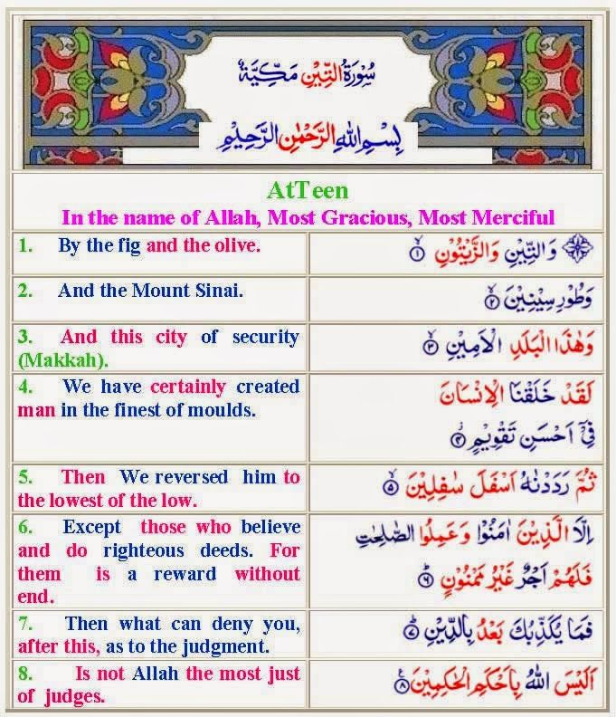

Slide 4
Surah al-Qadr - Power Word by Word Translation

Slide 5
Surah al-Qadr - Power

Slide 6
Surah al-Qadr - Power
Period of Revelation: Makkan
Surah Number: 97
Order of Revelation: 25
Theme and Subject Matter:
This Surah is to acquaint man with the value, worth of the Quran
Importance of the Qur'an
The Night of Qadr (destiny)

Slide 7
Surah al-Qadr - Power Ayah 1

Slide 8
Surah al-Qadr - Power What is the meaning of Qadr?
Qadr - Commonly translated as 'Night of Power'.
Because Qadr means Estimation and Determination. - Allah knows everything, so He informs His angels what He has decreed for the people for this upcoming year.
Qadr - nobility/honor/dignity - because of the Night's Dignity
Qadr - to Appreciate - in this Night those who obey Allah, Allah really Appreciates it. He counts this night as more than 1000 months

Slide 9
Surah al-Qadr - Power What is the meaning of Qadr?
Qadr - constriction / congestion / to be stuck in something. [see al Fajr 89:16] It's called this because SO many angels are sent down to the Earth on this Night, that the Earth is filled and congested / packed with angels on this Night
Qadr - Power.
All these meanings are embedded within the one word; Qadr.

Slide 10
Surah al-Qadr - Power Why does Allah use the plural?
Inna – We
Plural was used in semitic languages to show power and strength
I.e. A king wouldn't say "I have forgiven you", he would say "We are letting you go." "We have decided" (even though he was talking about himself)
A show of power, of royalty - a show of my strength being more than that of many men.

Slide 11
The Virtues of the Night of Al-Qadr (The Decree)
Allah informs that He sent the Qur'an down during the Night of Al-Qadr, and it is a blessed night about which Allah says,
إِنَّآ أَنزَلْنَهُ فِى لَيْلَةٍ مُّبَرَكَةٍ - We sent it down on a blessed night.) (Ad-Dukhan 44:3)
This is the Night of Al-Qadr and it occurs during the month of Ramadan.
This is as Allah says, -شَهْرُ رَمَضَانَ الَّذِى أُنزِلَ فِيهِ الْقُرْآنُ - The month of Ramadan in which was revealed the Qur'an.) (al-Baqara 2:185)

Slide 12
The Virtues of the Night of Al-Qadr (The Decree)
Ibn ʿAbbbās and others have said, "Allah sent the Qur'an down all at one time from the Preserved Tablet (Al-Lawh Al-Mahfuz) to the House of Might (Baytul-`Izzah), which is in the heaven of this world. Then it came down in parts to the Messenger of Allah based upon the incidents that occurred over a period of twenty-three years.''

Slide 13
Surah al-Qadr - Power Ayah 2

Slide 14
Wisdom behind the Night of Qadr being repeated
Then Allah magnified the status of the Night of Al-Qadr, which He chose for the revelation of the Mighty Qur'an
By Allah repeating the words 'Night of Qadr' again in the 2nd ayah, it shows the Night's strong importance
This gives the Night of Power a strong emphasis

Slide 15
Surah al-Qadr - Power Ayah 3

Slide 16
Why is Layla tul-Qadr hidden?
Laziness - people would only worship in this night and not in any of the other nights of the year
Removes Blame - The fact that we don't know the exact Night of Qadr - removes us from some blame, in comparison to if we knew when the Night of Qadr was, and if we were lazy then - that would bring us ALOT more blame
Eager to find it – Work hard in more than one night
Sahaba disputing and Allah making the forgetting of the exact night
Notes:
Imam al-Aloosi said: Made first two points
Imam Ibn Kahir mentions in his tafsir the thirs point

Slide 17
When is Layla tul-Qadr?
This is supported by what Imam Ahmad recorded from `Ubadah b. As-Samit that the Messenger of Allah said,
لَيْلَةُ الْقَدْرِ فِي الْعَشْرِ الْبَوَاقِي، مَنْ قَامَهُنَّ ابْتِغَاءَ حِسْبَتِهِنَّ فَإِنَّ اللهَ يَغْفِرُ لَهُ مَا تَقَدَّ مَ مِنْ ذَنْبِهِ وَمَاتَأَخَّرَ، وَهِيَ لَيْلَةُ وِتْرٍ: تِسْعٍ أَوْ سَبْعٍ أَوْ خَامِسَةٍ أَوْ ثَالِثَةٍ أَوْ آخِرِ لَيْلَة
The Night of Al-Qadr occurs during the last ten (nights). Whoever stands for them (in prayer) seeking their reward, then indeed Allah will forgive his previous sins and his latter sins. It is an odd night: the ninth, or the seventh, or the fifth, or the third or the last night (of Ramadan).
Notes:
Imam al-Aloosi said: Made first two points
Imam Ibn Kahir mentions in his tafsir the thirs point

Slide 18
Signs of when Layla tul-Qadr is?
The Messenger of Allah also said
إِنَّ أَمَارَةَ لَيْلَةِ الْقَدْرِ أَنَّهَا صَافِيَةٌ بَلْجَةٌ، كَأَنَّ فِيهَا ق مَرًا سَاطِعًا، سَاكِنَةٌ سَاجِيَةٌ، لَا بَرْدَ فِيهَا وَلَاحَرَّ، وَلَا يَحِلُّ لِكَوْكَبٍ يُرْمَى بِهِ فِيهَا حَتْى يُصْبِحَ، وَإِنَّ أَمَارَتَهَا أَنَّ الشَّمْسَ صَبِيحَتَهَا تَخْرُج
مُسْتَوِيَةً لَيْسَ لَهَا شُعَاعٌ، مِثْلَ الْقَمَرِ لَيْلَةَ الْبَدْ رِ، وَلَا يَحِلُّ لِلشَّيْطَانِ أَنْ يَخْرُجَ مَعَهَا يَوْمَئِذ
Notes:
Imam al-Aloosi said: Made first two points
Imam Ibn Kahir mentions in his tafsir the thirs point

Slide 19
Signs of when Layla tul-Qadr is?
The Messenger of Allah (peace be upon him) said
(Verily, the sign of the Night of Al-Qadr is that it is pure and glowing as if there were a bright, tranquil, calm moon during it. It is not cold, nor is it hot, and no shooting star is permitted until morning. Its sign is that the sun appears on the morning following it smooth having no rays on it, just like the moon on a full moon night. Shaytan is not allowed to come out with it (the sun) on that day.) This chain of narration is good.
Notes:
Imam al-Aloosi said: Made first two points
Imam Ibn Kahir mentions in his tafsir the thirs point

Slide 20
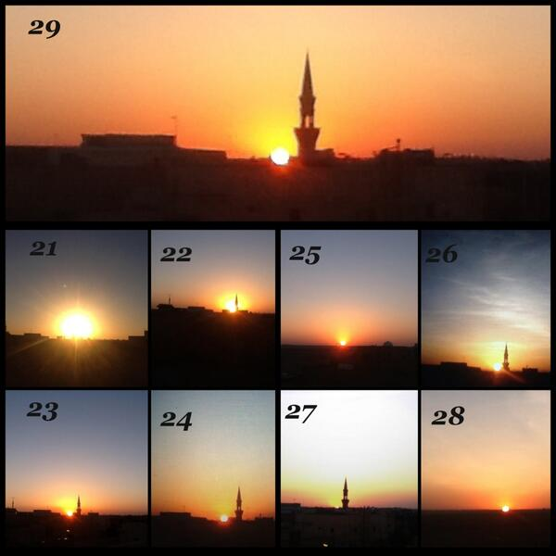
Signs of when Layla tul-Qadr is?
Notes:
Imam al-Aloosi said: Made first two points
Imam Ibn Kahir mentions in his tafsir the thirs point

Slide 21
Surah al-Qadr - Power Better Than a 1,000 Months
Deeds you do in this night is better than the deeds you do in more than 1000 months (around 83 years and 4 months).
The average lifespan in the USA at its peak is 80 for women, and 74 for men. So Allah is giving us a lifetime full of worships and reward within 1 night time.

Slide 22
Surah al-Qadr - Power Better Than a 1,000 Months
Allah is offering us a lifetime full of worship's reward, per every year in one night
So if we worshipped in the Night of Qadr for 50 years.
50 years multiplied by 80 years [1000 months] = 4000 years of worship's reward! It's like you worshipped Allah for 4000 years!

Slide 23
Why a 1,000 Months?
The mention of a “thousand” is to signify plenty;
The Prophet (peace be upon him) mentioned that a man from Bani Israel took arms in the name of Allah for a thousand years.
And the Muslims were in awe of this warrior, and they compared to him their efforts and found them to be deficient, so they were given the Night of Qadr as it is better action and reward than that of that warrior

Slide 24
The Virtues of the Night of Al-Qadr (The Decree)
Imam Ahmad recorded that Abū Hurayrah "When Ramadan would come, the Messenger of Allah would say
قَدْ جَاءكُمْ شَهْرُ رَمَضَانَ، شَهْرٌ مُبَارَكٌ، افْتَرَضَ اللهُ عَلَيْكُمْ صِيَامَهُ، تُفْتَحُ فِيهِ أَبْوَابُ الْجَنَّةِ،
وَتُغْلَقُ فِيهِ أَبْوَابُ الْجَحِيمِ، وَتُغَلُّ فِيهِ الشَّيَاطِينُ، فِيهِ لَيْلَةٌ خَيْرٌ مِنْ أَلْفِ شَهْرٍ، مَنْ حُرِمَ خَيْرَهَافَقَدْ حُرِم

Slide 25
The Virtues of the Night of Al-Qadr (The Decree)
(Verily, the month of Ramadan has come to you all. It is a blessed month, which Allah has obligated you all to fast. During it the gates of Paradise are opened, the gates of Hell are closed and the devils are shackled. In it there is a night that is better than one thousand months. Whoever is deprived of its good, then he has truly been deprived.)''

Slide 26
The Virtues of the Night of Al-Qadr (The Decree)
Also confirmed in the Two Sahihs from Abū Hurayrah that the Messenger of Allah said,
مَنْ قَامَ لَيْلَةَ الْقَدْرِ إِيمَانًا وَاحْتِسَابًا غُفِرَ لَهُ مَ ا تَقَدَّمَ مِنْ ذَنْبِه
(Whoever stands (in prayer) during the Night of Al-Qadr with faith and expecting reward (from Allah), he will be forgiven for his previous sins.)

Slide 27
Surah al-Qadr - Power Ayah 4

Slide 28
The Descent of the Angels and the Decree for Every Good during the Night of Al-Qadr
Meaning, the angels descend in Abūndance during the Night of Al-Qadr due to its Abūndant blessings
The angels descend with the descending of blessings and mercy, just as they descend when the Qur'an is recited, they surround the circles of Dhikr (remembrance of Allah) and they lower their wings with true respect for the student of knowledge.

Slide 29
Surah al-Qadr - Power Who is the Ruh?
By Ijma' (consensus) - the Muslim scholars all agree that ar-Ruh is Angel Jibreel
The Noble Angel Jibreel. So on this Night, the Angel - who revealed the Qur'an to Prophet Muhammad - descends every year in our world with other angels
What an honor

Slide 30
Surah al-Qadr - Power Ayah 4

Slide 31
Surah al-Qadr - Power Why is Allah's permission mentioned?
Qatāda and others have said, "The matters are determined during it, and the times of death and provisions are measured out (i.e., decided) during it.'‘

Slide 32
Surah al-Qadr - Power Why is Allah's permission mentioned?
Because a lot of polytheistic religions commit shirk with the Angels, making them into a deity which is worshipped
So Allah is implying that the angels can't do anything - except with His permission
The polytheists would make the angels into gods
Notes:
i.e. An angel which has power over the rain clouds might later be turned into a force, a 'god of the rain' etc. by future ignorant people.

Slide 33
Surah al-Qadr - Power Ayah 5

Slide 34
Peace Until Dawn
Mujāhid said, “Peace concerning every matter.”
Peace- “It is security in which Shaytan cannot do any evil or any harm.”
The angels giving the greetings of peace during the Night of Al-Qadr to the worshippers until the coming of Fajr (dawn)
The angels pass by the believers doing worship and give Salaam [prayers of peace] to every single one of them individually – What an honor!

Slide 35
