Slide 1
Hanafi Fiqh
Book Of Salah
Week 9

Slide 2
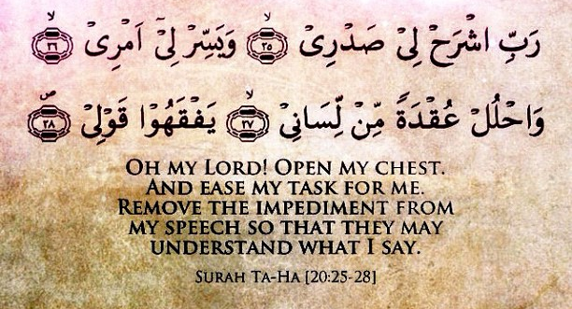
Dua for Studying

Slide 3
Intentions for Studying
I intend to study and teach,
take and give a reminder,
take and give benefit,
take and give advantage,
to encourage the holding fast to the book of Allah and the way of his Messenger,
and calling to guidance and directing towards good,
hoping for the support of Allah and His pleasure, closeness and reward, transcendent is He.

Slide 4
Week 9 – Objectives
The Book Of Salah
Azan
Other Issues Related to Azan and Iqamah
Prerequisites for Validity of Saläh
1. Purity, 2. Covering the Body, 3. Facing the Holy Ka’bah, 4. Time of Saläh, 5. Intention, 6. Prohibitive Words of Salah

Slide 5
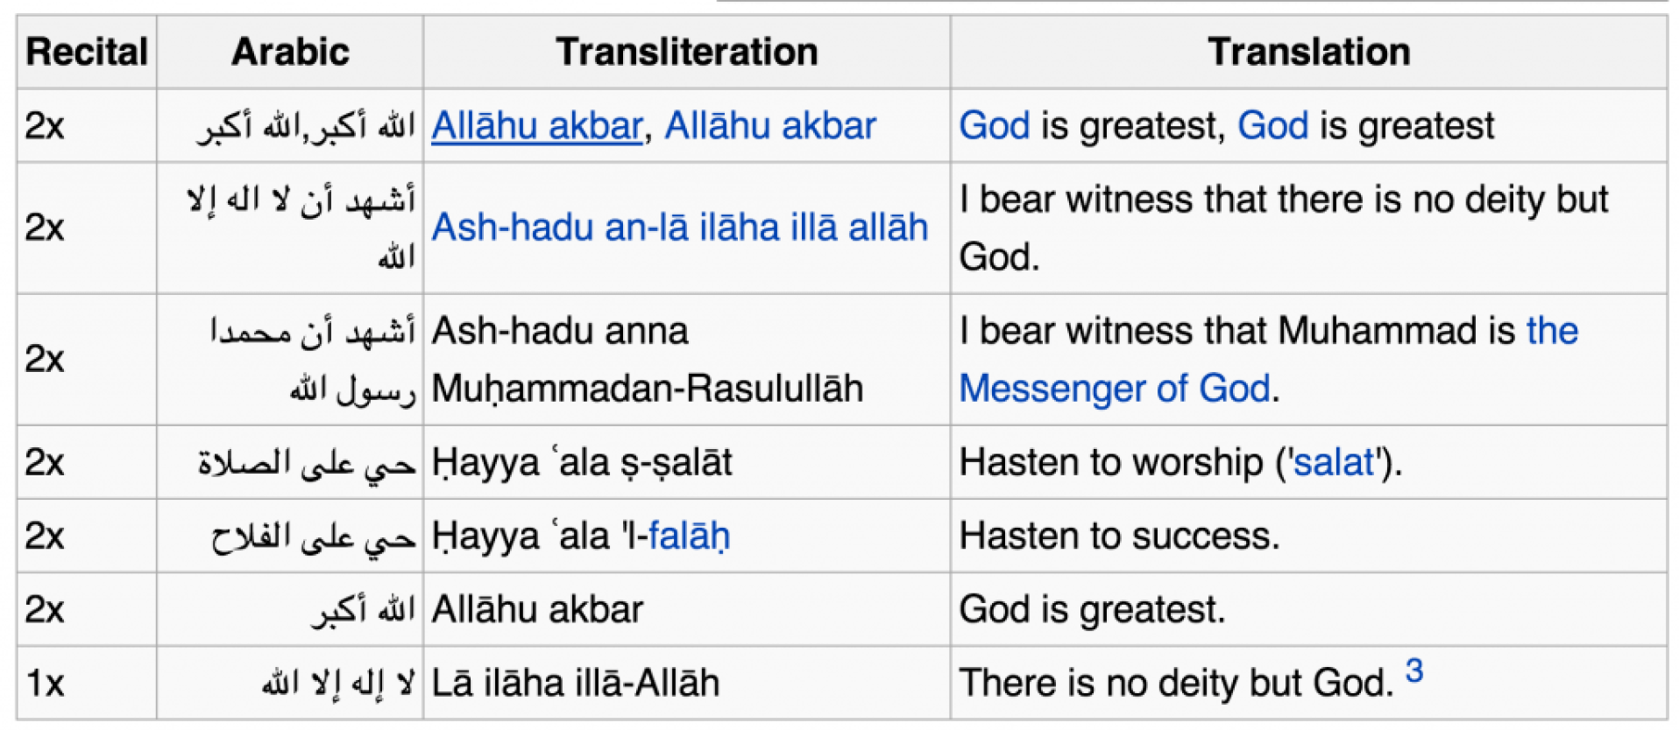
Azan
Notes:
The Saläh-caller should be in a state of Ablution.
He should be knowledgeable about the Tradition and the times of Salähs.
He should be pious.
He should face the holy Ka’bah at the time of the Saläh-call.
He should put his forefingers inside his ears.
He should turn his face right when saying Ḧayya àlas̈ s̈aläh and left when saying Ḧayya àlal faläḧ.
When the caller says: Ḧayya àlas̈ s̈aläh and Ḧayya àlal faläḧ, he should say in reply Lä ḧaula wa lä quwwata illä billäh

Slide 6
Other Issues Related to Azan and Iqamah
In the Fajr Azan, the caller should add the word, As salatu khairum minan naum, twice after the second, Hayya àlal falah⁽¹⁾.
Iqamah is similar to Azan except that the caller adds the words, Qad qamat-is salah, twice after the second, Hayya alal falah.
Azan is to be said slowly while Iqamah is to be said at a fast pace.
Azan is valid only in Arabic language.
Notes:
(1) When the Saläh-caller says As̈ s̈alätu khairum minan naum in Fajr, he should say S̈adaqta wa bararta

Slide 7
Prerequisites for Validity of Saläh
1.
Purity
2.
Covering the body
3.
Facing the Holy Ka’bah
4.
Time of Saläh
5.
Intention
6.
Prohibitive words of Saläh

Slide 8
Prerequisites for Validity of Saläh 1. Purity
Purity from both minor and major spiritual impurity
Purity of the body of the Saläh-performer should be free of Filth
Purity of the Garments
Purity of the Place

Slide 9
Prerequisites for Validity of Saläh 2. Covering the Body
It is necessary that the organs to be covered should remain covered from the start of the Saläh till the end
If a quarter or more of an organ to be covered is uncovered before starting the Saläh, the Saläh will not be valid
If a quarter or more of an organ to be covered gets uncovered during Saläh for a period in which the smallest Saläh-essential may be performed, then his Saläh will become invalid

Slide 10
Prerequisites for Validity of Saläh 3. Facing the Holy Ka’bah
The exact position of Ka’bah: It is the direction-to-face for a person who is in the holy city of Makkah and is able to view the Ka’bah from his place.
The general direction of Ka’bah: It is the direction to face for a person who is unable to view the Ka’bah whilst in Makkah. The general direction is also for a person who is not in Makkah
If a person is unable to face the stipulated direction owing to a disease or fear from an enemy, it is permissible for him to face whichever direction he is capable of.

Slide 11
Prerequisites for Validity of Saläh 4. Time of Saläh and 5. Intention
Saläh will not be valid before its start-time
If the Saläh is obligatory, specifying it is compulsory, like intending for Zuhr or Asr.
Similarly, if the Saläh is compulsory, specifying it is compulsory, like intending for Witr or Eid Saläh.
If the Saläh is supererogatory, specifying it is not a prerequisite. Intending just for a Saläh is enough.
It is necessary for a person praying in congregation to intend to follow the Imäm in the Saläh.

Slide 12
Prerequisites for Validity of Saläh 6. Prohibitive Words of Salah⁽¹⁾
The Saläh should be started with a remembrance formula meant only for Alläh, like saying:
Allähu Akbar - Alläh is the greatest
Allähu A`zam - Alläh is the supreme
Subhanallah - Glory be to Alläh
Notes:
(1) “Prohibitive” means that several permissible acts like walking, talking, eating, etc. become prohibited as soon as the Saläh-performer says these words

Slide 13
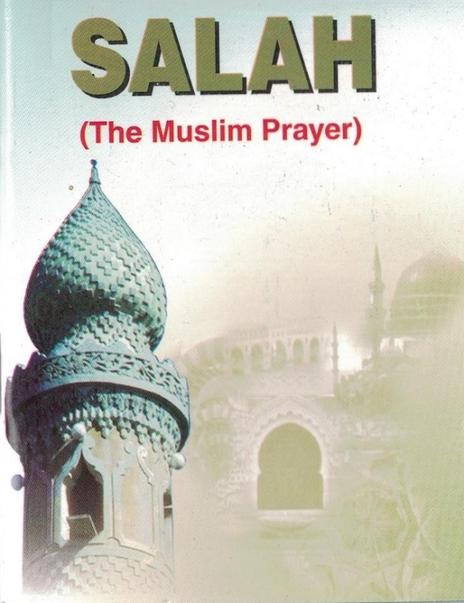
Week 10
The Book Of Salah
Essentials of Saläh
Compulsory Acts of Saläh

