Slide 1
Hanafi Fiqh
Book Of Taharah
Week 7

Slide 2
Dua for Studying

Slide 3
Intentions for Studying
I intend to study and teach,
take and give a reminder,
take and give benefit,
take and give advantage,
to encourage the holding fast to the book of Allah and the way of his Messenger,
and calling to guidance and directing towards good,
hoping for the support of Allah and His pleasure, closeness and reward, transcendent is He.

Slide 4
Objectives – Week 7
The Book Of Taharah
Mid Term
Masah On Socks
Masah On Splints or Bandages

Slide 5
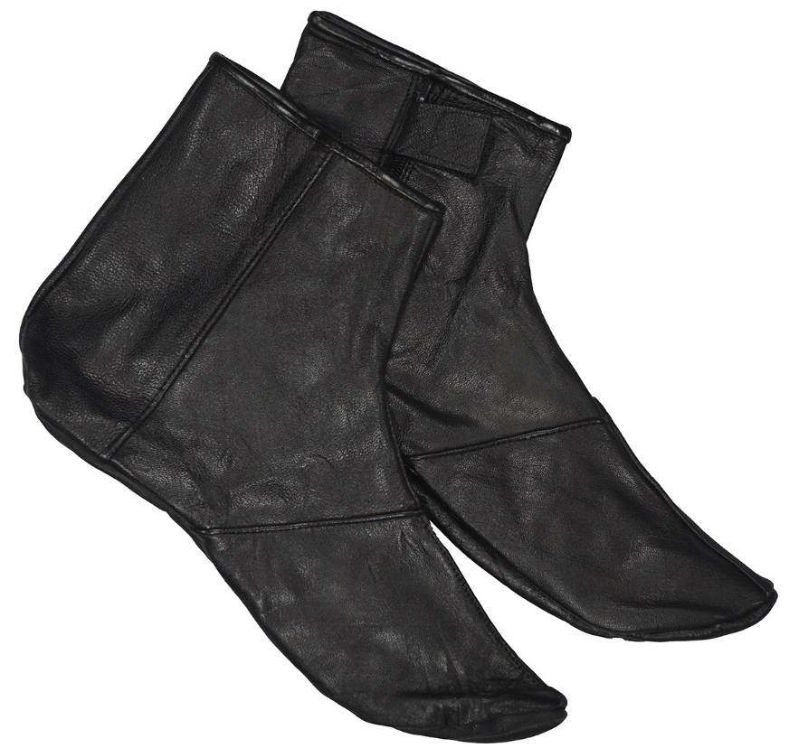
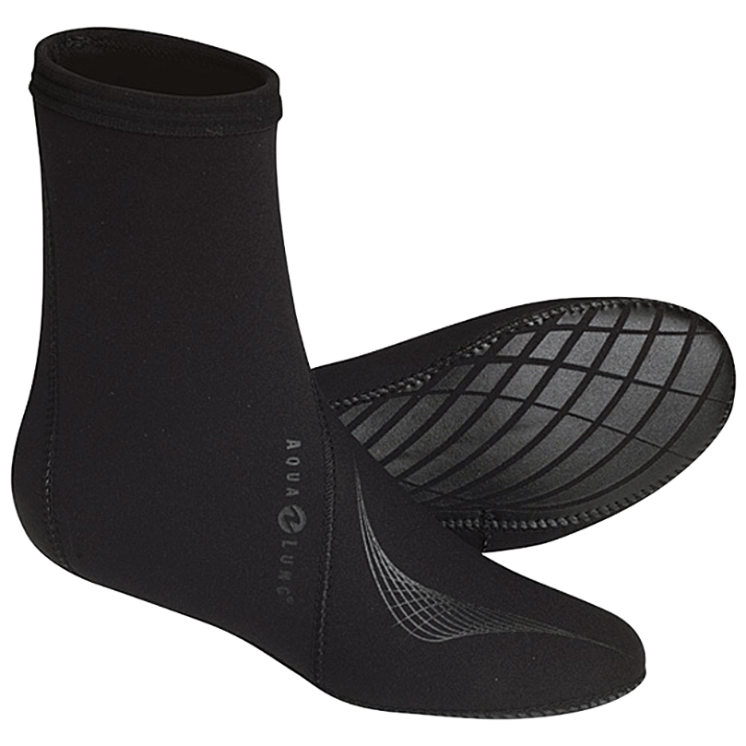
Wiping Over Thick Socks
Leather Socks
Divers Socks

Slide 6
Wiping Over Thick Socks Prerequisites for Validity
1
The person should have worn the thick socks in a state of Wudu
2
The thick socks should cover the ankles
3
The thick socks should be free of hole the size of 3 smallest toes
4
The thick socks should hold on to the legs without a need of tying
5
They should prevent outside water from reaching to the feet
6
It should be possible to take consecutive steps wearing them

Slide 7
Mandatory Acts and Traditions of Wiping
Mandatory Amount Wiping by the three smallest fingers of a hand over the top front part of each foot
The Tradition
Wipe with fingers apart longitudinally from the tip of toes to the shank

Slide 8
Period of Validity of Wiping the Socks
Resident
Period of permissibility of wiping socks is one day and night
Traveler
Period of permissibility of wiping socks is three days and nights

Slide 9
Invalidators for wiping thick socks
1
Anything that invalidates Ablution
2
Taking off a sock
3
If major part of a foot comes out to the shin portion of sock
4
Wiping is invalidated at the completion of the period of permissibility
5
If water reaches major part of either of the two feet
Wiping turban, cap or veil instead of wiping head during wudu is impermissible
6

Slide 10
Wiping Over Wound-Dressing etc
1
If an organ is injured, wound-dressing is applied on it and the person can neither wash nor wipe the organ directly, he will wipe the major part of the dressing from top.
2
Continue wiping till the wound is healed
3
Putting on the dressing in a state of Wudu is not a prerequisite
4
Permissible to wipe the splint of one of the feet and wash the other

Slide 11
Wiping Over Wound-Dressing etc
5
Wiping will not be invalidated if the bandage falls off before the wound has healed
6
Replacing the bandage is will not necessitate repetition of wiping over it
7
Preferable to repeat wiping on the new bandage after replacement
8
Intention is not a prerequisite

Slide 12
Week 8
Begin Book of Salah
Introduction
Kinds Of Salah
Prerequisites for Saläh to become obligatory
Times of Salähs
Other rulings related to Saläh-times
Times when Saläh is not permissible

