Slide 1
Hanafi Fiqh
Book Of Taharah
Week 4

Slide 2
Dua for Studying

Slide 3
Intentions for Studying
I intend to study and teach,
take and give a reminder,
take and give benefit,
take and give advantage,
to encourage the holding fast to the book of Allah and the way of his Messenger,
and calling to guidance and directing towards good,
hoping for the support of Allah and His pleasure, closeness and reward, transcendent is He.

Slide 4
Objectives – Week 4
The Book Of Taharah
Etiquettes of Wudu
When is Wudu Necessary
When is Wudu Encouraged?
What Breaks Ones Wudu?
What Does Not Breaks Ones Wudu?

Slide 5
Etiquettes of Wudu
2. Sit facing the Qibla
3. Not seek help from others
4. Combine niyyah for Wudu in heart with verbal intention
5. Recite while washing every organ
6. Perform Ablution before the time for Saläh starts
1. Sit on a raised place
Notes:
Etiquette or Adab is the act performing of which carries reward and missing it carries no censure.

Slide 6
Etiquettes of Wudu Dua After Wudu
I bear witness that there is no god except Allah and He has no partners
And I bear witness that Muhammad is His slave and messenger
O Allah, Make me of those who always repent & of those who are purified
Notes:
Etiquette or Adab is the act performing of which carries reward and missing it carries no censure.

Slide 7
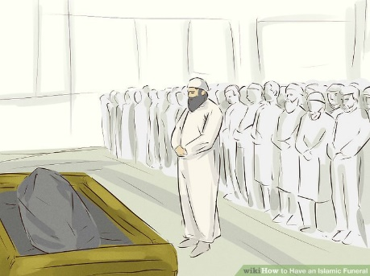
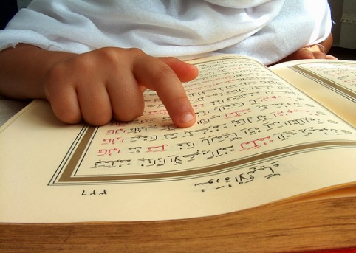
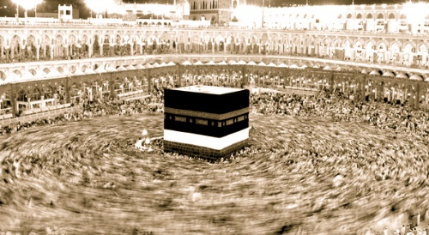
When is Wudu Necessary?
1
Offering Saläh
2
Funeral Saläh
3
Sajdah al-Tilaawah
4
Touching the holy Qurän
5
Tawaf of Ka`bah

Slide 8
When is Wudu Encouraged?
Getting up from sleep
Wudu over wudu
After sinning
Laughter outside Saläh
When angry
Reciting Qurän verbally
At time of every Saläh
Studying Islamic Science

Slide 9
What Breaks Ones Wudhu?
1
Anything comes out of the two exits
2
Blood/pus comes out of body & spreads to skin
3
Blood comes out with saliva in a quantity greater than or equal to saliva
4
The person vomits out food, water, blood clot or bile and the quantity is mouthful
5
Person sleeps & the rear doesn't remain on ground

Slide 10
What Breaks Ones Wudhu?
6
Falls unconscious
7
Loses sanity
8
Gets intoxicated
9
Adult laughs with sound during a Saläh with bowing and prostration⁽¹⁾
Notes:
(1)
• If a child laughs loudly in a Saläh, his Ablution will not be invalidated.
• The Ablution of a sleeping person is also not invalidated due to loud laugh.
• Similarly, if the person laughs loud in Funeral Saläh or Qurän Reciatation prostration, his Ablution remains valid.

Slide 11
What Does Not Breaks Ones Wudhu?
1
Blood appears at a cut but does not flows over its place
2
A piece of flesh falls down but blood does not flows out
3
A worm comes out of a wound or ear
4
The person vomits but the vomit is not mouthful
5
He vomits phlegm. Whether the phlegm is small or large in quantity makes no difference

Slide 12
What Does Not Breaks Ones Wudhu?
6
A Saläh-offerer falls asleep during Saläh – while standing, sitting, bowing or prostrating – provided that he remains in the prescribed Saläh posture
7
A person in a state of Ablution falls asleep but his bottom remains fixed on the ground
8
The person touches another person of opposite sex
9
A sleeping person sways while in a posture that does not invalidate Ablution

Slide 13
Week 5
The Process of Bathing (Fardh Ghusul)
When is Ghusul Fardh and when is it Sunnah
When is bathing encouraged

