Slide 1
Hanafi Fiqh
Book Of Taharah
Week 2

Slide 2
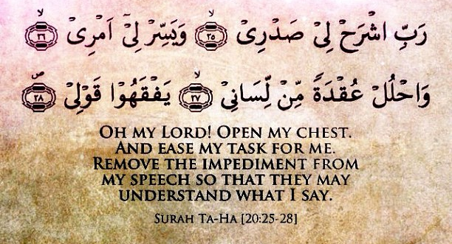
Dua for Studying

Slide 3
Intentions for Studying
I intend to study and teach,
take and give a reminder,
take and give benefit,
take and give advantage,
to encourage the holding fast to the book of Allah and the way of his Messenger,
and calling to guidance and directing towards good,
hoping for the support of Allah and His pleasure, closeness and reward, transcendent is He.

Slide 4
Objectives – Week 2
The Book Of Taharah
Basic Etiquettes of Reliving Oneself
Istibra and Istinja
Kinds of Filth
How To Remove Filth

Slide 5
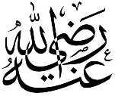
Etiquettes of Relieving Oneself
Abu Hurairah said: The Messenger of Allah said
((I am to you like a father to his son, and I teach you. So when you go to relieve yourselves, do not face the Qiblah or turn your backs towards it.' He ordered us to use three pebbles, and he forbade us to use dung and bones, and he forbade cleaning oneself with the right hand.))
Sunan Ibn Majah
Hadith is Hasan

Slide 6
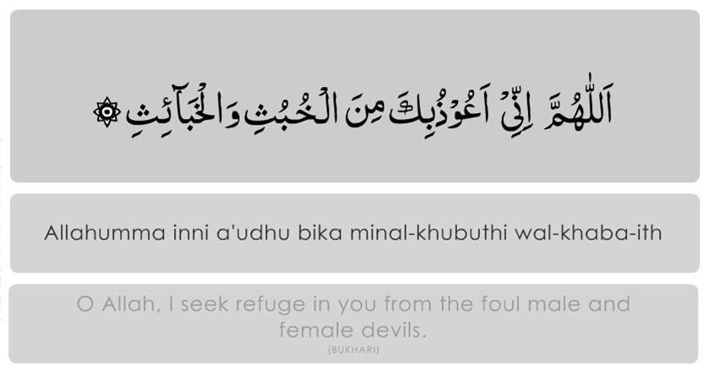
Etiquettes of Relieving Oneself
Before entering washroom he should recite:

Slide 7
Etiquettes of Relieving Oneself
Enter washroom with left foot & exit with right foot
Should sit putting more weight on the left foot
Cover head at the time of relieving and cleansing
Avoid talking without necessity
It is strictly prohibited to face or have the back to the Ka’bah
Avoid cleansing with right hand without any necessity
Avoid urinating in standing posture without necessity

Slide 8
Etiquettes of Relieving Oneself
Before entering washroom he should recite:

Slide 9
Istibra and Istinja
Istibra
Istibra is to make the urethra free from drops of urine. Wajib for men to do istibra, that is, not to leave any drops in the urethra, by walking, coughing etc
Istinja
Istinja is to clean urine and stool off private parts after urination and defecation.
Filth bigger than dirham – obligatory to wash with water
Notes:
They must not perform wudu' unless they are satisfied that there are no drops of urine left. One drop oozing out will both nullify their wudu' and soil their underpants. If less than a palmful oozes onto underpants, the salat one performed after doing wudu' will be rendered makruh. If more than this amount oozes, one's salat will not be valid.
Istinja is not required when one passes gas
When Filth oversteps the organ of urine or excretion and gets bigger than a dirham19, washing it with water becomes Obligatory20 and Saläh is not Permissible in its presence. When Filth oversteps the organ and is equal to a dirham, washing it with water is Compulsory. When Filth does not overstep the organ21, then Cleansing is customary.

Slide 10
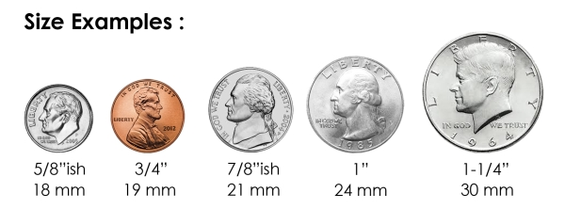
Size of a Dirham The area of a dirham is equal to that of the palm’s depression
Notes:
In viscous Filth, comparison to dirham will be done by weight and the weight of a dirham is about three gram. In thin fluid Filth, the comparison takes place by area and the area of a dirham is equal to that of the palm’s depression

Slide 11
Other Issues About Cleansing
Permissible to use water alone
Permissible to use only toilet paper or anything similar to it as long as the Filth does not exceed a dirham
The most Preferable way is to clean with toilet paper or a similar thing and then wash with water as this would clean more efficiently

Slide 12
Other Issues About Cleansing
When one has finished cleaning, first wash hand and then the organ with water
Should thoroughly clean the organ till the odor ends
Upon completing this Cleansing, one should wash the hand and thoroughly rub it till the odor finishes

Slide 13
Purification
Quran
al-Muddathir: 4
Hadith
((Salah is not acceptable without Purification))
And purify your clothes

Slide 14
Kinds of Filth and Their Rulings
Filth:
It is the state of a human body, garment or place which is disgusting to the Shari'ah and so the Shari'ah commands Purification from that state
Types of Filth
Spiritual/Ritual Impurity
Physical Impurity

Slide 15
Spiritual/Ritual Impurity
Minor
State of a person in which Ablution is Compulsory
Can’t
Major
State of a person in which a Bath/Ghusl is Compulsory
Can’t
(1) Pray
(2) Touch the Quran
(3) Tawaf
(1) to (3)
(4) Recite the Quran
(5) Enter the Masjid
Notes:
Minor Impurity: Going to the Toilet, passing gas, will cover in more details on the Chapter of Wudu
Major Impurity: Intimacy, menstruation,

Slide 16
Physical Impurity Impurity on body, clothes etc.
Severe Filth
Definition: Filthiness has been established by an evidence which is beyond doubt
Examples: blood, urine, stool, or wine
Extent of a dirham or less, salah is permissible, but if more than a dirham, salah is impermissible
Mild Filth
Definition: Filthiness is not certain due to presence of another evidence which indicates its Purity
Examples of Mild Filth: (1) Horse urine
(2)Urine of Flesh-edible animal:
like camel, cattle, goat and sheep
(3)Dropping of Flesh-inedible bird
Mild Filth is excusable as long as it’s not large-quantity (est. to be a ¼ of body or garment)
Notes:
Large-quantity is estimated to be a quarter of body or garment.

Slide 17
How to remove filth
Severe Filth
Definition: Filthiness has been established by an evidence which is beyond doubt
Examples: blood, urine, stool, or wine
Extent of a dirham or less, salah is permissible, but if more than a dirham, salah is impermissible
Mild Filth
Definition: Filthiness is not certain due to presence of another evidence which indicates its Purity
Examples of Mild Filth: (1) Horse urine
(2)Urine of Flesh-edible animal:
like camel, cattle, goat and sheep
(3)Dropping of Flesh-inedible bird
Mild Filth is excusable as long as it’s not large-quantity (est. to be a ¼ of body or garment)
Notes:
Large-quantity is estimated to be a quarter of body or garment.

Slide 18
How to remove filth
Purity from a visible Filth like blood and excreta is obtained by eradicating the body by washing once or more number of times. If removing filth is v difficult, then there is no issue
Purification from non-visible Filth like urine is obtained when the garment is washed thrice and wringed each time in such a way that water stops dropping provided that each time new, pure water is used
Shoes can also be purified by scrubbing over pure ground when the Filth has a body no matter if it is wet or dry

Slide 19
How to remove filth
Sword, knife, mirror and oiled utensils are purified by wiping off the filth
Ground becomes Pure when it dries up and the effect of Filth dies off. Salah is Permissible on it but Tayammum is not
If the semen of a person attaches to a garment or the person’s body and then dries up, it may be purified by scraping it off
But if the semen is wet, the garment will be purified only by washing

Slide 20
Week 3
Faraidh of Wudu
Etiquettes of Wudu
When is Wudu Necessary and When is it Encouraged

