Slide 1
FLEET Translation Project: Scanbot
Julian Ceddia
Supervisor: Agustin Schiffrin

Slide 2
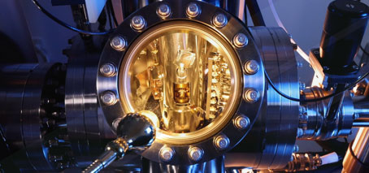
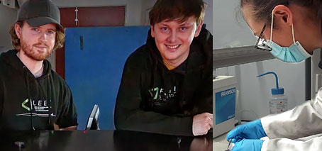
FLEET Translation Program
Liquid-Metal Printed Oxides
STM Automation
Pre-Characterised TMDs
Zinc Batteries
Notes:
In 2022-2023, FLEET allocated $400k to fund researchers to work on ideas with the potential to generate impact outside their specific research
10 translation projects were funded from prefab’d TMDs to new types of zinc batteries
I applied to the program with an idea I’d already been tinkering with in the lab: to automate aspects of our STM

Slide 3
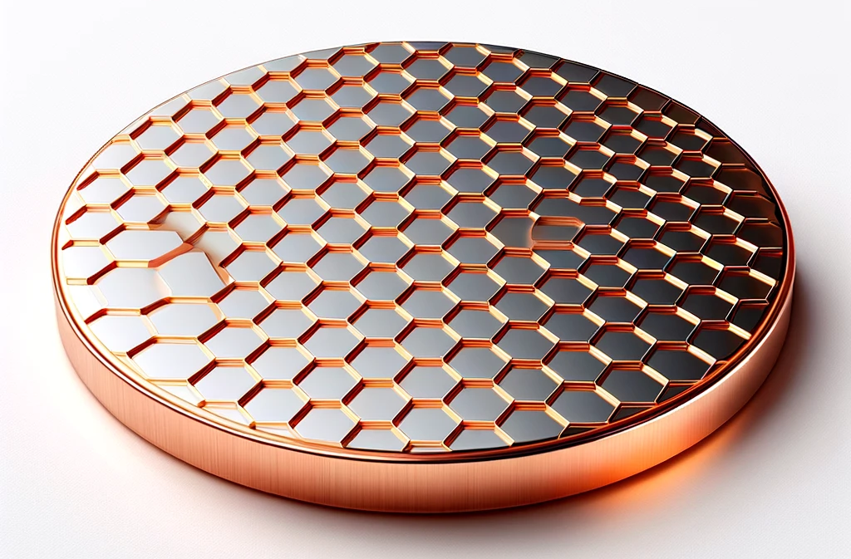
Scanning Tunnelling Microscopy (STM)
I_{T}
z_{Tip}
Metal Tip
Blanco, J. Prog. Surf. (2006). 10.1016/j.progsurf.2006.07.004
V_{b}
< 1 nm
I_{T}
e⁻
Notes:
STMs are powerful microscopes, capable of acquiring images of surfaces with atomic-scale resolution
They do this by scanning an atomically sharp probe across the surface of a sample while a feedback loop controls the height, z, of the tip to maintain a constant tunneling current
In this way, 2D STM images are constructed line by line

Slide 4
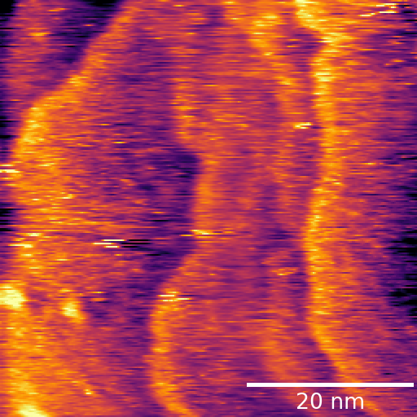
STM Imaging
Dicyanoanthracene (DCA)
Cu
Kumar, D. et al. Adv. Funct. Mater. 2021. https://doi.org/10.1002/adfm.202106474
Notes:
Many of you would have seen beautiful looking STM images (like the one on the left) which you can literally superimpose individual atoms or molecules on
Not many of you would have seen the garbage images STMs frequently produce
The quality of an STM image depends greatly on the exact geometry and composition of the apex of the scanning probe at the atomic scale

Slide 5
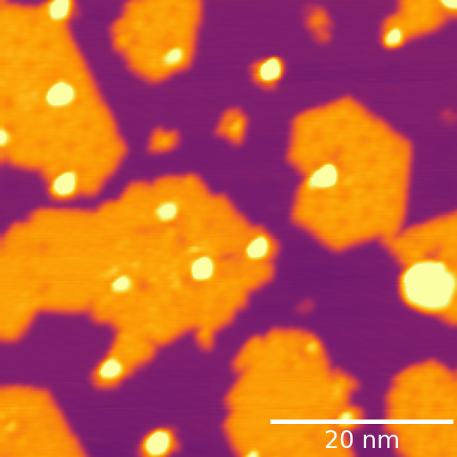
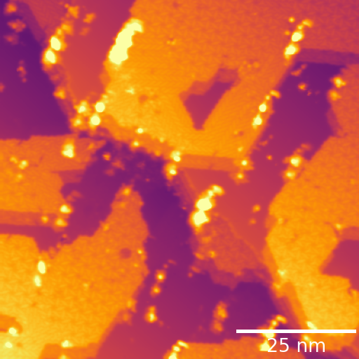
The ‘Tip’
Notes:
For example, blunt tips acquire blurry images
Doubled tips/tips with multiple apexes acquire images with ghosted or doubled features
Contaminated tips can interact with the sample during a scan to produce noisy images

Slide 6
Tip Shaping
Clean metal (e.g. Ag)
Notes:
To combat such tips, one common process we can use is called tip shaping
We park the tip over a clean region of an atomically flat metal surface (e.g. Ag, Au, Cu, etc.)
We poke the apex of the probe into the surface of the clean metal
And hope that when we pull it out, it has been reshaped for the better
This is a very annoying, time consuming process that is currently performed manually by a trained human operator

Slide 7
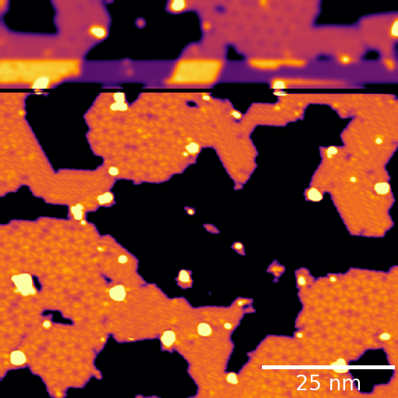
The tip can change ☹
Notes:
Even once you obtain a good tip, maintaining it is not guaranteed.
During a scan, the tip can crash into a small piece of debris on the sample which can cause it to change for the worse
In the image on the right, which was taken line-by-line from the bottom up, the tip started off nice and sharp which is why small features can be resolved in the bottom portion of the image
You can then see the exact line in the scan where the tip crashed into some debris on the sample and became blunt
Hence, the rest of the image, and images thereafter, are blurry

Slide 8
Tip Shaping
Notes:
This requires the need to tip shape once again.
During my many hours tip shaping, I noticed that if the tip-shaping action is small enough, the crater left behind can be imaged…

Slide 9
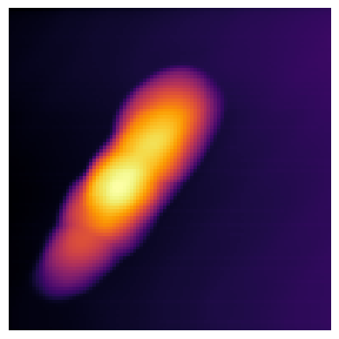
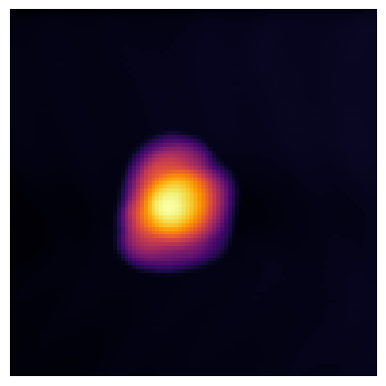
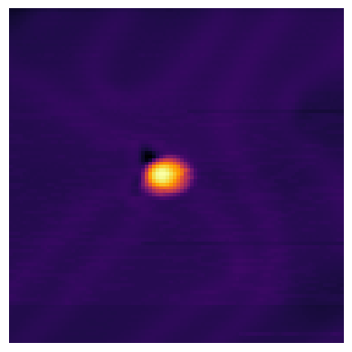
Imaging Tip Craters
$$2 nm$$
$$2 nm$$
$$2 nm$$
Notes:
Images of tip craters after a gentle tip shaping action reflect the geometry of the probe that made them.
For example, the imprint on the left was clearly made by a probe with multiple apexes.
The imprint in the middle was made by a probe that was acquiring blurry images (blunt probe)
The imprint on the right was made by a sharp tip that was acquiring high-resolution STM images.
This is a simple method that gives quantitative information about the geometry of the probe apex and allows us to predict in advance whether a probe will be suitable for imaging
When I first noticed this, I thought about how this could be leveraged to automate probe conditioning for image acquisition

Slide 10
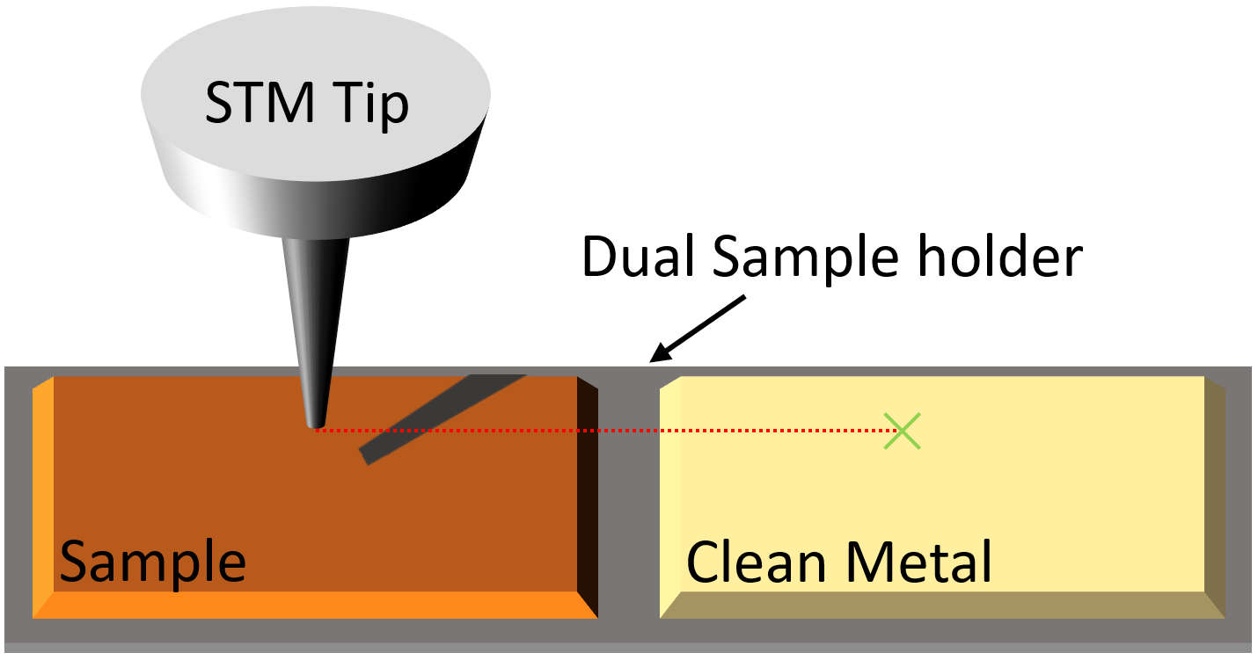
Scanbot
Tip
Sample
Clean Metal
Notes:
This is where Scanbot comes in. Scanbot is a Python program that can control the STM in our lab
Scanbot leverages a special piece of equipment called a dual sample holder, where a sample of interest can be mounted next to a clean reference metal which is ideal for tip shaping
Scanbot is programmed to acquire STM images autonomously on the sample
When it detects that the tip has changed or the images acquired are noisy, it can pause image acquisition and use a camera feed to track and move the tip from the sample to the clean metal (video)
It then kicks off an automated tip-shaping routine that involves iteratively poking the tip into the clean metal and looking at the imprints left behind to determine if the tip is suitable for imaging.
This process continues until a desired imprint is obtained, then Scanbot moves the tip back to the sample where it automatically continues surveying

Slide 11
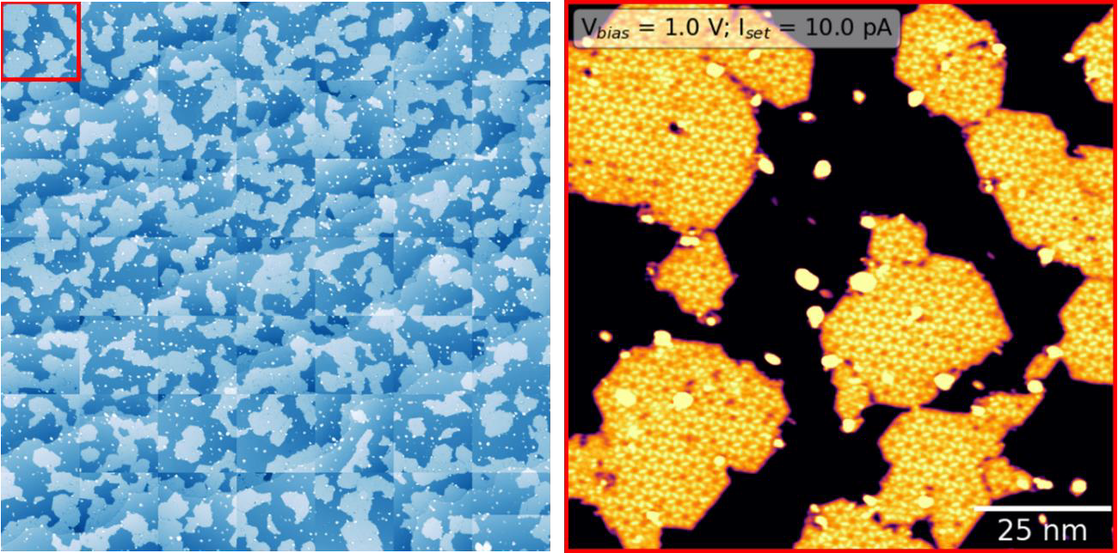
Automated Overnight Survey
Notes:
This is an example of an automated survey that ran over night after Scanbot autonomously prepared a ‘good tip’ according to the protocols discussed
Each image in the grid on the left is high-resolution STM image

Slide 12
Limitations
Tip Change
Contaminated Tip
Blunt Tip
Doubled Tip
Notes:
Scanbot still has room for improvement
It can detect when the tip changes during a scan, and when scans are noisy.
It cannot yet detect when scans are blurry or doubled, thus requires supervision in this regard
This is still a work in progress

Slide 13
Conclusion
Scanbot can autonomously tip shape and survey samples
Save time
Aid in data acquisition
Paper under review (Journal of Open Source Software)

Slide 14
Acknowledgements
A/Prof. Agustin Schiffrin (supervisor)
Dr. Benjamin Lowe
Dr. Daniel Moreno
Dr. Jack Hellerstedt
Kwan To
Dr. Gary Beane
Mitko Oldfield
Dr. Michael Harvey
Prof. Matt

Slide 15
Questions?

Slide 16
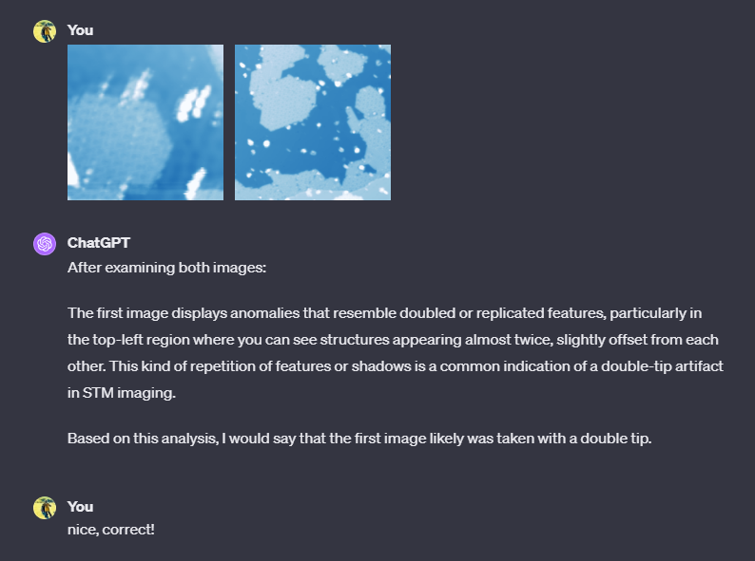
Scanbot Meets ChatGPT
Notes:
- An example of how a general models such as ChatGPT are becoming good enough to analyse STM images in simple ways without specific training.
- This can be useful for helping Scanbot make more accurate decisions about when the tip needs to be refined

