Slide 1
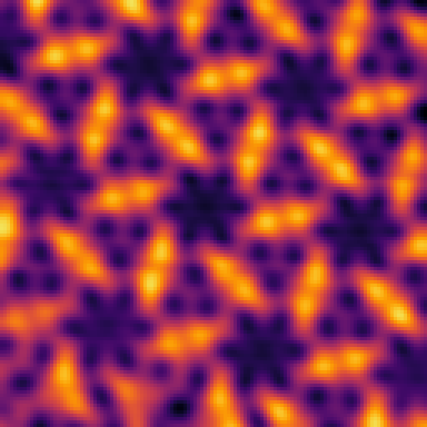
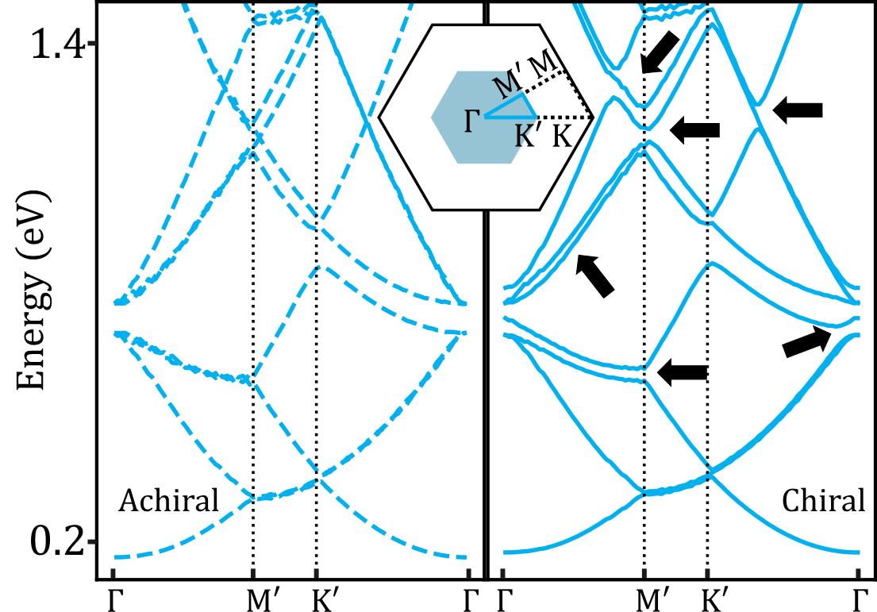
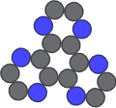

Tuning Interface Electronic Properties via Chiral 2D Metal-Organic Frameworks
$$2 nm$$
Dr. J. Ceddia, Dr. J. Hellerstedt, Dr. S. Fürer, Dr. B. Lowe, Prof. U. Bach, A/Prof. A. Schiffrin
Notes:
I want to emphasise here this theme of “tuning electronic properties”.
This is kind of central to what our group is excited about because we believe that the future of electronic technologies will rely on our ability to really tailor or engineer the electronic properties of quantum systems for different applications.
There are many ways to do this but one of those ways is by playing with the structural symmetries of a 2D interface to tune the electronic band structure - which is why chirality is an important concept here.
This work expands on the growing ‘toolkit’ we have for what people sometimes refer to as “band structure engineering”

Slide 2
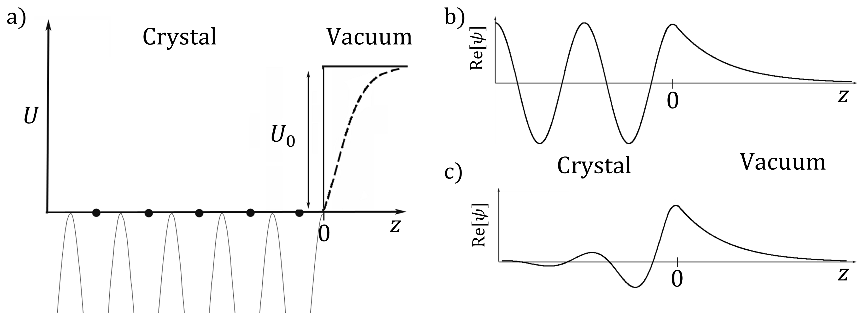
Shockley Surface State
Notes:
What is the “interface” I’m talking about?
1. For simplicity let’s start with a 1D model of a crystal surface.
2. For z < 0, we have a periodic potential, terminating abruptly at the crystal-vacuum interface at z = 0, as shown in panel (a).
3. If we solve the Schrödinger equation we can see there are two solutions:
1. First, bulk electrons form Bloch waves, oscillating in the crystal and decaying exponentially into the vacuum, as in panel (b).
2. Second, surface states are localised near the interface, decaying into both the bulk and vacuum, as in panel (c).
**For most metal surfaces, these surface states hybridise with bulk states, losing their confinement due to overlapping energies.**

Slide 3
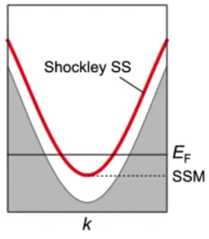
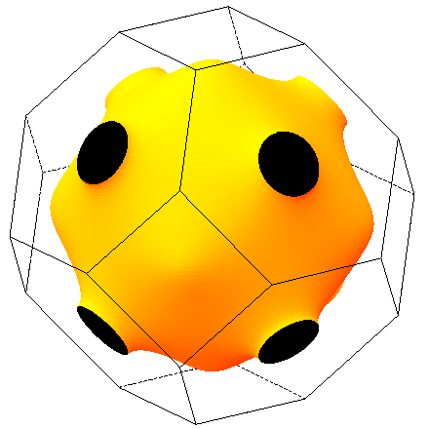
Shockley Surface State
Projection along [111]
[111]
Bulk states
Ag Fermi surface
C. Lehmann, S. Sinning, P. Zahn, H. Wonn, I. Mertig, Dresden 1996-1998
Yin, R., Zhu, X., Fu, Q. et al. Nat Commun 15, 2969 (2024).
Notes:
1. But… If we consider a noble metal such as copper, gold, or silver, the Fermi surface, shown on the left, is nearly spherical but has these “necks” that intersect the Brillouin zone boundary along the 111 direction.
2. If we project the bulk band structure onto the (111) surface’s 2D Brillouin zone - shown on the right - we can see a band gap where the Fermi level crosses this forbidden region around k = 0 where there are no bulk states.
3. This gap is key because it allows the surface state from our analogous 1D model to exist without mixing with bulk states.
4. What’s nice is that this surface state is confined in z but free in x and y, so it forms a very clean 2D electron gas with parabolic dispersion (red curve on the right).

Slide 4
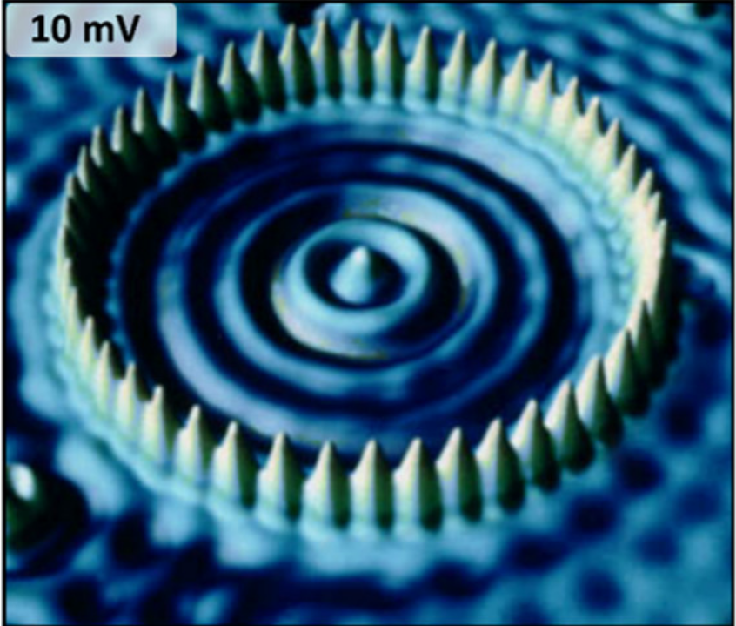
Surface-state confinement
Confined surface state electron
Fe atom ring “Quantum Corral”
Cu(111) surface
Crommie, M. F.; Lutz, C. P.; Eigler, D. Confinement of Electrons to Quantum Corrals on a Metal. Science 1993, 262, 218
Notes:
These SS electrons can be perturbed very easily by impurities, vacancies, or adsorbates on the surface.
Perhaps the most famous example of this is this image of a “quantum corral”.
You can see this ring of iron atoms on Cu(111) scattering and confining the surface state, giving rise to what is essentially particle in a box type standing wave solutions that can be imaged directly.
This is actually real data here acquired using a Scanning Tunnelling Microscope (STM) which was the main tool used to acquire data that I’ll present in this talk.

Slide 5
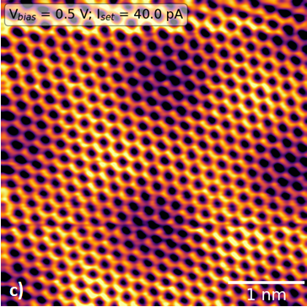


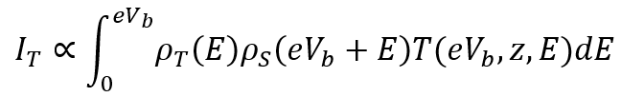
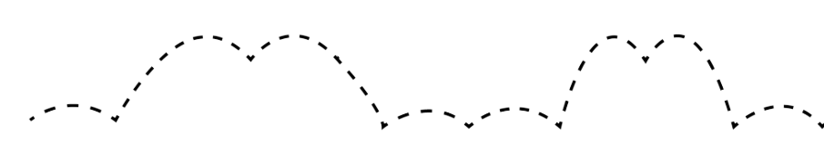
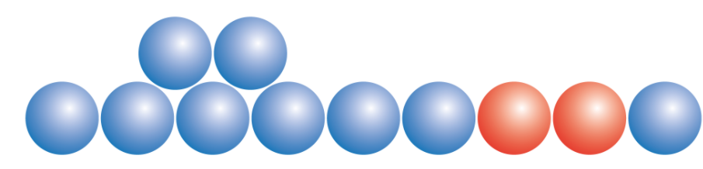
Scanning Tunnelling Microscopy (STM)
I_{T}
z_{Tip}
Metal Tip
Blanco, J. Prog. Surf. (2006). 10.1016/j.progsurf.2006.07.004
V_{b}
< 1 nm
I_{T}
e⁻
atoms
Notes:
STM is a scanning probe technique where you have a metallic probe that’s ideally sharpened down to a single hanging atom.
This probe approaches the surface of a sample to within about 1nm so that when a bias voltage is applied, electrons can tunnel across the gap and form a tunneling current
This tunneling current carries information about the density of states of the tip, the local density of states of the sample, and has an exponential dependence on the size of the tunneling junction
In STM, the tip is moved in a direction parallel to the surface while the tunneling current is fed to a feedback controller.
The goal of this feedback controller is to adjust the height of the probe in order to maintain a constant tunneling current.
So you can imaging that as the tip is moving parallel to the surface, at some point it might encounter an atomic step edge. Here, the feedback controller will retract the tip due to an increase in tunneling current. Similarly, the tip will also retract a bit as it passes over a region with a larger density of states (indicated by the orange atoms).
If you take many of these 1D line scans you can build up a 2D image of the surface with atomic-scale resolution. e.g., the STM image of graphene (right) we acquired in our lab where the honeycomb lattice is clearly visible.
With this technique, you can take the same probe you use for scanning and actually use it to physically interact with the surface - pushing and manipulating individual atoms or molecules on the surface. That’s how the quantum corral I showed on the previous slide was constructed.

Slide 6
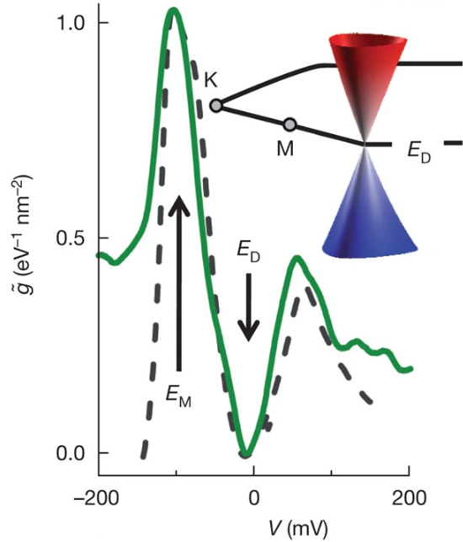
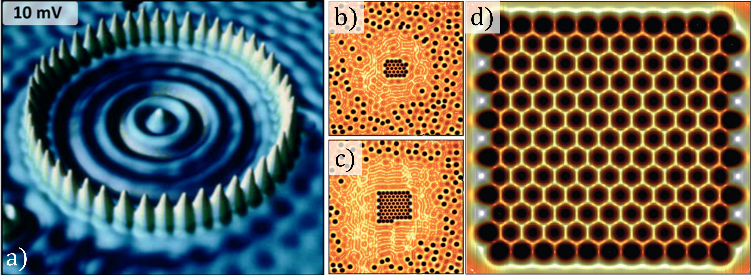

Molecular Graphene
Carbon monoxide Molecule
“Molecular graphene”
Gomes, K., Mar, W., Ko, W. et al. Designer Dirac fermions and topological phases in molecular graphene. Nature 483, 306–310 (2012). https://doi.org/10.1038/nature10941
Notes:
Another example of this, which takes it to the next level, is the experiment where people painstakingly manipulated individual CO molecules on Cu(111) into a honeycomb arrangement to create “artificial molecular graphene”.
They were able to show that key electronic features of graphene such as linear dispersion around a Dirac cone could be replicated.

Slide 7
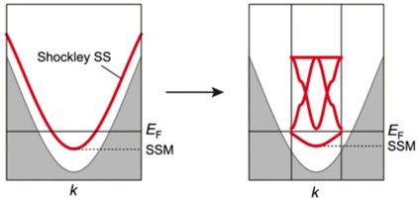
Band structure engineering
Yin, R., Zhu, X., Fu, Q. et al. Artificial kagome lattices of Shockley surface states patterned by halogen hydrogen-bonded organic frameworks. Nat Commun 15, 2969 (2024).
Notes:
So, an interface involving the Shockley SS can be a versatile platform for simulating existing materials or potentially new materials altogether.
You can basically take the parabolic dispersion of the 2DEG, which is gapped from the bulk states, and perturb it through periodic nanostructures on the surface to engineer it into something more interesting.

Slide 8
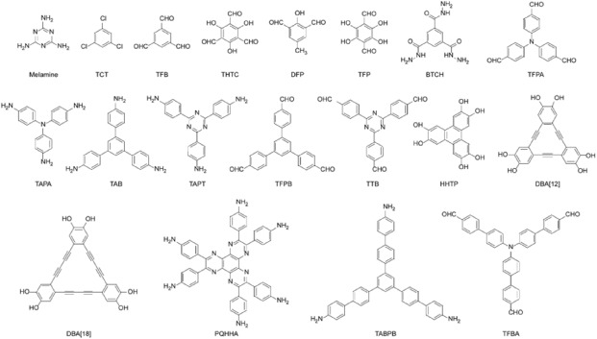
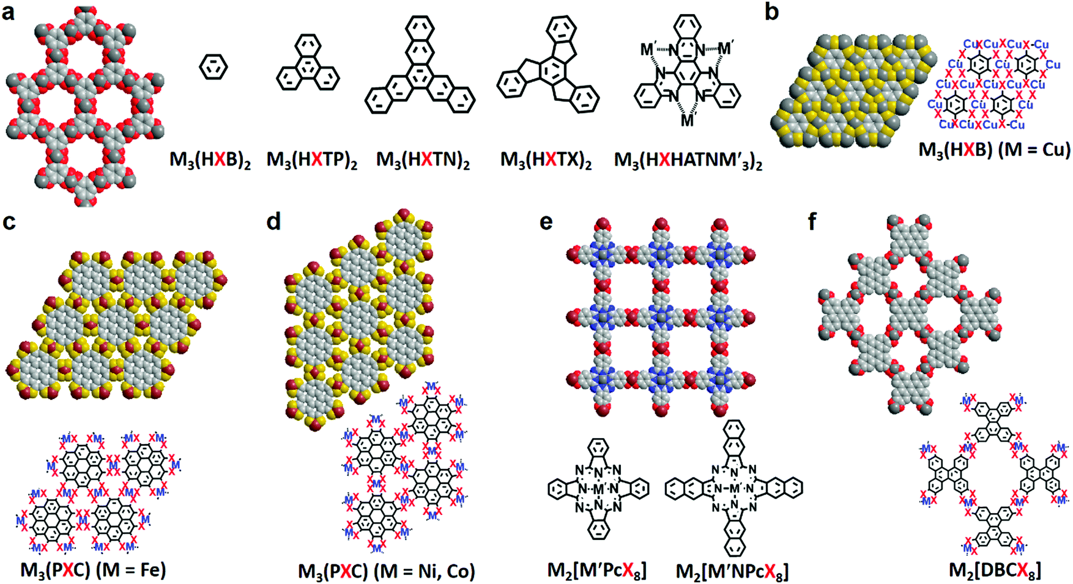
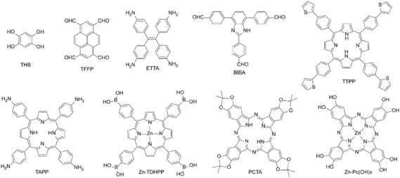
A more efficient approach…
Wang, M. Two-dimensional conjugated metal-organic frameworks. Chem. Soc. Rev., 2021
Notes:
1. There are more scalable approaches to this, where instead of painstakingly constructing lattices atom by atom with an STM probe, we can leverage techniques like molecular self-assembly where we just deposit organic molecules onto the surface where they can interact in predictable ways and spontaneously form highly ordered 2D crystalline films.
2. If you throw metals into the mix you can trigger metal-ligand coordination bonds to form what we call 2D metal-organic frameworks (MOFs).
3. 2D MOFs are typically porous materials with highly tunable structural and electronic properties. You can imagine that by playing around with the size and symmetry of the molecular building blocks you can really tune the resulting lattice structure to a great degree.

Slide 9
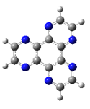
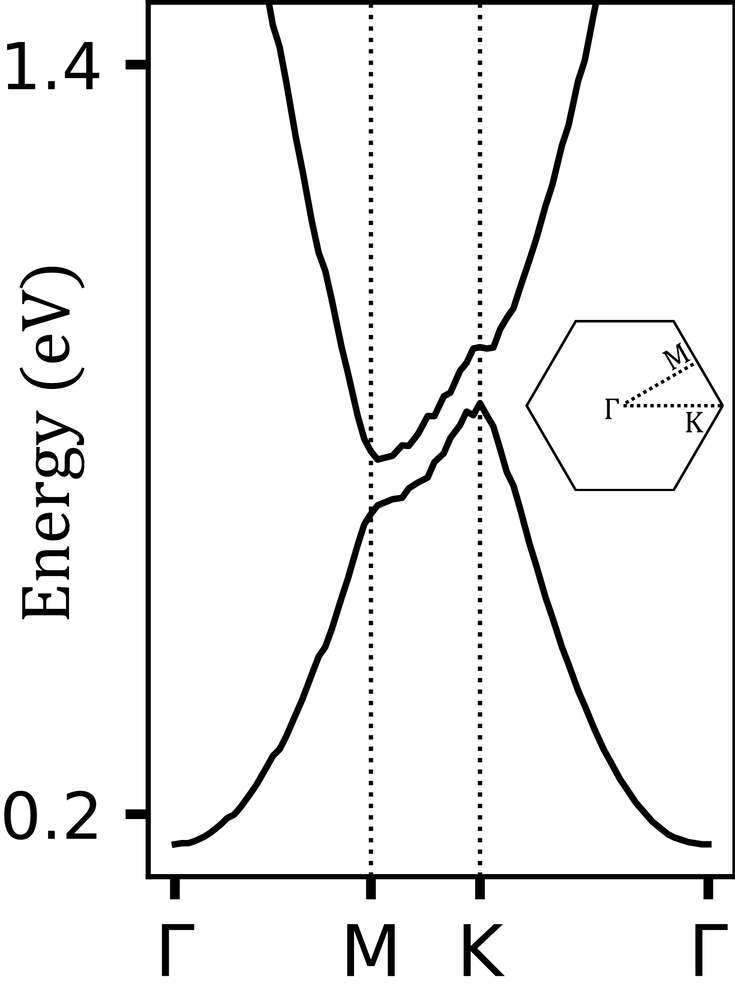

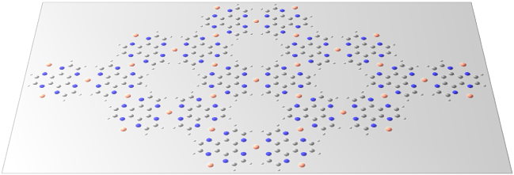
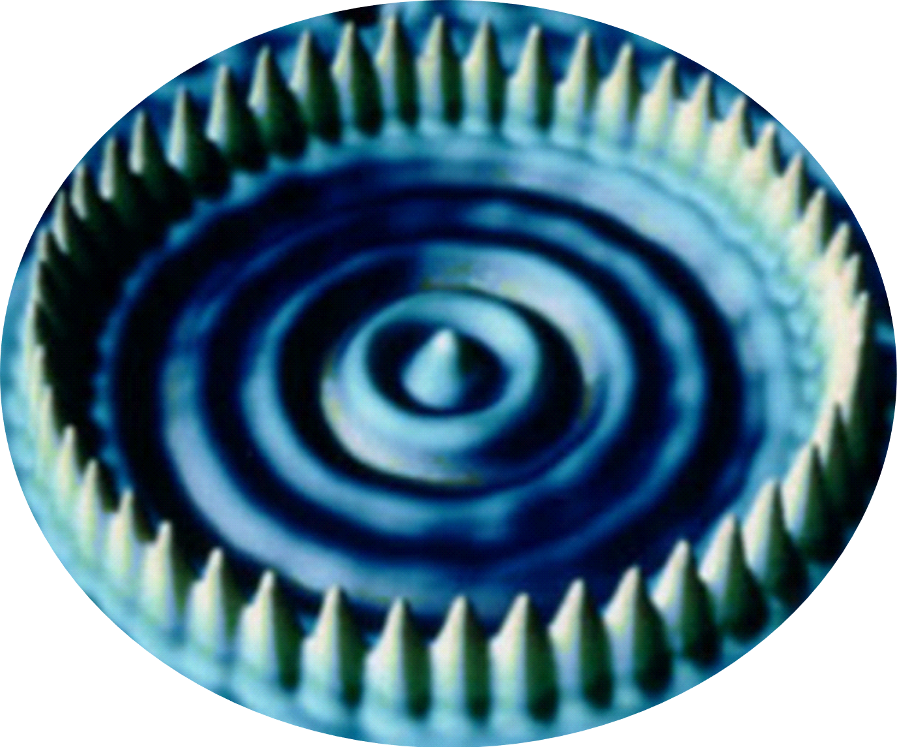


HAT-Cu MOF on Ag(111)
HAT
molecules
Cu atoms
$e$⁻
$e$⁻
Ag(111)
Notes:
So why is this relevant? If you synthesise one of these porous MOFs – in this case using copper atoms co-deposited with HAT molecules – on a surface that has a surface state, such as Ag(111), then the pores of the MOF can act like that quantum corral I showed earlier, except now you have a whole 2D network of them.
You can think of these as pores as a network of quantum dots which are coupled via some degree of transmission of the wavefunction through potential barriers imposed by the MOF.
And of course when you have a periodic system like this you can start to think of the 2DEG in terms of a modified band structure where the BZ is much smaller than that of the Ag(111) lattice.
For this system we calculated the band structure (right) by modelling a scattering potential around the geometry of the MOF and numerically solving the central equation.
What you can see is a gap that opens up; the size of this gap depends on the magnitude of the scattering potential.
We also performed this experiment in the lab… we deposited copper atoms and HAT molecules onto Ag(111) and then put it into our STM.

Slide 10
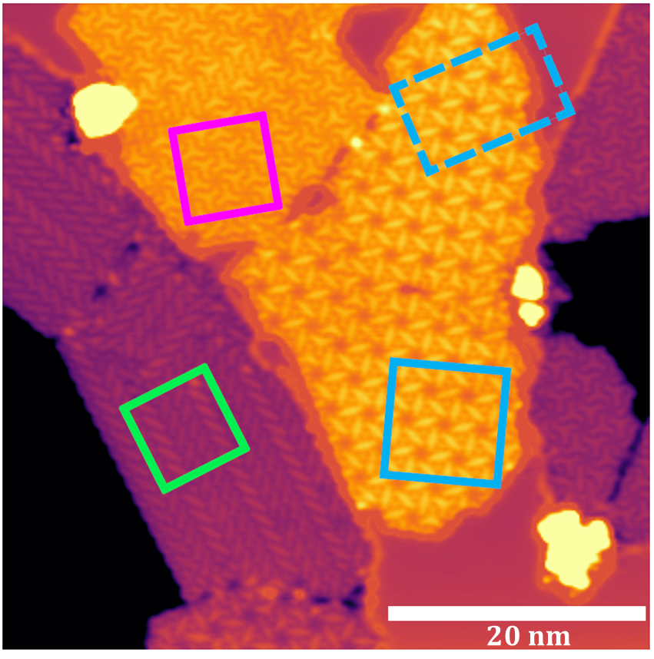
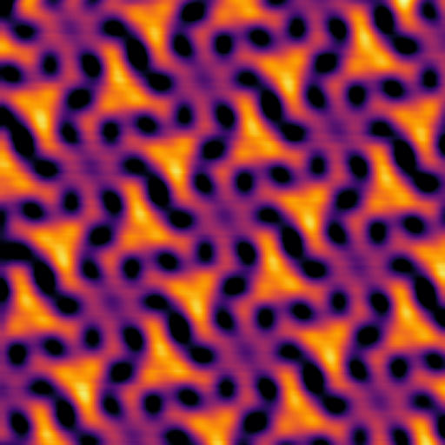





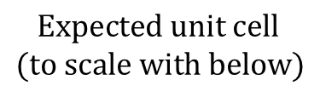


STM results… chiral structures?
$$Expected unit cell \\ (to scale with below)$$
$$Not chiral?$$
$$Ag(111)$$
$$Ag(111)$$
$$2 nm$$
$$2 nm$$
$$Pinwheel Phase$$
$$Y Phase$$
Notes:
But when we acquired our STM images, we found something quite unexpected and that is this beautiful looking chiral structures.
Of course the first question we had was where did this chirality come from, especially given that we deposited molecular building blocks that were definitely not chiral?
And when we zoom in to the blue and magenta regions, which we call the “pinwheel phase” and the “Y” phase, we can see that the unit cell of these structures are over 2 nm which is far larger than what we expected considering the size of HAT molecules. For reference you can see the unit cell we expected to see which is shown roughly to scale with the right two STM images.
4. So to gain more insight into the exact atomic structure we had to turn to a different technique…

Slide 11
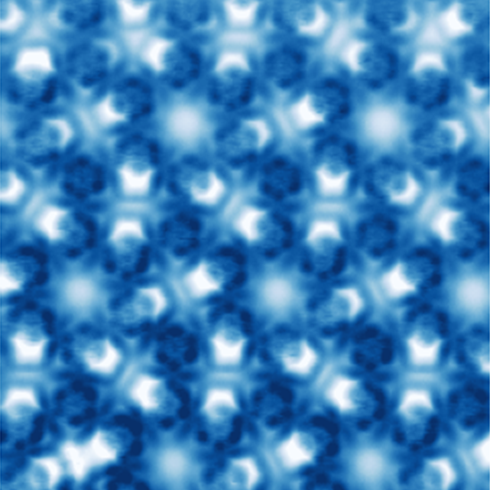
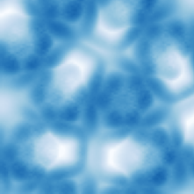
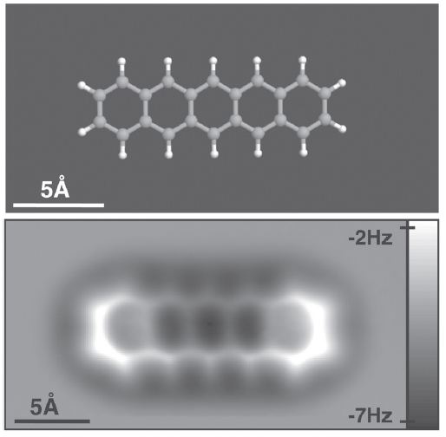
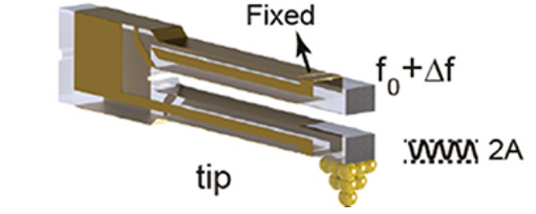



Non-contact atomic force microscopy (nc-AFM)
$$2 nm$$
$$2 nm$$
$$1 nm$$
Leo Gross, Fabian Mohn, Nikolaj Moll, Peter Liljeroth, and Gerhard Meyer. The
Chemical Structure of a Molecule Resolved by Atomic Force Microscopy. Science,
325(5944):1110–1114, August 2009.
Notes:
nc-AFM is another scanning probe technique that we can perform with the same apparatus, except now the STM tip is glued to a resonating tuning fork
And when the tip comes into close proximity of the surface, short-range forces such as the van der waals force or coulomb repulsion acting on the tip cause shifts in the resonance frequency of the tuning fork and this is something we can measure.
So now instead of being sensitive to the local density of states, this measurement is sensitive to the structural properties of the surface and can provide unprecedented resolution. And there is a famous example of this where the intramolecular features of a pentacene molecule can be resolved to the point where the image of the molecule looks like how you actually draw it.
So with this technique, we imaged our sample again and in this image on the right you can see three-fold symmetric structures composed of rings resembling the HAT molecule we deposited on the surface.
What’s interesting is that some of the rings within HAT molecules shine brighter than others, indicating that they were closer to the probe during image acquisition. So this suggests to us that some of the HAT molecules in the MOF were tilted.
And if we zoom out a bit we can see that this tilting isn’t just random, it’s actually giving rise to very ordered superstructures and not only that… these superstructures are chiral and are reminiscent of the structures we see in our STM images.
So the next question that we had was how do these chiral structures impact the surface state band structure?

Slide 12
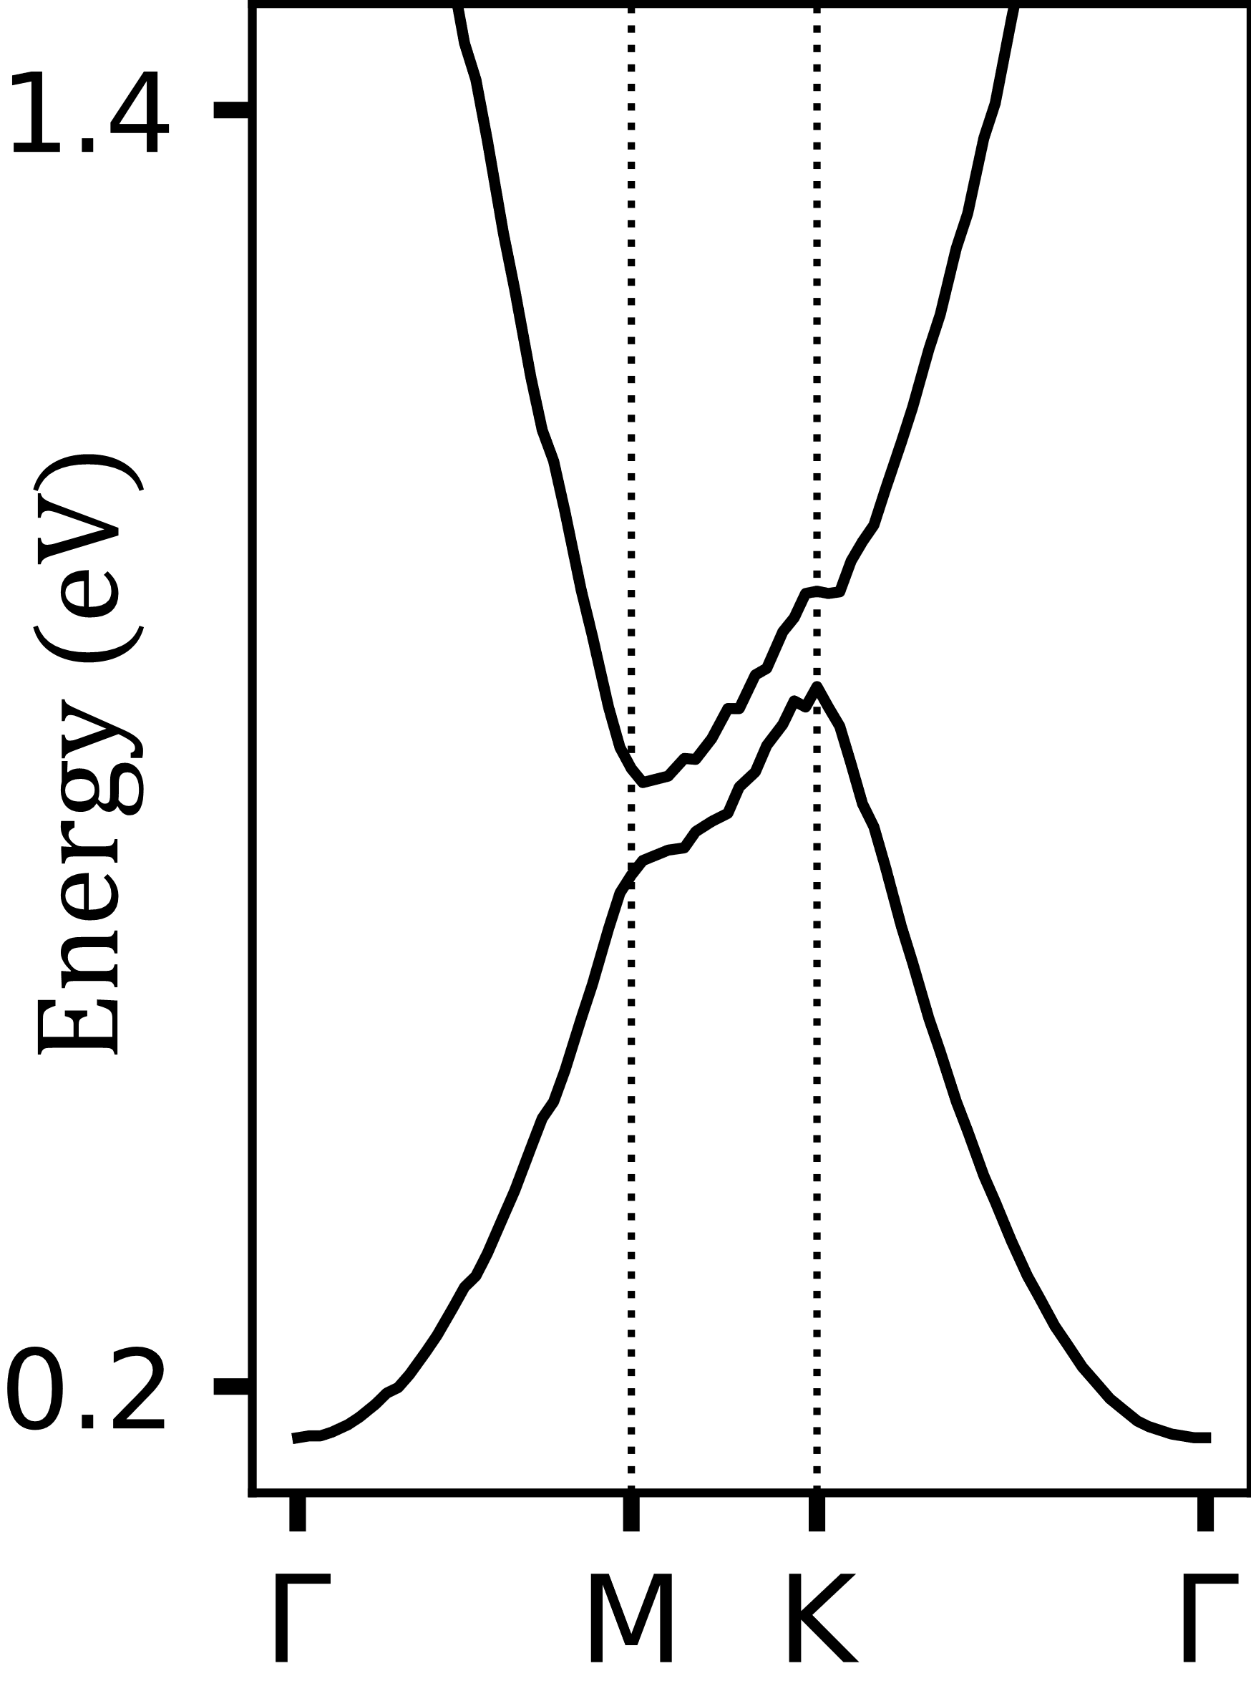
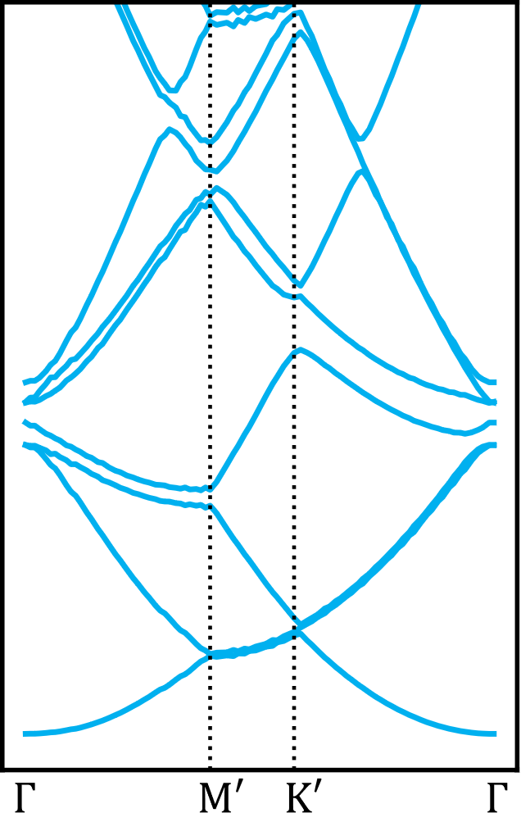
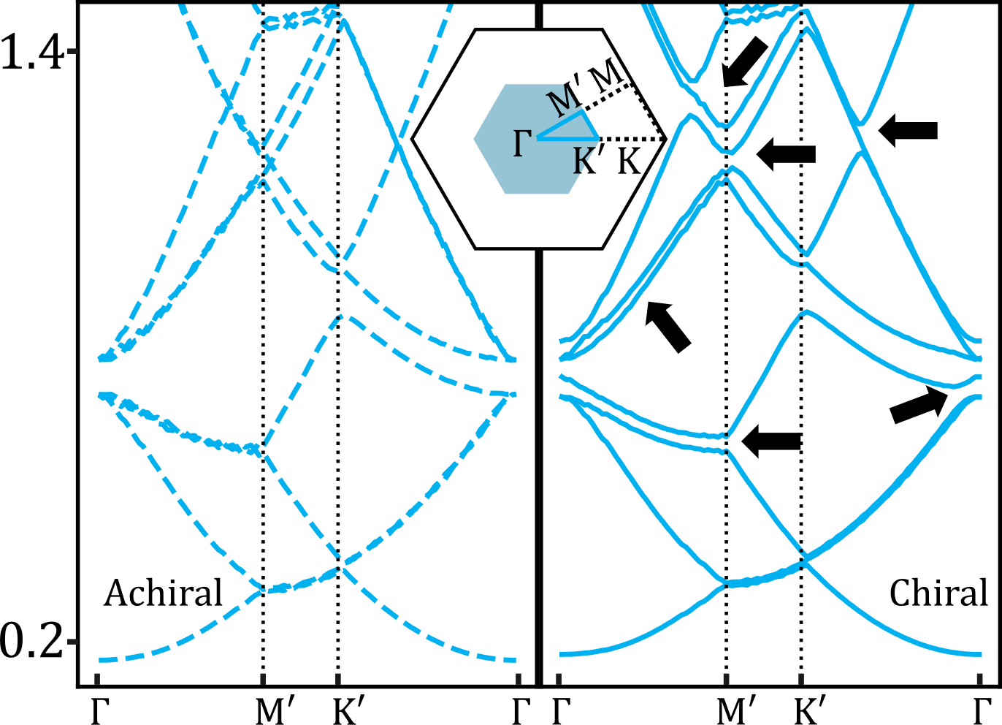
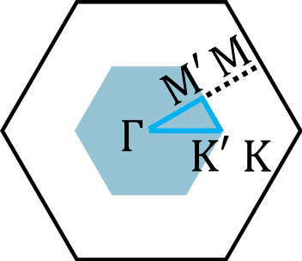



Pinwheel band structure
$$Energy (eV)$$
Notes:
On the left we have the band structure calculations resulting from the surface state scattered by the achiral MOF we thought we were going to get.
On the right we have the band structure of the pinwheel chiral superstructure.
What’s important to note is that the chiral superstructure has a significantly larger unit cell so the size of the BZ is much smaller so it’s difficult to compare these two band structures directly.
What we can do is take the achiral band structure and fold its bands from the larger BZ into the smaller one by translating k-points using the superstructure’s reciprocal lattice vectors.
When we do that, we arrive at the middle plot, where the k-space is now aligned between the achiral and chiral band structures, so we can compare directly to see the specific effects resulting from the system’s chirality.
You can see, marked by the arrows, that we see lifts of degeneracy at specific regions of the band structure.

Slide 13
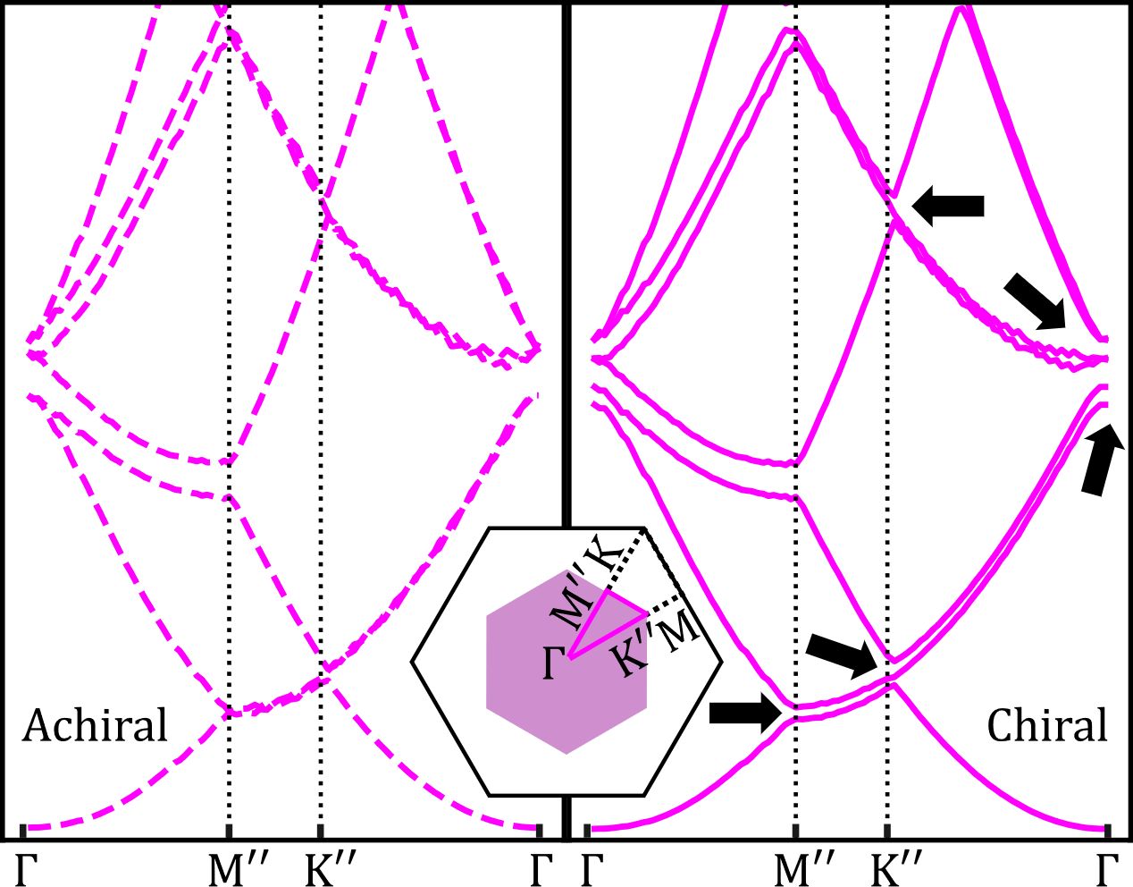



Pinwheel vs ‘Y’ band structure
$$Energy (eV)$$
$$Pinwheel Phase$$
$$Y Phase$$
Notes:
We can do the same exercise for the ‘Y’ phase and what’s nice is that you can see that these different chiral phases can alter different regions of the band structure as indicated by the black arrows.
This is a significant result because it provides a means by which we can “tune the electronic properties” of the system.
Now, these are just … “calculations”. How can we really take them seriously?
It turns out that after calculating these band structures we can extract information about the local electronic density of states of the system and this is now getting into the realm of something we can compare with data acquired in our STM experiment.

Slide 14
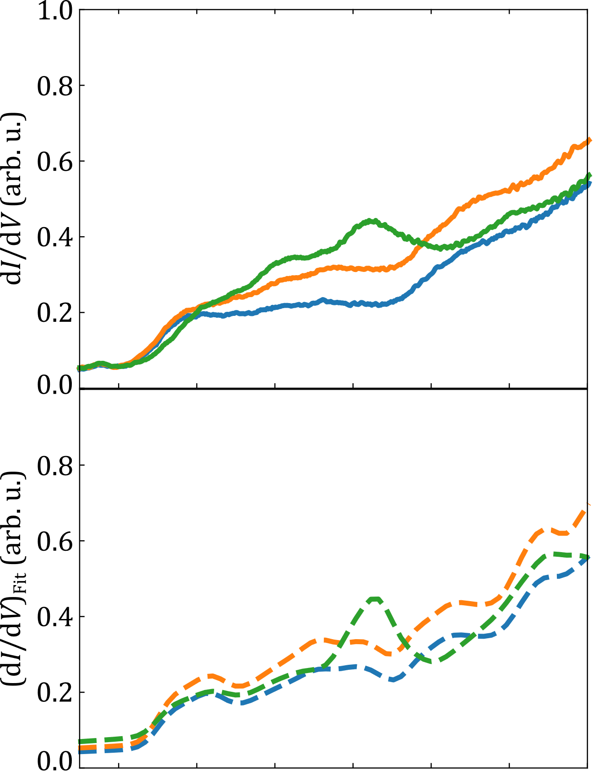
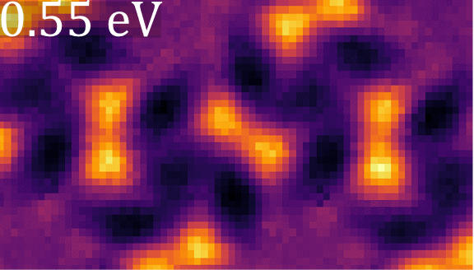
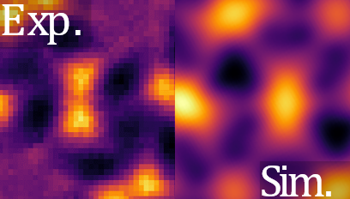
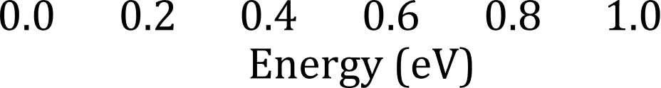
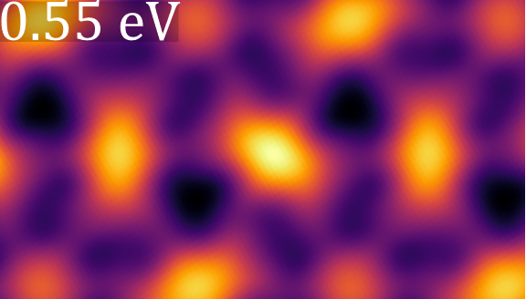





Validating our model
$$Experiment$$
$$\frac{dI}{dV}∝LDOS$$
$$Experiment$$
$$Simulation$$
$$Simulation$$
Notes:
We performed differential conductance scanning tunneling spectroscopy (STS), where you park the tip over a local region on the sample and sweep the bias voltage while measuring the tunneling current. Then when you take the partial derivative of the current with respect to voltage (so dI/dV), you get something that’s proportional to the local density of states and that’s what the curves on the left are.
Each curve corresponds to a specific location in the STM image represented by the coloured markers.
When we extract LDOS curves from our numerical calculations at equivalent points of the chiral scattering potentials, shown in the bottom panel here, we get very good agreement between what we calculate and what we measure.
What’s more is we can map the spatial distribution of the DOS at a given energy and also compare this with our numerical calculations.
So the map at the top right is our experimental data and the one below is what we obtain from our band structure calculations, and when we overlay the two we see very good agreement between the two.

Slide 15
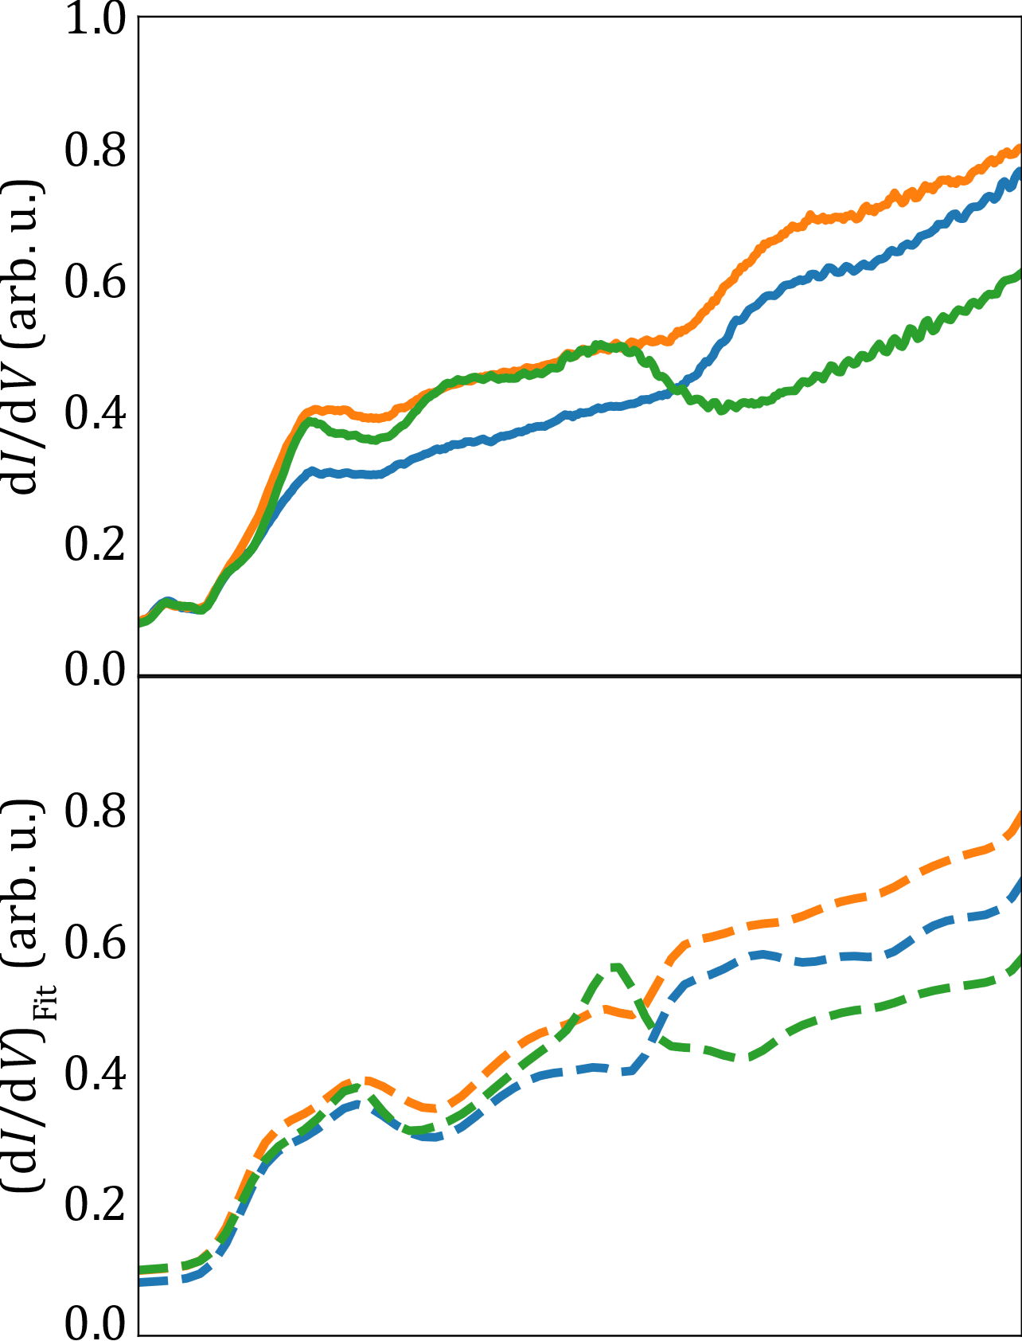
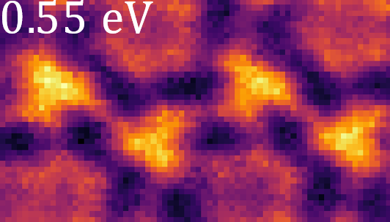
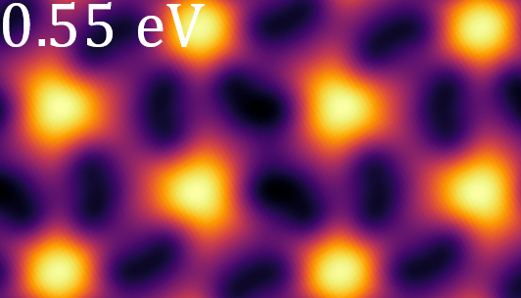
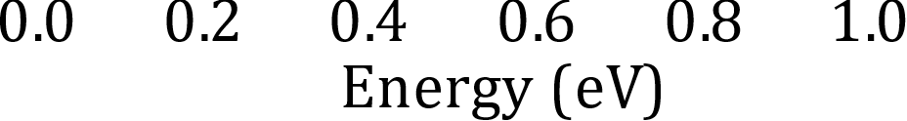


Same for the ‘Y’ phase
$$Experiment$$
$$\frac{dI}{dV}∝LDOS$$
$$Experiment$$
$$Simulation$$
$$Simulation$$
Notes:
1. For completeness, we can perform the same exercise for the ‘Y’ phase and again see nice agreement between our experimental spectroscopy measurements and the LDOS predicted by our band structure calculations.
2. And similarly strong agreement between the LDOS maps.
3. So this really gives us confidence in our model

Slide 16
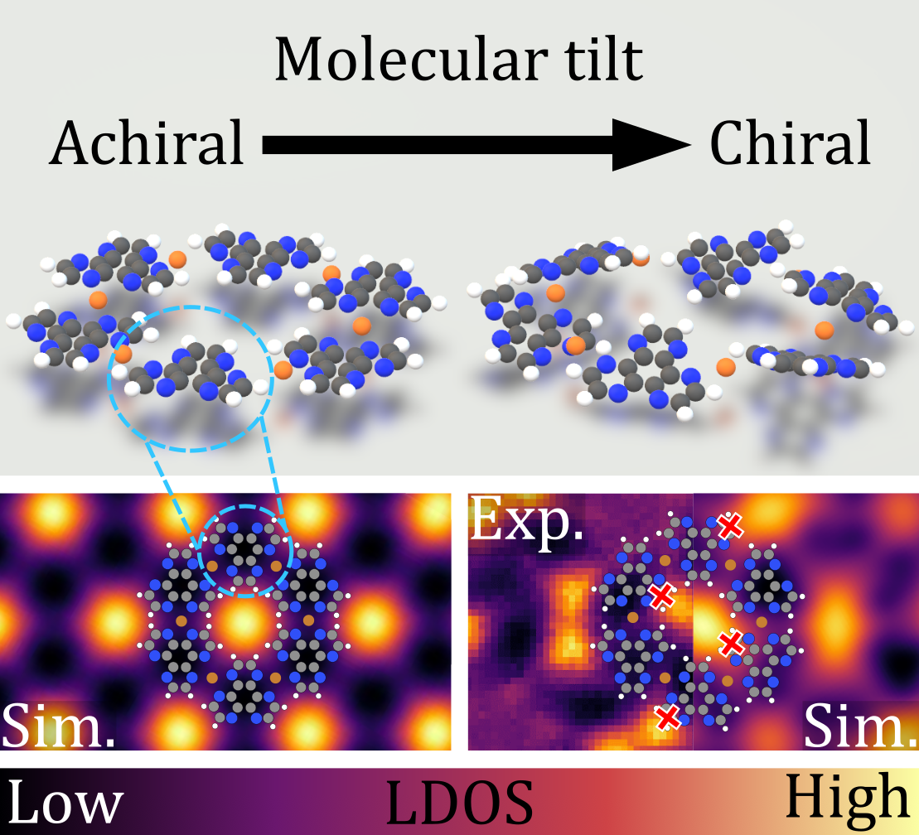

Conclusion
$$Energy (eV)$$
Notes:
1. In summary, we synthesized a 2D MOF on Ag(111) and a tilting of the molecules in this MOF gave rise to chiral superstructures.
2. We showed how these superstructures acted as chiral scattering potentials, perturbing the 2D free-electron band structure in unique ways which is nice because here we have a control mechanism to tune the band structure based on the chirality of the system.

Slide 17
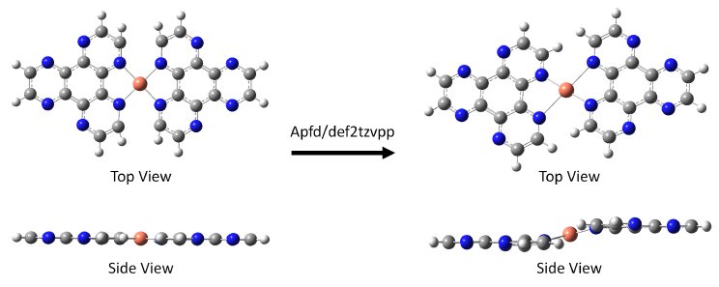
Why do the molecules tilt?
Notes:
Steric repulsion between neighbouring HAT molecules cause them to tilt

Slide 18
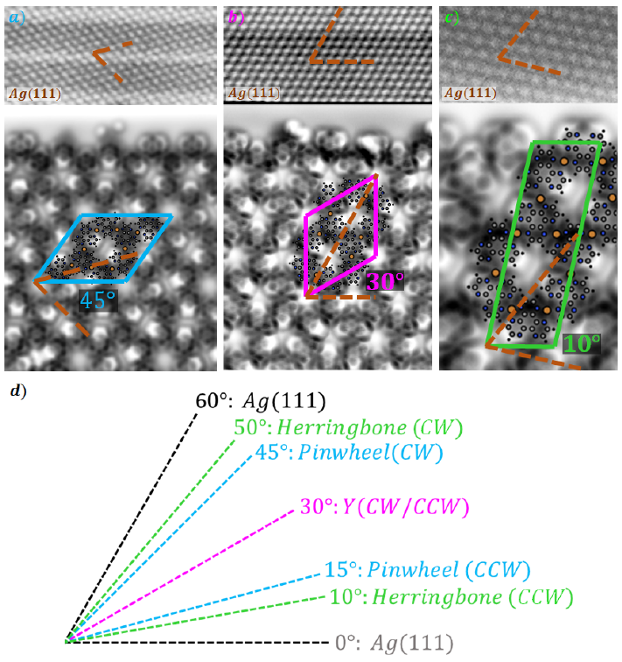
Why are there different MOF phases?
Notes:
Different MOF phases arise due to interaction with the underlying Ag(111) substrate. Depending on the orientation of the MOF with respect to the substrate, different phases emerge

