Slide 1
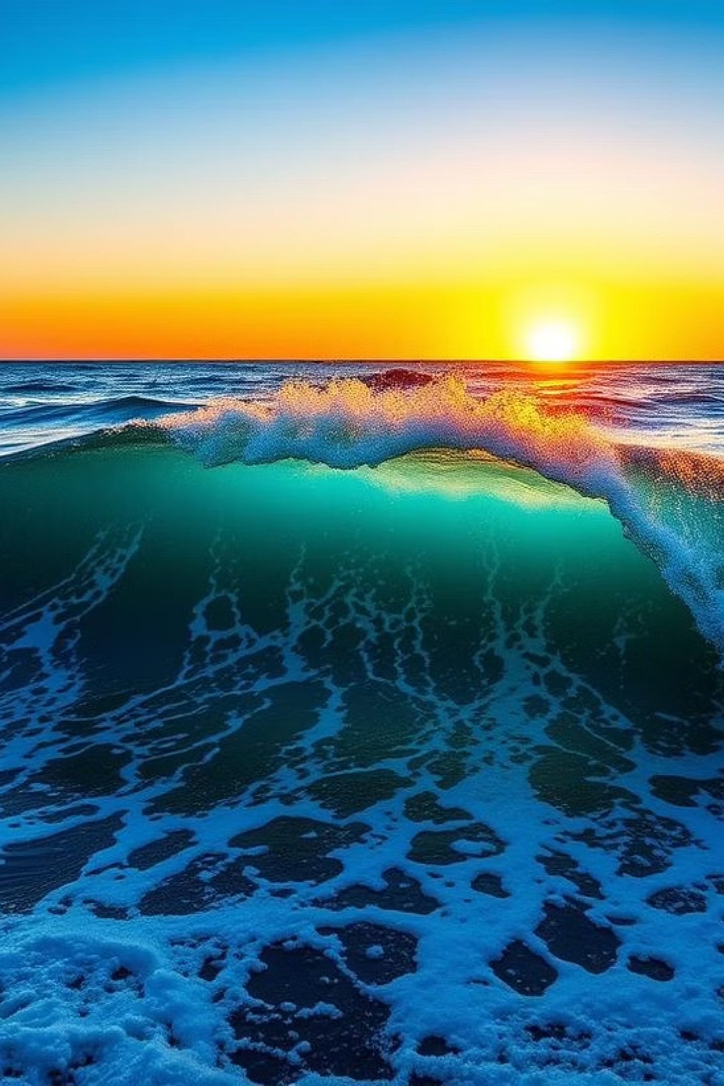
WATER – The Elixir of Life
A Presentation by [Group 3 / Roll no. 29-42]
“Thousands have lived without love, not one without water.” – W.H. Auden

Slide 2
The Lifeblood of Earth 🌍
Silent Architect of Life
Vast Yet Scarce
A Delicate Balance
Water shapes landscapes and sustains ecosystems, driving the very essence of life on our planet.
It covers 71% of Earth’s surface, yet a mere 0.3% is accessible for critical human needs.
This intricate balance positions water as our planet’s most invaluable and precious resource.

Slide 3
The Many Roles of Water 💧
Nourishing Agriculture
Powering Industries
Maintaining Biodiversity
Water nourishes crops, enabling agriculture to feed billions worldwide.
It fuels industries through cooling, cleaning, and driving energy systems.
Water sustains biodiversity, keeping our forests, rivers, and wetlands vibrant and alive.
Water is not merely a resource; it is the essence of life itself.

Slide 4
Sources of Freshwater 🌊
Rivers and Lakes: Earth’s vital arteries, delivering essential freshwater to ecosystems and communities.
Groundwater: Hidden aquifers, critical for many regions but facing significant challenges due to overuse.
Glaciers: Majestic frozen reservoirs that slowly release water, feeding rivers and sustaining downstream life.
Atmospheric Water: Clouds and rain, integral to the hydrological cycle, sustaining global water balance.

Slide 5
A World in Crisis 🚨
Ecological Strain
Access Inequality
Rampant pollution and over-extraction have pushed vital ecosystems to the brink of collapse.
Billions globally lack fundamental access to clean, safe drinking water, a basic human right.
Future Projections
Climate Impact
By 2040, projections indicate that water stress could critically affect one-third of humanity.
Climate change intensifies water insecurity, manifesting as severe droughts and devastating floods.

Slide 6
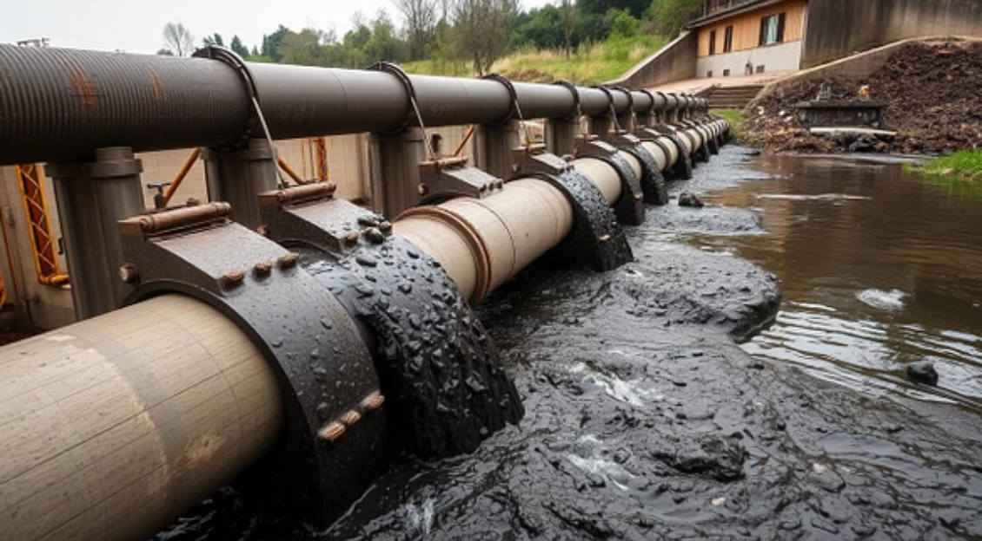
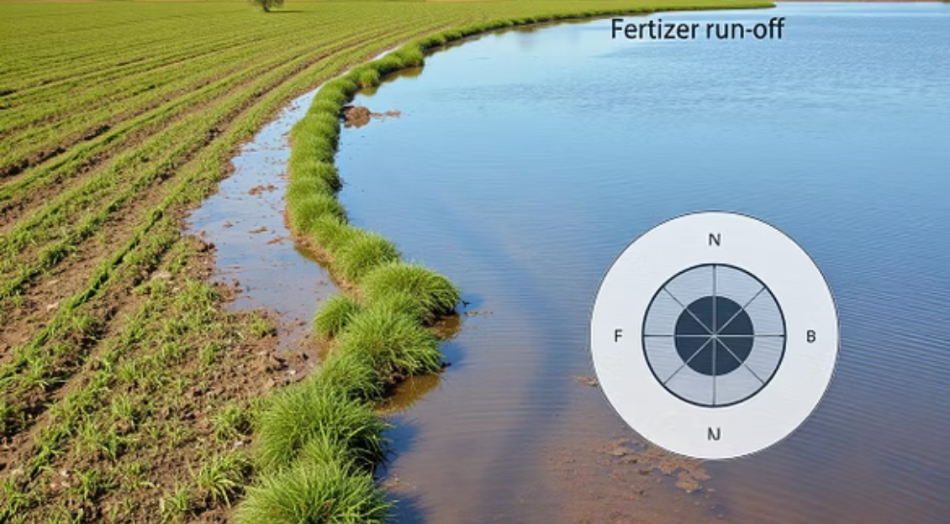
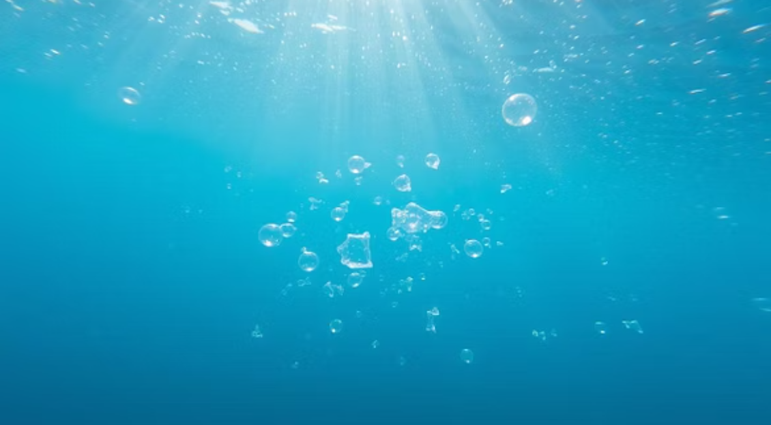
Pollution: The Invisible Killer
Industrial Waste : Untreated industrial discharge poisons our rivers and lakes, rendering them toxic.
Agricultural Runoff : Pesticides and fertilizers seep into groundwater, contaminating vital drinking supplies.
Plastic Debris : Macro and microplastic pollution permeates our water bodies and infiltrates the food chain.
Case Study : The Yamuna River: A stark example of a sacred waterway suffocated by relentless pollution.

Slide 7
India’s Water Woes 🇮🇳
Major rivers like the Ganga and Yamuna are severely choked with industrial and urban pollutants.
River Contamination
Groundwater tables are plummeting rapidly due to unsustainable over-extraction for agriculture and urban use.
Groundwater Depletion
Rapid urbanization and extensive deforestation are critically disrupting natural water cycles.
Disrupted Cycles

Slide 8
Conservation: Path to Hope 🌱
Rainwater Harvesting
Smart Irrigation
Adopt rainwater harvesting systems to effectively recharge depleted aquifers.
Implement smart irrigation technologies to achieve significant water savings in farming.
Desalination Promotion
Community Awareness
Promote advanced desalination technologies for wise and sustainable ocean water utilization.
Foster community awareness and engagement for initiating lasting behavioral change.

Slide 9
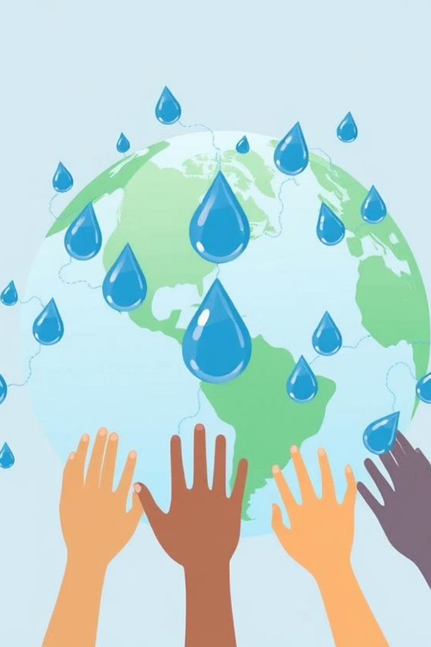
Global and Local Solutions 🌐
Global Unity for Water
Local Action for Impact
Establish international treaties for shared water resource management.
Implement advanced wastewater recycling for sustainable urban water reuse.
Promote afforestation efforts to restore natural rain cycles and water retention.
Water is a shared responsibility demanding unwavering global unity and action.

Slide 10
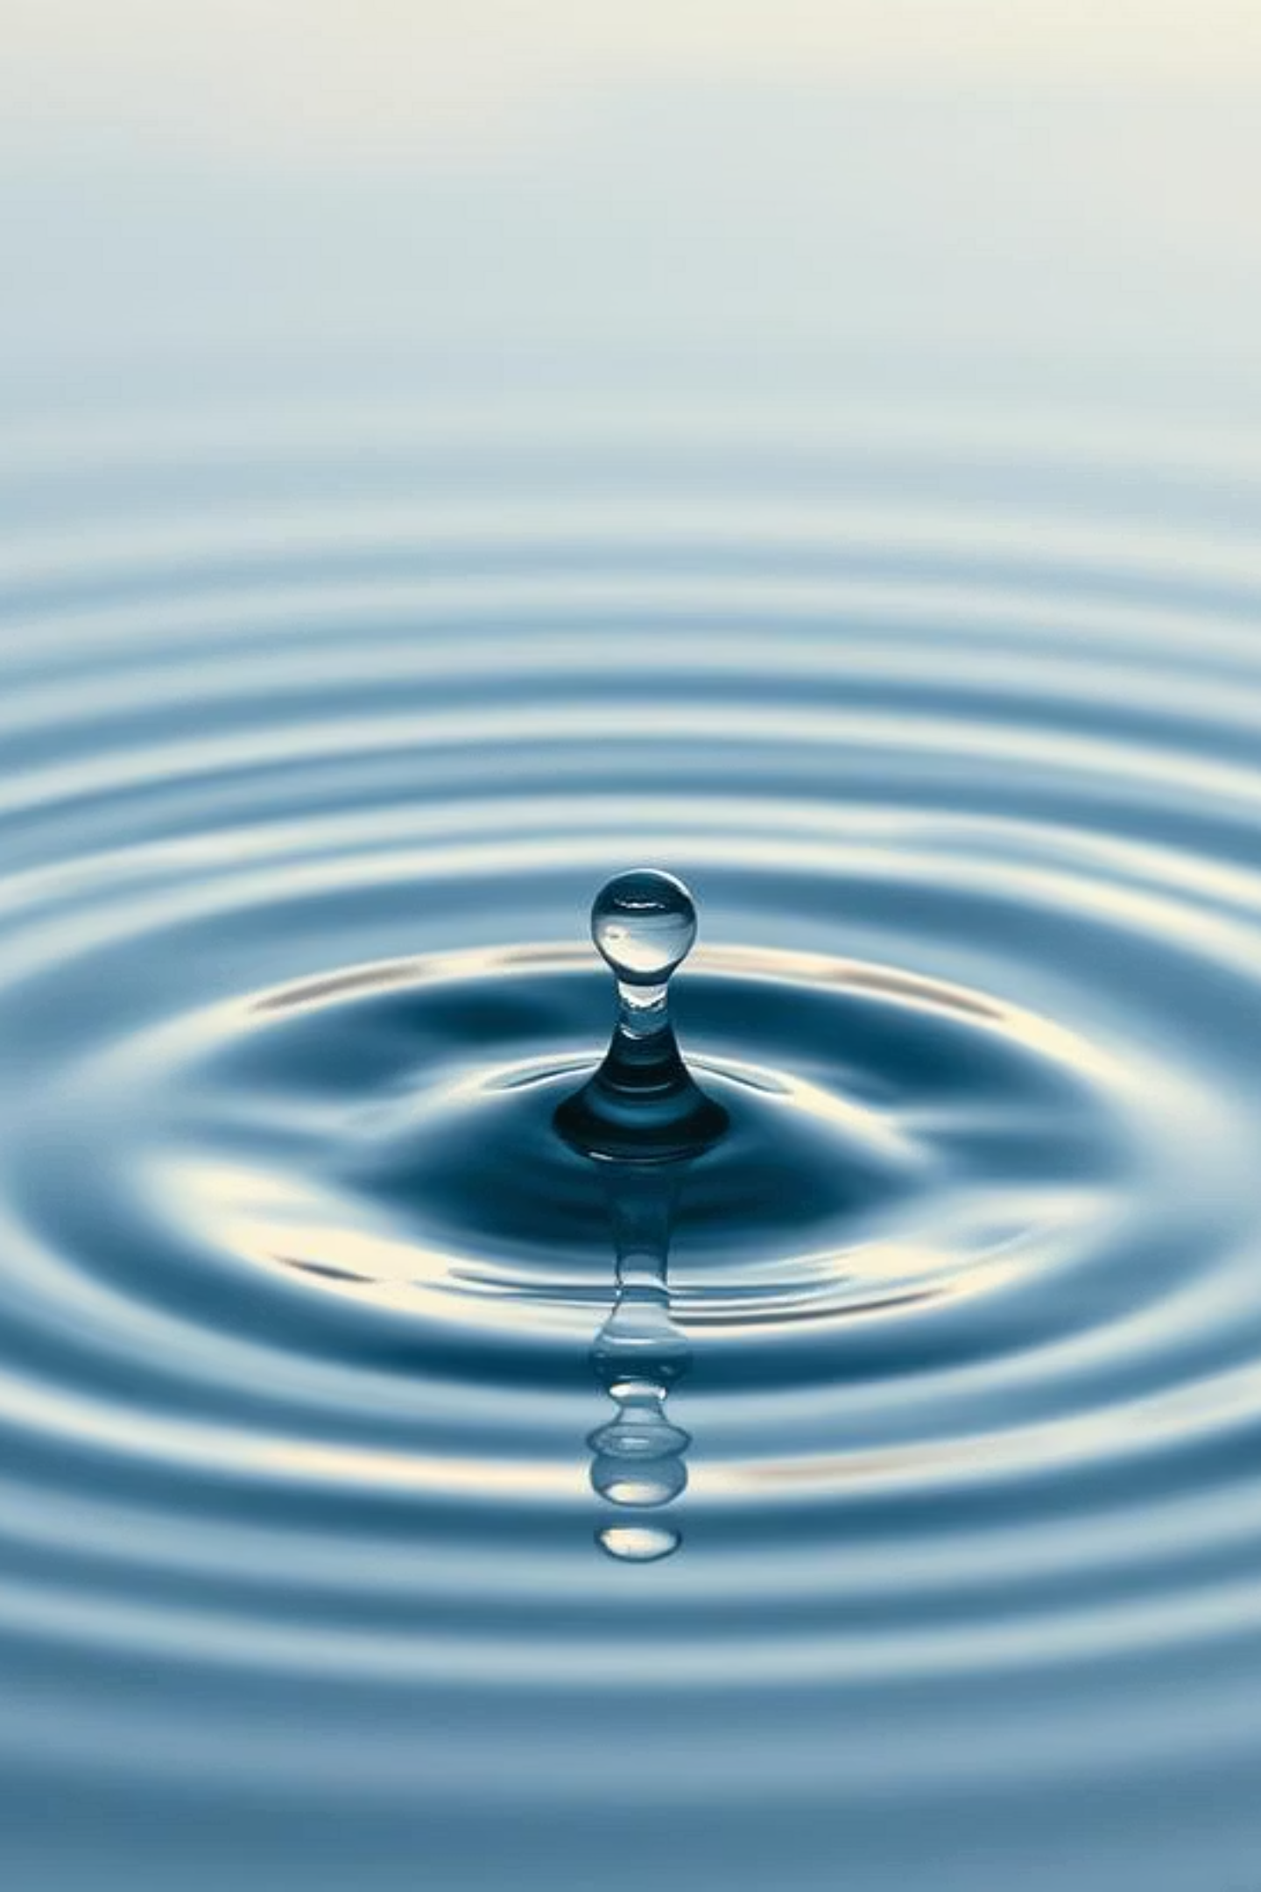
Our Call to Action 💧
“We do not inherit the Earth from our ancestors; we borrow it from our children.” – Native American Proverb
One Earth. One Chance. Save Water.
Every drop saved today is a solemn promise of life and sustainability for tomorrow.

