Slide 1
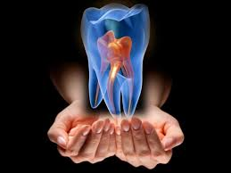
ROOT CANAL MORPHOLOGY AND ACCESS CAVITY PREPARATION 2
Yrd.Doç. Dr. Emrah KARATAŞLIOĞLU İZMİR KATİP ÇELEBİ ÜNİVERSİTESİ DİŞ HEKİMLİĞİ FAKÜLTESİ ENDODONTİ A.D.

Slide 2
The aim of the access preparation is to provide an
easy and comfortable endodontic treatment
with restoration of normal structure and function of the tooth.

Slide 3
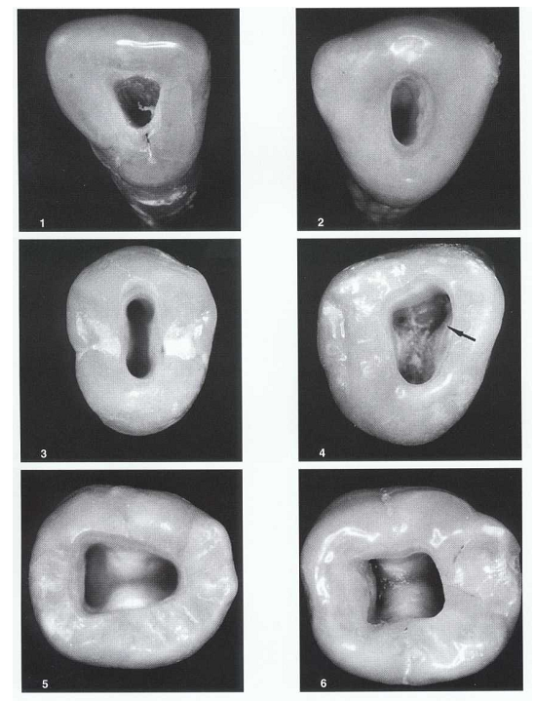
1. Maxillary lateral
2. Mandibular canine
3. Maxillary premolar
4. Four-canal maxillary molar (arrow indicates dentin shelf covering mesiolingual orifice)
5. Three-canal mandibular molar
6. Four-canal mandibular molar

Slide 4
MAXILLARY CENTRAL INCISOR
Developmental and anatomic data
Average time of eruption-: 7-8 Years
Average age of calcification-: 10 Years
Average tooth length-: 22.5mm
Average root length-:13mm

Slide 5
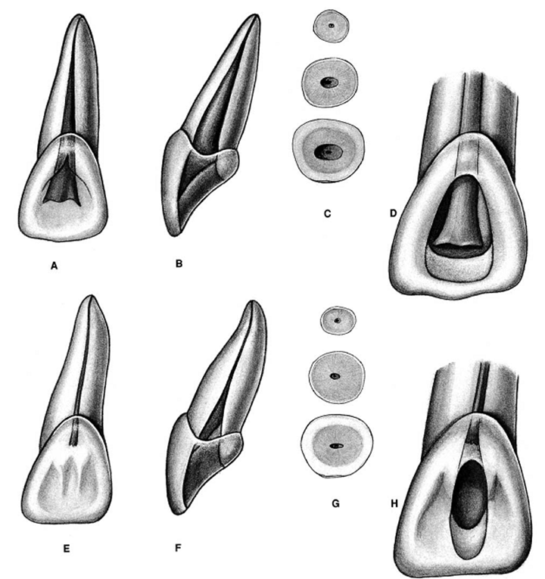
MAXiLLARY CENTRAL iNCiSOR
Pulp chamber
It is located in the centre of crown equidistant from the dentinal wall.
It is broad m-d, with its broadest part incisally.
It has three pulp horns that corresponds to the double mammelons in a young tooth.

Slide 6
MAXiLLARY CENTRAL iNCiSOR
Root and root canal
It has one root with one root canal.
Root canal is broad labio-palatally, conical shape, and centrally located.
In cross-section, canal is ovoid m-d in cervical third, rounded in middle and apical third.
Multiple canals are rare , but lateral canals are common.

Slide 7
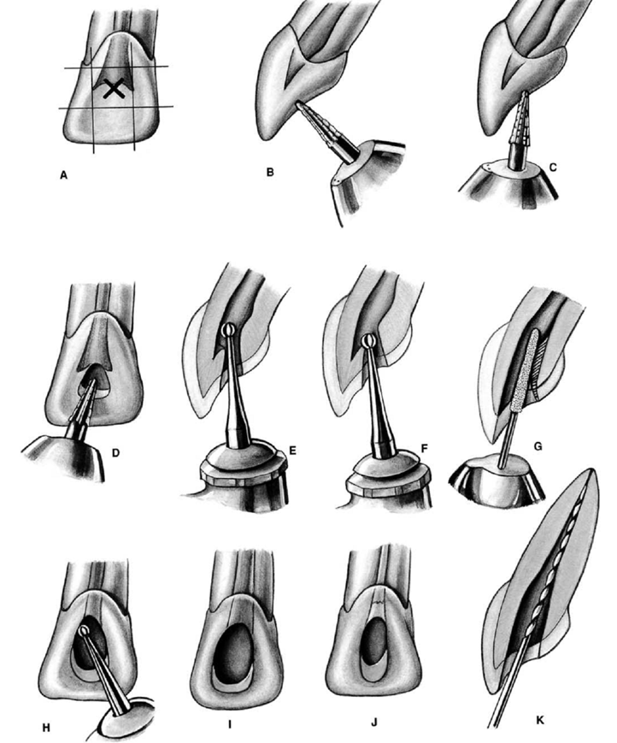
MAXiLLARY CENTRAL iNCiSOR
Access opening
Shape, size and coronal extension of pulp chamber are estimated by diagnostic radiograph.
Enamel is penetrated in the centre of the lingual surface at an angle perpendicular to it, with a number 4 round bur in high speed contra-angle.

Slide 8
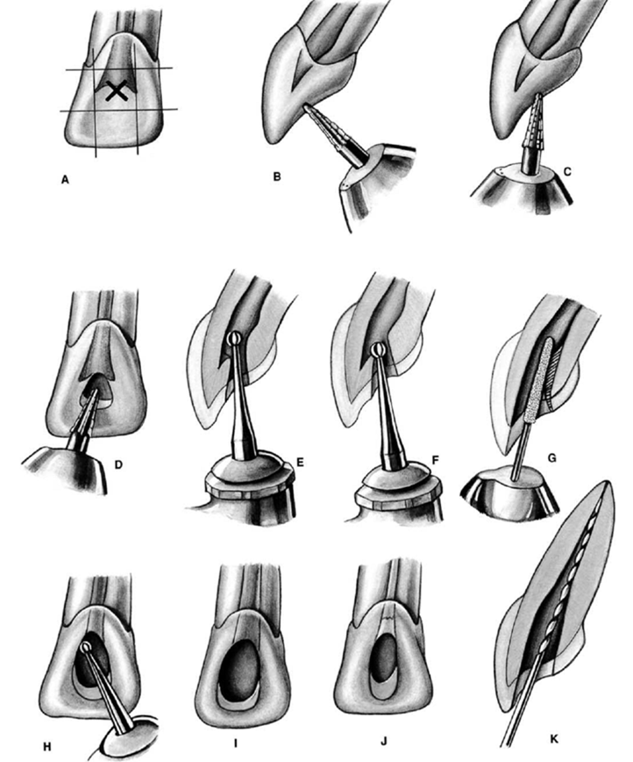
After penetration of the enamel, a carbide bur in a slow speed contra-angle is directed along the long axis of the tooth until the pulp chamber is reached.
A “drop” of the bur into the chamber may be felt if the chamber is large enough.
The overhanging enamel and dentin on lingual surface of the pulp chamber is removed with a round bur in a slow speed contra-angle by working from inside to outside following internal anatomy.

Slide 9
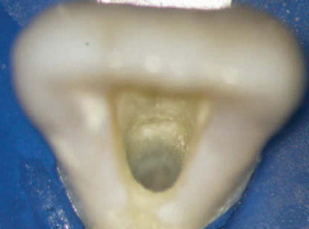
Direct access can be verified by placing a straight end of the endodontic explorer in the canal orifice.
The external access outline form for the maxillary central incisor is a rounded triangle with its base toward the incisal aspect.
The width of the triangular base is determined by the distance between the mesial and distal pulp horns.

Slide 10
The mesial and distal external walls should converge toward the cingulum.
All internal walls should funnel to the root canal orifice.
The outline form of the access cavity changes to a more oval shape as the tooth matures and the pulp horns recede because the mesial and distal pulp horns are less prominent.

Slide 11
MAXiLLARY CENTRAL iNCiSOR

Slide 12
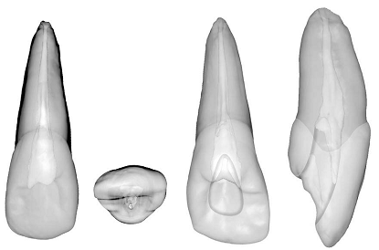
MORPHOLOGY AND ACCESS CAVITY PREPARATION FOR MAXILLARY LATERAL INCISOR
Developmental and anatomic data
Average time of eruption-: 8-9Years
Average age of calcification-: 11Years
Average tooth length-: 22mm

Slide 13
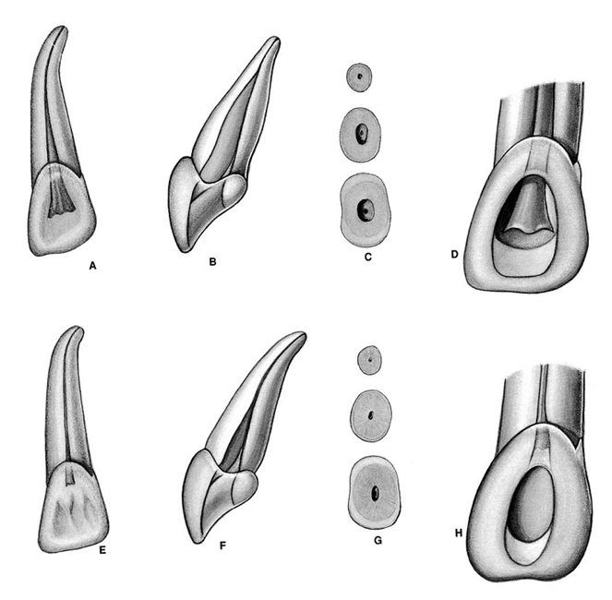
MAXILLARY LATERAL INCISOR
Pulp chamber
The shape of the pulp chamber is similar to the maxillary central incisor.
It only has two pulp horn, corresponding to the developmental mamelons.
A cross-section at the CEJ shows a pulp chamber centered in the root, and its shape may be triangular, oval, or round.

Slide 14
MAXILLARY LATERAL INCISOR
Root and root canal
Configuration of the root canal is conical but it has a finer diameter than maxillary central incisor.
In cross-section, the canal is ovoid labio-palataly in the cervical third and middle third, round in apical third.
From the CEJ the pulp canal becomes round in cross-section in the midroot and apical areas.
Normally only one root canal is present.

Slide 15
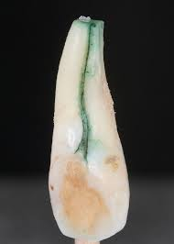
MAXILLARY LATERAL INCISOR
Root and root canal
The maxillary lateral incisor often has anomalies such as a lingual radicular or developmental groove.
Although this groove may be present on the roots of all anterior teeth, it is more common in the maxillary lateral.
The groove can lose its periodontal attachment as a result of both periodontal and endodontic etiologies.
There is generally direct communication between the groove and the pulp cavity and this occurs primarily through dentinal tubules.

Slide 16
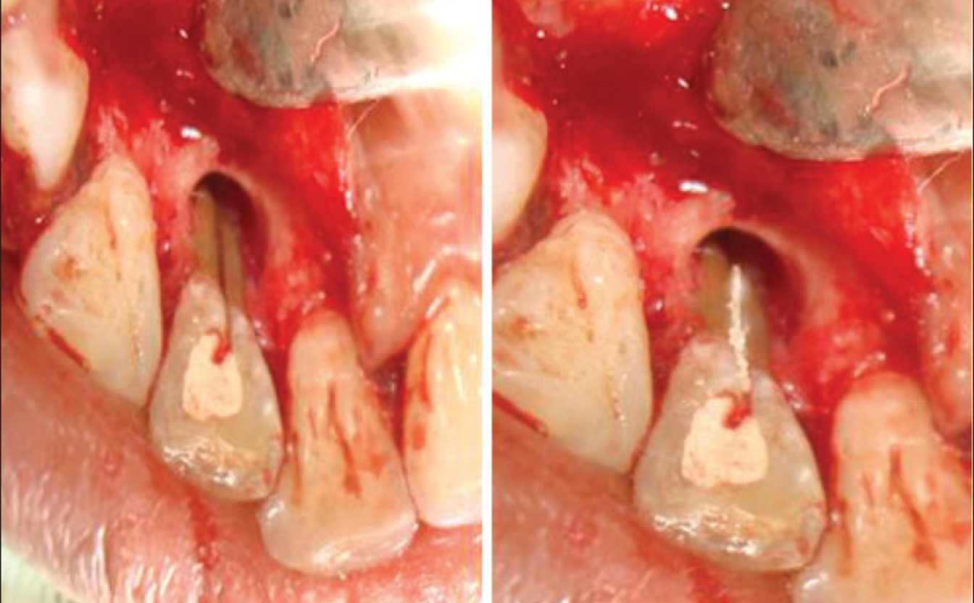
MAXILLARY LATERAL INCISOR

Slide 17
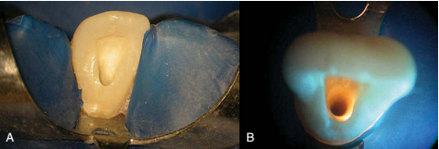
MAXILLARY LATERAL INCISOR
Access opening
It is similar to that for a maxillary central incisor, but is smaller and usually more ovoid.
The external access outline form for the maxillary lateral incisor may be a rounded triangle or an oval, depending on the prominence of the mesial and distal pulp .
When the horns are prominent, the rounded triangular shape is compressed mesiodistally relative to a central incisor, producing a more slender triangle.
The outline form usually is oval if the mesial and distal pulp horns are not prominent.
All other aspects of the access preparation are the same as those for the central incisor.

Slide 18
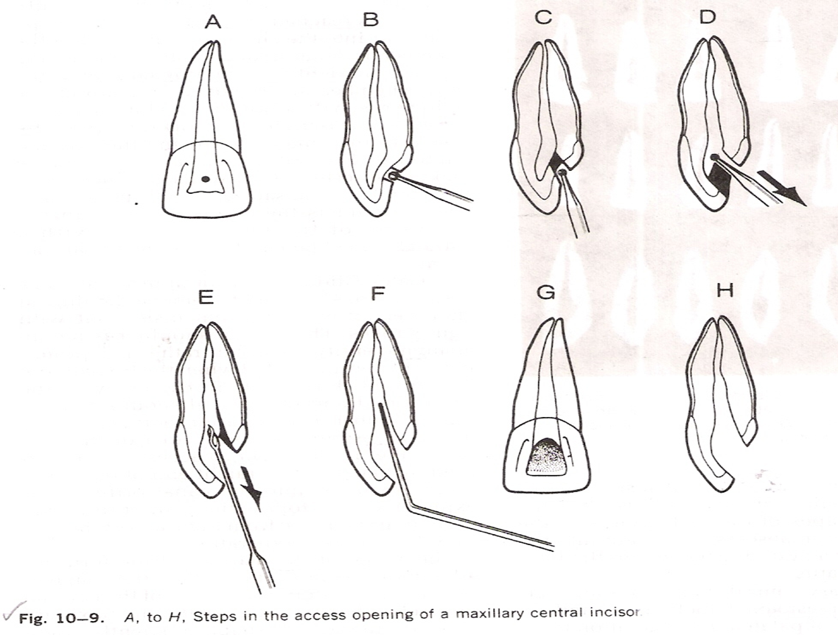
MAXILLARY LATERAL INCISOR Access opening

Slide 19
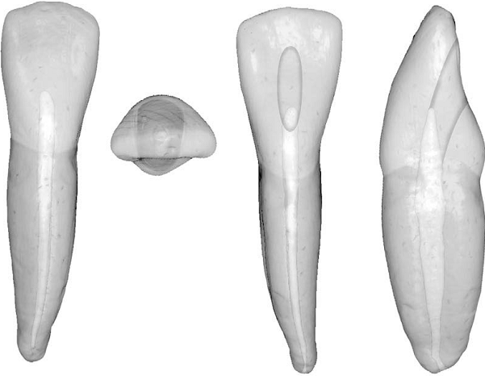
Morphology And Access Cavity Preparation For Mandibular Central And Lateral Incisor
Developmental and anatomic data
Average time of eruption-: 7-8Years
Average age of calcification-: 9-10Years

Slide 20
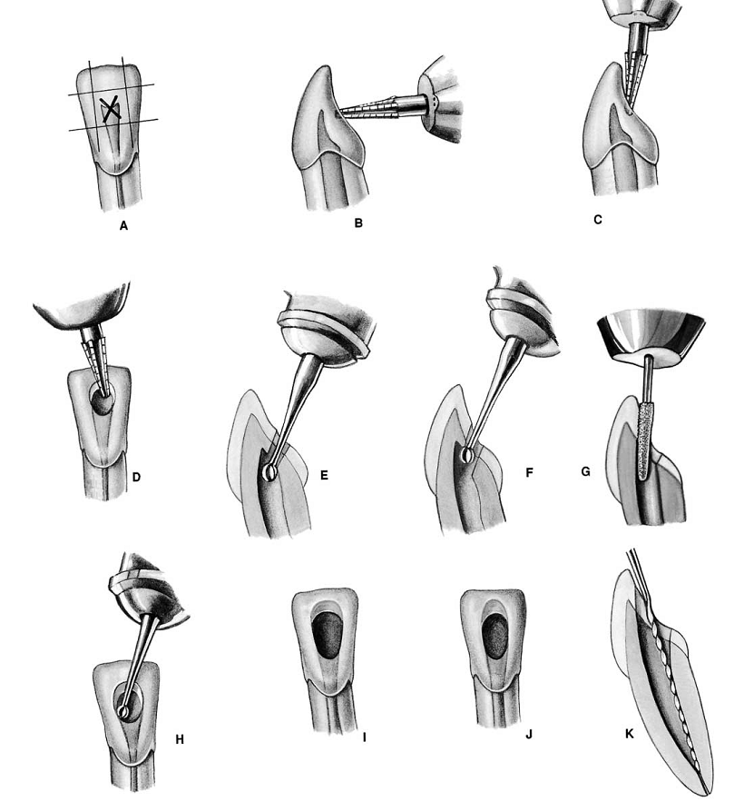
Morphology And Access Cavity Preparation For Mandibular Central And Lateral Incisors
The root canal systems and access cavities for the two mandibular incisors are so similar.
As with the maxillary incisors, a lingual shoulder must be eliminated to allow direct-line access.
The shoulder hides or covers the orifice to a second canal.
Unlike the maxillary incisors, the pulp outline of the mandibular incisors is wider labiolingually.

Slide 21
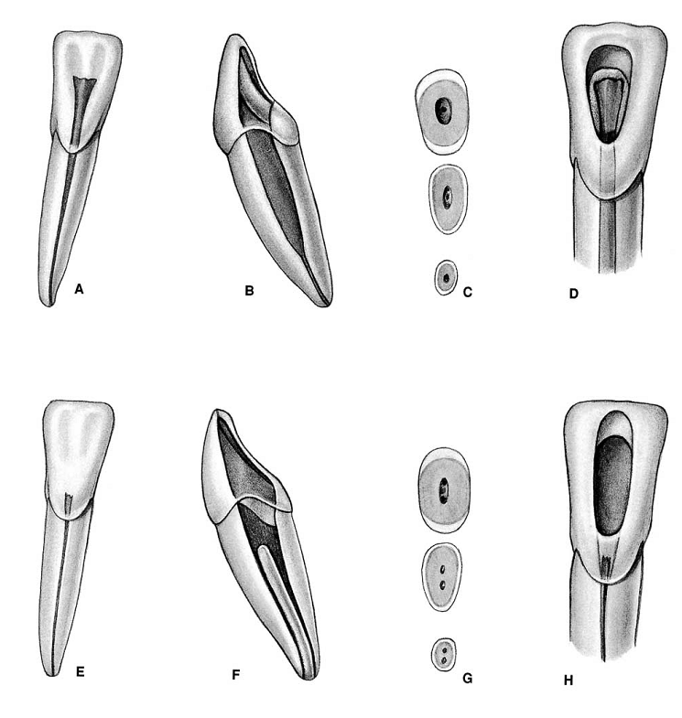
Morphology And Access Cavity Preparation For Mandibular Central And Lateral Incisors
At the CEJ the pulp outline is oval, wider labiolingually than mesiodistally.
At midroot the canal outline is still oval, but the canal is more constricted and narrower labiolingually.
Most mandibular incisors have a single root with what radiographically appears to be a long, narrow canal.
However, it is a broad canal labiolingually.
Often a dentinal bridge is present in the pulp chamber that divides the root into two canals.

Slide 22
Morphology And Access Cavity Preparation For Mandibular Central And Lateral Incisors
The two canals usually join and exit through a single apical foramen, but they may persist as two separate canals.
On occasion one canal branches into two canals, which subsequently rejoin into a single canal before reaching the apex.
One study determined that a relationship existed between crown size (expressed as the M-D/F-L index) and the incidence of bifid root canals in these teeth. Double root canals occur more often in teeth with a smaller index.

Slide 23
Morphology And Access Cavity Preparation For Mandibular Central And Lateral Incisors
Double root canals occur more often in teeth with a smaller index.
The mandibular incisors, because of their small size and internal anatomy, may be the most difficult access cavities to prepare.
The external outline form may be triangular or oval, depending on the prominence of the mesial and distal pulp horns.

Slide 24
Morphology And Access Cavity Preparation For Mandibular Central And Lateral Incisors
When the form is triangular, the incisal base is short and the mesial and distal legs are long incisogingivally, creating a long, compressed triangle.
Without prominent mesial and distal pulp horns, the oval external outline form also is narrow mesiodistally and long incisogingivally.
One study determined that by age 40 years the mandibular incisor pulp chamber has decreased in size sufficiently to routinely justify an oval access cavity.

Slide 25
Morphology And Access Cavity Preparation For Mandibular Central And Lateral Incisors
Complete removal of the lingual shoulder is critical, because this tooth often has two canals that are buccolingually oriented, and the lingual canal most often is missed.
To avoid missing this canal, the clinician should extend the access preparation well into the cingulum gingivally.
Butt joint junctions between the internal walls and the lingual surface are not required, because the lingual surface of this tooth is not involved with occlusal function,

Slide 26
MANDIBULAR LATERAL INCISOR
Pulp chambers
Same as mandibular central incisor but it has larger dimension.
Root and root canal
Larger than mandibular central incisor.
Majority of root are straight.
Distal root curvature is more sharper than central incisor.
Access opening
Same as mandibular central incisor

Slide 27
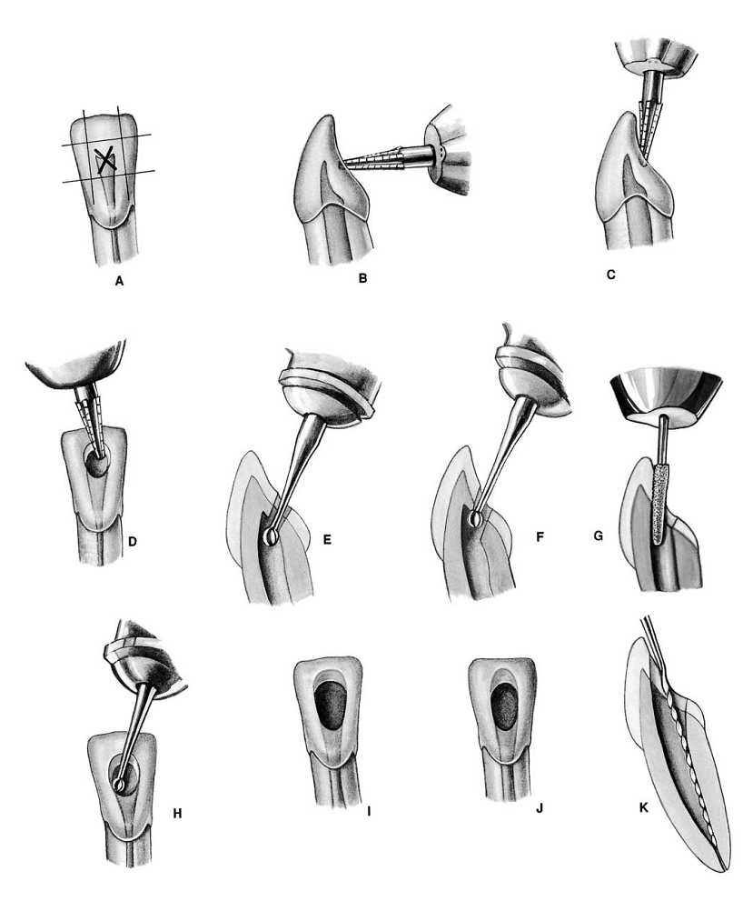
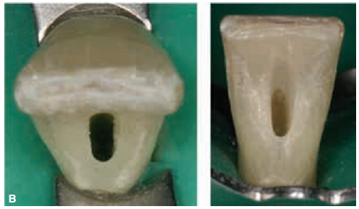
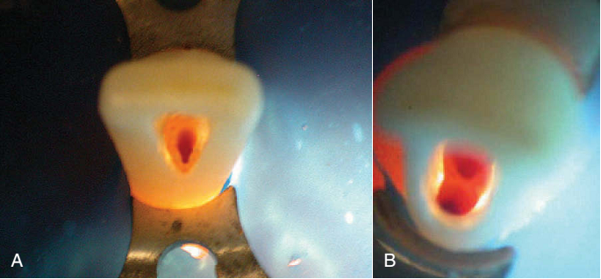
MANDIULAR CENTRAL AND LATERAL INCISORS

Slide 28
MANDIBULAR CENTRAL and LATERAL INCISOR

Slide 29
MORPHOLOGY AND ACCESS CAVITY PREPARATION FOR MAXILLARY CANINE
Developmental and anatomic data
Average time of eruption-: 10-12Years
Average age of calcification-: 13-15Years
Average tooth length-: 27mm

Slide 30
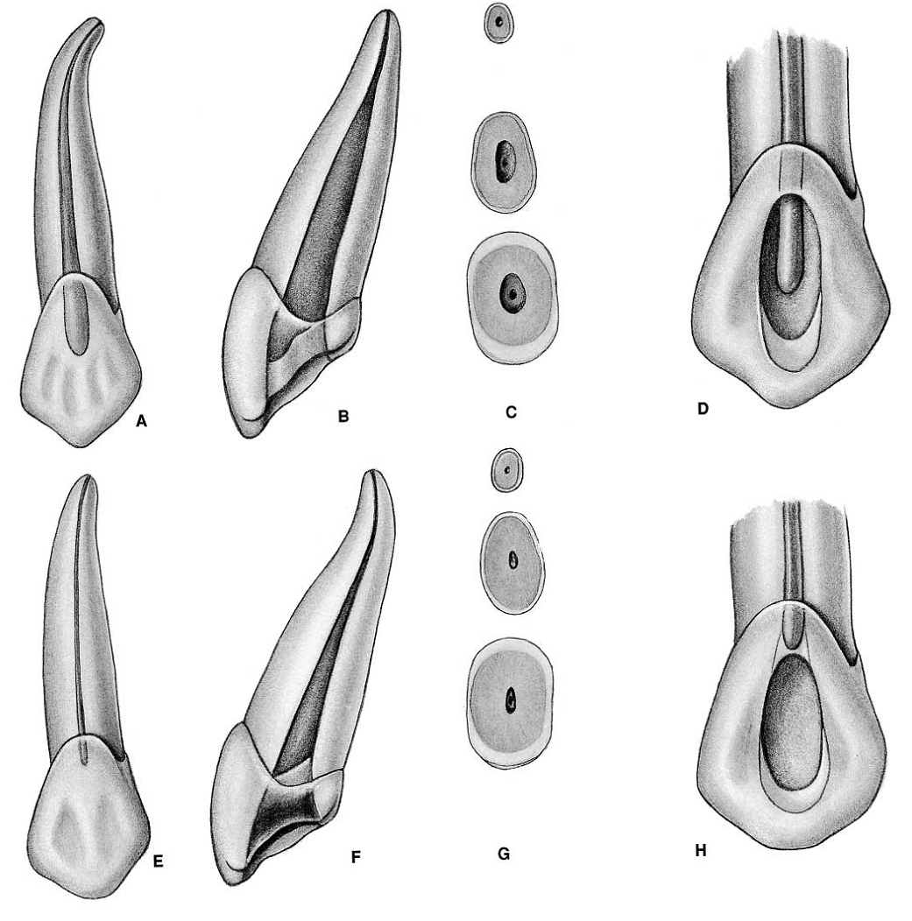
MAXILLARY CANINE
Pulp chamber
It has the largest pulp chamber than any single rooted tooth.
Labio-palatally triangular in shape, apex of triangle is toward the single cusp and base toward the cervical third of crown.
Mesio-distally it is narrower and may resemble like flame.
In cross-section it is ovoid in shape, with greater diameter labio-palatally.
Only one pulp horn is present.
Notes:
The root canal system of the maxillary canine is similar in many ways to that of the maxillary incisors.
A major difference is that it is wider labiolingually than mesiodistally.
Another difference is that it has no pulp horns.
Its smallest pointed incisal edge corresponds to the single cusp.
The pulp chamber outline at the CEJ is oval.
A lingual shoulder is present, which may prevent shaping and cleaning of the root canal in its lingual dimension.
From this point, the root canal remains oval until it approaches the apical third of the root, where it becomes constricted.
Because of this oval shape, the clinician must take care to circumferentially file labially and palatally to shape and clean the canal properly.
Usually one root canal is present, although two canals have been reported.
The thin buccal bone over the canine eminence often disintegrates, and fenestration is an occasional finding.
Accurate determination of the length is critical.
Another effect of this fenestration is a slight, permanent apical pressure sensitivity that occasionally occurs after root canal therapy.
This sensitivity can best be corrected by apical root surgery.
The external access outline form is oval or slot shaped because no mesial or distal pulp horns are present.
The mesiodistal width of the slot is determined by the mesiodistal width of the pulp chamber.
The incisogingival dimension is determined by straight-line access factors and removal of the lingual shoulder.
The incisal extension often approaches to within 2 to 3 mm of the incisal edge to allow for straight-line access.
The incisal wall meets the lingual surface of the canine in a butt joint to provide adequate thickness for restorative material, because this tooth is heavily involved in excursive occlusal guidance and function.
All internal walls funnel to the orifice.

Slide 31
MAXILLARY CANINE
Root and root canal
Single root canal of maxillary cuspid is larger than that of maxillary incisor.
It is wider labio-palatally than its mesio-distal diameter, and on reaching middle third, it tapers gradually to an apical constriction.
In cross-section, root canal is ovoid in the cervical and middle third and generally round in the apical third

Slide 32
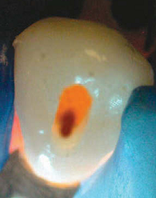
MAXILLARY CANINE
Access opening
External access outline form is oval or slot shaped because no mesial or distal pulp horn are present
Mesio-distal width of access opening is determined by the mesio-distal width of pulp chamber.
Inciso-gingival diameter is determined via straight line access factor and removal of the lingual shoulder.

Slide 33
MAXILLARY CANINE
Access opening
Incisal extension of access is approached with in 2-3 mm of the incisal edge to allow for straight line access.
All internal walls funnel to the orifice.

Slide 34
MAXILLARY CANINE

Slide 35
Morphology And Access Cavity Preparation For Mandibular Canine
Developmental and anatomic data
Average time of eruption: 9-10Years
Average age of calcification : 13Years
Average tooth length: 25.6mm

Slide 36
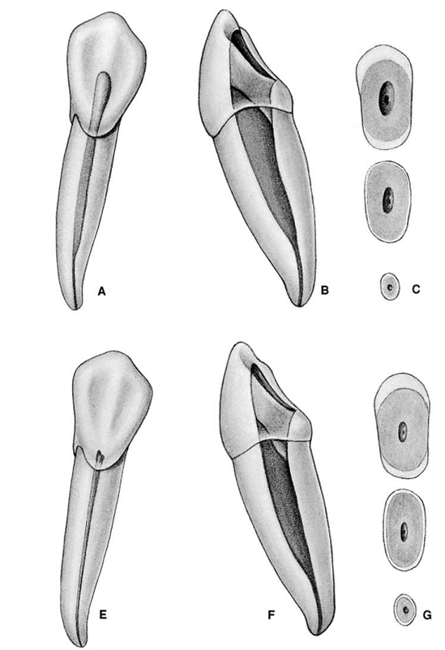
MANDIBULAR CANINE
Pulp chamber
Root and root canal
The root canal system of the mandibular canine is very similar to that of the maxillary canine, except that the dimensions are smaller, the root and root canal outlines are narrower in the mesiodistal dimension, and the mandibular canine occasionally has two roots and two root canals located labially and lingually.
Notes:
The access cavity for the mandibular canine is oval or slot shaped (Figs. 7-121 through 7-126). The mesiodistal width corresponds to the mesiodistal width of the pulp chamber. The incisal extension can approach the incisal edge of the tooth for straight-line access, and the gingival extension must penetrate the cingulum to allow a search for a possible lingual canal. As with the mandibular incisors, but joint relationships between internal walls and the lingual surface are not necessary

Slide 37
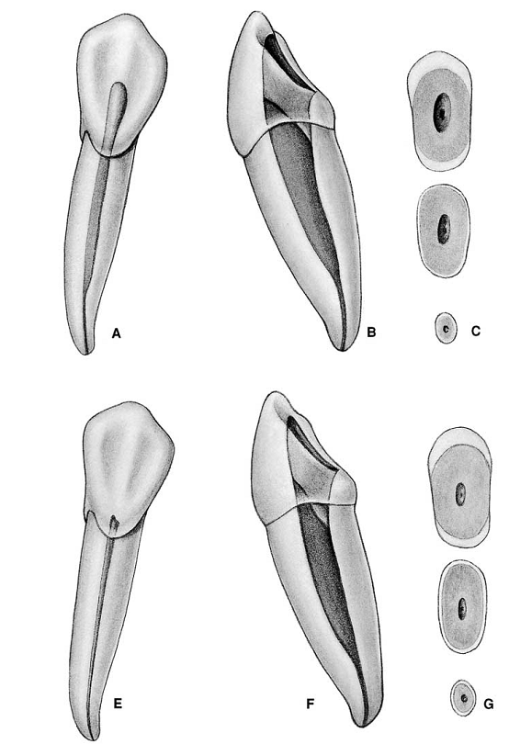
MANDIBULAR CANINE
Root and root canal
The root canal of the mandibular cuspid is narrow mesiodistally but usually very broad buccolingually.
A lingual shoulder must be removed to gain access to the lingual wall of the root canal or to the entrance of a second canal.
The lingual wall is almost slit like compared with the larger buccal wall, which makes the canal a challenge to shape and clean.

Slide 38
MANDIBULAR CANINE
Access opening
Similar to maxillary canine.
The mesiodistal width corresponds to the mesiodistal width of the pulp chamber.
The incisal extension can approach the incisal edge of the tooth for straight-line access, and the gingival extension must penetrate the cingulum to allow a search for a possible lingual canal.
As with the mandibular incisors, but joint relationships between internal walls and the lingual surface are not necessary.

Slide 39
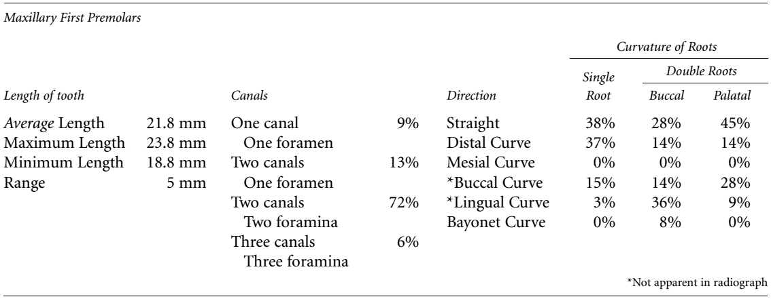
MORPHOLOGY AND ACCESS CAVITY PREPARATION FOR MAXILLARY 1ST PREMOLAR
Developmental and anatomic data
Average time of eruption-: 10-11Years
Average age of calcification-: 12-13Years
Average tooth length-: 20.6mm

Slide 40
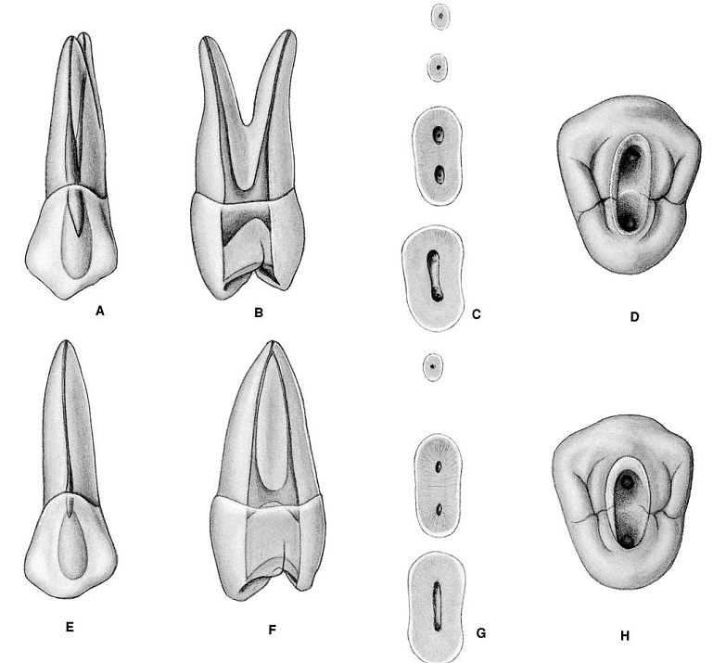
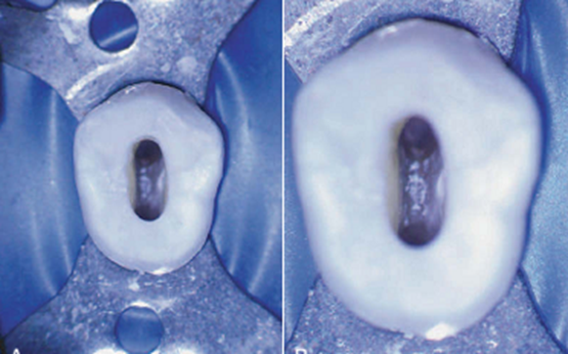
MAXILLARY 1ST PREMOLAR
Pulp chamber
It is narrow M-D, wider bucco-palatally.
The buccal pulp horn is more prominent than the palatal in young tooth.
The floor of the pulp chamber is convex usually with two canal orifices with one buccal and other palatal, it lies deep in the coronal third of the
The roof of the pulp chamber is coronal to the cervical line.

Slide 41
MAXILLARY 1ST PREMOLAR
Root and root canal
It may have one, two, or three roots(very rare) and canals.
It most often has two roots namely buccal and palatal.
The roots are considerably shorter and thinner than the canine.
The palatal orifice is slightly larger than buccal orifice.

Slide 42
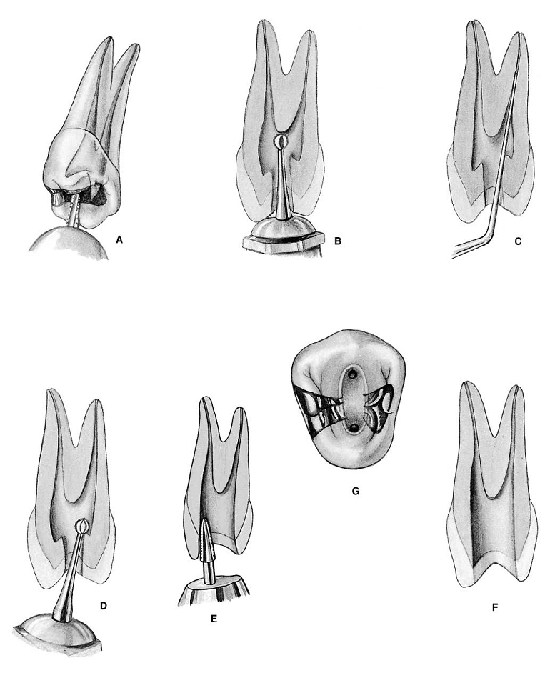
MAXILLARY 1ST PREMOLAR
Access opening
The diagnostic radiograph is used for measuring the shape and extension of the pulp chamber mesially, distally and coronally.
The access preparation is oval or slot shaped.
It is also wide bucco-lingually, narrow mesio-distally and centered mesio-distally between the cusp tips.

Slide 43
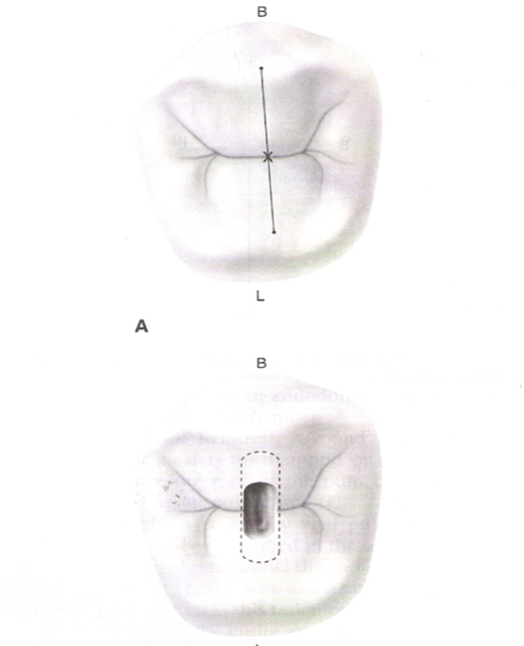
MAXILLARY 1ST PREMOLAR
Access opening
The border of the ovoid access cavity should not exceed beyond half the lingual inclination of the facial cusp and half the facial inclination of the palatal cusp.
The orifice of the buccal canal lies beneath the buccal cusp and the orifices of the palatal canal lies beneath the palatal cusp.

Slide 44
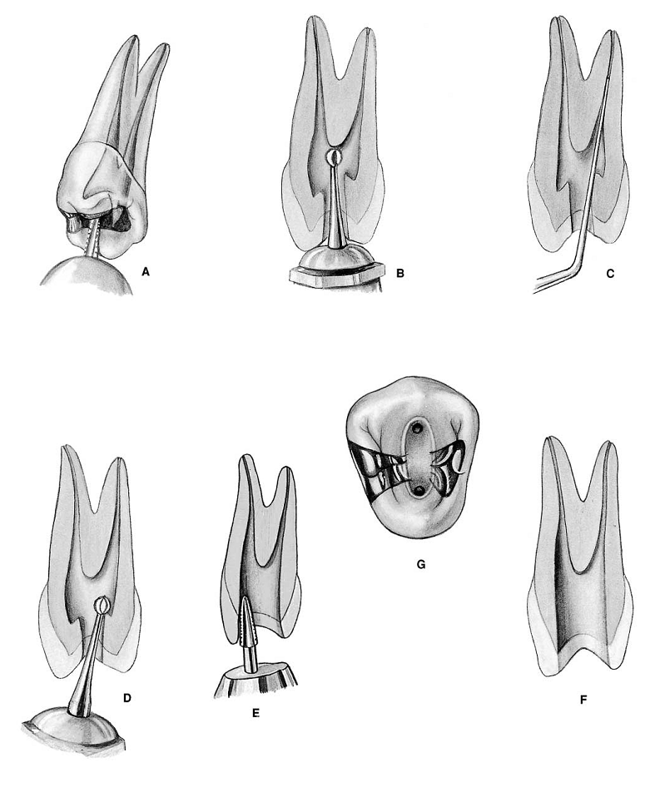
MAXILLARY 1ST PREMOLAR

Slide 45
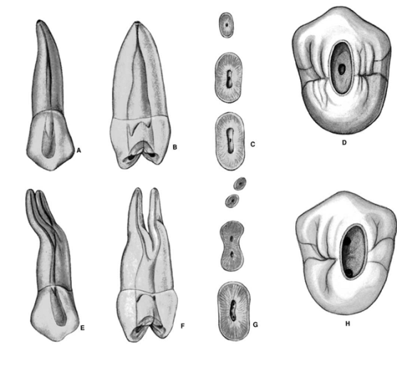
MORPHOLOGY AND ACCESS CAVITY PREPARATION FOR MAXILLARY 2ND PREMOLAR
Developmental and anatomic data
Average time of eruption-: 10-12Years
Average age of calcification-: 12-14Years
Average tooth length-: 21.5mm

Slide 46
MAXILLARY 2ND PREMOLAR
Pulp chamber
It is like maxillary 1st premolar
It is wider bucco-lingually than the maxillary 1st pre molar and shows two pulp horn in this projection, a buccal and a palatal.
In cross-section, the pulp chamber has a narrow ovoid shape.

Slide 47
MAXILLARY 2ND PREMOLAR
Root and root canal
Single rooted tooth but may be two or three root and canal .
The majority of canal may be curved.
They may be curved distally, buccally, palatally or bucco-palatally.
A single root is oval and wider bucco-lingually than m-d.
The canal remain oval from the pulp chamber floor and taper rapidly to the apex.

Slide 48
MAXILLARY 2ND PREMOLAR
Access cavity preparation
Nearly identical to 1st maxillary premolar.
If three canals are present, the external access outline form are triangular in shape.

Slide 49
MORPHOLOGY AND ACCESS CAVITY PREPARATION FOR MANDIBULAR 1st PREMOLAR
Developmental and anatomic data
Average time of eruption-: 10-12Years
Average age of calcification-: 12-13Years
Average tooth length-: 21.6mm

Slide 50
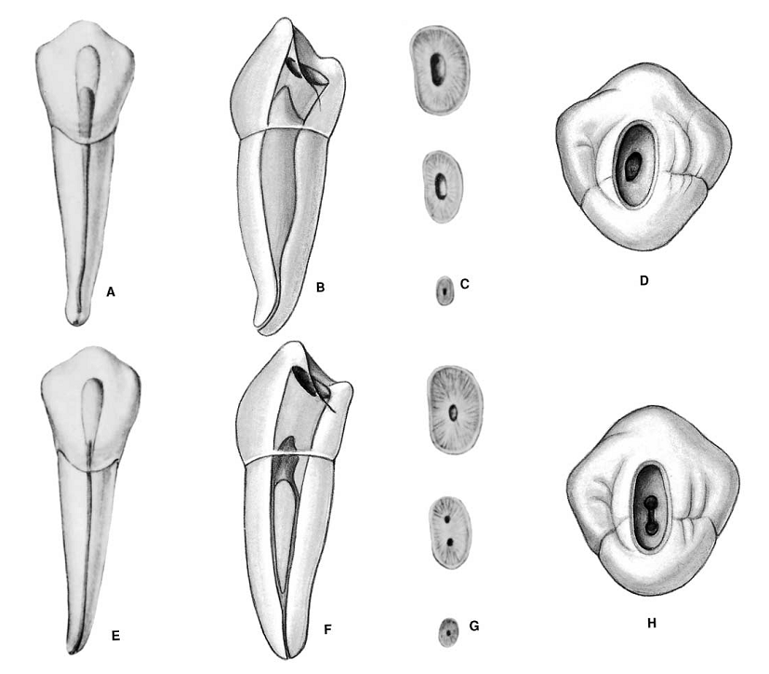
MANDIBULAR 1st PREMOLAR
Pulp chamber
It is the transition tooth between anteriors and posteriors.
The m-d width is narrow.
Bucco-lingually the pulp chamber is wide with prominent buccal pulp horn that extend under a well-developed buccal cusp.
In cross-section the chamber is ovoid with the greater diameter bucco lingually.
Single canal is present.
The crown has a 30 degree lingual tilt.

Slide 51
Root and root canal
It has a short conical root which may divide in the apical third into 2 or 3 roots(very rare).
Root is usually straight (48%) but may be curved also.
One canal and and apical foramen is present.
Canal is cone shaped and simple in outline.
Root canal is m-d narrow and b-l broad and tapers towards the apical third.
In cross-section, the cervical and middle third are ovoid and apical third is conical.
MANDIBULAR 1st PREMOLAR

Slide 52
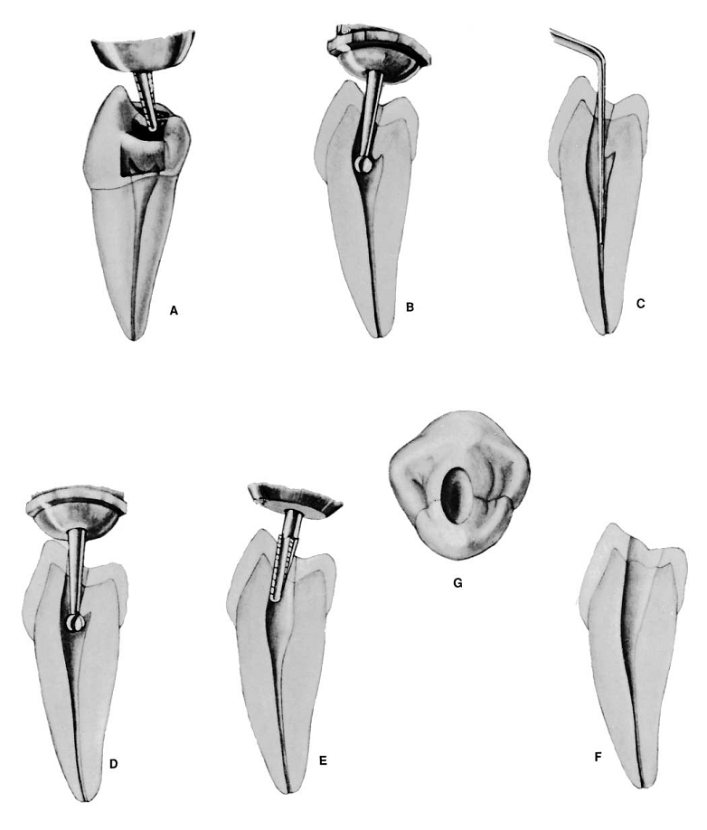
MANDIBULAR 1st PREMOLAR

Slide 53
MANDIBULAR 1st PREMOLAR

Slide 54
MORPHOLOGY AND ACCESS CAVITY PREPARATION FOR MANDIBULAR 2ND PREMOLAR
Developmental and anatomic data
Average time of eruption-: 11-12Years
Average age of calcification-: 13-14Years
Average tooth length-: 22.3mm

Slide 55
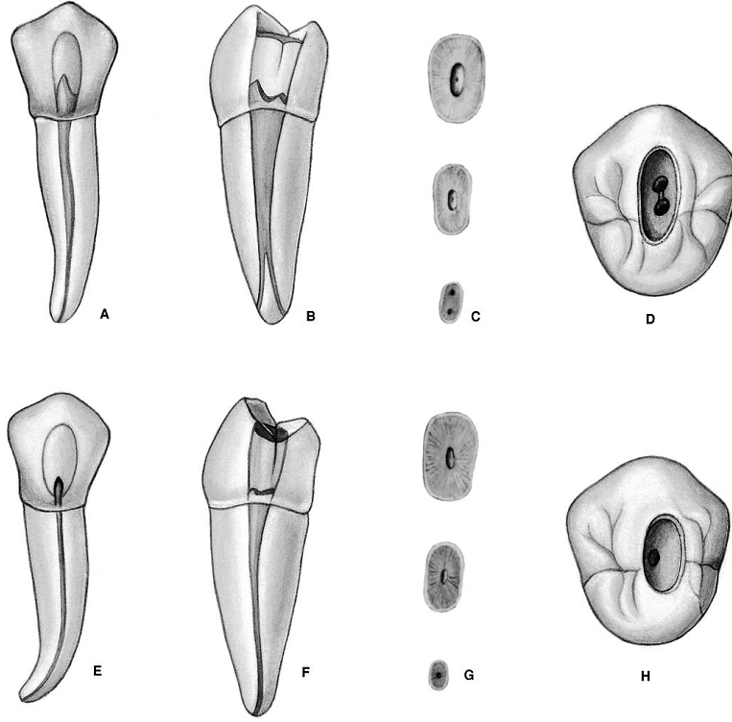
MANDIBULAR 2ND PREMOLAR
Pulp chamber
Same as mandibular 1st premolar.
Lingual pulp horn is more prominent under well developed lingual cusp.

Slide 56
MANDIBULAR 2ND PREMOLAR
Root and root canal
Single root but rarely two or three roots.
Root is wider bucco-lingually than the counter tooth.
It may curve distally (40%)
Single canal is present.
Lateral canal in (48.3%) cases.

Slide 57
MANDIBULAR 2ND PREMOLAR
Access opening
Same as mandibular 1st premolar.
Enamel penetration is initiated in the central fossa .
Ovoid access cavity is wider m-d and dictated by the wide pulp chamber.

Slide 58
MORPHOLOGY AND ACCESS CAVITY PREPARATION FOR MAXILLARY 1ST MOLAR
Developmental and anatomic data
Average time of eruption-: 6-7Years
Average age of calcification-: 9-10Years
Average tooth length-: 20.8mm

Slide 59
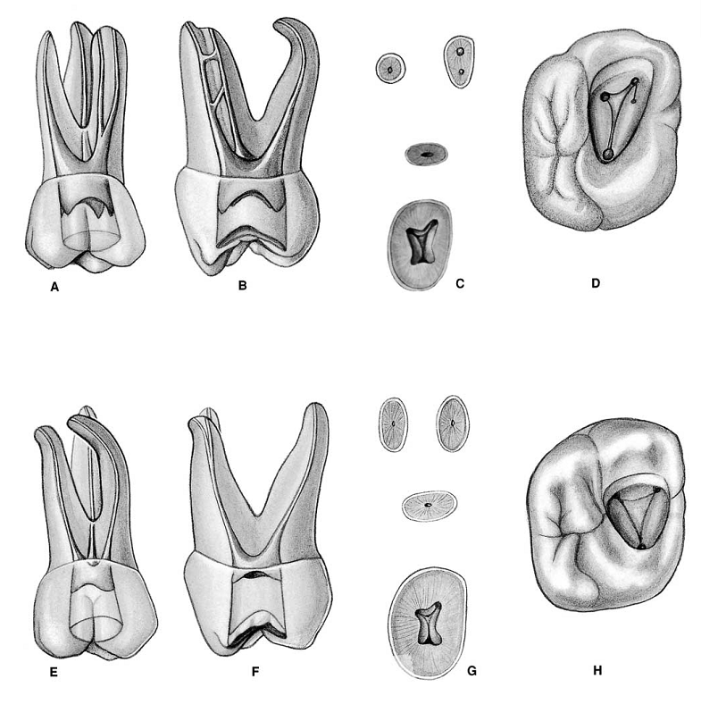
MAXILLARY 1ST MOLAR
Pulp chamber
It has four pulp horns m-b, d-b, m-p, d-p, the arrangement of the four pulp horn gives the pulpal roof of a rhomboidal shape in cross-section.
The four walls forming the roof converge towards the floor where the lingual wall almost disappear.
The floor of the pulp chamber thus has a triangular form in cross-section.
The orifices of the root canal are located in the three angles of the floor.

Slide 60
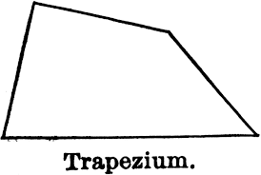
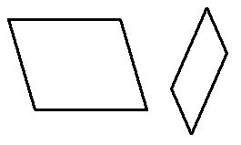
Rhombus
Yamuk
Eşkenar dörtgen
İkizkenar yamuk
Rhomboid
parelelkenar

Slide 61
MAXILLARY 1ST MOLAR
Palatal orifice is the largest, round or oval in shape and easily accessible for exploration.
The mesio-buccal orifice is under the mesio-buccal cusp.
The disto-buccal orifice is located slightly distal and palatal to the mesio-buccal orifice and is accessible from the mesial for exploration.
The floor of the pulp chamber in the cervical third of the root and the roof is in cervical third of crown.

Slide 62
MAXILLARY 1ST MOLAR
Root and root canal
It has three root with usually 4 canal situated mesio-buccally, mesio palatinally, disto-buccally, palatally.
Mesio-buccal root
It is broad in the bucco-palatal direction.
Majority of the m-b roots have a distal curve and some are “s” shaped or bayonet shaped.
It has one root and one canal, it is narrowest of the 3 canals, flattened in a m-d direction in the orifice, but round in the apical third.

Slide 63
MAXILLARY 1ST MOLAR
Root and root canal
Disto-buccal root
It is small and is more or less round in shape.
It may be straight (54%), distally curved mesial curve or “s” shaped.
It is a narrow, tapering canal sometimes flattened in a mesio –distal direction , but generally cone shaped.
Palatal root
It has larger diameter and is the longest root of the maxillary 1st molar.
It may be straight, curved buccally, mesially or distally.
Root may curve in the apical third toward buccal side.
The palatal canal is ovoid m-d and tapers toward apex.

Slide 64
MAXILLARY 1ST MOLAR
Access opening
Radiograph is used to determine the shape and size as well as the extension of the pulp chamber mesially, distally and coronally.
The enamel is penetrated by positioning the instrument in the central fossa and angling it toward palatal root.
The bur is angled toward the palatal root until the pulp chamber is reached.
Because the maxillary first molar almost always has four canals, the access cavity has a rhomboid shape, with the corners corresponding to the four orifices (MB-1, MB-2, DB, and P)

Slide 65
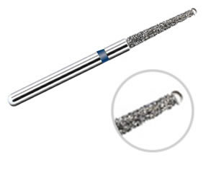
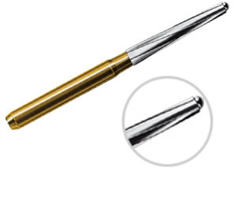
MAXILLARY 1ST MOLAR
Safe Ended Access Bur
A “drop” of the bur into the pulp chamber may be felt if the chamber becomes large.
The internal anatomy of the pulp chamber guides the occlusal cutting.
A tapered cylinder self limiting diamond in a slow speed contra angle is used to remove the remaining roof of the pulp chamber.
The walls of the access cavity should be in good confluence with the walls of pulp chamber and should be slightly divergent to the occlusal surface.

Slide 66
MAXILLARY 1ST MOLAR
Any loose debris is removed by irrigating the access cavity with 5.2% sodium hypochlorite solution.
Excess solution is removed by suction
The anatomic dark lines in the pulpal floor should be examined with an endodontic explorer.

Slide 67
MAXILLARY 1ST MOLAR

Slide 68
MAXILLARY 1ST MOLAR

Slide 69
MORPHOLOGY AND ACCESS CAVITY PREPARATION FOR MAXILLARY 2ND MOLAR
Developmental and anatomic data
Average time of eruption-: 11-13Years
Average age of calcification-: 14-16Years
Average tooth length-: 20mm

Slide 70
MAXILLARY 2ND MOLAR
There are two types of maxillary second
molars when viewed from the occlusal aspect:
(1)Rhomboidal:four-cusp outline similar to the first
molars but more rounded. This is the more
common form.
(2) Triangular:three-cusp form more similar to the
third molar form where the distolingual cusp is
poorly developed.
From Ingle

Slide 71
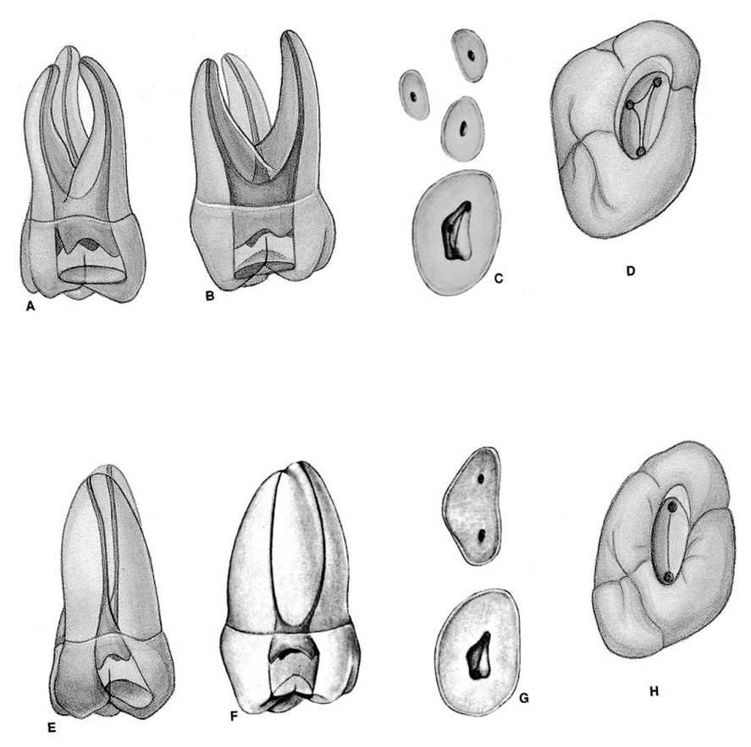
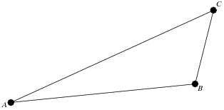
MAXILLARY 2ND MOLAR
Pulp chamber
Similar to maxillary 1st molar, except it is narrower m-d.
It is rhomboidal in shape.
The roof of the pulp chamber is more rhomboidal in cross-section,
The floor of the pulp chamber is an obtuse triangle in cross-section.
The mesio-buccal and disto-buccal root canal are closer together and appear to have a common opening.

Slide 72
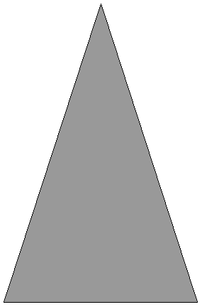
MAXILLARY 2ND MOLAR
Root and root canal
It has usually one canal in each root however , it may have two or three mesio-buccal canal, one or two disto-buccal canal, or two palatal canal.
The three main orifice ( M-B, D-B, P) usually form a flat triangle and sometimes a straight line.
The mesio-buccal canal orifice is located to the buccal and mesial than 1st molar.
Disto-buccal orifice approaches the mid point between the m-b and palatal orifice
Palatal orifice usually located at the most palatal aspect of the root.

Slide 73
MAXILLARY 2ND MOLAR
Access cavity preparation
Same as 1st molar.
When four canal are present, access cavity preparation has a rhomboid shape,
if three canal are present, it is a rounded triangle with the base placed buccally.
If two canal are present the access outline form is oval and widest bucco-lingually.

Slide 74
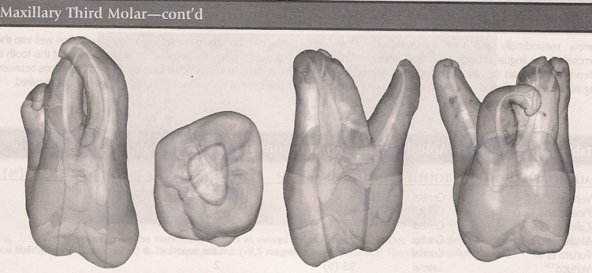
MORPHOLOGY AND ACCESS CAVITY PREPARATION FOR MAXILLARY 3ND MOLAR
Developmental and anatomic data
Average time of eruption-: 17-22Years
Average age of calcification-: 18-25Years
Average tooth length-: 17mm

Slide 75
MAXILLARY 3ND MOLAR
It is considered as a strategic abutment after loss
of maxillary 1st and 2nd molars.
Pulp chamber
Anatomic resemblance to maxillary 2nd molar.
It may also have an odd shaped pulp chamber with four or five root canal orifice.
Some times conical chamber with only one root canal.
Roots and root canal
Three well developed roots, fused root, one conical root or four or more independent roots.
Root may be straight, curved or dilacerated.
One may find a “C shaped” pulp chamber with a “C shaped root canal.

Slide 76
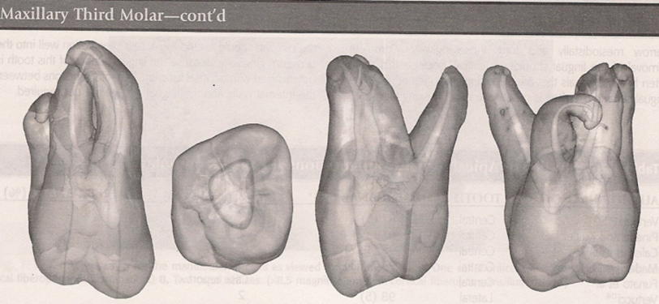
MAXILLARY 3ND MOLAR
The access cavity form for the third molar can vary greatly.
Because the tooth typically has one to three canals, the access preparation can be anything from an oval that is widest in the buccolingual dimension to a rounded triangle similar to that used for the maxillary second molar.
The MB, DB, and P orifices often lie nearly in a straight line as the DB orifice moves even closer to the line connecting the MB and P orifices.
The resultant access cavity is an oval or highly obtuse triangle.

Slide 77
MAXILLARY 3ND MOLAR

Slide 78
MORPHOLOGY AND ACCESS CAVITY PREPARATION FOR MANDIBULAR 1ST MOLAR
Developmental and anatomic data
Average time of eruption-: 6 Years
Average age of calcification-: 9-10Years
Average tooth length-: 21mm

Slide 79
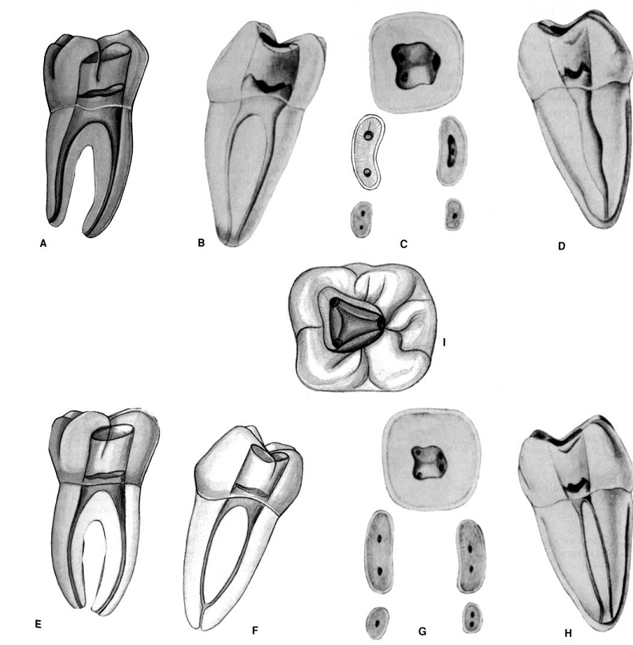
MANDIBULAR 1ST MOLAR
Pulp chamber
Roof of the pulp chamber is often rectangular.
The mesial wall is straight and distal wall converge round.
Buccal and lingual walls converge to meet mesial and distal wall to form a rhomboidal floor.
The roof of the pulp chamber has four pulp horns m-b, m-l, d-b and d-l.
The four pulp horns regress with age.
The roof of the pulp chamber is located in cervical third of crown just above the cervix

Slide 80
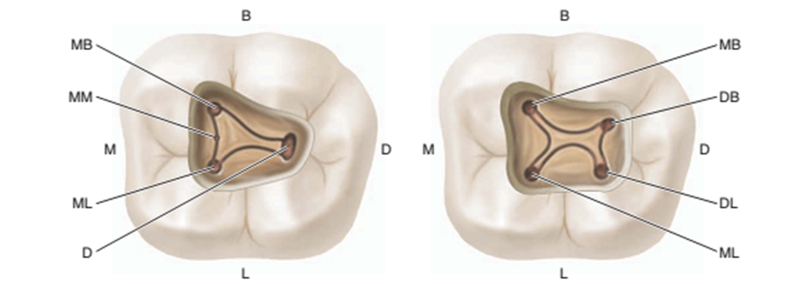
MANDIBULAR 1ST MOLAR
Pulp chamber
Floor is located in the cervical third of the root.
Three distinct orifice are present in the pulpal floor m-b, m-l and distal.
The m-b orifice is located under the m-b cusp and difficult to find. It can be penetrated by a long shank explorer.
The mesiobuccal and the mesio-lingual orifice may be close under the mesio-buccal cusp.

Slide 81
MANDIBULAR 1ST MOLAR
Root and root canal
Two roots mesial and distal.
The roots are wide and flat, with a depression in the middle of the root b-l.
Sometimes third root is present (5.3%)
(radix entemolaris(DL), radix paramolaris(MB)).
Three canals are usually present.
Mesial root may have two canals and apical foramina.
Distal root has one canal (71%).
Mesial root is curved distally.
Distal root is straight.
In cross-section three canals are ovoid in cervical and middle third and round in apical third

Slide 82
MANDIBULAR 1ST MOLAR
Access opening
It follows the anatomy of the pulp chamber.
The enamel and dentin are penetrated in central fosa.
The bur is angled toward the distal root, where the pulp chamber is largest.
It is trapezoid or rhombus in shape with round corners.

Slide 83
MORPHOLOGY AND ACCESS CAVITY PREPARATION FOR MANDIBULAR 2nd MOLAR
Developmental and anatomic data
Average time of eruption-: 11-13Years
Average age of calcification-: 14-15Years
Average tooth length-: 19.8mm

Slide 84
MANDIBULAR 2nd MOLAR
Pulp chamber
It is smaller than the mandibular 1st molar.
Root canal orifice are small and close to each other.

Slide 85
MANDIBULAR 2nd MOLAR
Root and root canal
It has mesial and distal root.
Rarely three rooted.
The mesial root has one canal and foramina.
The distal root has one canal and foramina.
In cross-section all three root canal are small and ovoid in cervical and middle third and round in the apical third.
In 27% cases a single root may be present and in 2% cases it is three rooted.

Slide 86
MANDIBULAR 2nd MOLAR
may have one to six canals,
most prevalent configurations are two, three, and four canals

Slide 87
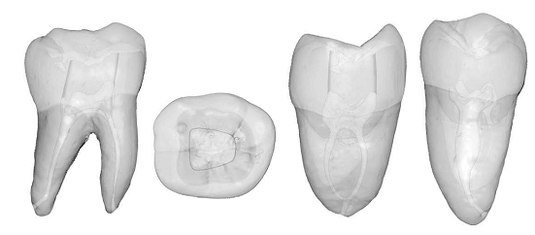
MANDIBULAR 2nd MOLAR

Slide 88
MANDIBULAR 2nd MOLAR
Access cavity preparation
When three canals are present, the access cavity is similar to that for the mandibular first molar, although perhaps a bit more triangular and less rhomboid.
The access cavity for a two-canal second molar is rectangular, wide mesiodistally and narrow buccolingually.
The access cavity for a single canal mandibular second molar is oval and is lined up in the center of the occlusal surface.

Slide 89
MORPHOLOGY AND ACCESS CAVITY PREPARATION FOR MANDIBULAR 3RD MOLAR
Developmental and anatomic data
Average time of eruption-: 17-21Years
Average age of calcification-: 18-25Years
Average tooth length-: 18.5mm

Slide 90
MANDIBULAR 3nd MOLAR
Pulp chamber
It is similar to mandibular 1st and 2nd molars.
It is large and has an anatomic configuration of a “c shaped” root canal orifice
Root and root canal
Two roots with two canals are present.
Three roots with three canals are generally large and short.
Anatomic relation in situ
The alveolar socket may project to the lingual plate of mandible.
Apex of root is in close proximity of the mesio-distal canal

Slide 91
MANDIBULAR 3nd MOLAR
Access opening
It is same as the mandibular 1st and 2nd molars
The anatomy of the mandibular third molar is unpredictable; therefore the access cavity can take any of several shapes.
When three or more canals are present, a traditional rounded triangle or rhomboid shape is typical.
When two canals are present, a rectangular shape is used. For single-canal molars, an oval shape is customary.

Slide 92
1. Maxillary lateral
2. Mandibular canine
3. Maxillary premolar
4. Four-canal maxillary molar (arrow indicates dentin shelf covering mesiolingual orifice)
5. Three-canal mandibular molar
6. Four-canal mandibular molar

Slide 93
Conclusion
The aim of the access preparation is to provide an easy and comfortable endodontic treatment with restoration of normal structure and function of the tooth.

Slide 94
THANK YOU

