Slide 1
e-payment for
Profession Tax
GOVERNMENT OF MAHARASHTRA
DEPARTMENT OF SALES TAX

Slide 2
General Instructions
For PTRC holders ‘enrollment for PTRC e-services’ is mandatory. PTRC holders shall make e-payment under TIN starting with 27.
PTEC holders shall make e-payment under TIN starting with 99.
If no such TIN is available, then immediately contact concerned Profession Tax Officer (Registration).

Slide 3
List of Banks Providing e-Payment Facility for Profession Tax Act 1975
Sr. No. | List of Authorized banks for e-payment | Accepting cash across the counter (account in the bank not required) | Directly from Bank’s website | By Using Sales Tax Website
1 | STATE BANK OF INDIA | YES | YES | NO
2 | STATE BANK OF HYDERABAD | NO | YES | NO
3 | STATE BANK OF TRAVANCORE | NO | YES | NO
4 | STATE BANK OF MYSORE | NO | YES | NO
5 | STATE BANK OF BIKANER &JAIPUR | NO | YES | NO
6 | STATE BANK OF PATIALA | NO | YES | NO
7 | BANK OF BARODA | YES | YES | NO
8 | IDBI BANK | NO | YES | YES
9 | CORPORATION BANK | NO | YES | YES
10 | BANK OF MAHARASHTRA | NO | YES | YES
CONTD ….2…..

Slide 4
List of Banks Providing e-Payment Facility for Profession Tax Act 1975
Sr. No. | List of Authorized banks for e-payment | Accepting cash across the counter (account in the bank not required) | Directly from Bank’s website | By Using Sales Tax Website
11 | CENTRAL BANK OF INDIA | NO | YES | YES
12 | DENA BANK | NO | NO | YES
13 | UNION BANK OF INDIA | NO | YES | NO
14 | INDIAN OVERSEAS BANK | NO | YES | NO
15 | CANARA BANK | NO | NO | YES
16 | VIJAYA BANK | NO | NO | YES
17 | BANK OF INDIA | NO | YES | NO
18 | INDIAN BANK | NO | YES | YES
19 | SYNDICATE BANK | NO | NO | YES
20 | Punjab National Bank | NO | YES | NO
21 | UCO BANK (from 25th June 2012) | No | YES | NO

Slide 5
Steps for e-payment
Step 1 is common for both i.e. PTEC and PTRC
Step 2, 3 and 4 are applicable only for PTRC.
Step 5 is applicable only for PTEC.
Step 6 onwards are common for both i.e. PTEC and PTRC .

Slide 6
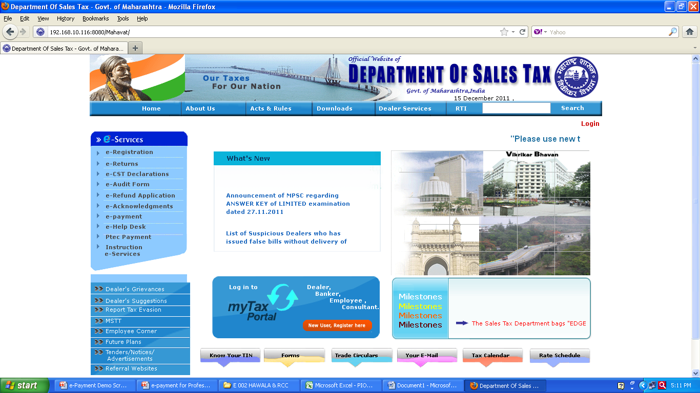
PTRC e-Payment
Step – 1 : Go to web-site of Department of Sales Tax ‘www.mahavat.gov.in’
Click here for PTRC e-payment
Click here for PTEC e-payment

Slide 7
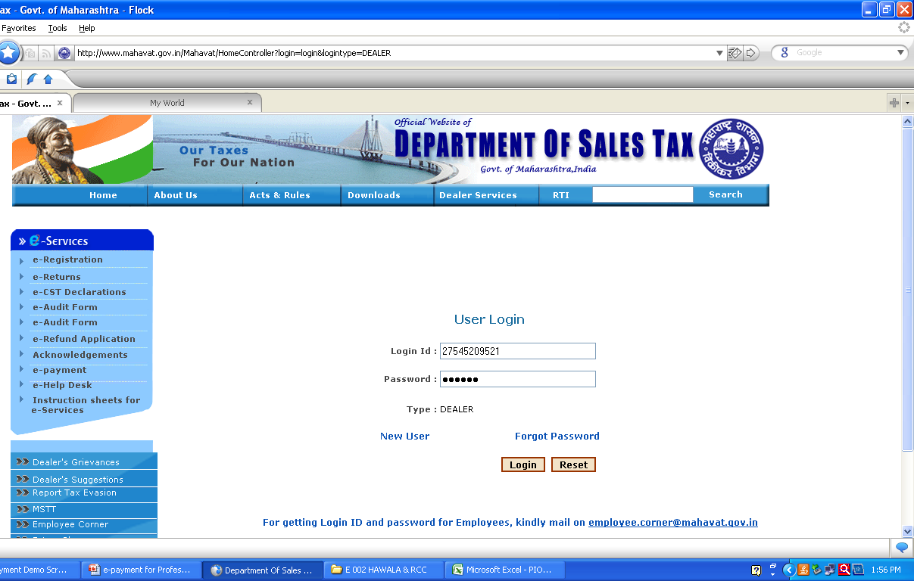
PTRC e-Payment
Step -2 : Login Page
Enter your PTRC TIN starting with 27 without suffix ‘P’. Enter your password and click ‘Login’

Slide 8
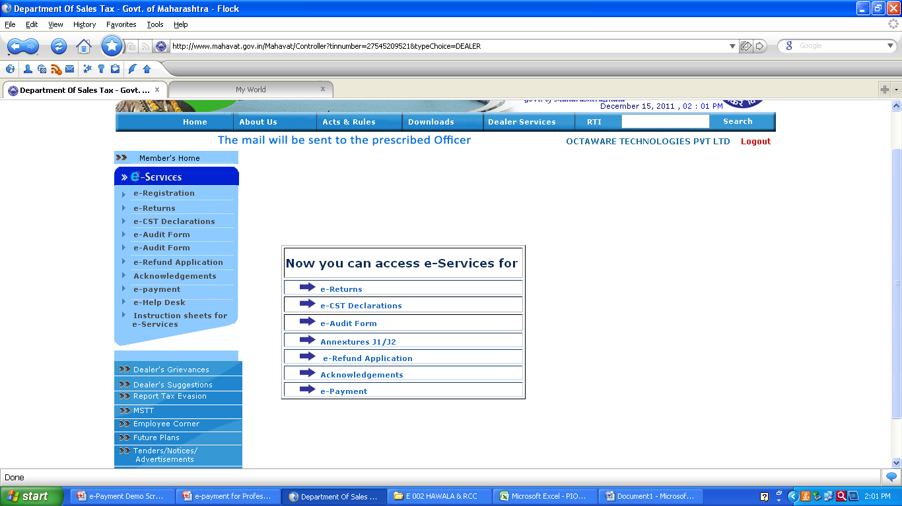
PTRC e-Payment
Step – 3 : e-services page.
Select e-Payment

Slide 9
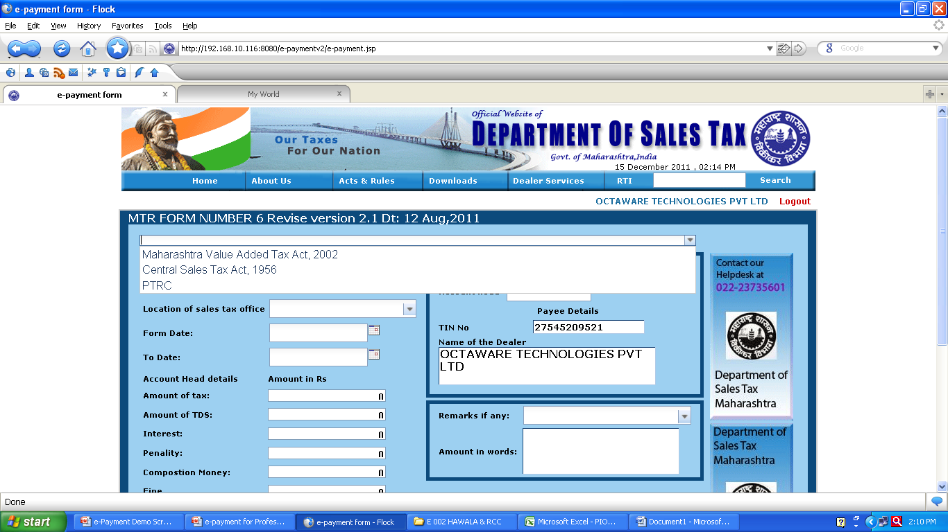
PTRC e-Payment
Step – 4 : Select Act from Drop down List for which payment is to be made
Select ‘PTRC’

Slide 10
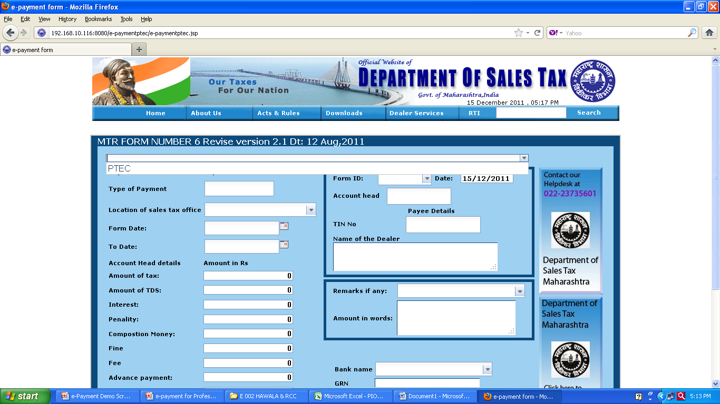
Step 5 : PTEC e-payment
Select ‘PTEC’

Slide 11
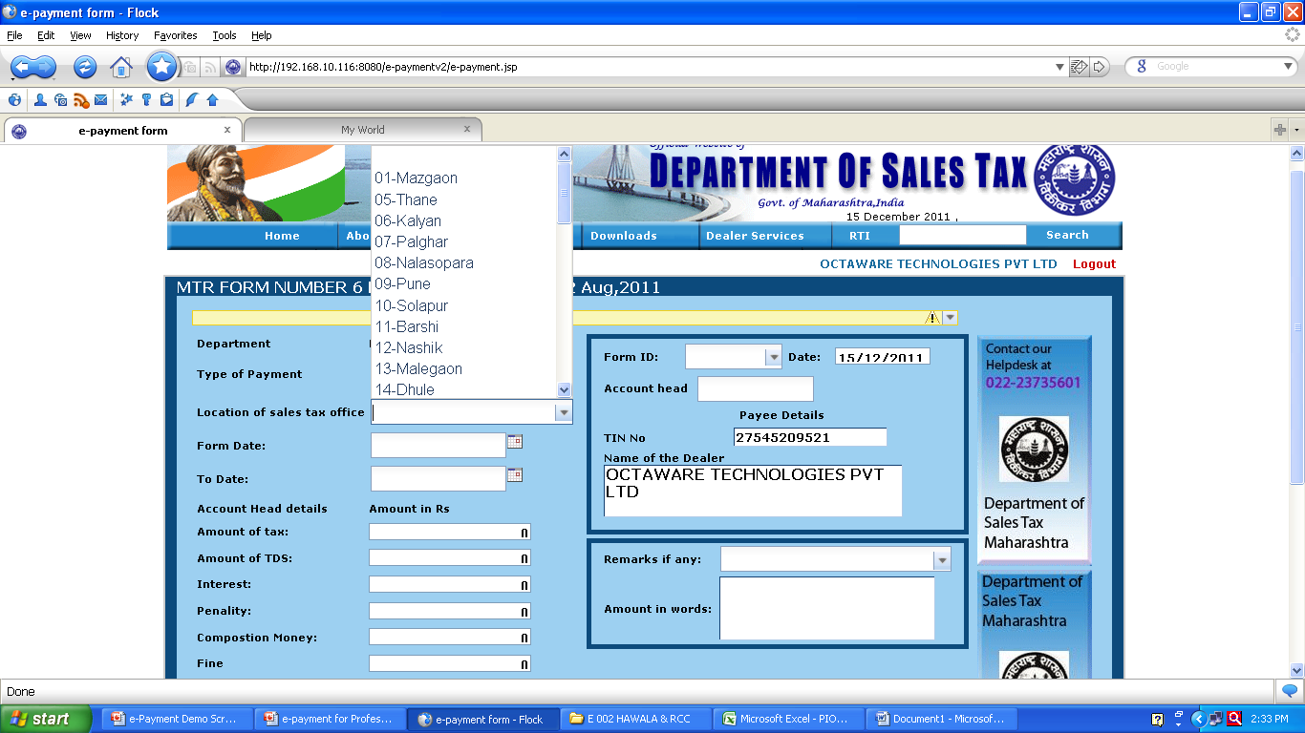
Step – 6 : Select Location from Drop down list
Select Location from Drop Down

Slide 12
Form IDs
Select Form ID ‘III’ for manual returns i.e. prior to 1/4/2010.
Electronic Return filling is mandatory for all from 1/4/2010. So select Form ID ‘IIIB’ for electronic returns.
PTEC holders Should select Form ID ‘VIII’ for Tax payment
For any other payments select ‘Other’

Slide 13
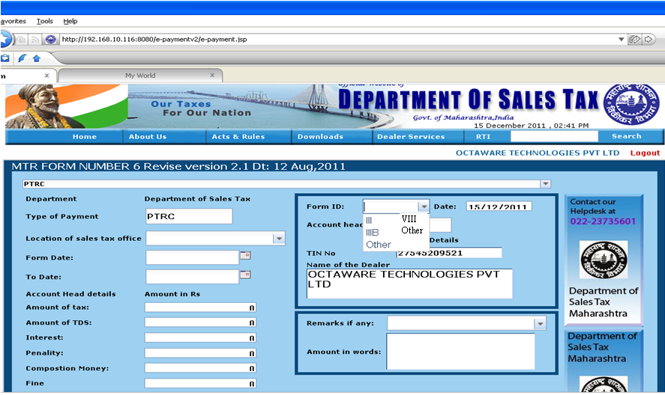
Step – 6 : Select Form ID from Drop Down List
Select Form ID from Drop Down

Slide 14
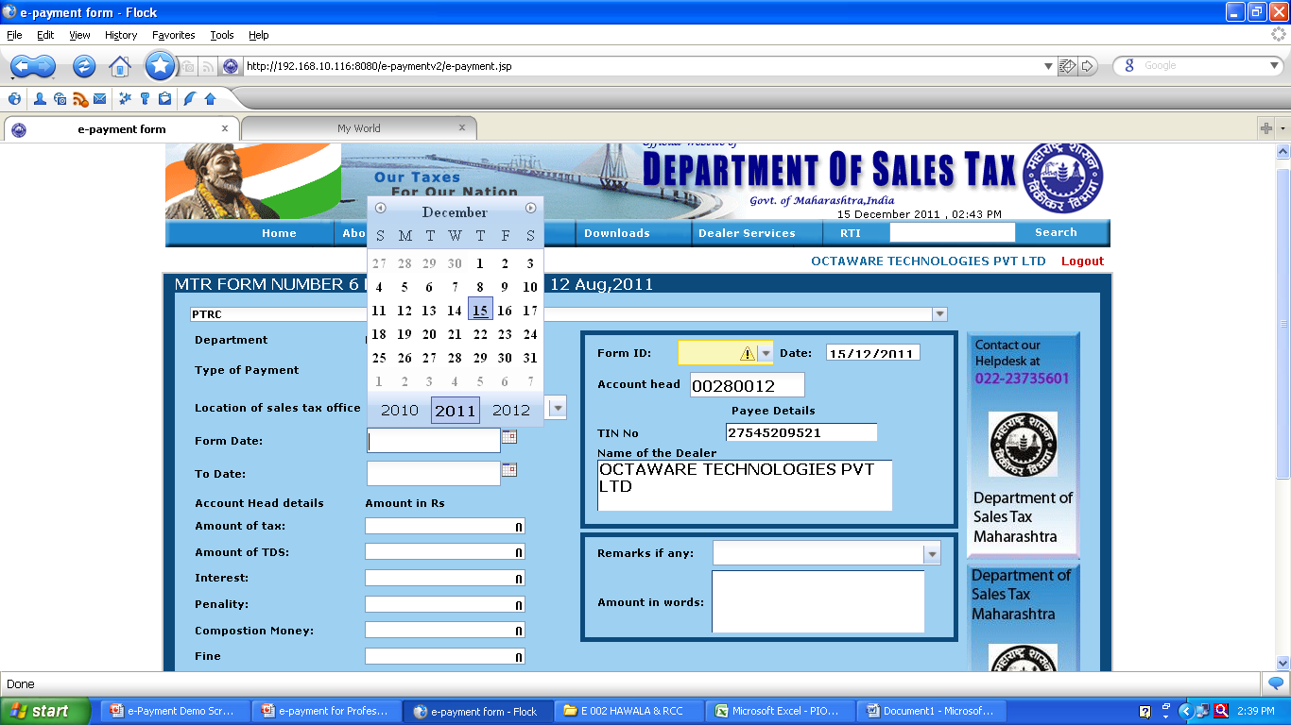
Step – 7 : Select From Date and To Date from the Calendar
Select From Date and To Date

Slide 15
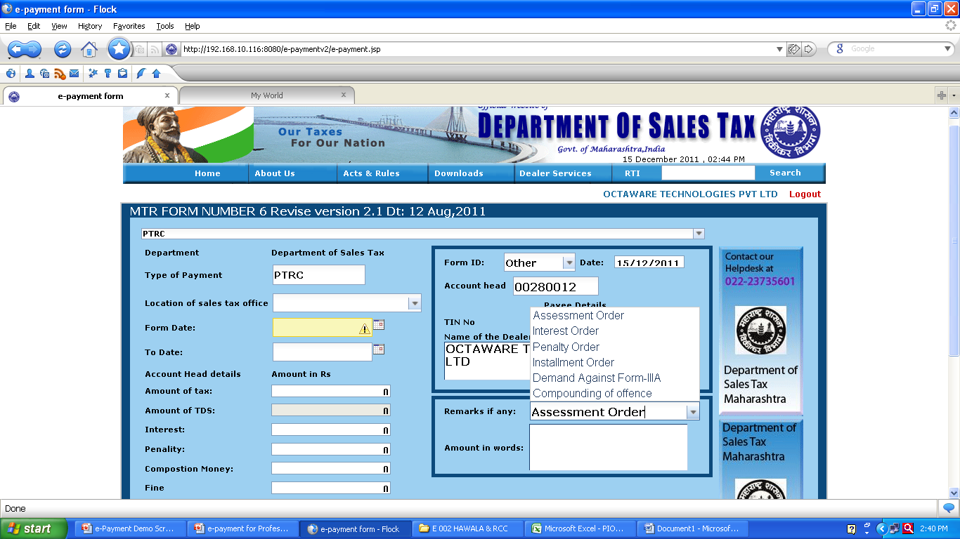
Step – 8 : If Form ID is selected as ‘other’ then select proper ‘Remarks’ from Drop Down List
Select proper Remarks if Form ID is ‘Other”.
In case of payment under Amnesty / Incentive scheme etc select remarks as ‘Compounding of offence ‘

Slide 16
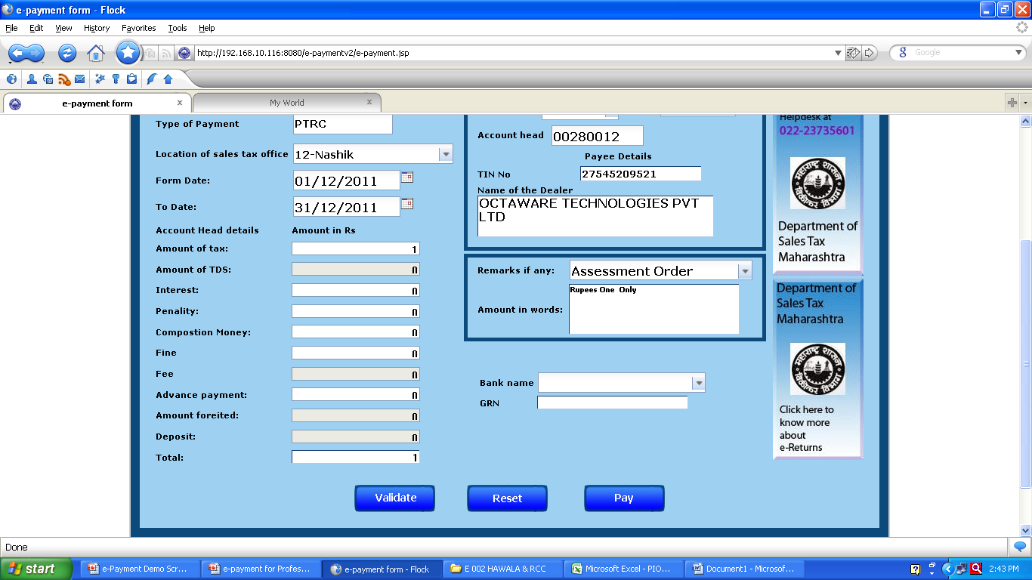
Step – 9 : Enter the Amount under respective heads.
Enter Amount under respective Heads

Slide 17
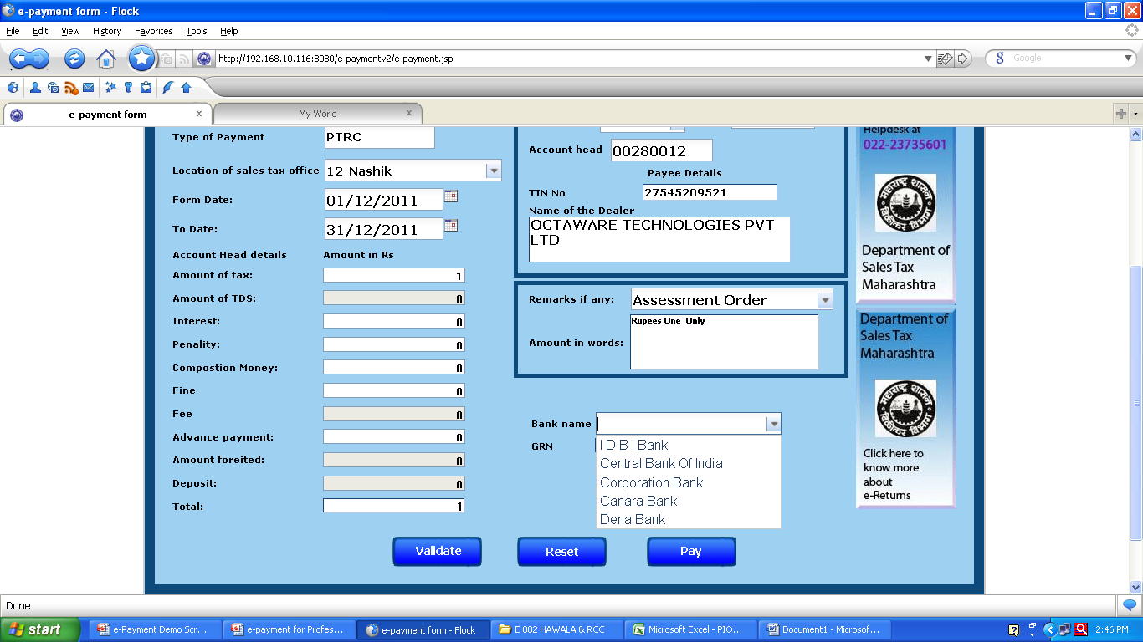
Step – 10 : Select the Bank from Drop Down list in which you are having Net Banking Account
Select Bank in which you are holding Net Banking Account

Slide 18

Step – 11 : Click on ‘Validate’ button. GRN will be generated. Then Click on ‘Pay’ button
Press Validate Button . GRN will be generated. Then Click ‘Pay’ button
In case of any corrections to be made press ‘Reset’

Slide 19
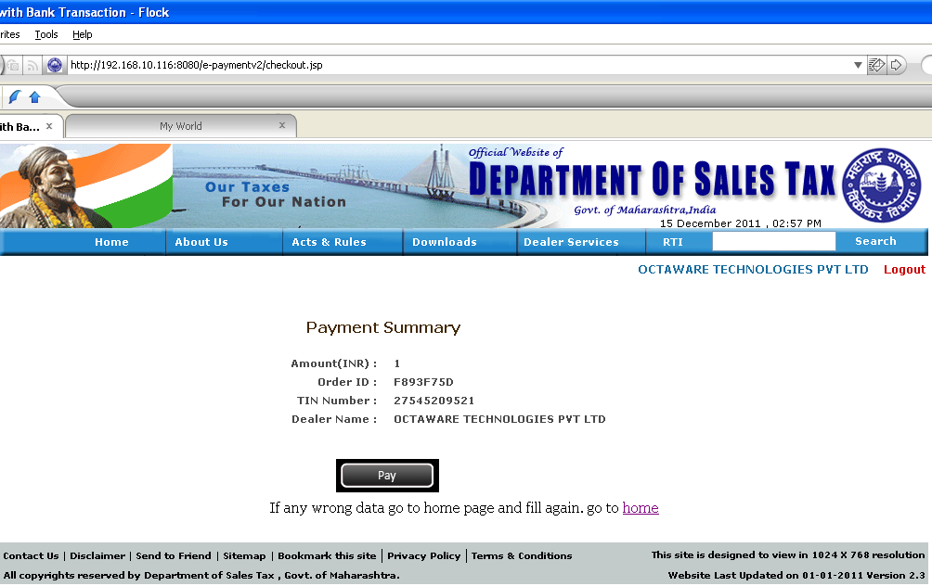
Step 12 : Check the details and if found correct, click ‘Pay’ button
Click ‘Pay’ button

Slide 20
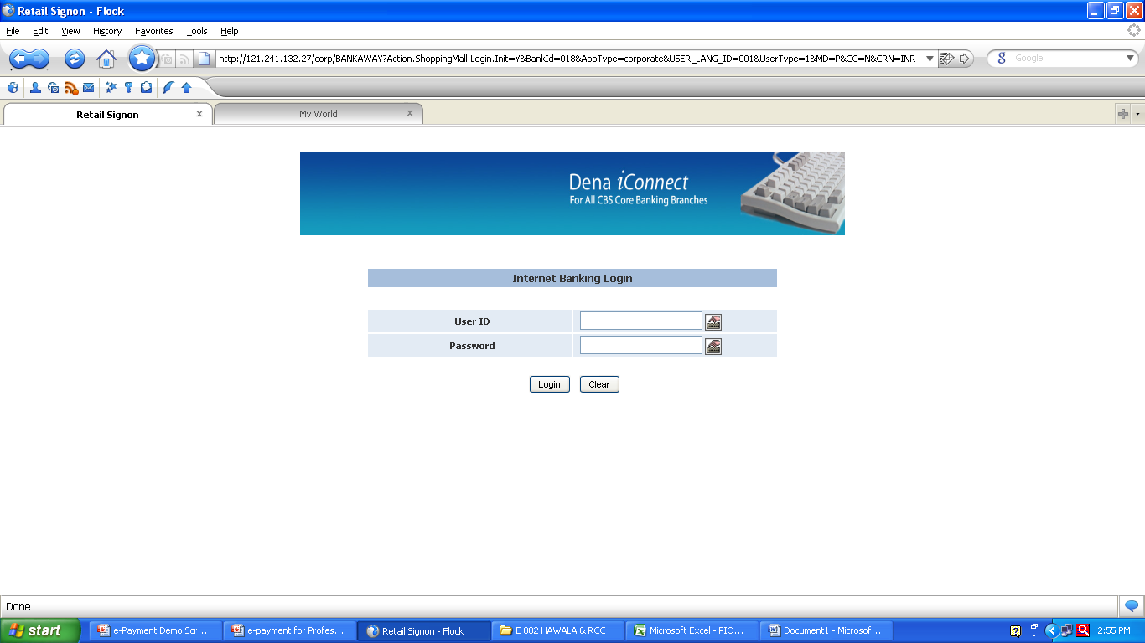
Step – 13 : After Clicking ‘Pay’ Button on ‘Payment Summary’ page, you will be directed to the respective Bank’s Net Banking Page, for making e-Payment

Slide 21
Help Desk Telephone Nos.
Mumbai :
022-2376 0194
Shri P. N. Chavan 2659 1171,
2659 1747 / 1757 / 1767 Extn : 5305
Thane,
Shri A. G. Hedau : 022-2549 6108
Pune :
Shri N. G. Borkar : 020-2660 9090
Nagpur :
Shri M. A. Kate : 0712 : 2560782 / 2561447 Extn : 406
E-mail ID : pteservices@mahavat.gov.in

Slide 22
THANK YOU
Keep using simple, fast and reliable e-services

