Slide 1
Unit 1
Introduction: Functional units of a computer system, Different types of computers, Computer Software and Hardware, Types of software-System software and Application programme. Characteristic of computers. Input Devices – Keyboard, Mouse, Optical input devices, Output devices – Monitors and Printers

Slide 8
Characteristic Features of 1G Computers
They were the fastest calculating devices of their time
They were too bulky in size, requiring large rooms for installation.
They used thousands of vacuum tubes that emitted large amount of heat and burnt out frequently. Hence air-conditioned rooms required.
Each vacuum tubes consumed about half a watt power. Since a computer typically used more than ten thousand vacuum tubes, power consumption was very high.
As vacuum tubes filaments, they had a limited life.
Due to low mean time between failures, these computers required constant maintenance.
Commercial production of these computers was difficult and costly.

Slide 12
Characteristic Features of 2G Computers
Faster than 1G computers.
Smaller than 1G computers
Consumed less power and dissipated less heat than 1G computers.
Less hardware failures than 1G computers.
Larger primary and secondary storage.
Easier to program than 1G computers.
Commercial production is difficult and costly.

Slide 16
Characteristic Features of 3G Computers
They were more powerful than 2G computers.
Smaller in size than 2G.
Consumed less power and dissipated less heat than 2G.
Less hardware failures. Hence lower maintenance cost.
They had faster and larger primary and secondary storage.
Suitable for both scientific and commercial applications.
Commercial production of these systems was easier and cheaper.

Slide 20
Characteristic Features of 4G Computers
PCs were smaller and cheaper than mainframes or minicomputers of 3G.
No air-conditioning was required for PCs.
Consumed less power than 3G computers.
Less hardware failures than 3G computers.
They had faster and larger primary and secondary storage as compared to 3G computers.
Manufacturing cost is less. Hence commercial production was easier and cheaper.
Programs written in high level languages are allowed.
Graphical User Interface (GUI) enabled new users to quickly learn how to use computers.
Network computers enabled sharing of resources like disks, printers etc.

Slide 23
Characteristic Features of 5G Computers
Portable PCs (Notebook computers) are much smaller and handy than PCs of 4G.
More powerful than 4G computers.
Consume less power.
Less hardware failures than 4G.
Faster and larger primary and secondary storage than 4G.
Manufacturing cost is less.
High level language programs are allowed
More GUI.

Slide 24
Functional units of a computer system

Slide 25
Input unit
Input units are used by the computer to read the data. The most commonly used input devices are keyboards, mouse, joysticks, trackballs, microphones, etc.
However, the most well-known input device is a keyboard. Whenever a key is pressed, the corresponding letter or digit is automatically translated into its corresponding binary code and transmitted over a cable to either the memory or the processor.
Central processing unit
Central processing unit commonly known as CPU can be referred as an electronic circuitry within a computer that carries out the instructions given by a computer program by performing the basic arithmetic, logical, control and input/output (I/O) operations specified by the instructions.

Slide 26
Input unit
Input units are used by the computer to read the data. The most commonly used input devices are keyboards, mouse, joysticks, trackballs, microphones, etc.
However, the most well-known input device is a keyboard. Whenever a key is pressed, the corresponding letter or digit is automatically translated into its corresponding binary code and transmitted over a cable to either the memory or the processor.
Central processing unit
Central processing unit commonly known as CPU can be referred as an electronic circuitry within a computer that carries out the instructions given by a computer program by performing the basic arithmetic, logical, control and input/output (I/O) operations specified by the instructions.

Slide 27
Storage Unit(Memory unit)
The Memory unit can be referred to as the storage area in which programs are kept which
are running, and that contains data needed by the running programs.
The Memory unit can be categorized in two ways namely, primary memory and secondary
memory.
Primary storage (RAM) is the fastest memory that operates at electronic speeds. It is also known as the volatile form of memory, means when the computer is shut down, anything contained in RAM is lost.
Cache memory is also a kind of memory which is used to fetch the data very soon. They are highly coupled with the processor.
The most common examples of primary memory are RAM and ROM.
Secondary memory is used when a large amount of data and programs have to be stored for a long-term basis.
It is also known as the Non-volatile memory form of memory, means the data is stored permanently irrespective of shut down.
The most common examples of secondary memory are magnetic disks, magnetic tapes, and optical disks.

Slide 28
Arithmetic & logical unit
Most of all the arithmetic and logical operations of a computer are executed in the ALU (Arithmetic and Logical Unit) of the processor. It performs arithmetic operations like addition, subtraction, multiplication, division and also the logical operations like AND, OR, NOT operations.
Control unit
The control unit (CU) is a component of a computer's central processing unit that coordinates the operation of the processor. It tells the computer's memory, arithmetic/logic unit and input and output devices how to respond to a program's instructions.
CU does not perform any actual processing of jobs, but act as the central nervous systemfor other components of the computer system.
It manages and coordinates the operations of all other components.
It obtains instructions from a program stored in main memory, interprets the instructions, and issues signals causing other units of the system to execute them.
Output Unit
The primary function of the output unit is to send the processed results to the user. Output devices display information in a way that the user can understand.
Output devices are pieces of equipment that are used to generate information or any other response processed by the computer. These devices display information that has been held or generated within a computer.
The most common example of an output device is a monitor.

Slide 29
Types of Computers
Personal Computers (Micro Computers)
A personal computer (PC) is a multi-purpose microcomputer whose size, capabilities, and price make it feasible for individual use.
Designed for use by only one person at a time.
Personal computers are used to create spreadsheets, play games, track our finances, account, run databases, and many other tasks.
2. Mini Computers
They are used by business and government organizations to process large volume of information.
Minicomputers were used for scientific and engineering computations, business transaction processing, file handling, and database management.
Mini Computers are less expensive and less powerful than mainframe and supercomputers. But more powerful and expensive than micro computers.

Slide 30
Types of Computers…
Mainframe Computers
Mainframes are high performance computers with large amounts of memory and processors that process billions of transactions in Real time.
A mainframe computer is a computer used primarily by large organizations for critical applications like bulk data processing for tasks such as censuses, industry and consumer statistics, enterprise resource planning, and large-scale transaction processing.
A mainframe computer is large but not as large as a supercomputer and has more processing power than micro and mini computers.
2. Super Computers
A supercomputer is a computer with a high level of performance as compared to a general-purpose computer.
The performance of a supercomputer is commonly measured in floating-point operations per second (FLOPS) instead of million instructions per second (MIPS).
Supercomputers are used in various fields, including quantum mechanics, weather forecasting, climate research, oil and gas exploration, molecular modelling etc.

Slide 31
Computer Software and Hardware

Slide 39
Dot Matrix Printer

Slide 46
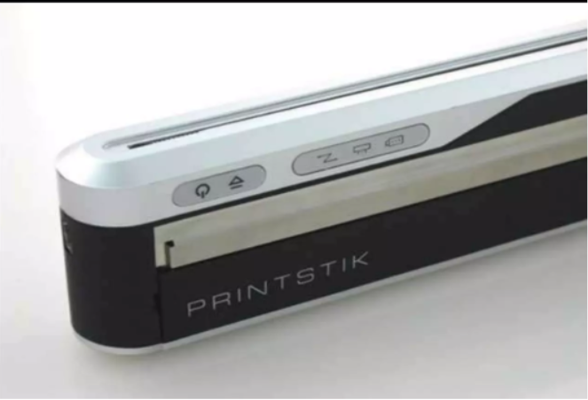

Slide 63
THANK YOU

