Slide 1
Unit 2
Introduction to Operating Systems and Networking: Definition of an Operating System - Different types of PC Operating Systems. Computer Networks- categories of networks - LAN, WAN,MAN. The Internet - Working of Internet - Major Features of Internet.

Slide 3
Operating System is an integrated set of programs that control the resources (CPU, memory, I/O devices, etc) of a computer system and provide its users with an interface. The two primary objectives of an OS are
1. Make a computer system easier to use : A computer system consists of one or more processors, main memory and many types of I/O devices. Writing programs for using these hardware resources correctly and efficiently is an extremely difficult job requiring in-depth knowledge of functioning of these resources. Hence to make a computer system usable by a large number of users, computer systems need some mechanism to shield the programmers and users from the complexity of hardware resources.

Slide 4
Logical Architecture of an OS
Computer Hardware
Users
Computer Hardware
Other System Software and Application Program
Computer Hardware
Operating System
Computer Hardware

Slide 5
2. Manage the Resources of a computer system :- An OS manages all the resources of a computer system. This involves performing such tasks as keeping track of who is using what resources, granting resource requests, accounting for resource usage etc.
Main Functions of OS
1. Process Management
2. Memory Management
3. File Management
4. Device Management
5. Security Management
6. Command Interpreter

Slide 6
Process management module takes care of creation and deletion of processes, scheduling of system resources to different processes and providing mechanism for synchronization and communication among processes.

Slide 9
Security module protects the resources and information of a computer system against destruction and unauthorized access. It also ensures that when the system executes several disjoint processes simultaneously, one process does not interfere with others.

Slide 10
Device Management :- Normally a computer system consists of several I/O devices such as printer, disk and tape. The device management module controls all I/O devices. It keeps track of I/O requests from processes, issues command to I/O devices, and ensures correct data transmission to/from an I/O device.

Slide 11
The command interpreter module interprets user commands and direct system resources to process the commands. This module allows the user to communicate with the operating system using commands.

Slide 12
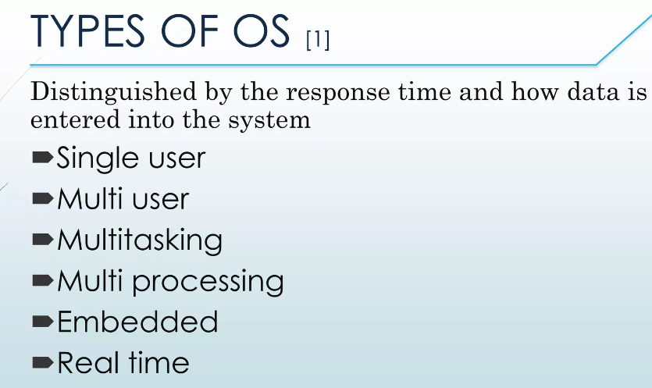
Different Types of Operating Systems

Slide 13
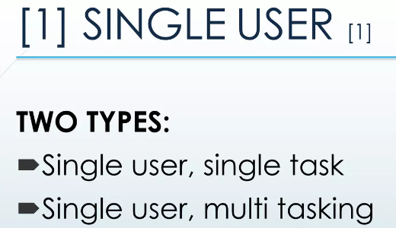
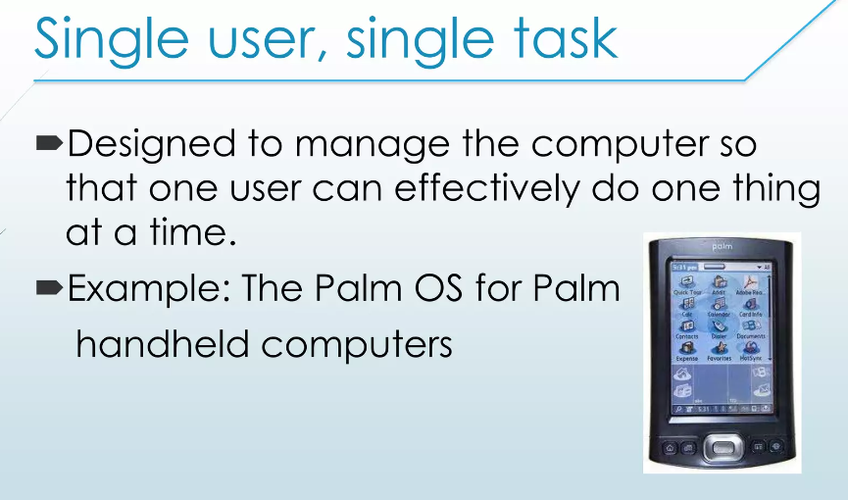

Slide 14
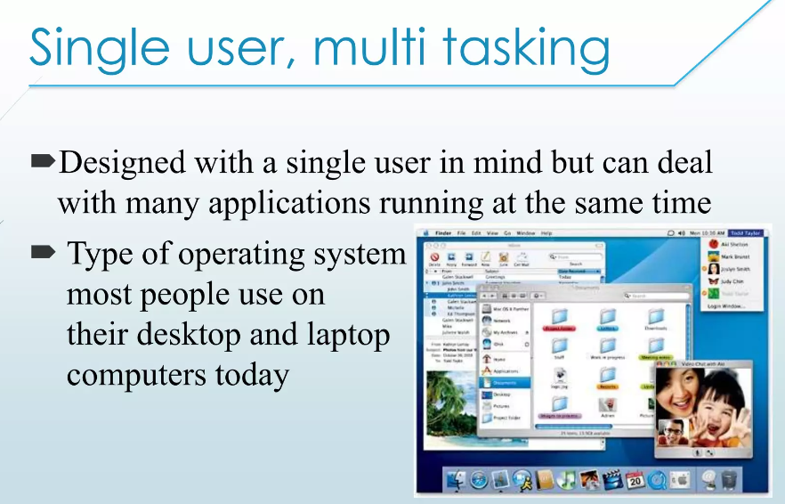

Slide 15
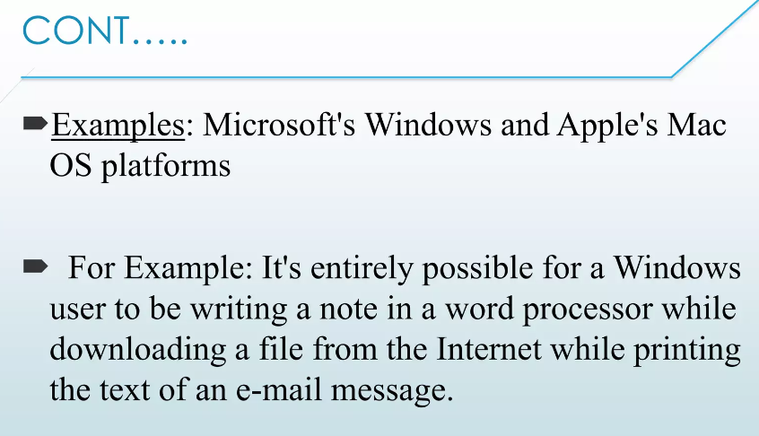

Slide 16
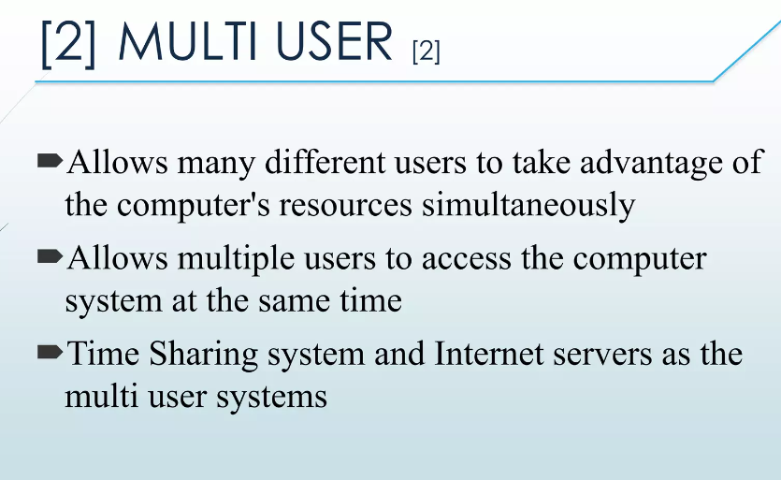

Slide 17
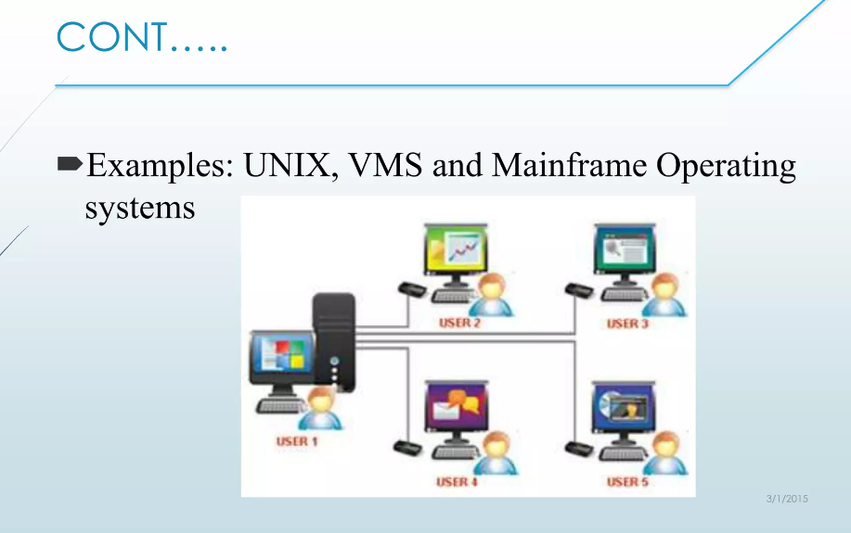

Slide 18
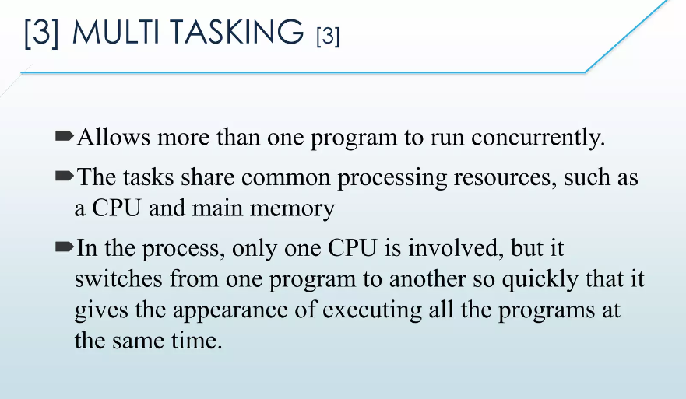

Slide 19
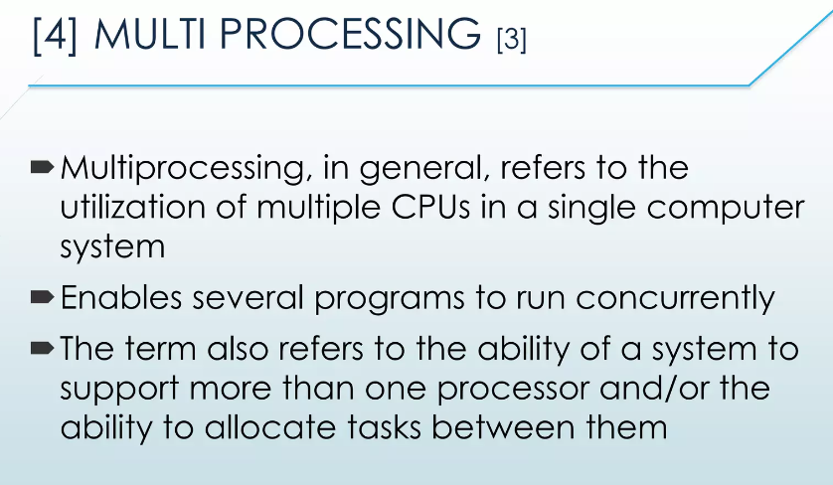

Slide 20
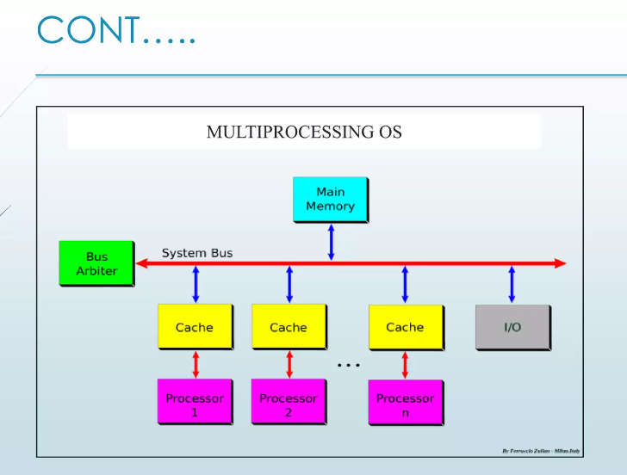

Slide 21
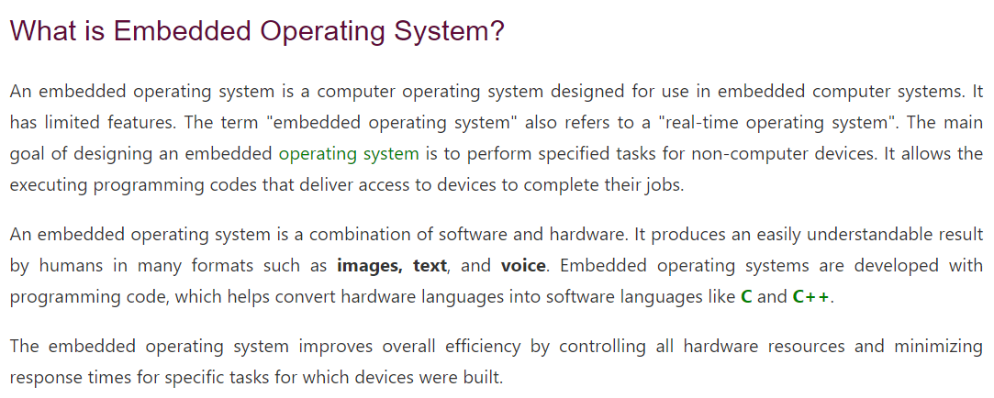
5. Embedded Operating System

Slide 22
