Slide 1
Module II
C Character Set, Delimiters, Types of Tokens, C Keywords, Identifiers, Constants, Variables, Rules for defining variables, Data types, C data types, Declaring and initialization of variables, Type modifiers, Type conversion, Operators and Expressions- Properties of operators, Priority of operators, Comma and conditional operator, Arithmetic operators, Relational operators, Assignment operators and expressions, Logical Operators, Bitwise operators.

Slide 2
History of C
The root of all modern languages is ALGOL introduced in early 1960s. ALGOL was the first computer language to use a block structure.
In 1967, Martin Richards developed BCPL(Basic Combined Programming Language) primarily for writing system software.
In 1970, Ken Thompson created a language using many features of BCPL and it is called B.
In 1972, Dennis Ritchie developed C at Bell Laboratories with combined features of ALGOL, BCPL and B languages. C has the added concept of data types.
C language became more popular after publication of the book ‘ The C Programming Language’ by Brian Kerningham and Dennis Ritchie in 1978. The book was so popular that the language came to be known as ‘K&R C’. The rapid growth of C led to the development of different versions that were similar but often incompatible.
In 1989, American National Standards Institutes(ANSI) committee approved a version of C which is known as ANSI C. It was approved by ISO (International Standards Organization) in 1990.

Slide 3
Importance of C
C is a language with rich set of built-in functions and operators can be used write any complex programs.
C compiler combines the features capabilities of an assembly language with the features of a high-level language and therefore it is well suited for writing both system software and business packages.
Due to the variety of data types and powerful operators in C, programs written in C are efficient and fast.
Several standard functions are available in C.
C is highly portable. Therefore C programs written for one computer can be run on another with little or no modification.
C has the ability to extend itself. We can add our own functions to the C library.

Slide 4
The documentation section consists of a set of comment lines.
The link section provides instructions to the compiler to link functions from the system library.
The definition section defines all symbolic constants.
There are some variables that are used in more than one function. Such variables are called global variables and are declared in the global declaration section, that is outside of all the functions. This section also declares all the user defined functions.
Every C program must have one main() function section. This section contains two parts.
a) Declaration part – This part declares all the variable used in the executable part. ( eg int a,b; float s;)
b) Executable Part – All the executable statements are appeared here. There is at least one statement in the executable part (eg s=a+b;)
The two parts must appear between the opening and closing braces. The program execution begins at the opening brace and ends at the closing brace. The closing brace of the main function section is the logical end of the program.
The sub program section contains all the user defined functions that are called in the main function. User defined functions are generally placed immediately after the main function.

Slide 9
C Character Set
The characters that can be used to form words, numbers and expressions depend upon the computer on which the program is run.
The characters in C are grouped into the following categories
Letters
Digits
Special Characters
White spaces

Slide 17
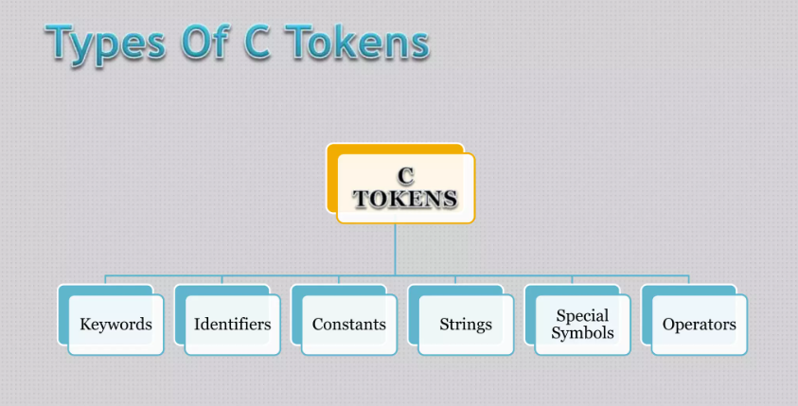

Slide 23
Character Constants (Single Character Constants)
A single character constant contains a single character enclosed within a pair of single quote marks.
Eg ‘3’ , ‘A’ , ‘n’, ‘ ‘
The character constant ‘3’ is not same as the number 3.Character constants have integer values known as ASCII values.
Eg.
char ch;
ch=‘A’;
printf(“%c”,ch) // print the output A
printf (“%d”,ch) // print the output 65. The ASCII value of A.

Slide 24
“Hello” , “1234”, “Well Done”

Slide 25
Backslash Character Constants (Escape Sequences)
C supports some special backslash character constants that are used in output functions. The escape sequence characters are as follows.

Slide 28
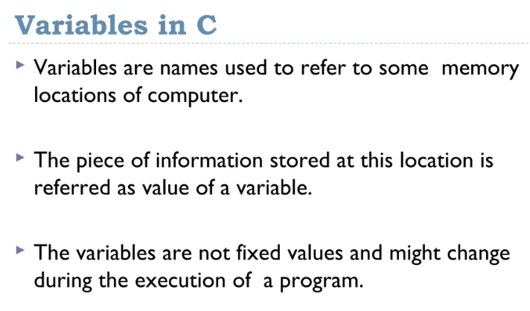

Slide 29
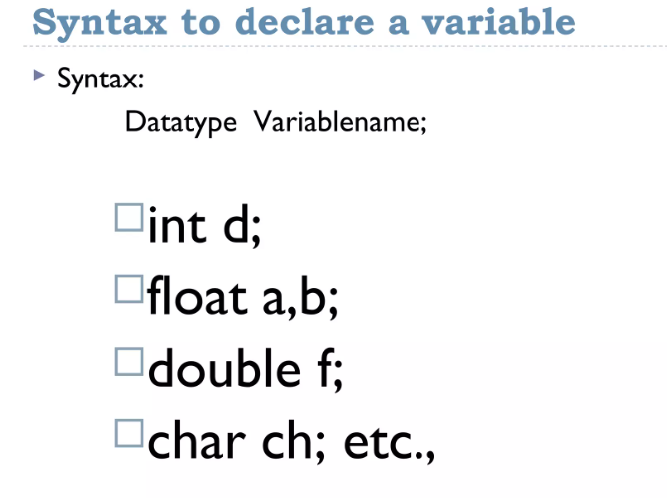
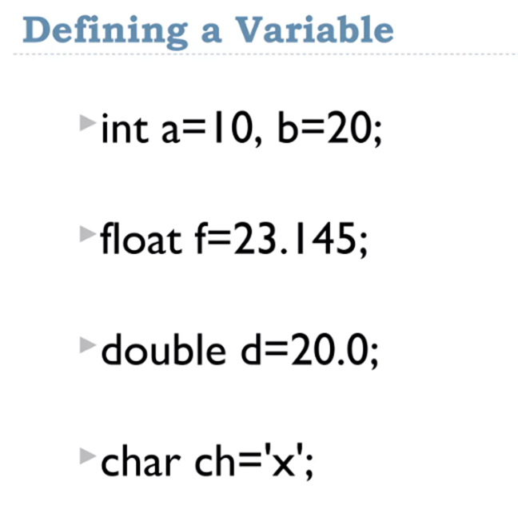

Slide 30
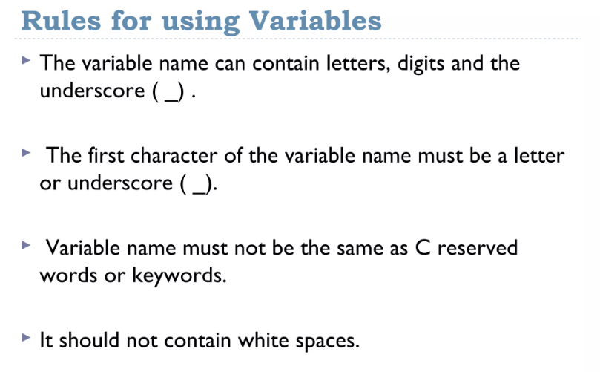

Slide 31
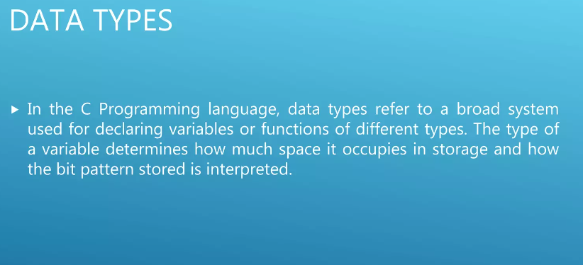

Slide 32
Data Types in C
Data Types
Primary
User Defined
Derived
enum
typedef
Arrays
Pointers
Structure
Union

Slide 33
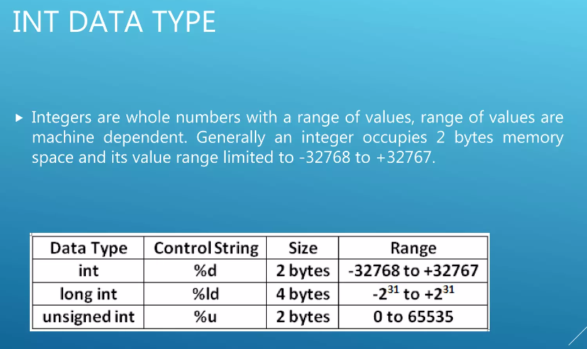

Slide 34
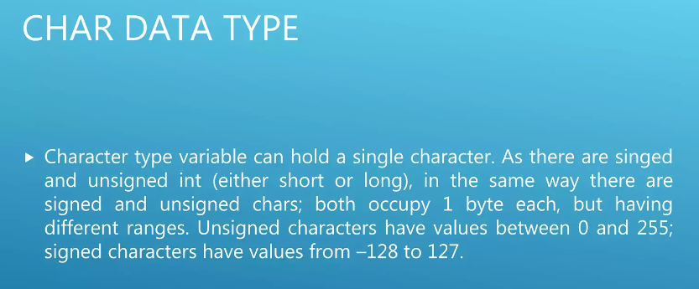

Slide 35
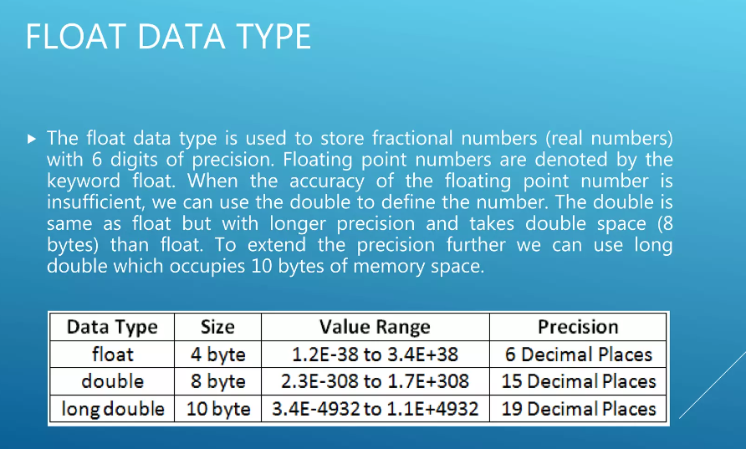

Slide 36
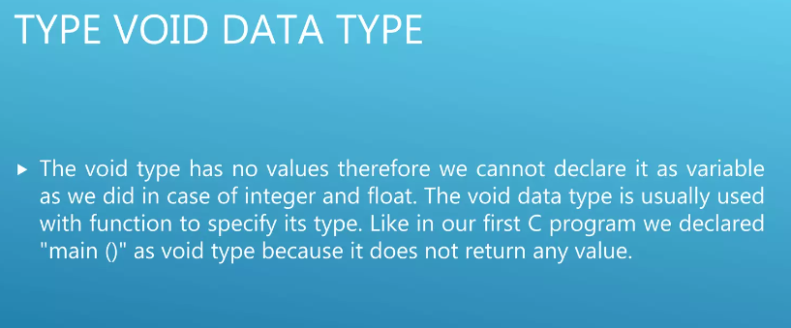

Slide 37
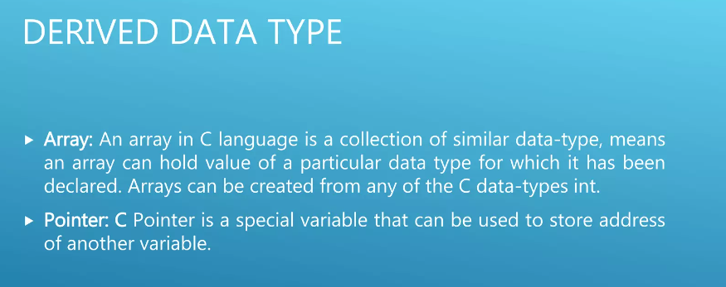
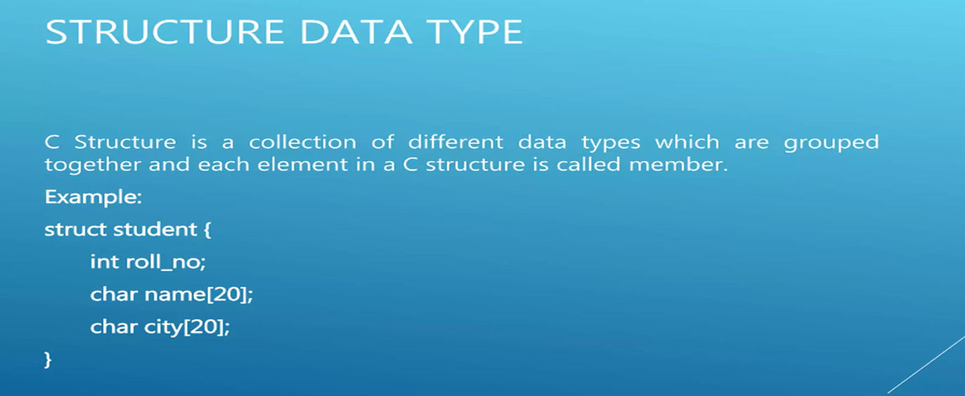

Slide 38
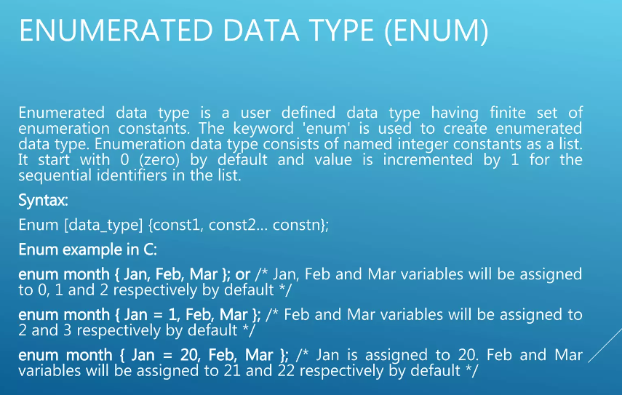

Slide 39
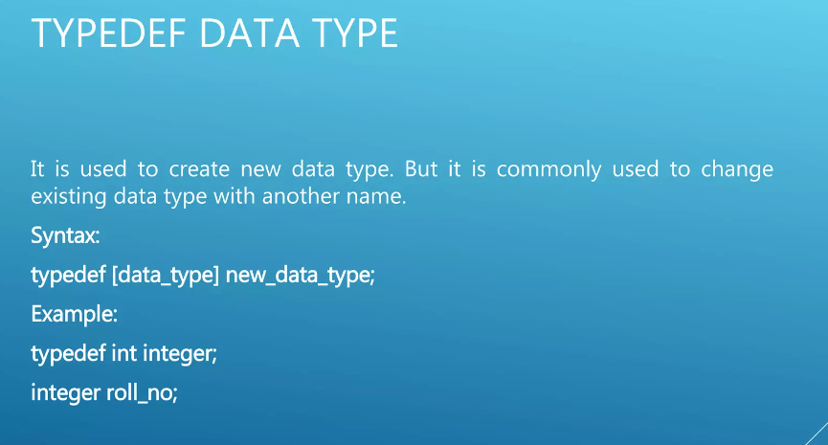

Slide 40
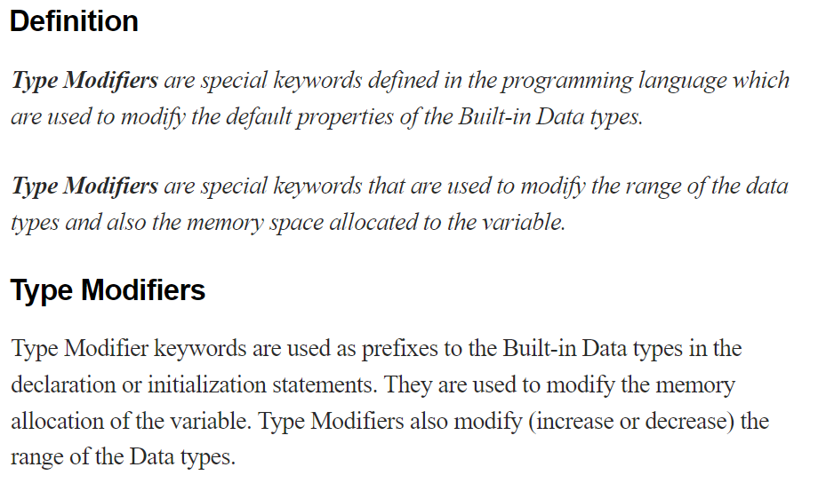

Slide 41
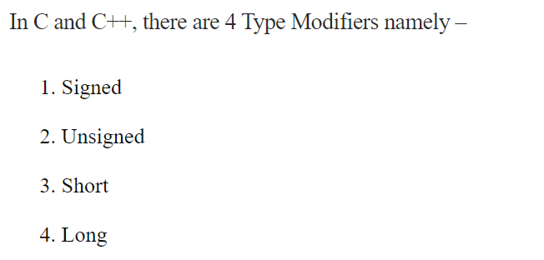

Slide 42
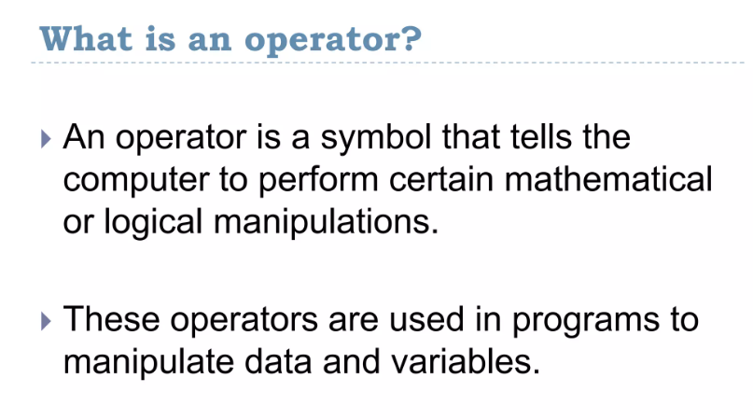

Slide 43
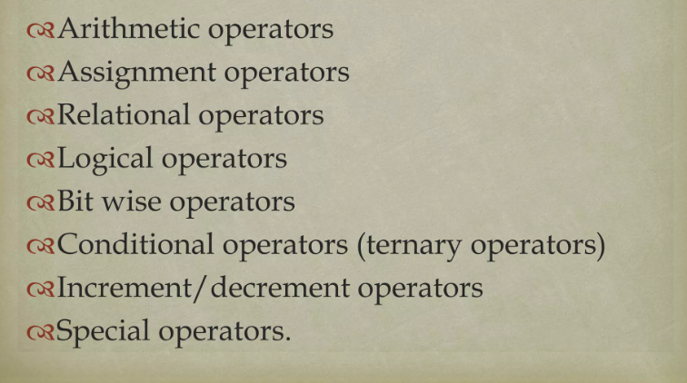

Slide 44
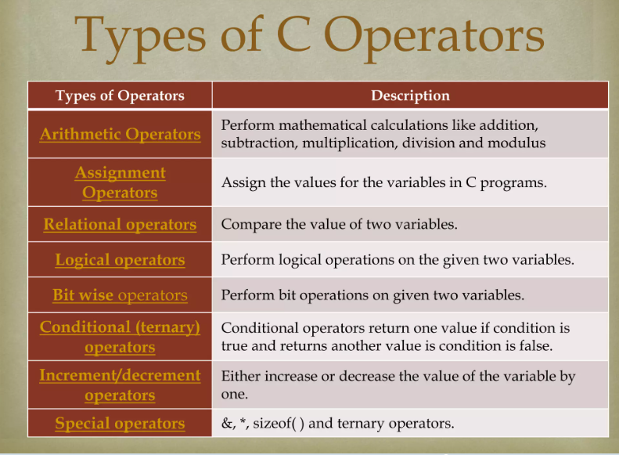

Slide 45
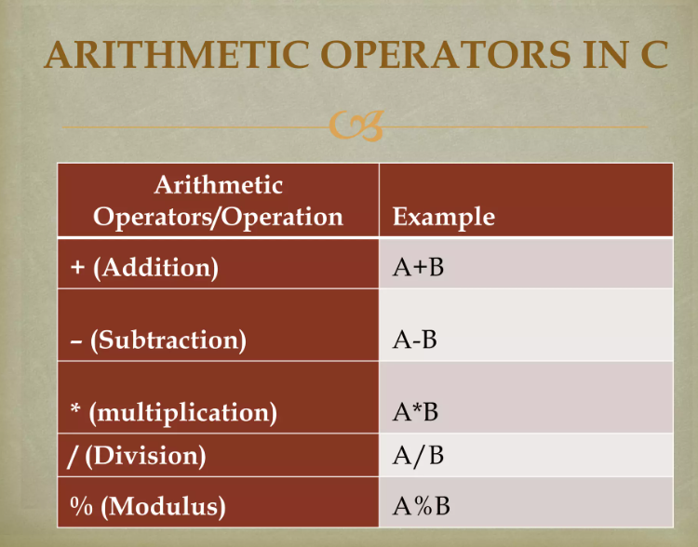

Slide 46
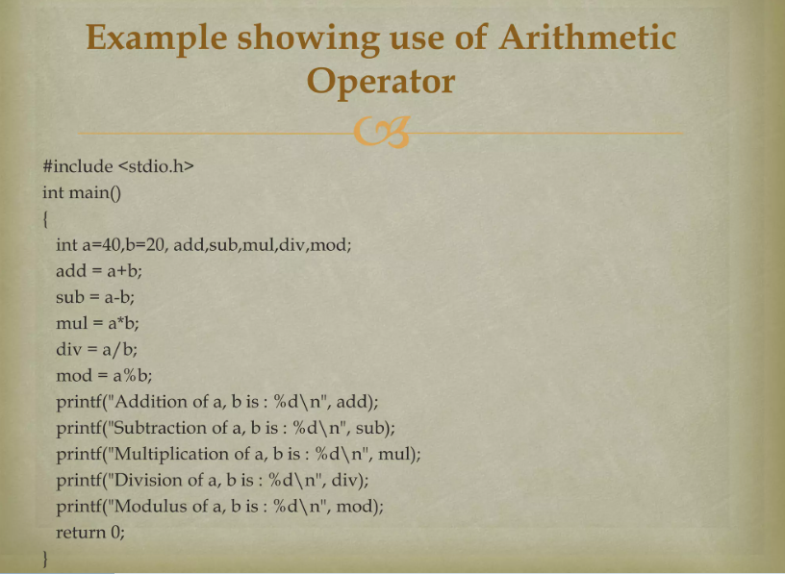

Slide 47
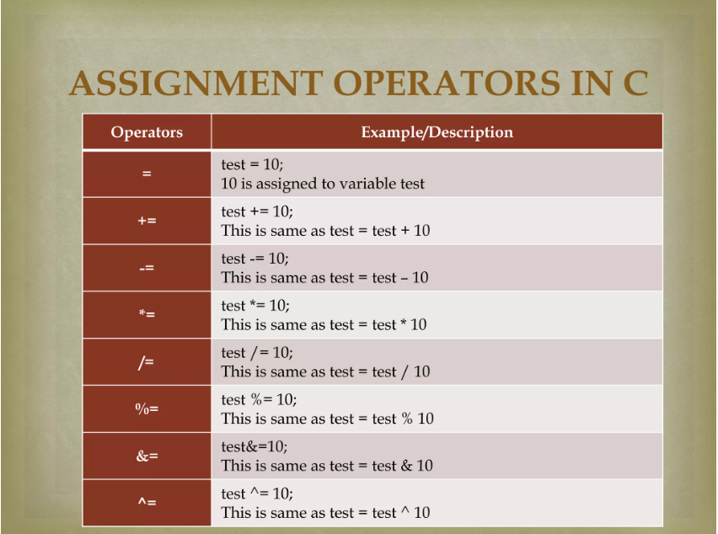

Slide 48
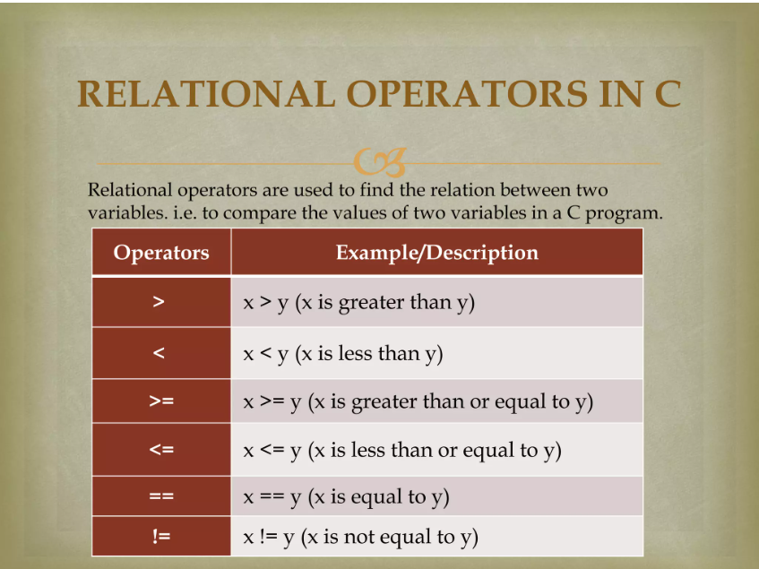
Eg. Input 2 numbers and check whether they are equal, greater than or less than the other number.

Slide 49
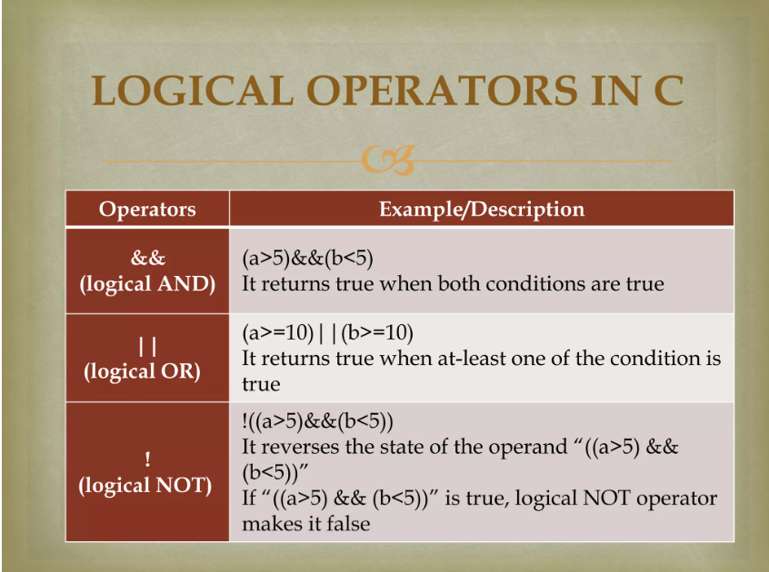
Eg. WAP showing the use of Logical Operators.

Slide 50
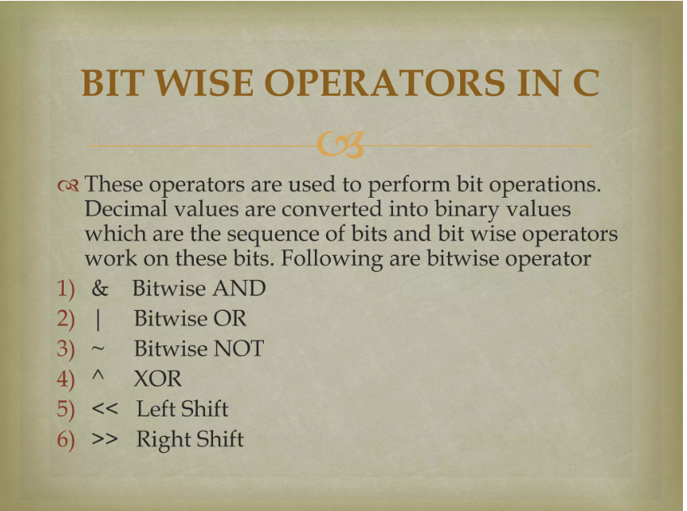
Bitwise operators may not be applied to float or double.

Slide 51
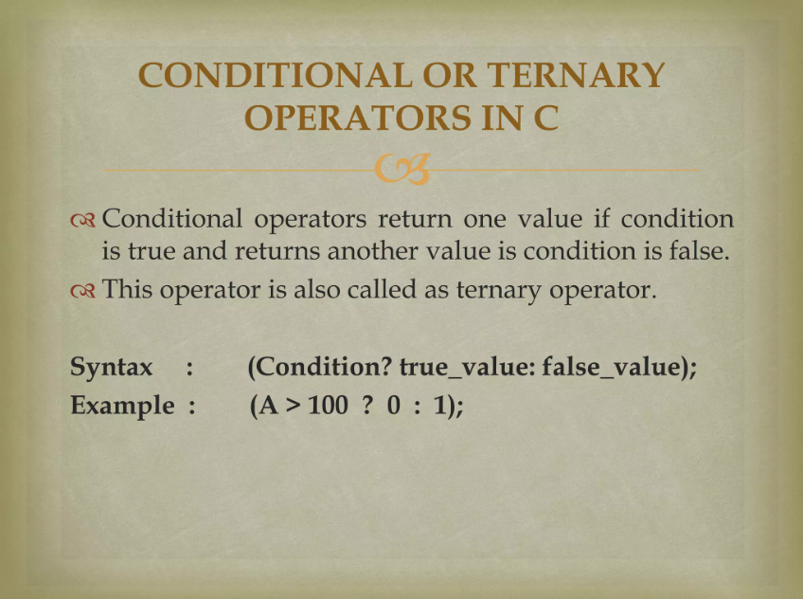
Eg. WAP to print the greatest among two input numbers using ternary operators.

Slide 52
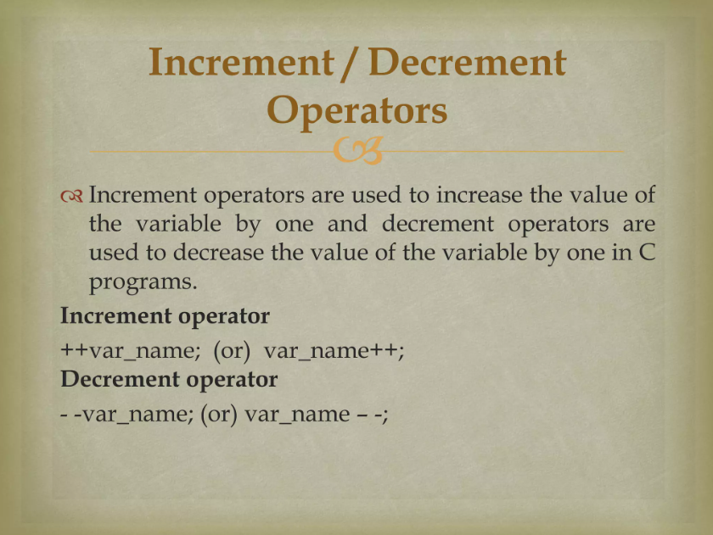
WAP to explain the increment and decrement operators.

Slide 53
Special Operators
The Comma Operator :- This operator can be used to link the related expressions together. Since comma operator has the lowest precedence of all operators, the parenthesis are necessary.
Eg
value=(x=10, y=5,x+y);
First assigns the value 10 to x, then assigns 5 to y, and finally assigns 15 to value.
The sizeof operator :- sizeof is a compile time operator and when used with an operand, it returns the number of bytes the operand occupies.
eg
m = sizeof(sum);
n= sizeof(int);

Slide 54
Programs
WAP to count and print the number of positive numbers and negative numbers in a given set of numbers.
WAP to input an integer between 0 and 128 and print its ASCII character.
WAP to convert temperature in fahrenheit to its equivalent degree Celsius.
              F-32
C =
1.8
4. WAP to print the sum of the following series for a given value of n
1+ ½ + 1/3 +…….+1/n
5. The price of 1 kg of rice is Rs 52.75 and 1 kg of sugar is Rs 40. WAP to get these values along with quantity of items from the user and display the total prices. The output should be in a neat format.

Slide 55
Type conversion, Properties of operators, Priority of operators,

