Slide 1
Module - I
Introduction to programming, Classification of computer languages, Language translators (Assembler, Compiler, Interpreter), Linker, Characteristics of a good programming language, Factors for selecting a language, Subprogram, Purpose of program planning, Algorithm, Flowchart, Pseudocode, Control structures (sequence, selection, Iteration), Testing and debugging.

Slide 2
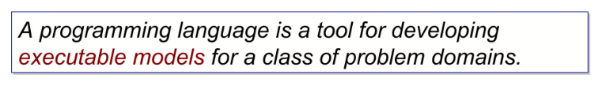


Slide 3
Classification of computer languages
Computer languages are classified into three categories
Machine Language
2. Assembly Language
3. High-Level Language

Slide 5
A machine language instruction normally has a two part format.
The first part is operation code that tells the computer what function to perform.
The second part is operand that tells where to find or store the data on which the computer has to perform the function.
OPCODE
OPERAND
All computers use binary digits (0s and 1s) for performing internal operations. Hence most computer’s machine language instructions consist of binary numbers.

Slide 10
High Level Languages

Slide 12
Language translators

Slide 21
Linker

Slide 22
Characteristics of a good programming language
Selection Criteria for a Programming Language
1. Usability
Easy to learn, ease of use for an experienced programmer.
2. Performance
Speed of program execution, speed of compiler execution (a program which translates the program into machine code), stability (lack of defects).
3. Portability
A portable language is one which is implemented in variety of computers (design relatively machine dependent). Well defined language are more portable than others e.g. C, C++.
4. Extendibility
Possibility of developing the language and its implementation, existence function libraries, class libraries, etc.
5. Continuity
Continuity of the manufacturer, language continuity, implementation continuity, existence of international standards for defining the language, conformity of implementation by following standards, existence of other manufacturers for that language.

Slide 23
Factors for selecting a language,
Targeted platform: The most important thing to decide is how and where the program would function. It is well known that not all the languages can run in all types of platforms. When the program is written in the renowned C language, it requires compilers to function on Linux and Windows-based systems.
Efficiency: It is important for the compilers to match with the language you are selecting. It should be efficient so that it helps in making the language to function fast.
Performance and elasticity: When you are choosing a language, you have to remain flexible enough. By being flexible, you can add extra features and programs in it.
Tool support: It is recommended to purchase tool oriented language which provides several elements and also methods to control, work and edit.

Slide 24
Subprograms
In computer science, a subroutine or subprogram (also called procedure, method, function, or routine) is a portion of code within a larger program, which performs a specific task and is relatively independent of the remaining code.
As the name "subprogram" suggests, a subroutine behaves in much the same way as a computer program that is used as one step in a larger program or another subprogram.
A subroutine is often coded so that it can be started ("called") several times and/or from several places during a single execution of the program, including from other subroutines, and then branch back (return) to the next instruction after the "call" once the subroutine's task is done.
There are two distinct categories of subprograms:
1. Procedures 2. Functions.

Slide 25
Function
In a programming language, function is said to be a set of instructions that take some input and execute some tasks. A function can either be predefined or user-defined. In the C program, a function can be called multiple times to provide reusability and modularity. It may or may not return a value.
Procedure
It is an important programming construct for a compiler. The procedure is used for generating good code for procedure calls and returns. It does not deal with an expression. It is defined as the set of commands that are executed in order.
In DBMS, a procedure (often called a stored procedure) is a collection of pre-compiled SQL statements stored inside the database. It is a subroutine or a subprogram in the regular computing language. A procedure always contains a name, parameter lists, and SQL statements. In structured query language (or SQL), it does not return a value. In Java, both function and procedure are the same and called sub-routines.

Slide 26
Purpose of program planning
Planning is the first step in developing and clarifying the concept for a program.
In addition to writing down the idea for their program, students may also draw and label a diagram of what the program will look like.
Planning software can be a powerful tool to organize projects and resources into phases and tasks with attainable deadlines – all in one place

Slide 27
Algorithm

Slide 29
Eg. Develop an Algorithm to find the average of three numbers taken as input from the user.
Algorithm AVERAGE
Step 0 START
Step 1 INPUT first number into variable A
Step 2 INPUT second number into variable B
Step 3 INPUT third number into variable C
Step 4 COMPUTE sum= A+B+C
Step 5 COMPUTE Average = sum/3
Step 6 DISPLAY Average
Step 7 END

Slide 30
Eg. Develop an Algorithm to divide one number by another and find the quotient
Algorithm DIVISION
Step 0 START
Step 1 INPUT first number into variable A
Step 2 INPUT second number into variable B
Step 3 If B!=0 then
Q=A/B
DISPLAY Q
End if
Step 4 END

Slide 31
Questions
Develop an algorithm to find the maximum of two input numbers.
Write an algorithm to check whether the input number is even or odd.
Write an algorithm to check whether the input number is divisible by 5.
Write an algorithm to check whether the input number is a multiple of 6.
Write an algorithm to find the product of three input numbers.

Slide 32
FLOWCHART

Slide 39
Average of three numbers
START
Input A
Input B
Input C
Sum= A+B+C
Average=Sum/3
Display Average
END

Slide 40

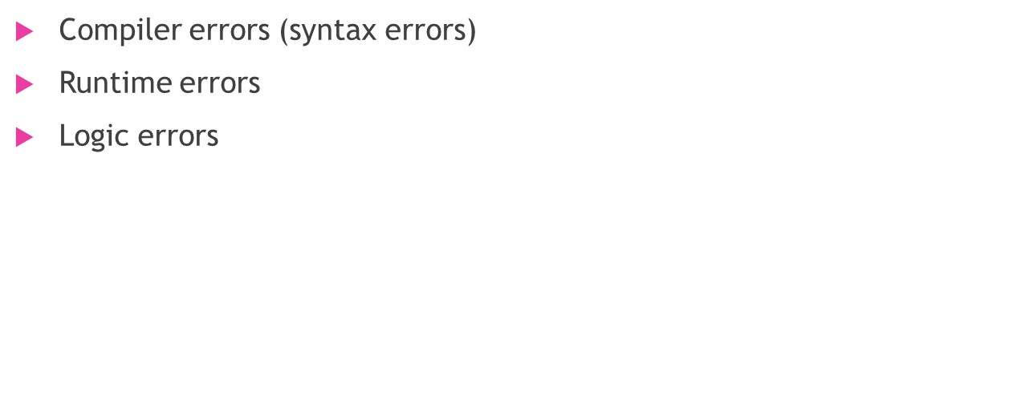
Testing and Debugging

Slide 41
Compiler Errors
Syntax error
  Error in usage of Code
  Detected by the compiler
  A program with compilation errors cannot be run
Syntax warning
  Warning message generated by the compiler
  The program can be run

Slide 42
Compiler Errors
Very common (but sometimes hard to understand). Examples of syntax errors:
  Forgetting a semicolon
  Leaving out a closing bracket }
  Redeclaring a variable
  Others?

Slide 43
Compiler Errors
Hints to help find/fix compiler errors:
  Compiler errors are cumulative: when you fix one, others may go away
  Read the error messages issued by the compiler
  Realize that the error messages from the compiler are always not very helpful
    The compiler does not know what you intended to do, it merely scans the code

Slide 44
Runtime Errors
Runtime error: program runs but gets an exception error message
    Program may be terminated
Runtime errors can be caused by
  Program bugs
  Bad or unexpected input
  Hardware or software problems in the computer system

Slide 45
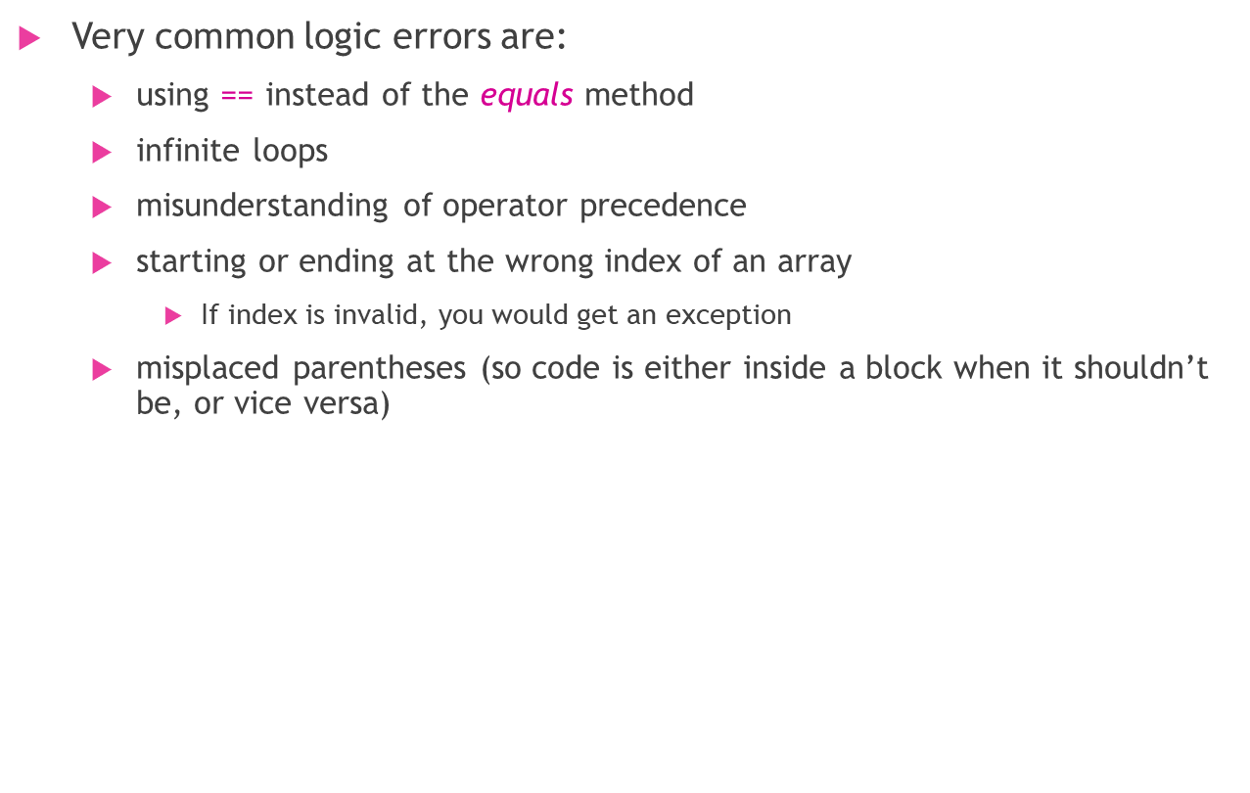
Logic Errors
Logic error: program runs but results are not correct
Logic errors can be caused by:
  incorrect algorithms

Slide 46
Thank You

