Slide 1

Toothpaste Supply Chain
Network Game
Estimated duration: 2h15
https://zensimu.com/

Slide 2
Plan
Total: 2h15
Supply Chain topics introduction (10 min)
Game introduction (15 min)
Round 1 (35 min) – 20 min play + 15 min debrief
Round 2 (35 min)
Round 3 (35 min)
General debrief and discussion (5 min)

Slide 3
Supply chain basics

Slide 4
Supply chain basics
Supply chain definition:
The planning, sourcing, manufacturing, distribution, and delivery of products or services from the point of origin (raw materials) to consumption (arrival at the end consumer).
The supply chain includes all internal and external factories, warehouses, transportation services and all the information flows and processes to coordinate the different elements.
Marketing = create more demand
Operations / Supply chain = fulfill the demand

Slide 5
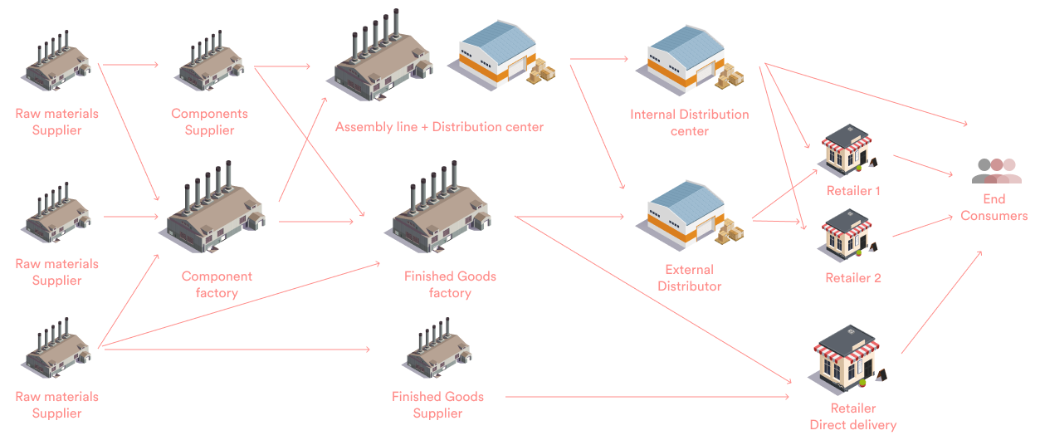
Supply chain network

Slide 6
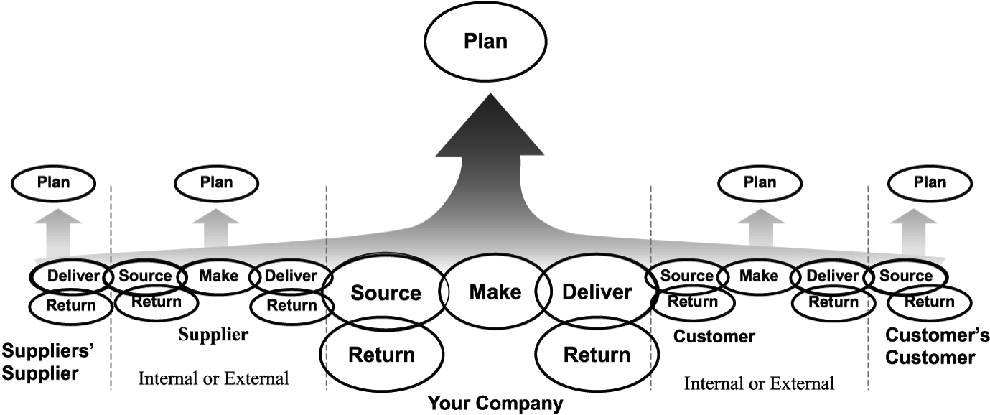
Supply chain basics
The « SCOR » model - Supply Chain Operations Reference :

Slide 7
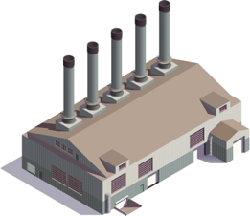
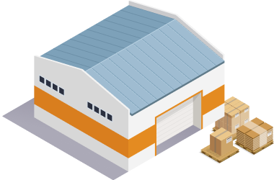
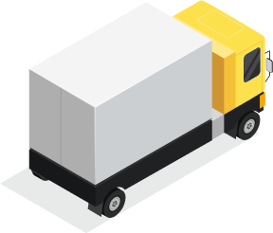
Supply chain basics
Supply Chain Contraints :
Production :
  Components availability,
  Minimum batch size,
  Manufacturing lead time,
  Workforce availability,
  Machine performance
Storage :
  Maximum surface
  Shipping/receiving capacity
Transportation :
  Delivery lead time
  Truck capacity

Slide 8
Supply chain basics
Typical Supply chain KPIs:
Service level
Inventory coverage
Inventory turnover
Forecast accuracy
Logistics costs
Customer satisfaction
Lead time
Supply chain Strategy:
Objectives
Trade-offs :

Slide 9
Game introduction
Rules and How to Play

Slide 10
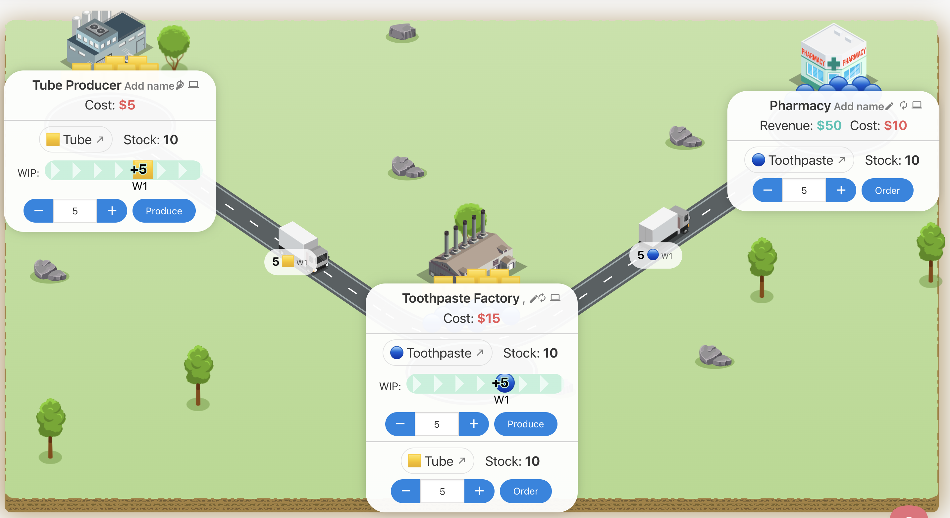
Game Description
The game simulates a Toothpaste supply-chain composed of 3 sites/4 roles:

Slide 11
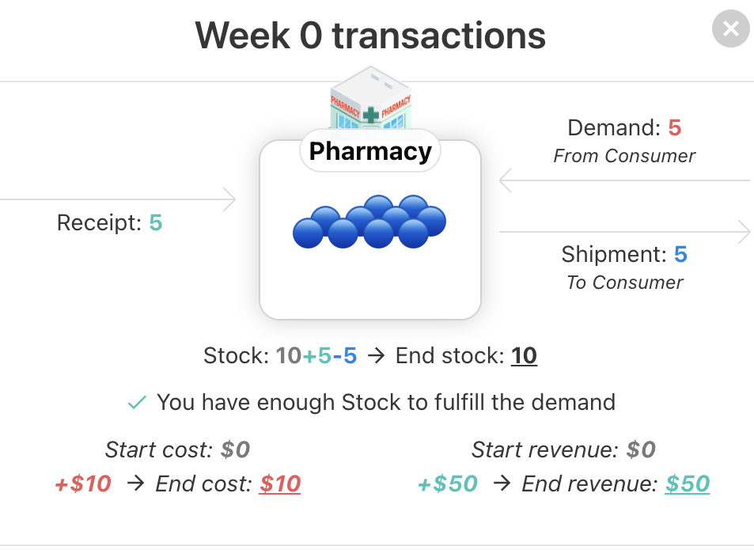
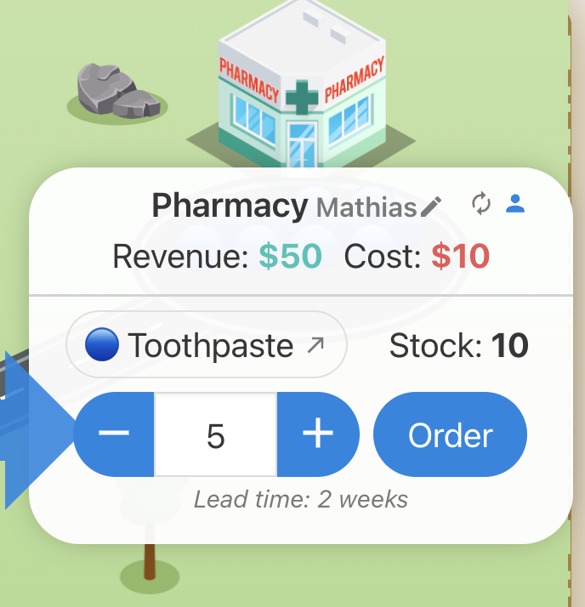
Game Description - Pharmacy
Pharmacy
Manages its stock of toothpaste,
Client: Consumer to which it ships toothpaste
Supplier: Toothpaste Factory, to which it sends supply orders and from which it receives toothpaste with a 2 weeks lead time.
🔵 Toothpaste:
Stock cost: 1$/pc
Backorder cost: 2$/pc
Sale Price: 10$/pc

Slide 12
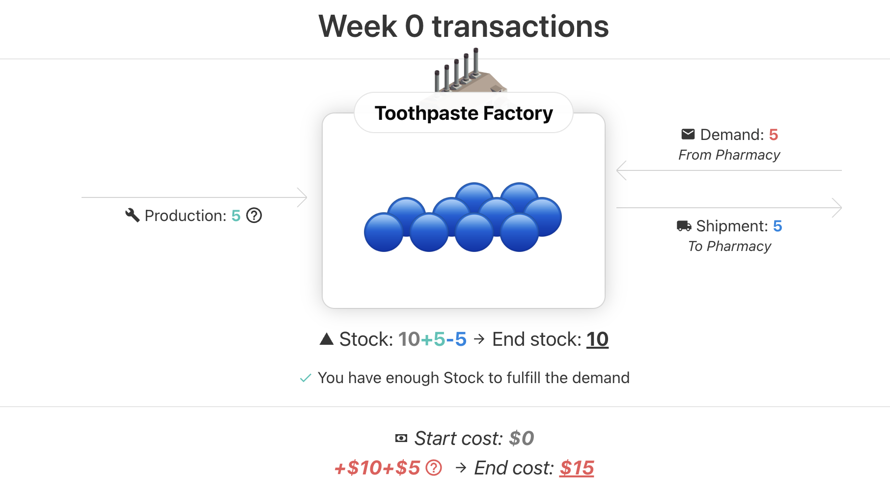
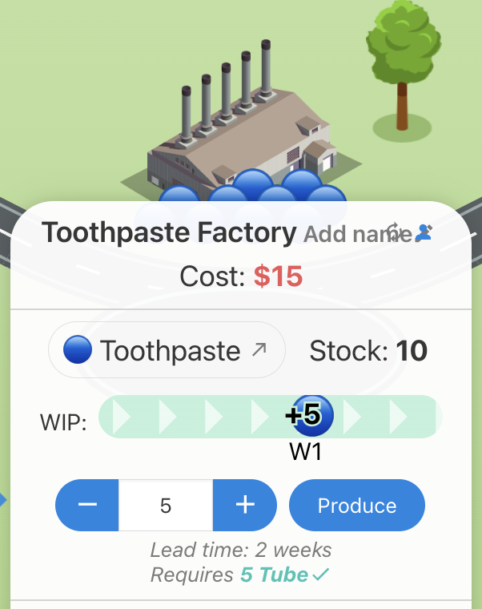
Game Description – Factory 1/2
Toothpaste Production
Manages its stock of toothpaste,
Client: Pharmacy
Producing toothpaste takes 2 weeks and requires Tubes.
🔵 Toothpaste:
Stock cost: 1$/pc
Backorder cost: 2$/pc

Slide 13
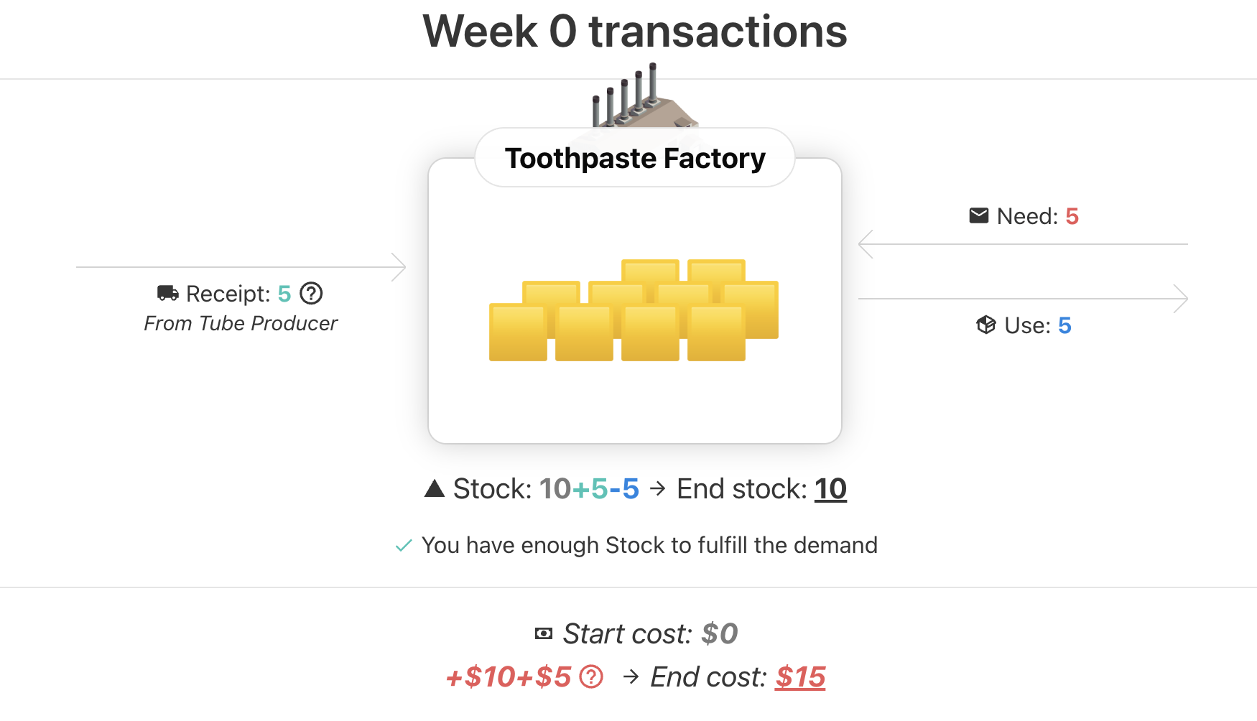
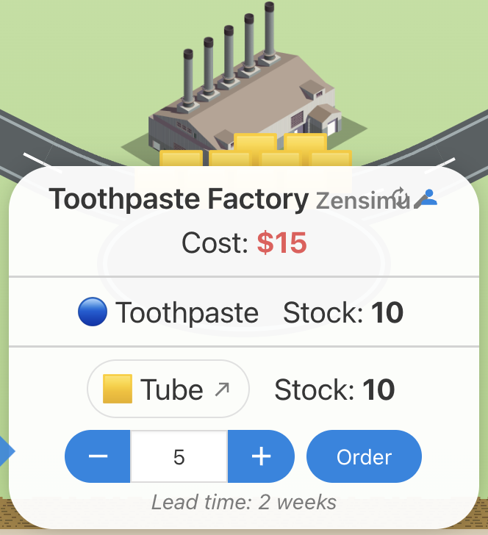
Game Description – Factory 2/2
Tube Procurement
Manages its stock of tubes,
Client: Toothpaste Production
Order tubes from the Tubes Suppliers, the delivery takes 2 weeks
🟨 Tube:
Stock cost: 0.5$/pc
Backorder cost: 1$/pc

Slide 14
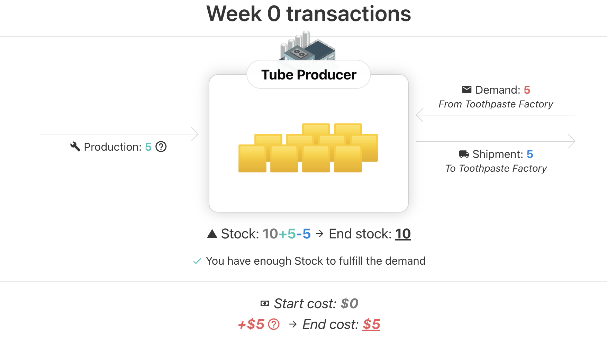
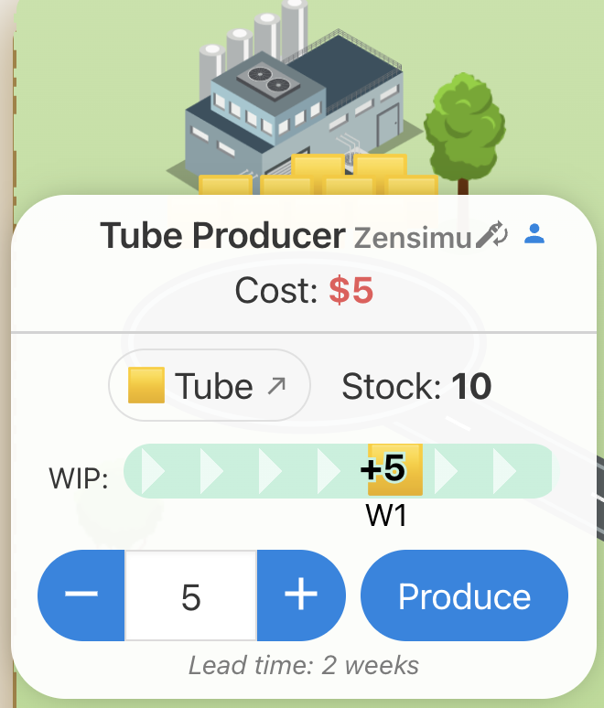
Game Description – Tubes Producer
Tubes Producer
Manages its stock of tubes,
Client: Toothpaste Factory (Procurement)
Producing tubes takes 2 weeks
🟨 Tube:
Stock cost: 0.5$/pc
Backorder cost: 1$/pc

Slide 15
Objectives
The game lasts for an unknown number of weeks
Fullfill your client’s demand every week
Revenue and Costs cumulate every week:
  Sale price: 10$ per toothpaste delivered by the pharmacy
  Stock cost: Toothpaste: 1$, Tube 0.5$
  Backorder* cost: Toothpaste 2$, Tube 1$
➔ Try to keep costs low with an optimized stock, and ensure availability for the customers
*Backorder = stockouts, late quantities waiting to be fulfilled

Slide 16
Let’s play! Round 1

Slide 17
Round 1 Debriefing

Slide 18
Global Results
➔ Who is the winning SC ?
What was the main driver of costs ?
Can you see on the graphs when and where ?

Slide 19
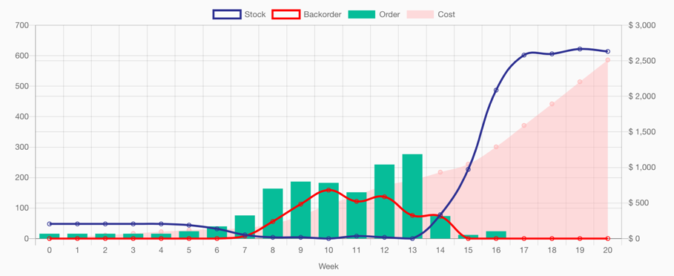
Global Results
High stock
High backorders

Slide 20
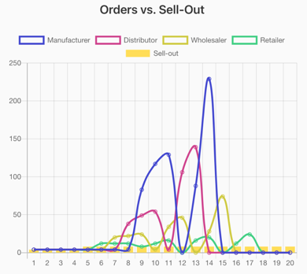
The Bullwhip effect
Orders vs Final Demand :
Question : How do you compare the final demand (“sell-out”) with the Supply Chain orders?

Slide 21
The Bullwhip effect
Orders vs Final Demand :
➔ Answer : Orders fluctuates a lot vs. the real demand. The variations increase as we go upstream to the manufacturer.
No coherence with the actual final demand profile
Sell-out of 4 pcs/week for the first 4 weeks then 8 pcs
(Quite flat)

Slide 22
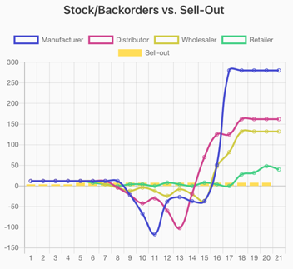
The Bullwhip effect
Stock/Backorders vs Final Demand :
Question : How do you compare the stock profile of the SC stages ?
Answer : Stages alternate between phases of out-of-stock and over-stock at different moments during the game.
This variation increases as we go up the chain to the manufacturer.

Slide 23
The Bullwhip effect

Slide 24
The Bullwhip effect: Discussion
Question :
What led you to order with these high variations ?
Did you have a specific stategy ?

Slide 25
The Bullwhip effect: Discussion
« I didn’t have visibility on the future demand »
« I ordered more to keep a safety stock »
« My supplier wouldn’t deliver so I increased my orders »
« I was afraid I wouldn’t have enough stock »
« I started to have backorders so I increased my orders to be safe »
« My client suddenly increased his orders »
« The Lead Time didn’t allow me to react quickly »
« I tried to optimize my own stock »
« I lost count of how much I had ordered before »

Slide 26
The Bullwhip effect: Discussion
In one word:
Uncertainty
In the demand / in the supply

Slide 27
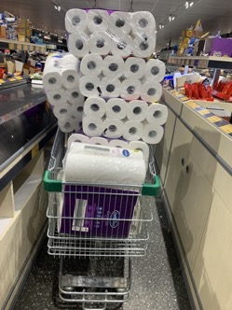
The Bullwhip effect
Example of shortages we can link to a bullwhip effect during the COVID-19 pandemic :
People want to secure stock so buy more than needed
Toilet paper :
Source : Forbes
Playstation 5 :
Source : Games Radar
Face masks :
Source : OECD

Slide 28
The Bullwhip effect: Discussion
Question :
How could we reduce the Bullwhip effect ?

Slide 29
The Bullwhip effect: Discussion
Potential Answers :
Communicate more and build a strategy (information sharing/collaboration)
Re-order only what is needed to keep a minimum stock at each stage, avoid peaks (planning tools/kanban)
Project the future sales to order/plan in advance (demand forecasts)
Reduce the lead times to be able to supply more quickly between both ends of the supply chain (improve performance)
Reduce the number of stages, ship from the manufacturer to the retailer (supply-chain design)

Slide 30
Round 2 - Rules

Slide 31
Round 2 – New Rules
Everyone can see the stock/orders of the other players.
New product to manage: 🟢 Standard Toothpaste
  Uses the same 🟨 Tubes,
  Sames stock cost: 1$ and backorder cost: 2$,
  The sale price is lower: 5$ (vs. 10$ for premium)
  We expect higher sale volumes

Slide 32
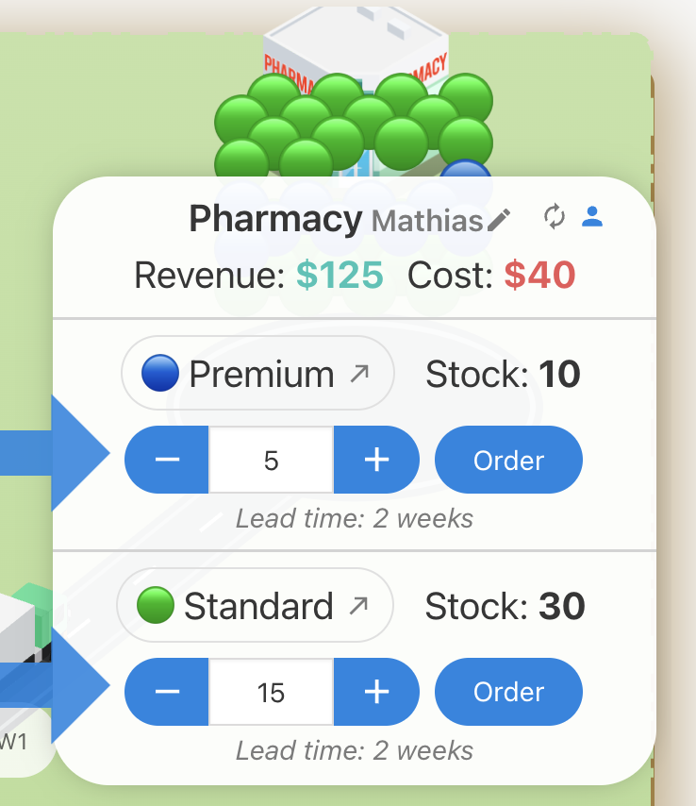
Round 2 – Role Changes
At the Pharmacy, the two products are sold: 🔵Premium (10$/sale) and 🟢Standard (5$/sale)

Slide 33
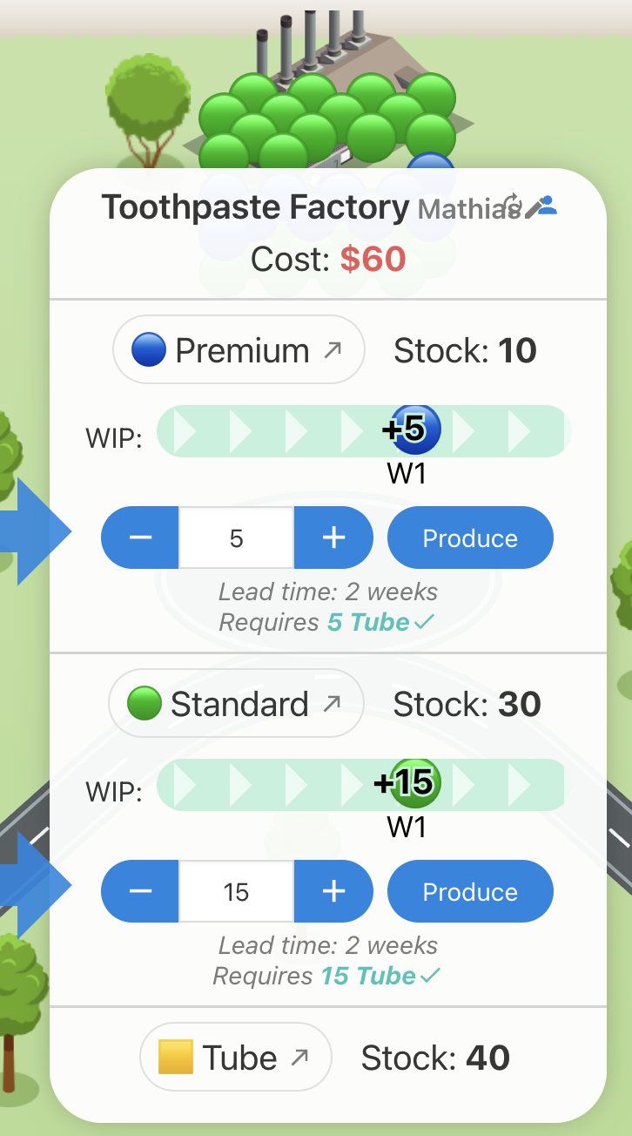
Round 2 – Role Changes
Toothpaste Production manages the production of both 🟢Standard and 🔵Premium toothpaste
➔ Both consume the same 🟨 Tubes
Tube Procurement: same role (orders tubes),
Tube Producer: same role (produces tubes)

Slide 34
Round 2 Debriefing

Slide 35
Round 2 Debriefing
Did you meet some constraints?
Did you employ specific collaboration strategies?

Slide 36
Examples of collaboration
Example of collaborative strategies:
All players see the final demand and discuss the future.
➔ « Demand Review »
Players can see/discuss what can be available + share their needs.
➔ « Supply Review »
Players can synchronize their ordering quantities.
➔ Kanban/DDMPR replenishment
Players can strategically decide to put safety stock at specific sites.
➔ Inventory plan

Slide 37
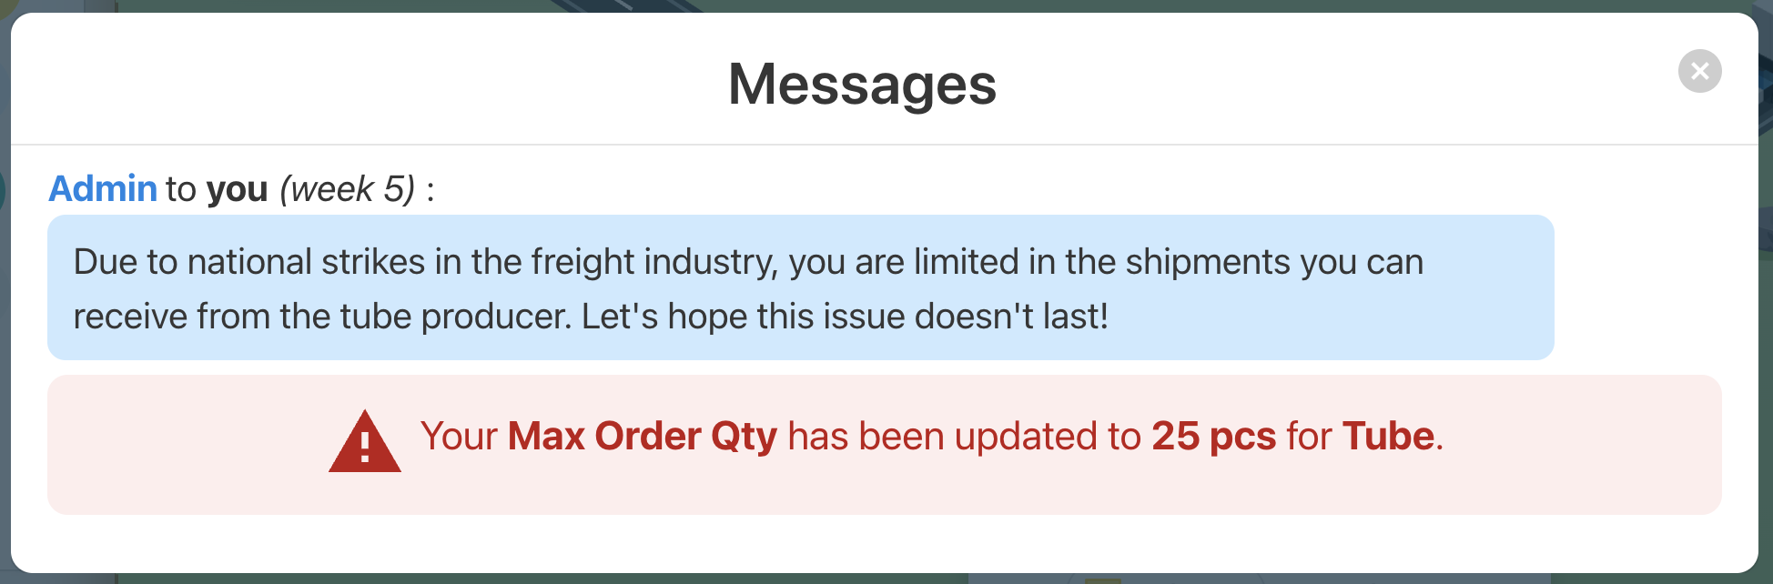
Tube Supply Disruption
How did you react to the Tube Procurement maximum orders issue?

Slide 38
Tube Supply Disruption
Building Resiliency:
Adapt Fast
Refresh forecasts, negotiate with suppliers, re-allocate inventory. Speed reduces downtimes.
Buffer Strategically
Map vulnerabilities and build safety stocks or flexible contracts to absorb shocks.
Diversify Suppliers
Eliminate single point of failures. Secure backup sources for critical inputs.
Leverage Tech for Agility
Real-time data + AI tools can help identify risks and automate mitigations, turning chaos into control.

Slide 39
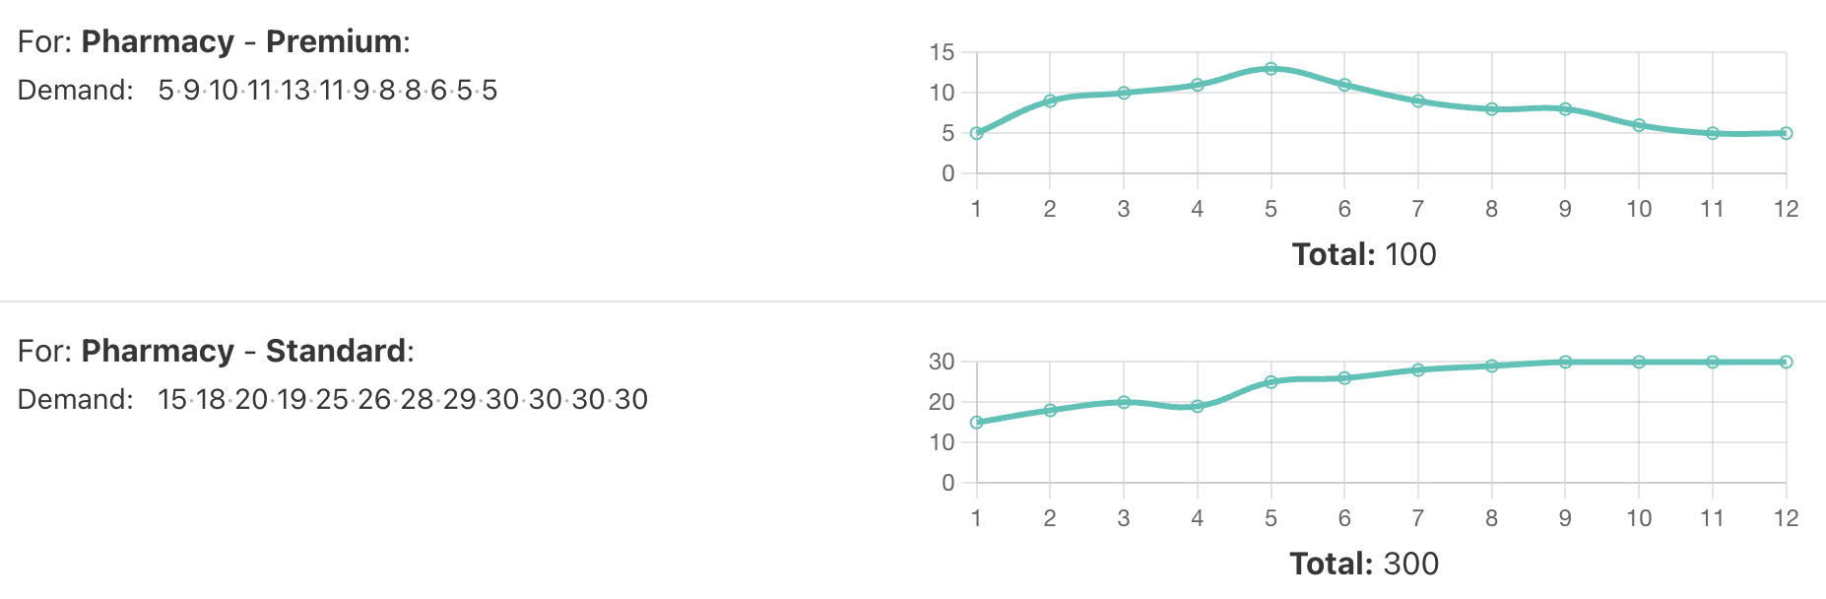
Trade-off at the Factory
Tubes constraint, to be used for both 🔵Premium and 🟢Standard.
Did you prioritize producing Premium because of higher profit?
Or ensured availability for both SKUs?
Demand patterns:

Slide 40
Before the next round
How could you have improved your results even more?
Would another supply chain network work better?

Slide 41
Let’s play! Round 3

Slide 42
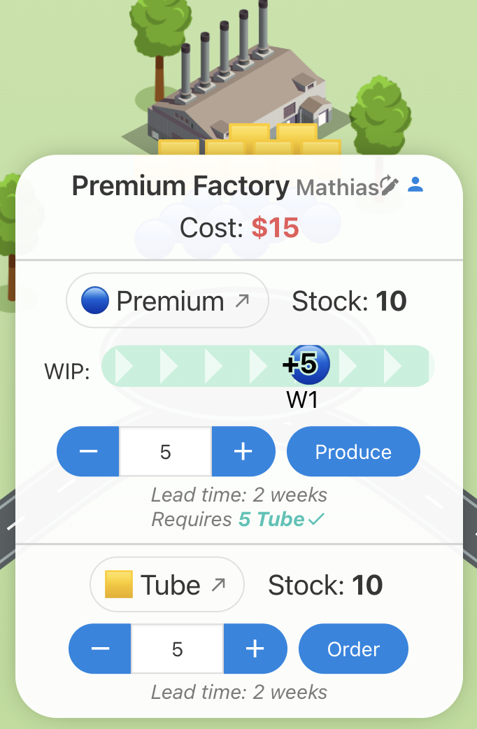
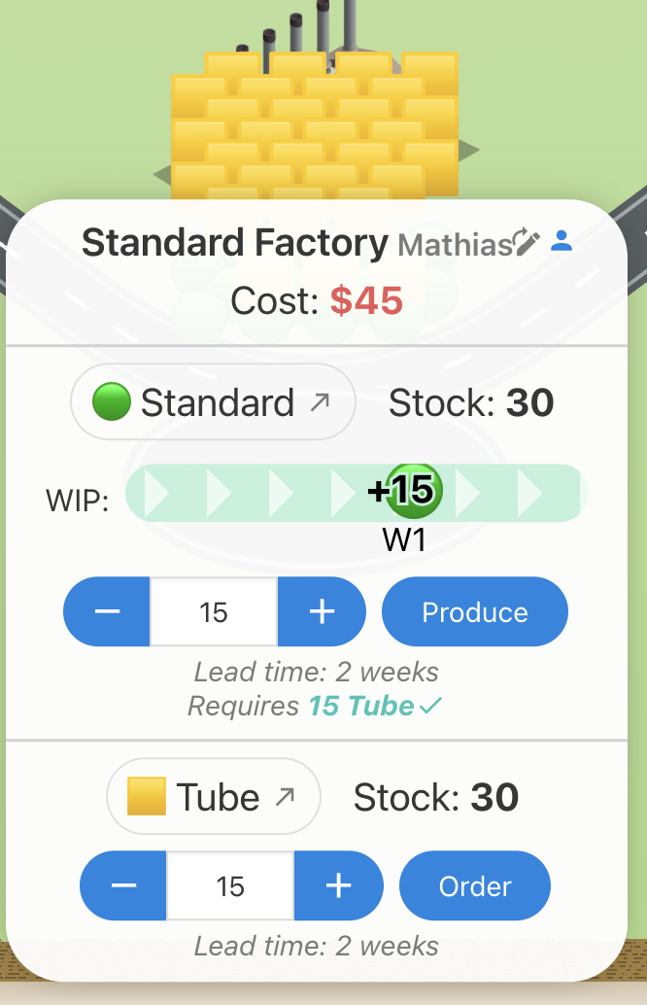
Round 3 – Role Changes
Tube Producer, Pharmacy: same roles - But now:
Premium Factory: manages Premium production and its own Tubes supply
Standard Factory: manages Standard production and its own Tubes supply

Slide 43
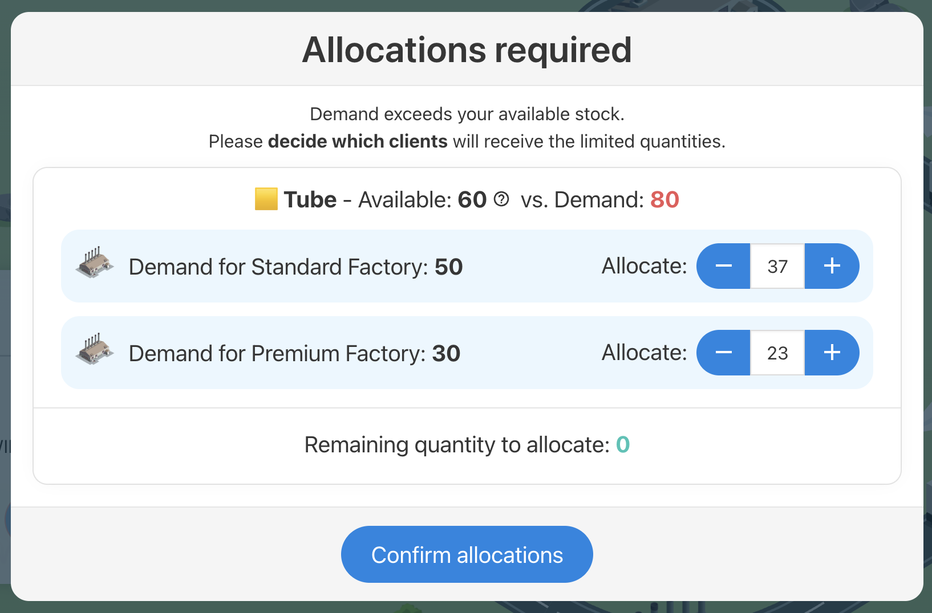
Round 3 – Allocations
Tube Producer
If the orders from both factories are higher than your stock, you need to allocate the quantities to be sent.

Slide 44
Round 3 Debriefing

Slide 45
Round 3 Debriefing
Did you meet some constraints?
Did you employ specific collaboration strategies?

Slide 46
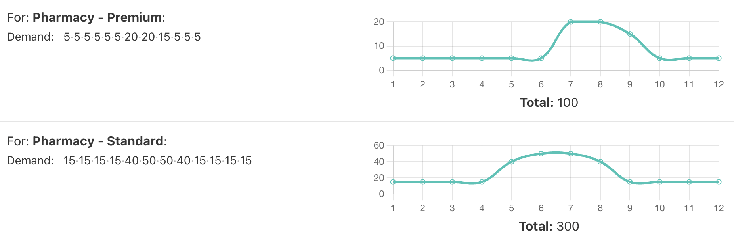
Trade-off at the Tube producer
How did you prioritize the limited tubes ?
Conflicting
Promotion/Demand
Patterns ➔

Slide 47
If there was a next round
How could you have improved your results even more?
Would another supply chain network work better?
Ex: « Standard tubes supplier » ?

Slide 48
Final debriefing

Slide 49
Key Learnings
Reduce uncertainty:
Improve collaboration (S&OP, IBP...)
Open IT system
Manage complexity:
Where are the bottlenecks, trade-offs...
Responsibilities, incentives,
Crisis/Disruption management
« What did you experience today that will change how you approach a decision tomorrow? »

Slide 50
Merci / Thanks!
Mathias Le Scaon
mathias@zensimu.com
https://zensimu.com/

