Slide 1

MRP Game
Demand and Inventory Planning
Estimated duration: 3h
https://zensimu.com/

Slide 2
Plan
Three-Rounds session – Total: 3h-3h30
Introduction to Supply Chain Planning (15 min)
Game description (15 min)
Round 1 (30 min)
Debriefing and discussion (20 min)
Round 2 (30 min)
Debriefing and discussion (20 min)
Round 3 (60 min)
Final debriefing and discussion (20 min)

Slide 3
Introduction to
Supply Chain Planning

Slide 4
Introduction to Supply Chain Planning
Why do we need to plan?
Production personnel needs: full-time, part-time,
Production capacity needs: equipments, buildings,
Purchase needs: raw materials, contracts,
Transportation needs: capacity booking,
Inventory needs: distribution, product launches

Slide 5
Introduction to Supply Chain Planning
Why do we keep inventory?
Demand/supply uncertainties,
Anticipating higher demands (production smoothing),
Economies of scale

Slide 6
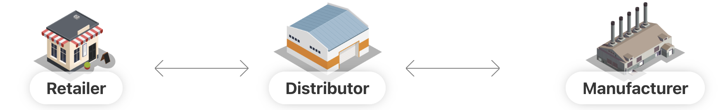
Introduction to Supply Chain Planning
Forecast
Supply
Plan
Distribution
Plan
Supply
Plan
Distribution
Plan
Production
Plan

Slide 7
Introduction to Supply Chain Planning
What information do we need?
Forecasts
Constraints
Strategy /
Policy
Master Data + Engine

Slide 8
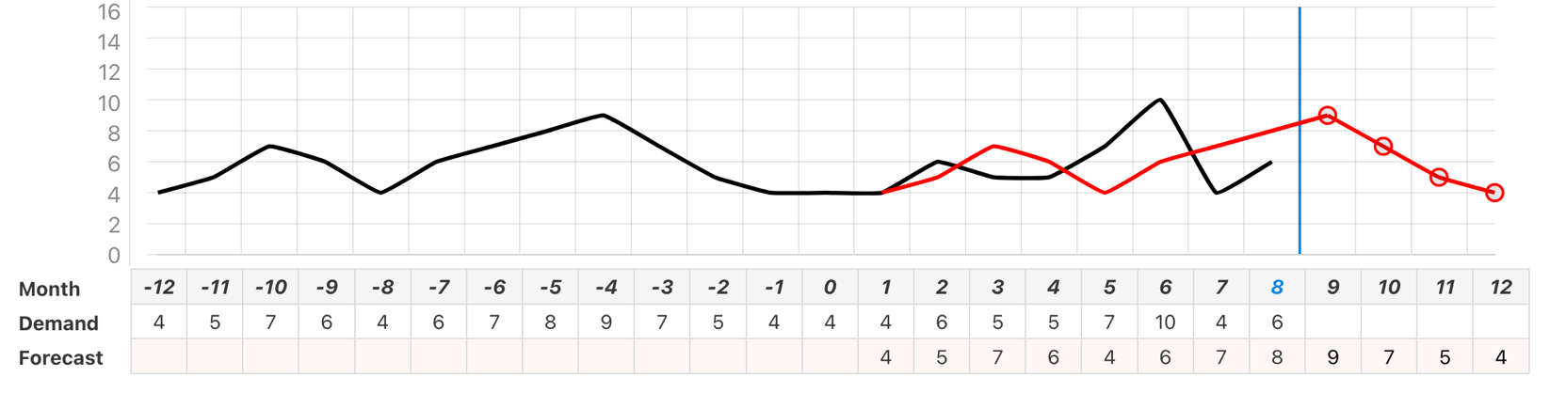
Introduction to Planning
Forecast
Model, for example:
  Fixed Moving Average,
  Seasonal Moving Average,
  Exponential Smoothing,
  Machine Learning Model,
Insights :
Marketing plan (promotions/discounts),
Market trends,
Product changes,
Distribution channels
Business strategy / investments

Slide 9
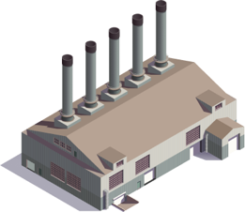
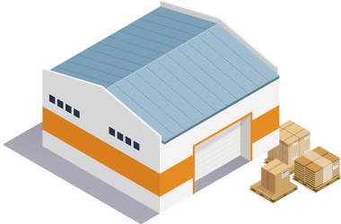
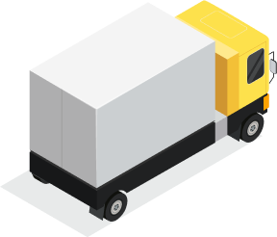
Introduction to Planning
Things you can’t decide
Constraints
Production :
  Components/Materials availability,
  Lot size, MOQ,
  Setup Cost, Machine performance,
  Manufacturing lead time,
  Workforce availability
Supply :
  Delivery lead time,
  Order cost,
  Unit cost
Inventory :
  Maximum storage,
  Holding cost

Slide 10
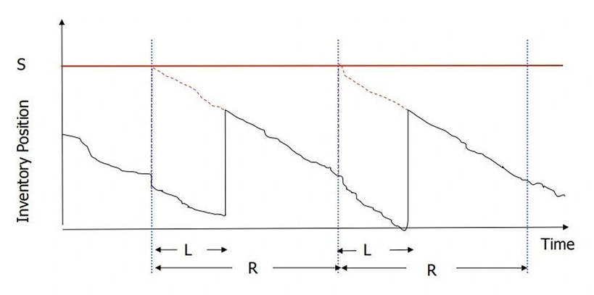
Introduction to Planning
Things you can decide
Strategy/Policy
Your Objectives :
  Service Level Target,
  Costs/ROI Target
Safety Stock :
  Localization,
  Fixed vs. Dynamic
Inventory policy:
  Demand vs. Forecast driven,
  Periodic vs. Continuous Review,
  Variable vs. Fixed (Economical) Quantity
Periodic Review (R) + Up-to level (S)

Slide 11
Game introduction
Rules and How to Play

Slide 12
Game Description
The game simulates a Beer supply-chain composed of 3 stages.
You’ll be playing as one of them :
The game is played in several turns (= weeks)

Slide 13
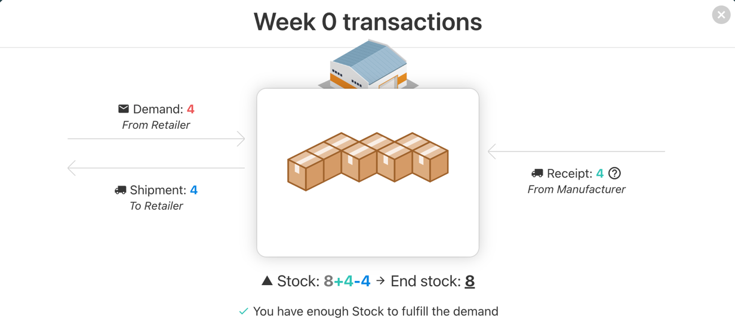
Game Description
Every week, you will see some transactions:
You will receives cases from your supplier (or from production)
You will receive an order (demand) from your client
If you have enough stock, you will ship the quantities to him

Slide 14
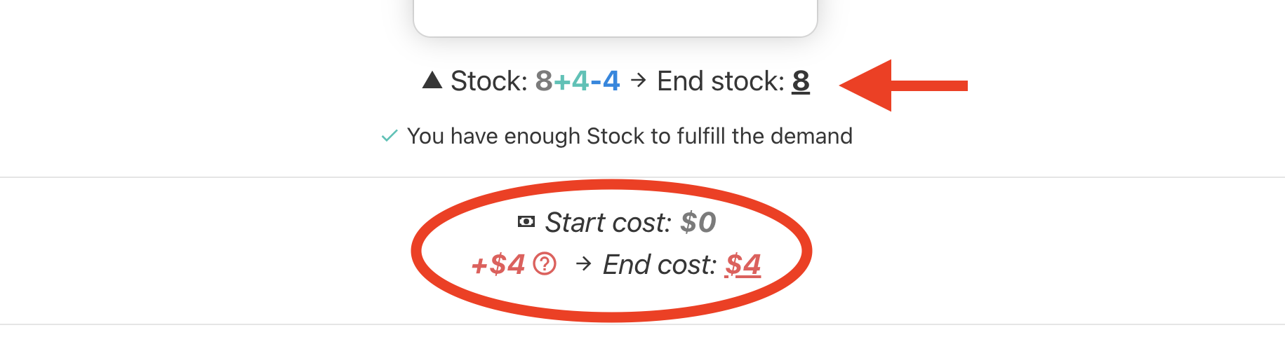
Game Description
Every week, costs cumulate:
  Stock cost : +0.5$ /case/week
  Backorder* cost : +1$ /case/week
  *Backorder = stockouts, late quantities waiting to be fulfilled

Slide 15
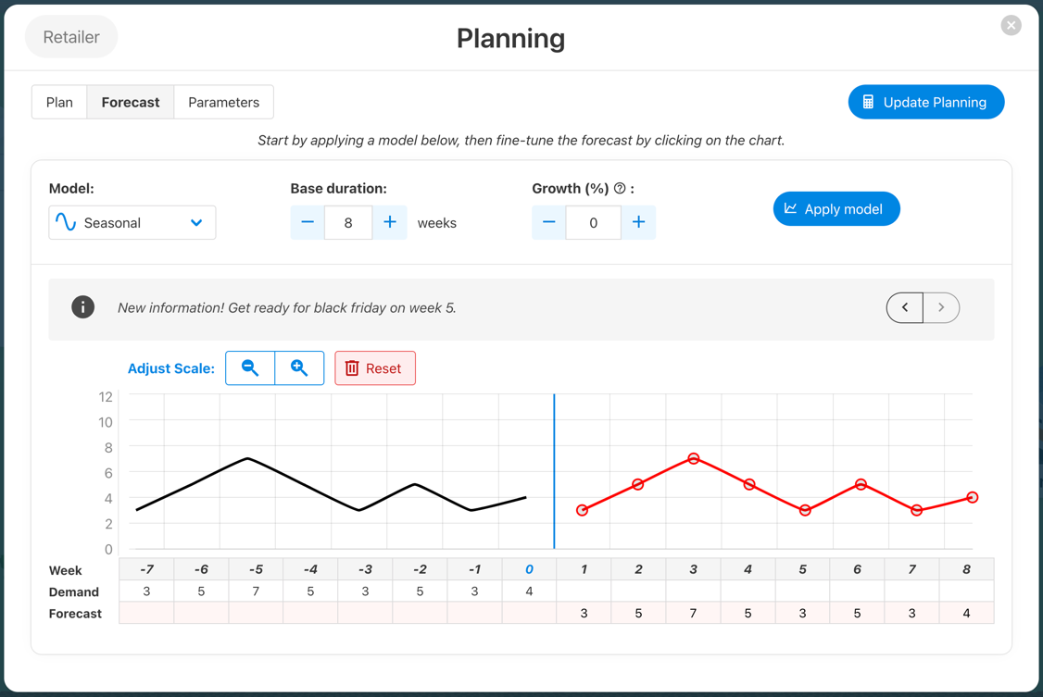
Game Description
Then – The retailer adjusts the forecast:
Apply model to quickly generate a baseline
Read market insights
If needed, click on the chart to adjust the profile

Slide 16
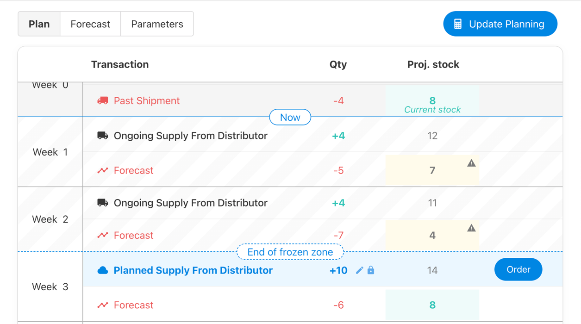
Game Description
Then – One by one, players:
Update Planning
Starting parameters:
Lead time: 3 weeks
Safety stock: 8 units
Confirm Weekly Order

Slide 17
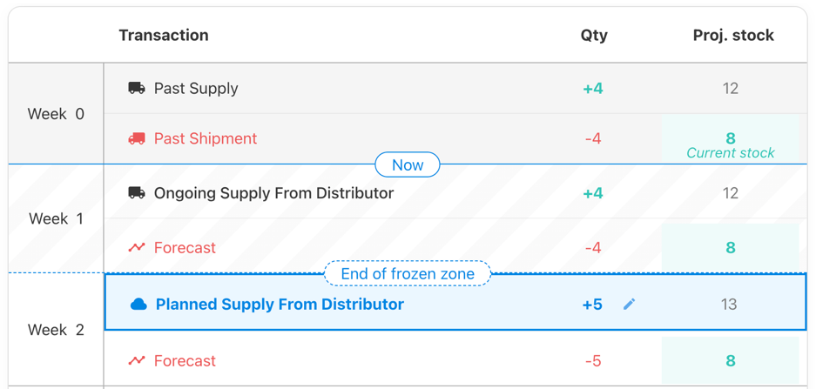
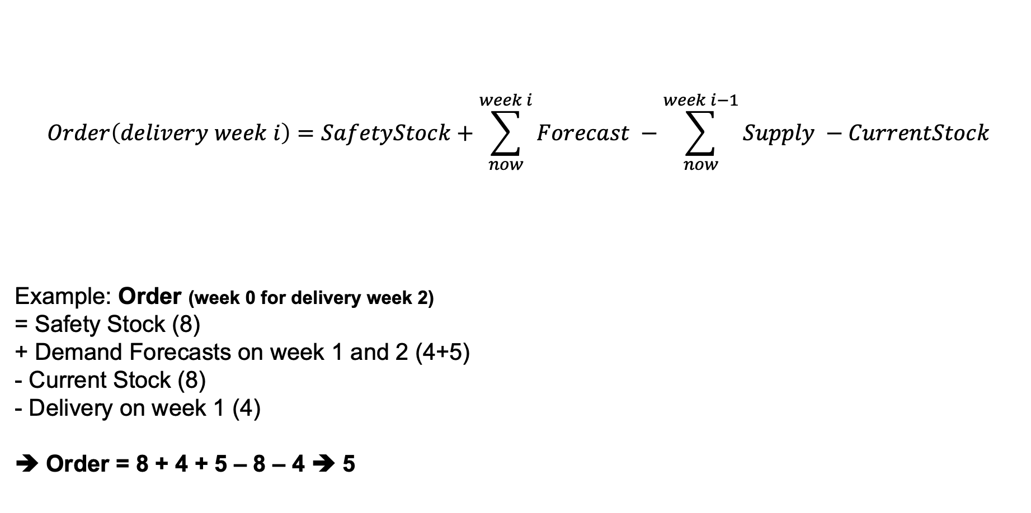
Reading the net needs calculation
$$Order\left(delivery week i\right)=SafetyStock+\sum_{now}^{week i}{Forecast} −\sum_{now}^{week i−1}{Supply} −CurrentStock$$
Example: Order (week 0 for delivery week 2)
= Safety Stock (8)
+ Demand Forecasts on week 1 and 2 (4+5)
- Current Stock (8)
- Delivery on week 1 (4)
➔ Order = 8 + 4 + 5 – 8 – 4 ➔ 5

Slide 18
Game Description
Recap:
New week starts
1
2
3
Retailer:
Verify/Adjust forecast
Calculate MRP
Confirm order
Distributor:
Calculate MRP
Confirm order
Manufacturer:
Calculate MRP
Confirm order
Total: 8 weeks

Slide 19


Slide 20
Your Objectives
Manage your supply plan
Keep costs low:
  Stock cost : +0.5$ /case/week
  Backorder cost : +1$ /case/week
Number of Game Cycles: 8 weeks

Slide 21
Let’s play! Round 1

Slide 22
Round 1 Debriefing

Slide 23
General Results
Who is the winning Team / Supply Chain ?
How did you feel during the game ?

Slide 24
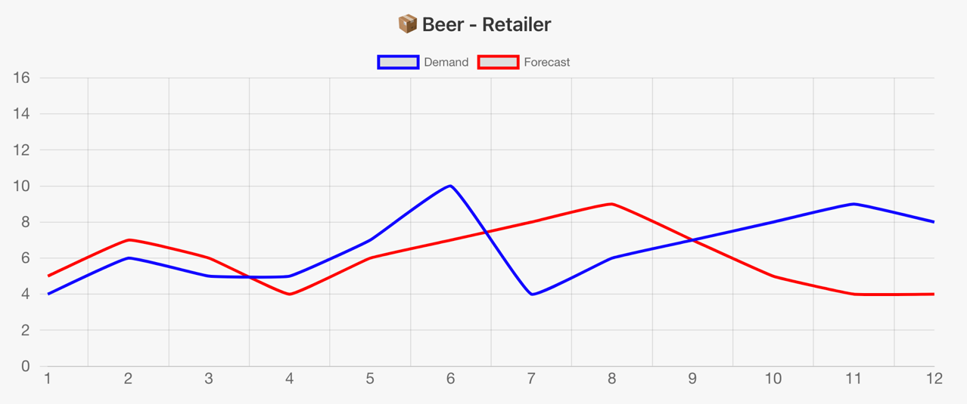
Forecast Accuracy
Question : How reliable was the demand signal sent to the supply chain?
Key metrics: MAE, RMSE and Biais. Look at your team score.

Slide 25
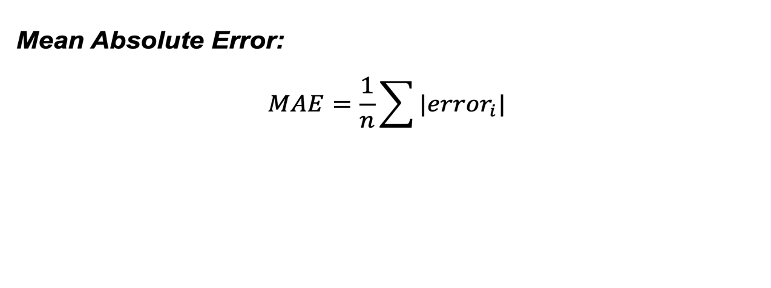
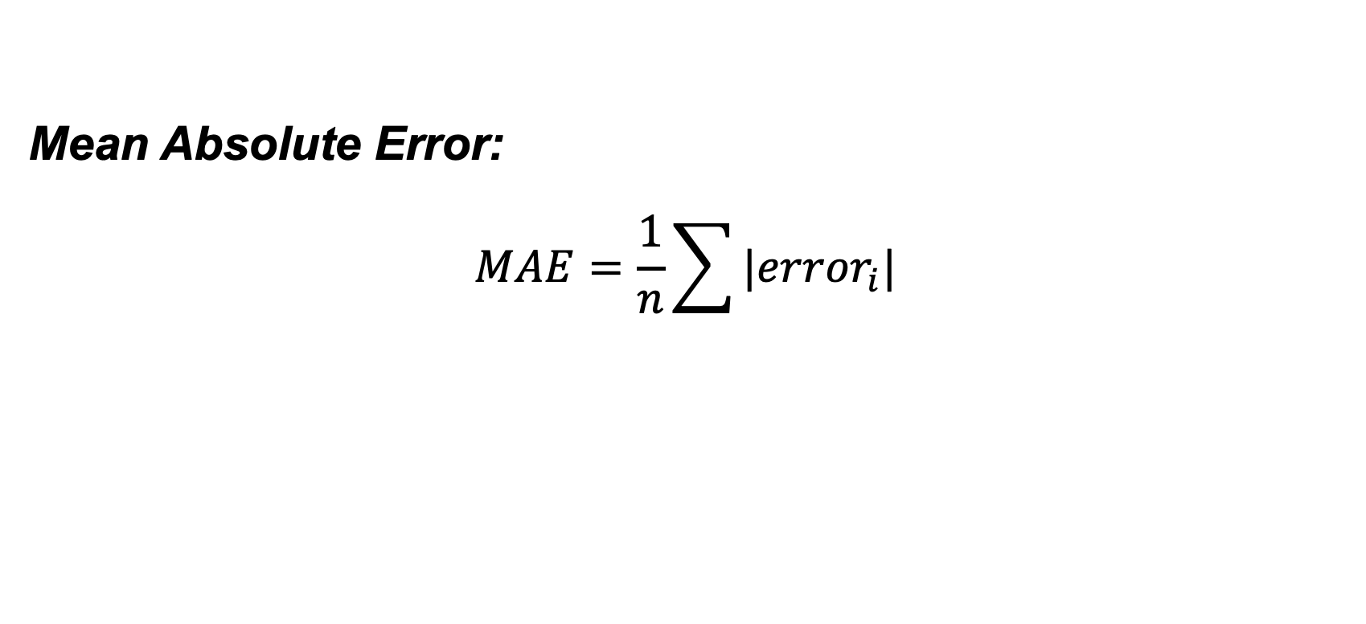
Forecast Accuracy KPI - MAE
Mean Absolute Error:
$$MAE=\frac{1}{n}\sum{|{error}_{i}| }$$
e2
e3
e1

Slide 26
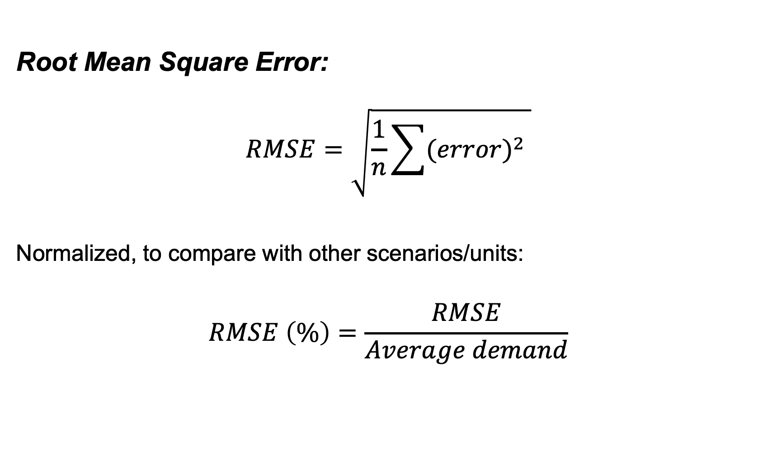
Forecast Accuracy KPI - RMSE
Root Mean Square Error:
$$RMSE=\sqrt{\frac{1}{n}\sum{{(error)}^{2} }}$$
Normalized, to compare with other scenarios/units:
$$RMSE \left(\%\right)=\frac{RMSE}{Average demand}$$

Slide 27
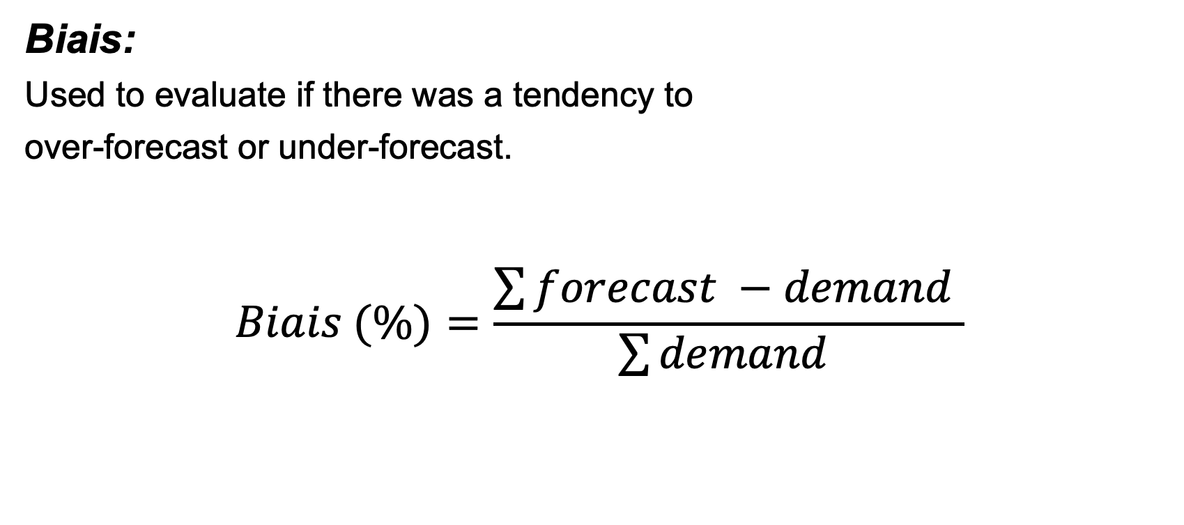
Forecast Accuracy KPI - Biais
Biais:
Used to evaluate if there was a tendency to
over-forecast or under-forecast.
$$Biais (\%)=\frac{\sum{forecast −demand }}{\sum{demand }}$$

Slide 28
Safety Stock
Why do we need safety stocks?
Protect against:
Demand uncertainty,
Supply uncertainty
A mathematical way to balance:
Service level,
Inventory costs

Slide 29
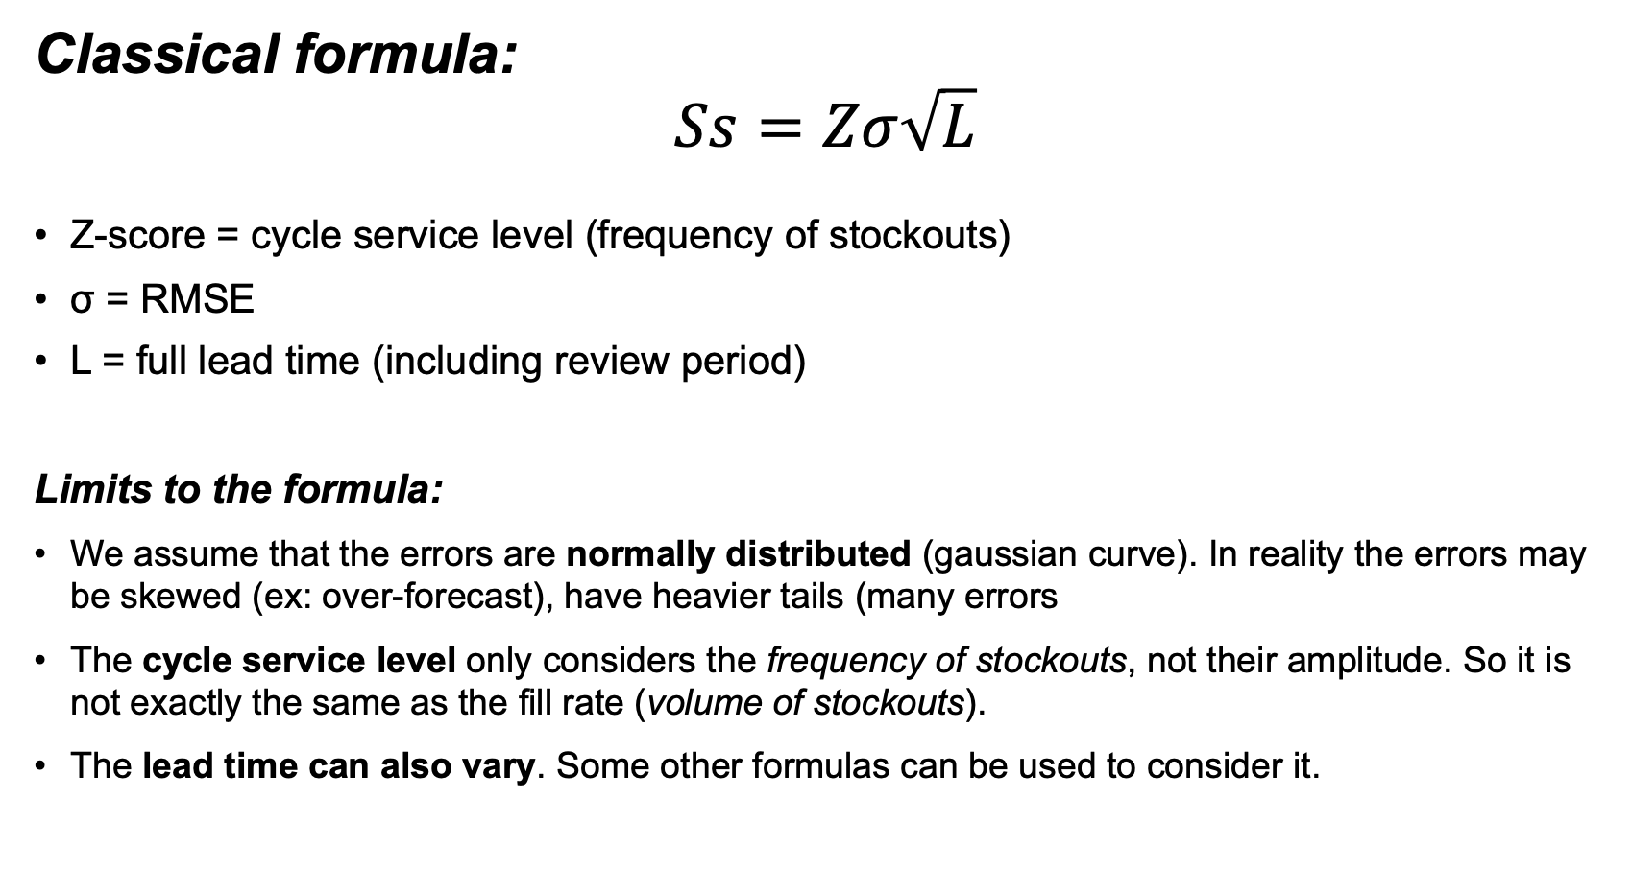
Safety Stock Formula
Classical formula:
$$Ss=Zσ\sqrt{L}$$
Z-score = cycle service level (frequency of stockouts)
σ = RMSE
L = full lead time (including review period)
Limits to the formula:
We assume that the errors are normally distributed (gaussian curve). In reality the errors may be skewed (ex: over-forecast), have heavier tails (many errors
The cycle service level only considers the frequency of stockouts, not their amplitude. So it is not exactly the same as the fill rate (volume of stockouts).
The lead time can also vary. Some other formulas can be used to consider it.
Service Level | Z
85% | 1.04
90% | 1.28
95% | 1.65
97% | 1.88
98% | 2.05
99% | 2.33
99.9% | 3.09

Slide 30
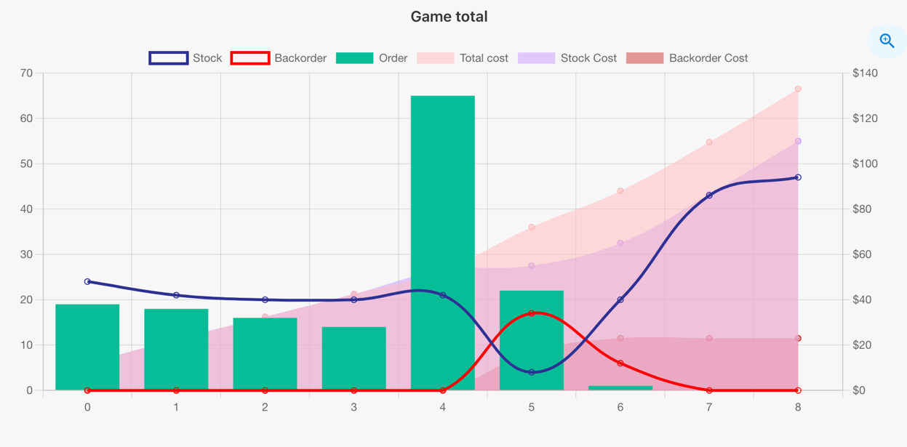
Game Evolution
➔ What caused the spike in orders and backorders on week 4?

Slide 31
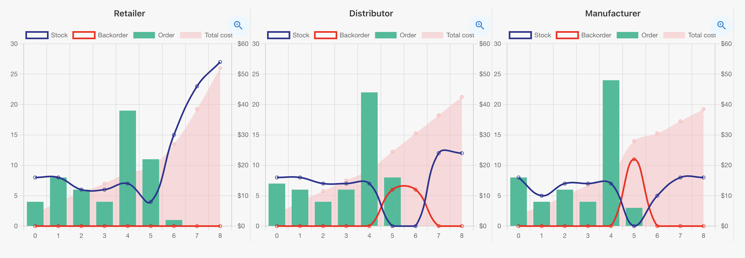
Game Evolution
⚠️ Beware: Safety stock updates create an urgent need and even backorders in the chain.

Slide 32
Round 2 rules

Slide 33
Round 2 Rules 1/2
Games cycles: 8 weeks,
You can view the stock and the planning for all the roles,
The Retailer and Distributor have a Minimum Order Quantity of 4,
The Manufacturer has a Batch size of 4

Slide 34
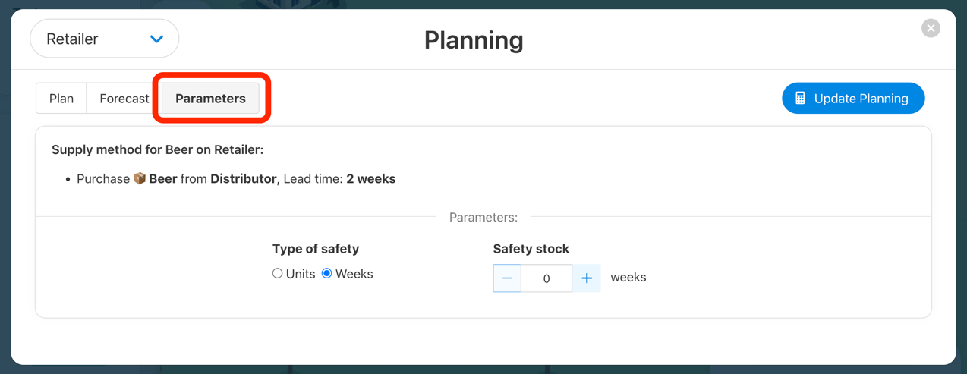
Round 2 Rules 2/2
You can decide your safety stock for each role, expressed as units or « time » (extra coverage)

Slide 35
Round 2 debriefing

Slide 36
Round 2 debriefing
Which team had less cost?
Did your result improve vs. Round 1?
What was your safety stock / buffering strategy ?
Safety units or time coverage ?
Same amount for each role ?

Slide 37

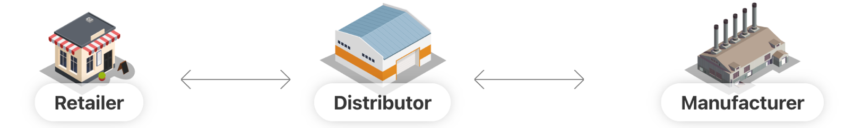
Round 2 debriefing
Safety Stock Strategy 1:
Buffer at each stage to cover the variability during the supply from the previous stage.
LT: 2 weeks
LT: 2 weeks
LT: 2 weeks
XX
XX
XX
supply
supply
production

Slide 38
Round 2 debriefing
Safety Stock Strategy 2:
Buffer at the retailer only, to cover the variability during the full supply duration.
Lead time: 6 weeks
XX
supply + production

Slide 39
Round 2 debriefing
MOQ and Batch sizes:
➔ Started at 4 then increased to 8.
What was their impact on the demand signal ?

Slide 40
Round 3 rules

Slide 41
Round 3 Rules 1/2
Games cycles: 12 weeks,
Lead times: 3 weeks instead of 2,
The Retailer and Distributor have a Minimum Order Quantity of 16,
The Manufacturer has a Batch size of 16

Slide 42
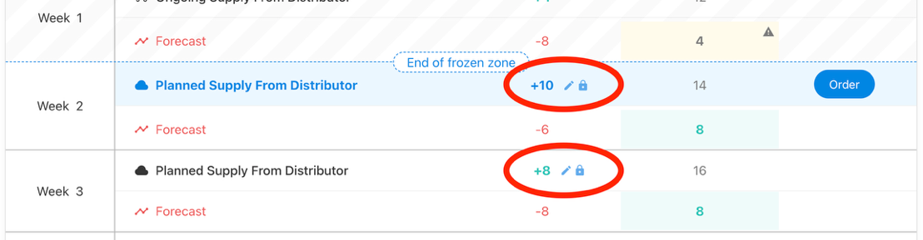
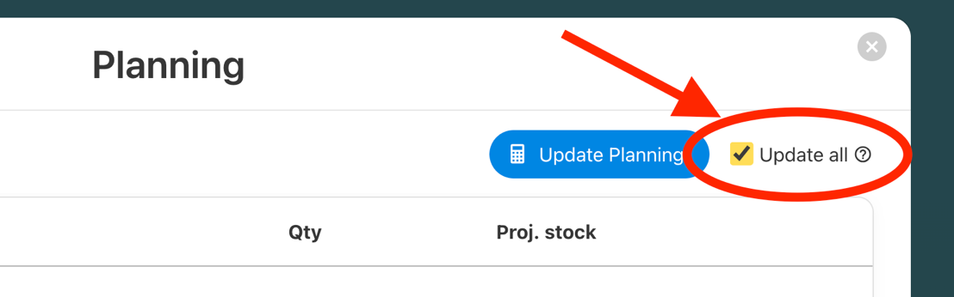
Round 3 Rules 2/2
Players can now edit and lock planned quantities:
Players can now launch the MRP calculation for all roles at once:

Slide 43
Round 3 debriefing

Slide 44
Round 3 Debriefing
Which team had less cost?
Did you have a specific strategy in terms of safety stock?

Slide 45
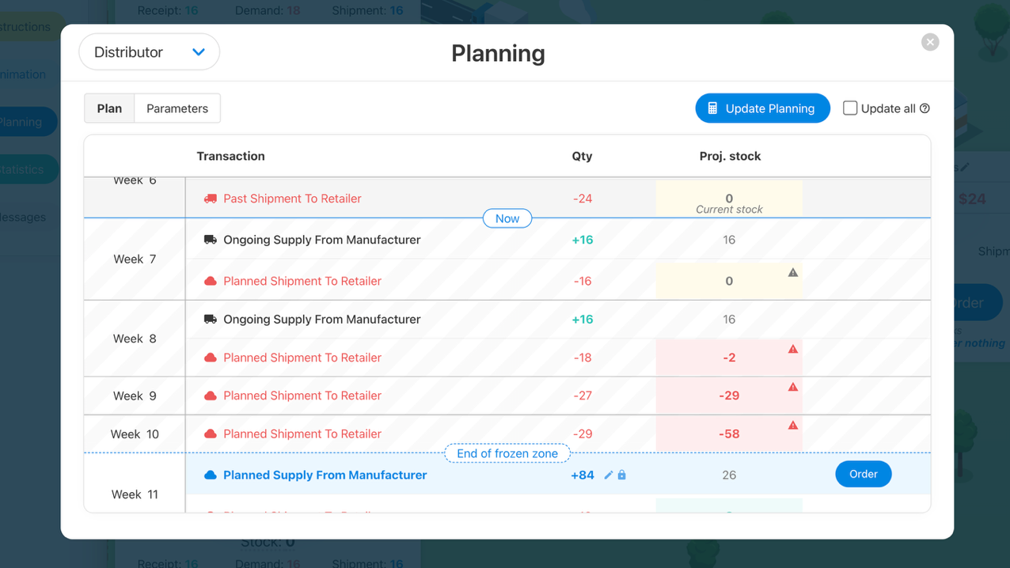
Round 3 Debriefing
What was the impact of the longer « frozen duration » ?
Event where the lead time increases from 3 to 5 weeks

Slide 46
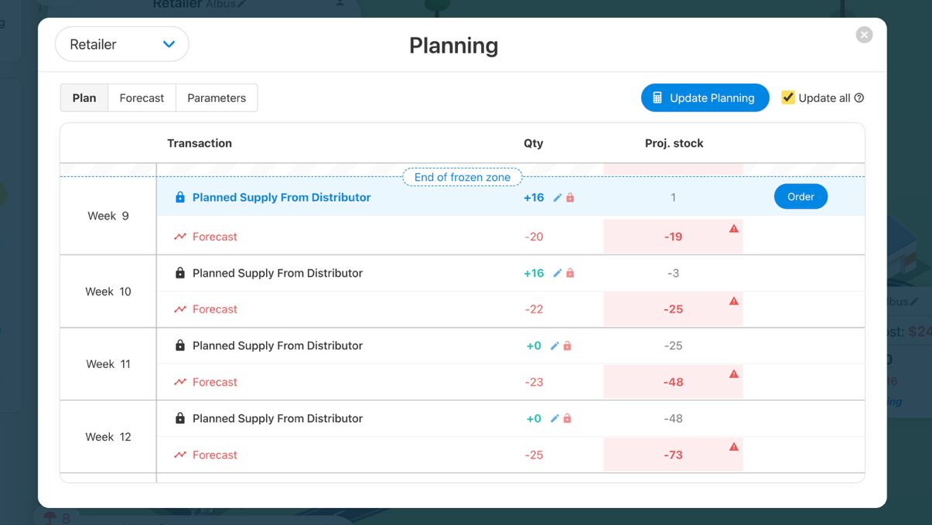
Round 3 Debriefing
Did you manually adjust the plan and if so, how?
Example: lock a smaller supply plan if you know you are constrained
Gives visibility on the potential missed sales

Slide 47
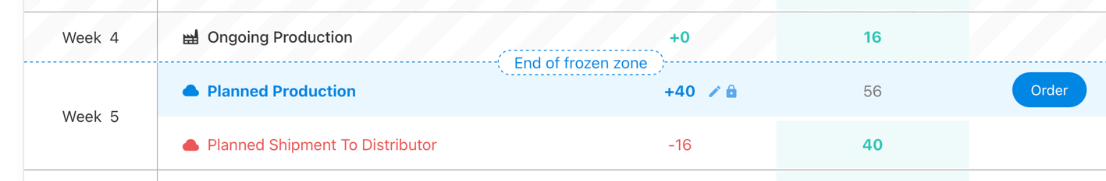
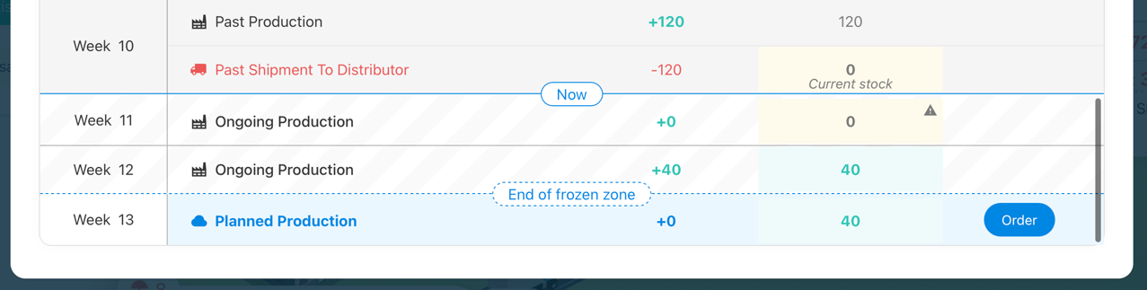
Round 3 Debriefing
What was the impact of the high MOQ / batch sizes ?
Ex: Decision making: Overstock vs. Stockout risk
Risk: producing a big quantity only to cover the safety stock:

Slide 48
General debriefing

Slide 49
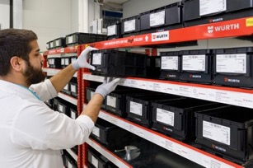
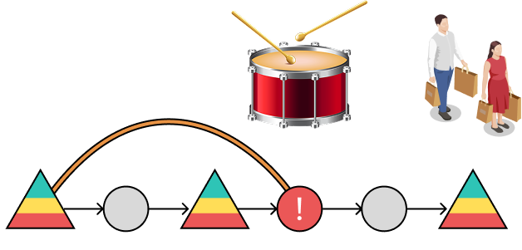
Other planning methods
Kanban
“Re-order what was shipped last week”
Theory of Constraints
“Focus on the bottleneck”
DDMRP
“Buffers + Follow Pace of the final demand”

Slide 50
Merci / Thanks!
Mathias Le Scaon
mathias@zensimu.com
https://zensimu.com/

